Slide 1


Introduction to Objects
Full-Stack Web Development Bootcamp

Slide 2


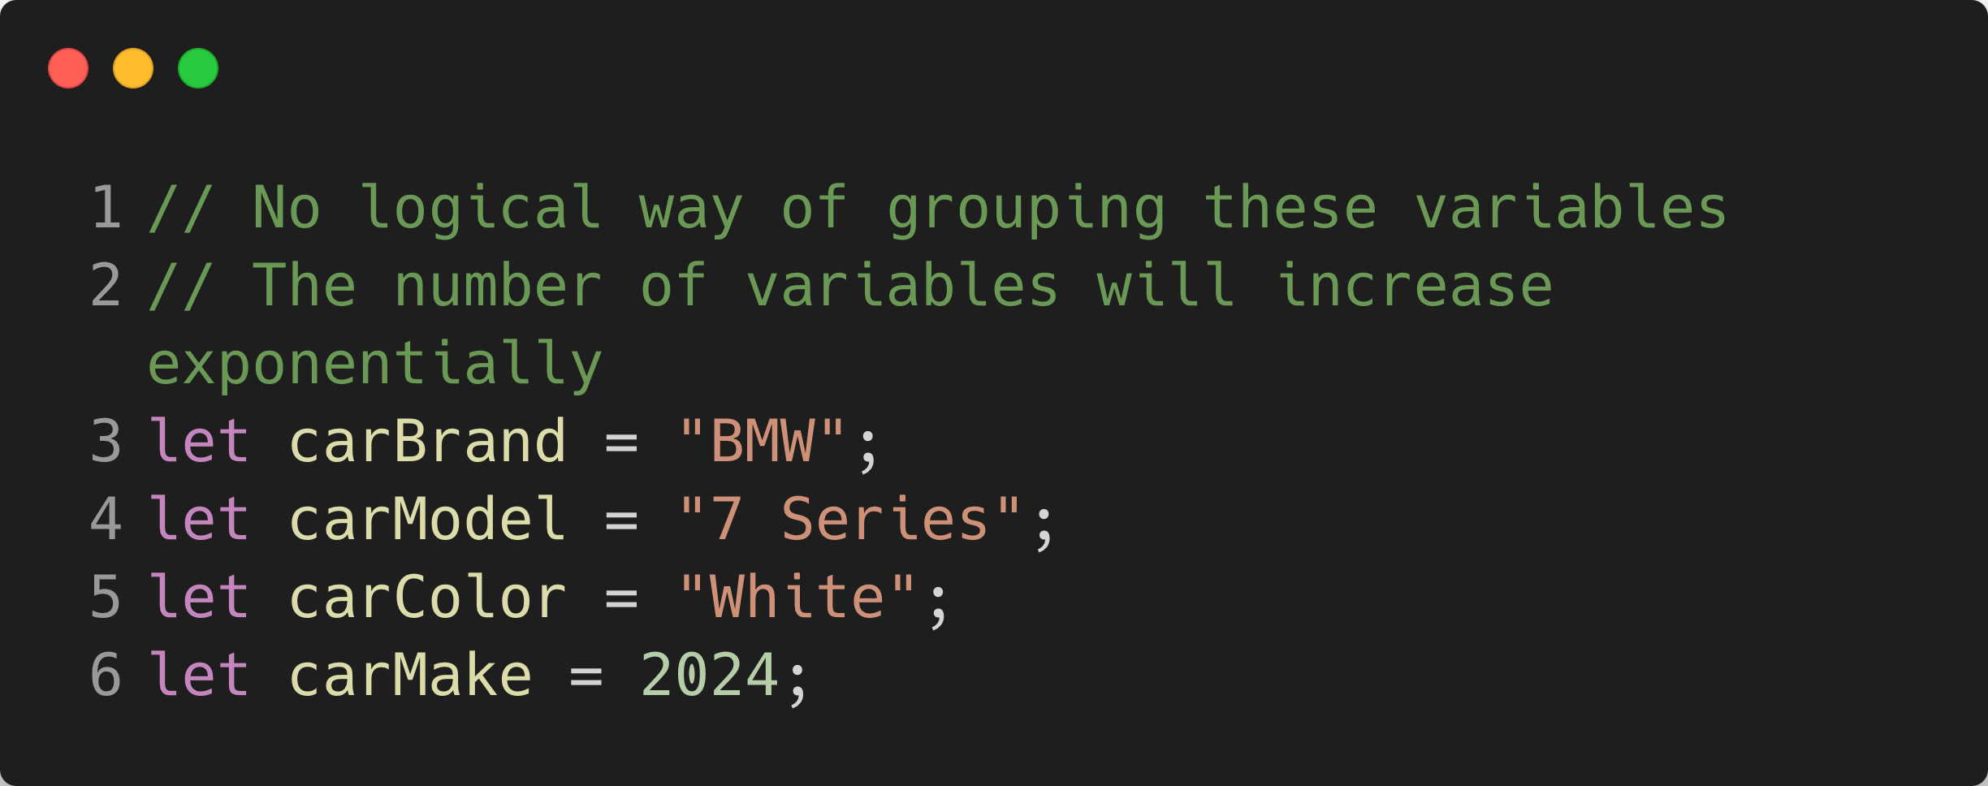
Problem Working With Variables

Slide 3
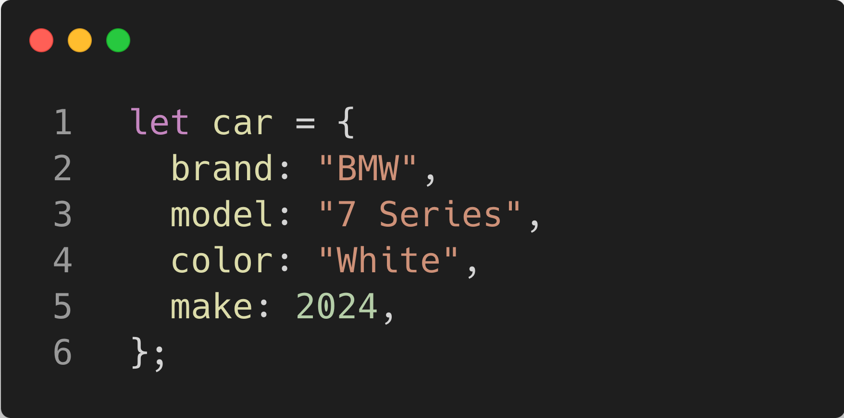
Objects Allow You to Group Properties

Slide 4
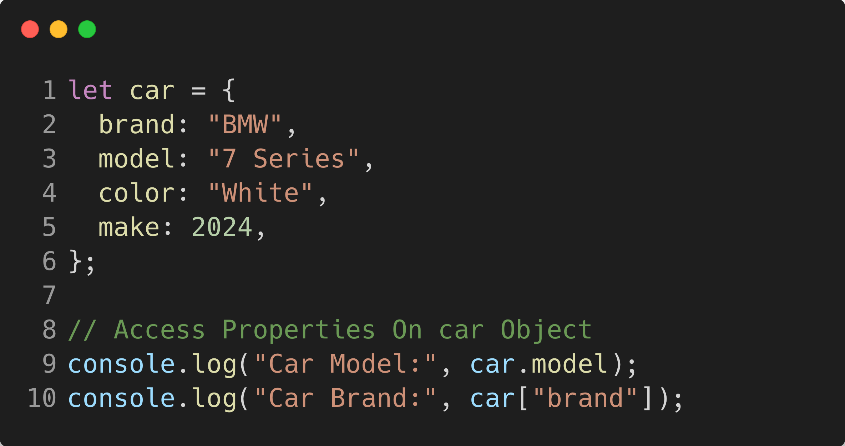
Objects Allow You to Group Properties

Slide 5
Objects and Mutability

Slide 6
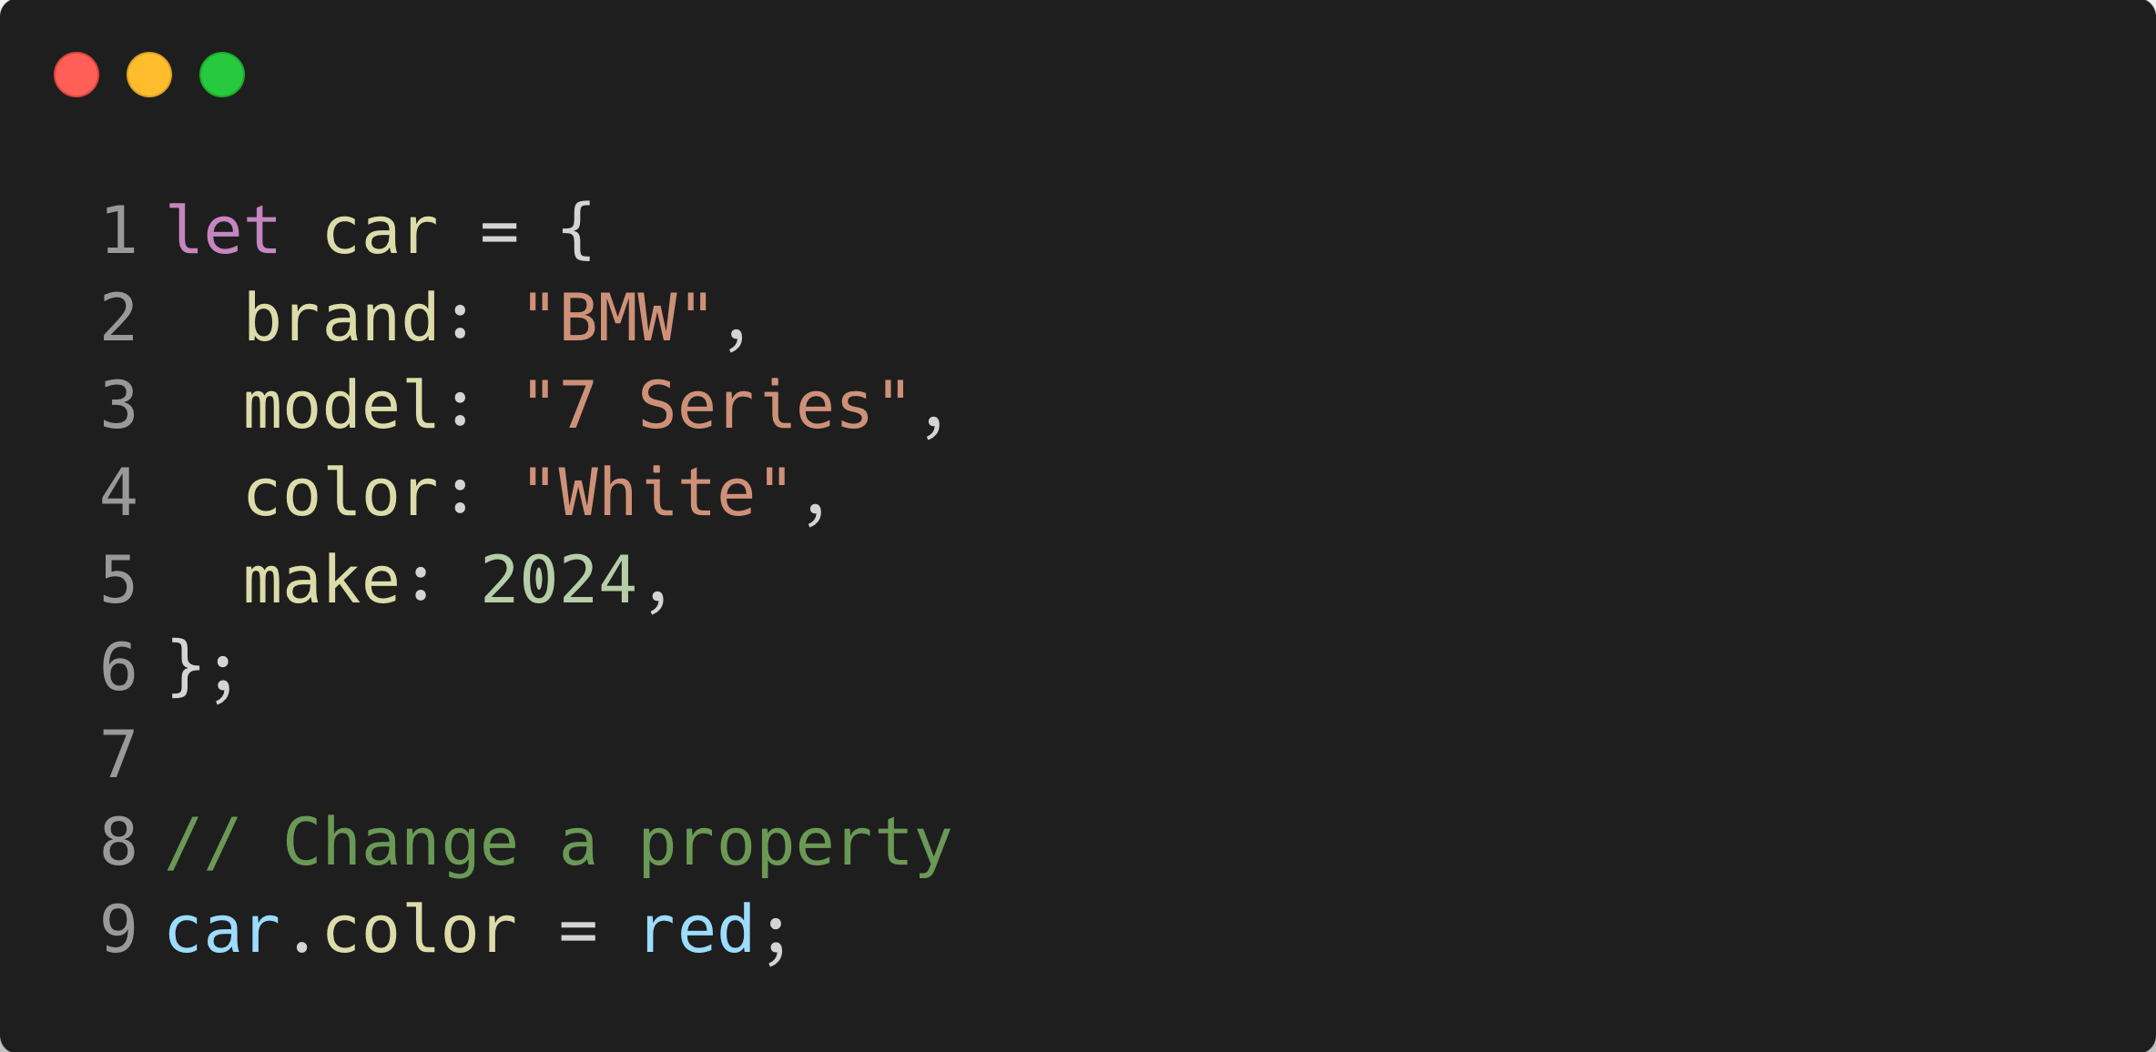
Objects and Mutability
Memory
car
Objects in memory mutate or CHANGE, hence mutable
Object assignment: When an object is assigned to a variable, the variable holds a reference to the memory location of that object.
Property modification: Changing a property of the object (e.g., car.color = "red";) modifies the existing object in memory, without creating a new object.
Mutability: Objects are mutable, meaning changes to properties directly affect the original object in memory, unlike primitive values, which are immutable.

