Slide 1


Introduction to Arrays
Full-Stack Web Development Bootcamp

Slide 2


An Example of an Array
0
1
2
3
4
14
Total 15 books
Think of an array as a bookshelf with numbered slots, and each slot can hold one book (or value). Just like a bookshelf, the slots are in a specific order, starting from 0. You can place, replace, or remove a book from any slot.

Slide 3
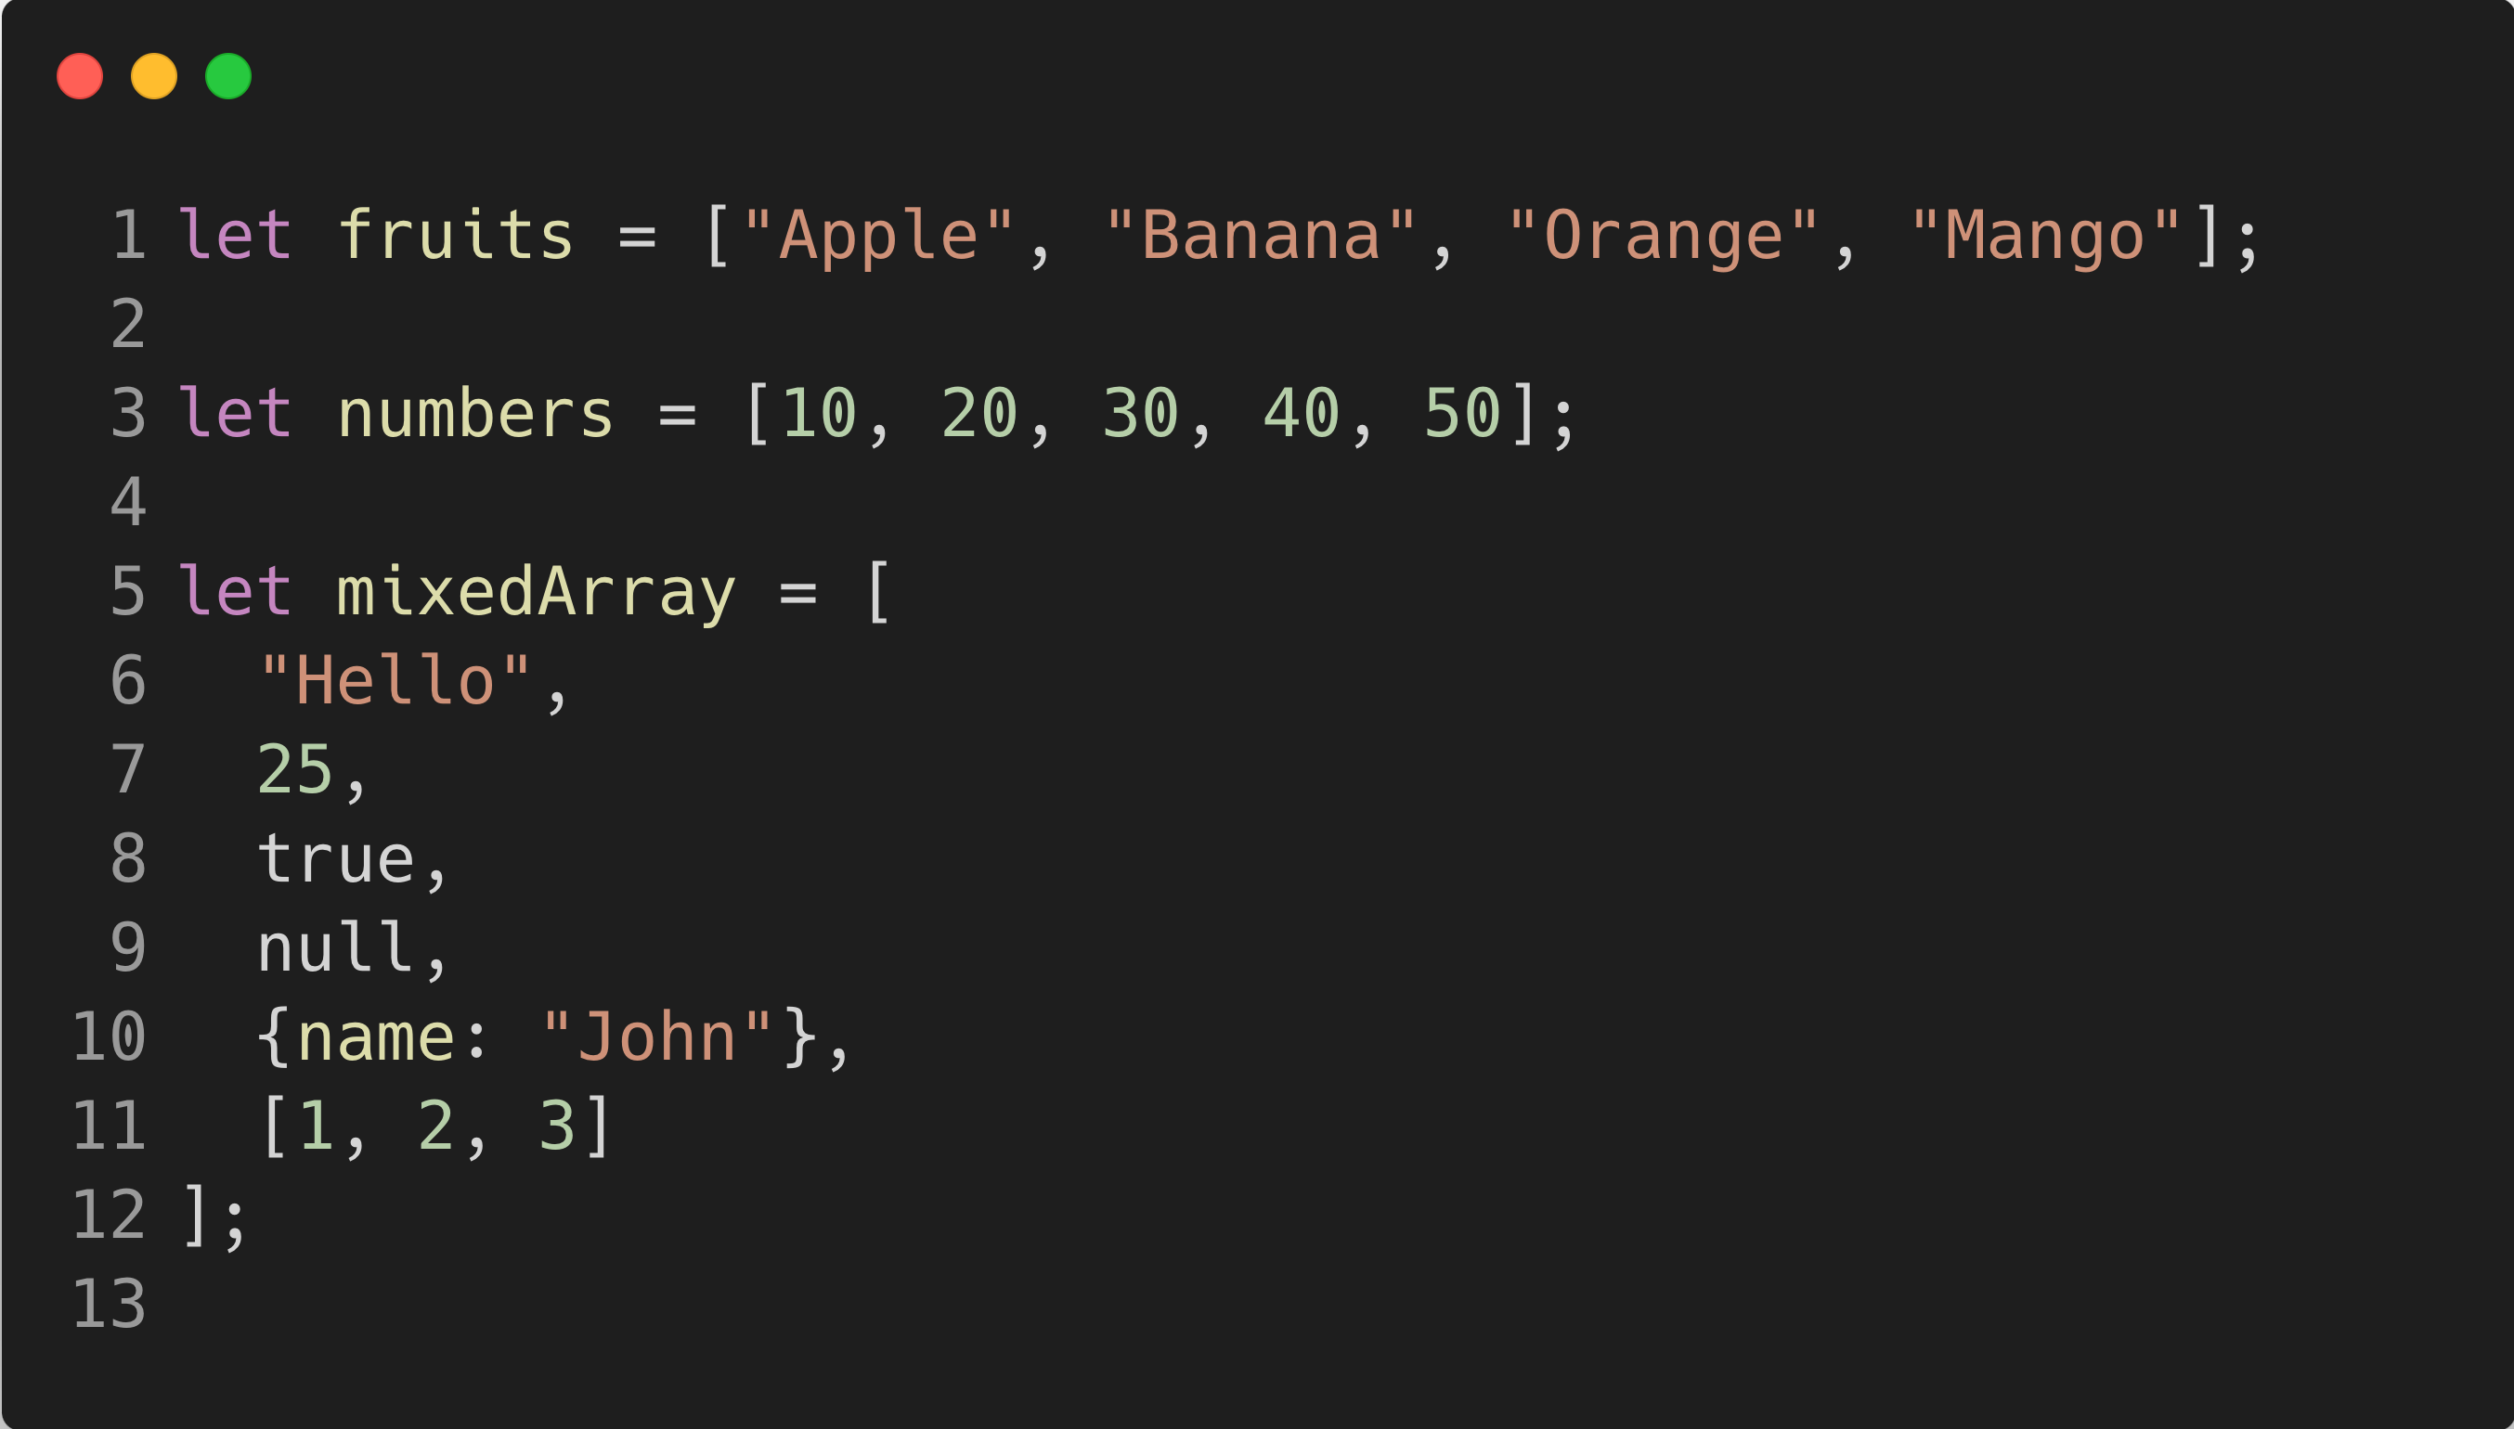
Syntax For Declaring Arrays

