Slide 1

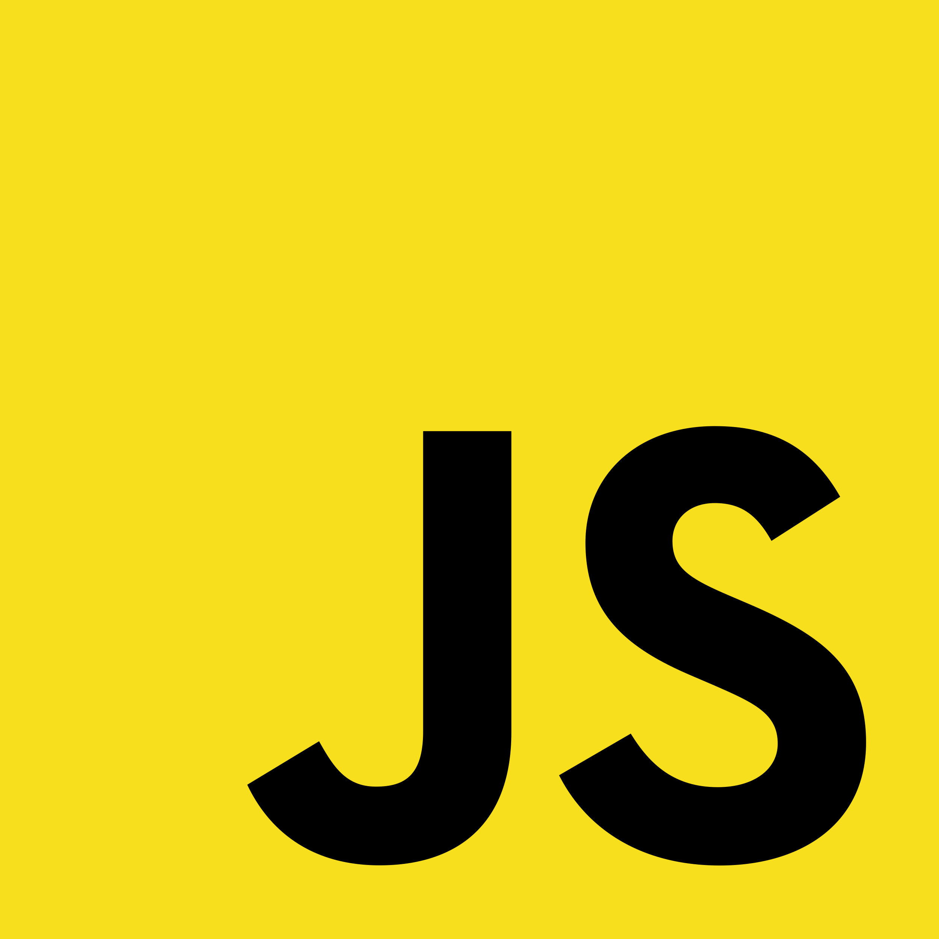
Introduction to Functions
Full-Stack Web Development Bootcamp

Slide 2


What is a Function
a=10, b=20
30
sum(a , b)
What is a Function?
A function in JavaScript is a reusable block of code that performs a specific task. It can take input, process it, and return an output. Functions allow you to organize and reuse code efficiently.

Slide 3
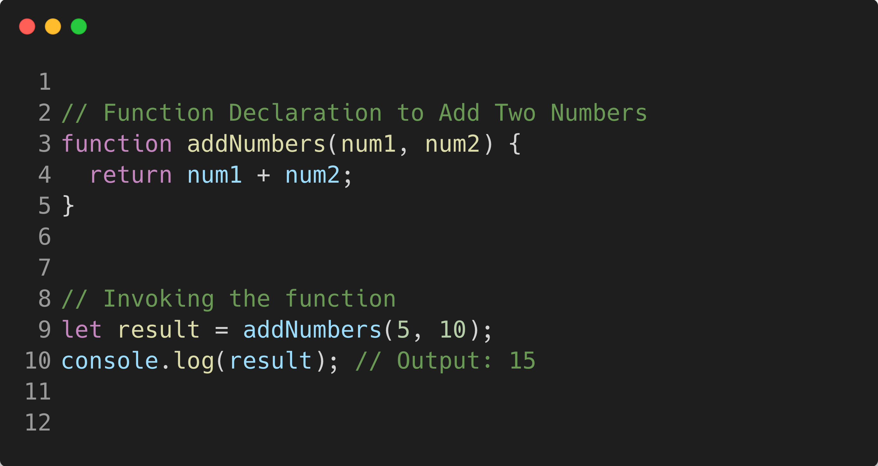
Syntax for Using Functions
Function name
parameters
declaration
function body
Function invocation

