Slide 1


Introduction to Lexical Scope
Full-Stack Web Development Bootcamp

Slide 2

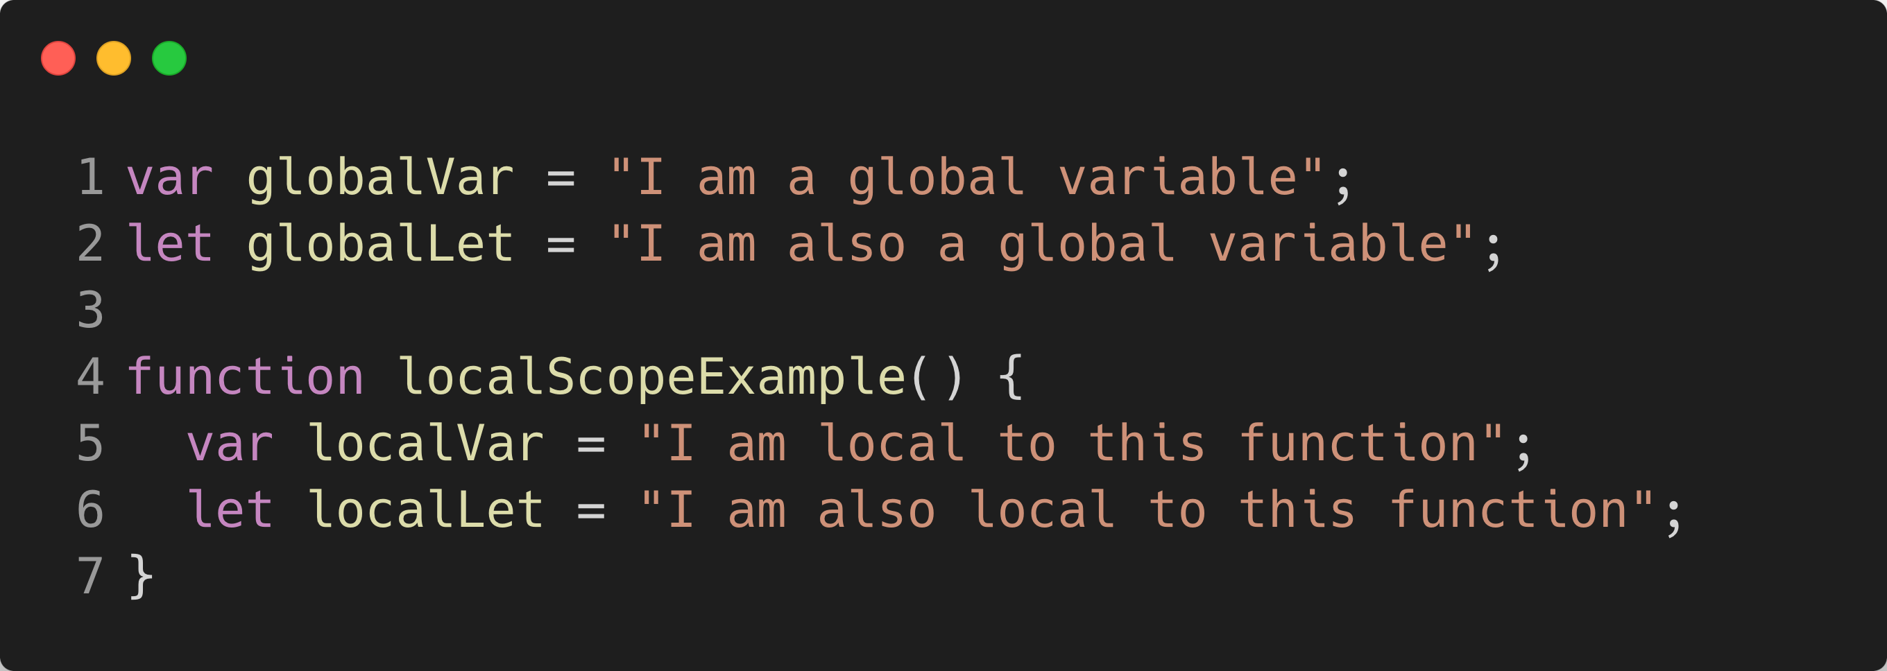
What is a Lexical Scope
What is a Lexical Scope?
Lexical scope in JavaScript refers to the visibility of variables and functions, which is determined by their position in the source code. Functions can access variables defined in their own scope and in any outer scopes, but not from inner scopes.

Slide 3




Types of Scopes
Global Scope
Local Scope
Block Scope
Nested Scope
Variables declared outside any function or block are globally accessible throughout the entire program.
Variables declared within a function are accessible only inside that function.
Variables declared with let or const within a block (such as if, for) are restricted to that block.
A scope inside another scope where inner functions can access variables declared in outer scopes.

Slide 4
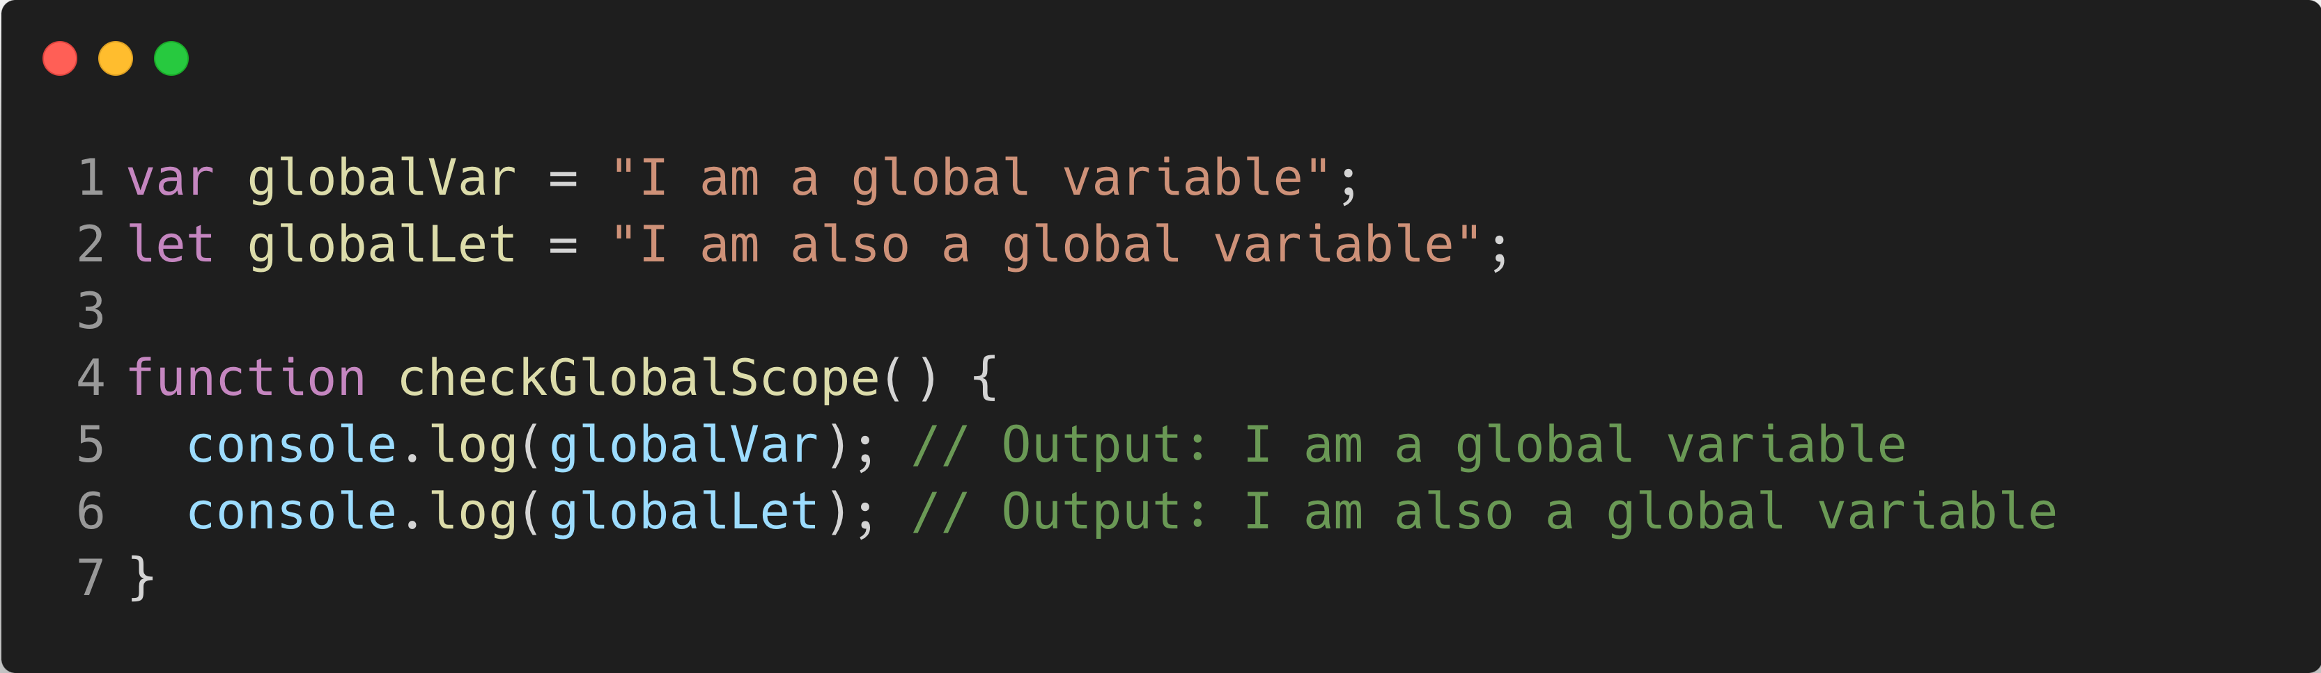
What is a Global Scope
Global Scope
In this code, both globalVar and globalLet are declared in the global scope, meaning they are accessible from anywhere in the code, including inside the checkGlobalScope function. As global variables, they can be used and modified by any function or block within the script. Accessing them inside the function demonstrates their global availability, ensuring they can be logged or manipulated within any function or scope in the program.

Slide 5
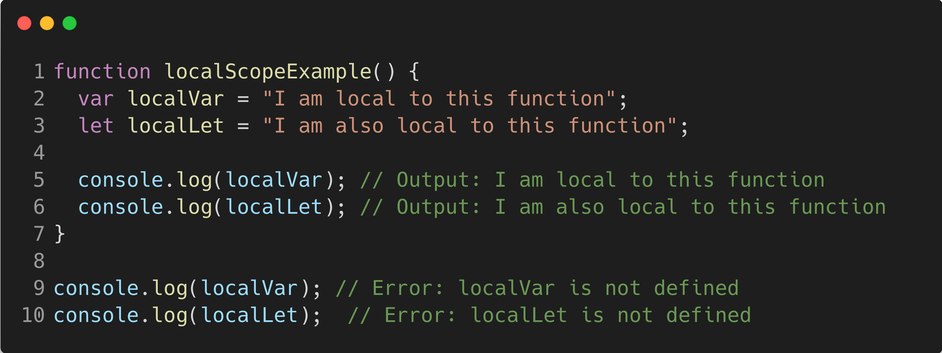
What is a Local Scope
Local Scope
In this code, localVar and localLet are declared inside the localScopeExample function, making them accessible only within the function's scope. This is called local scope, meaning variables declared with var and let inside the function are confined to that function. When you try to access localVar or localLet outside the function, you get an error because they are not defined in the global or any other scope. This isolation protects local variables from being accidentally modified by other parts of the code.

Slide 6
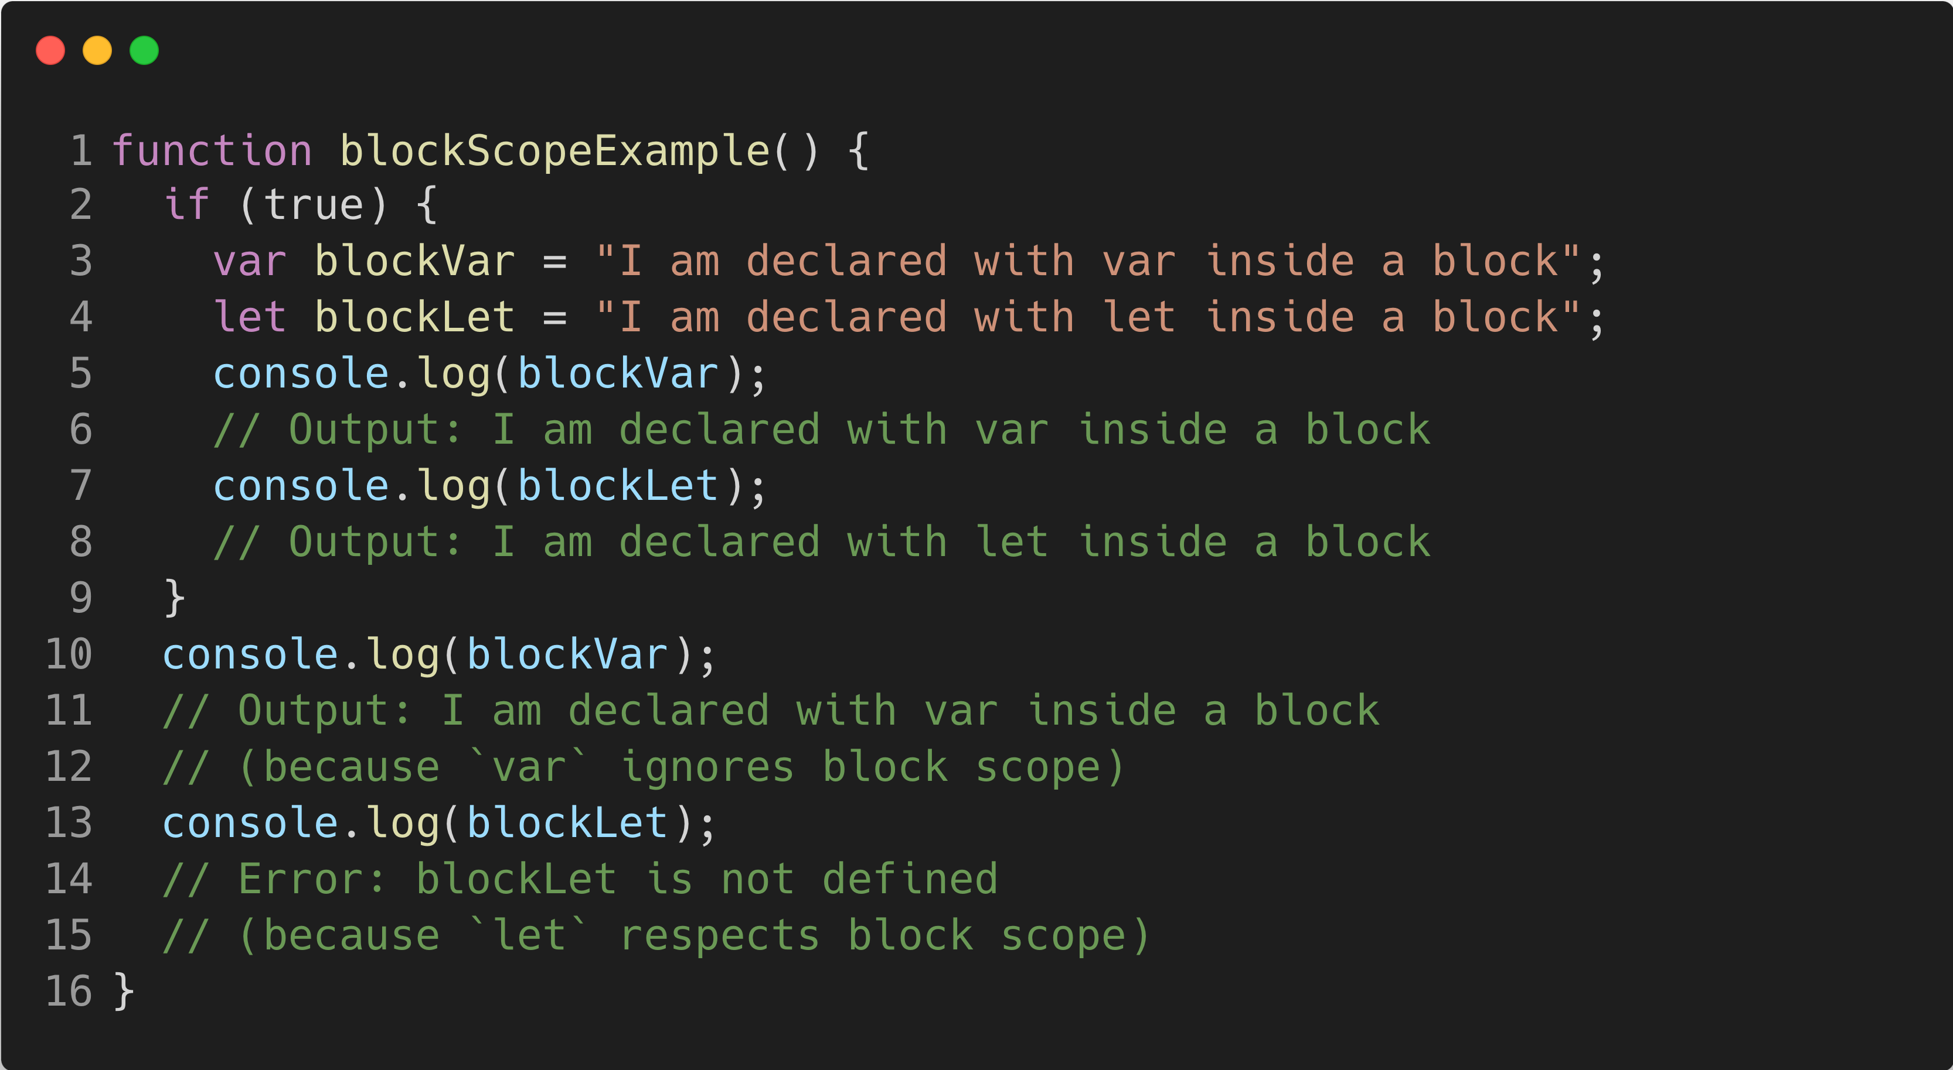
What is a Block Scope
Block Scope
In this code, blockVar (declared with var) is accessible outside the if block, as var ignores block scope. In contrast, blockLet (declared with let) is limited to the block inside the if statement, making it inaccessible outside. This demonstrates block scope, where variables declared with let and const are confined to the block they are defined in, while var does not respect block scope.

Slide 7
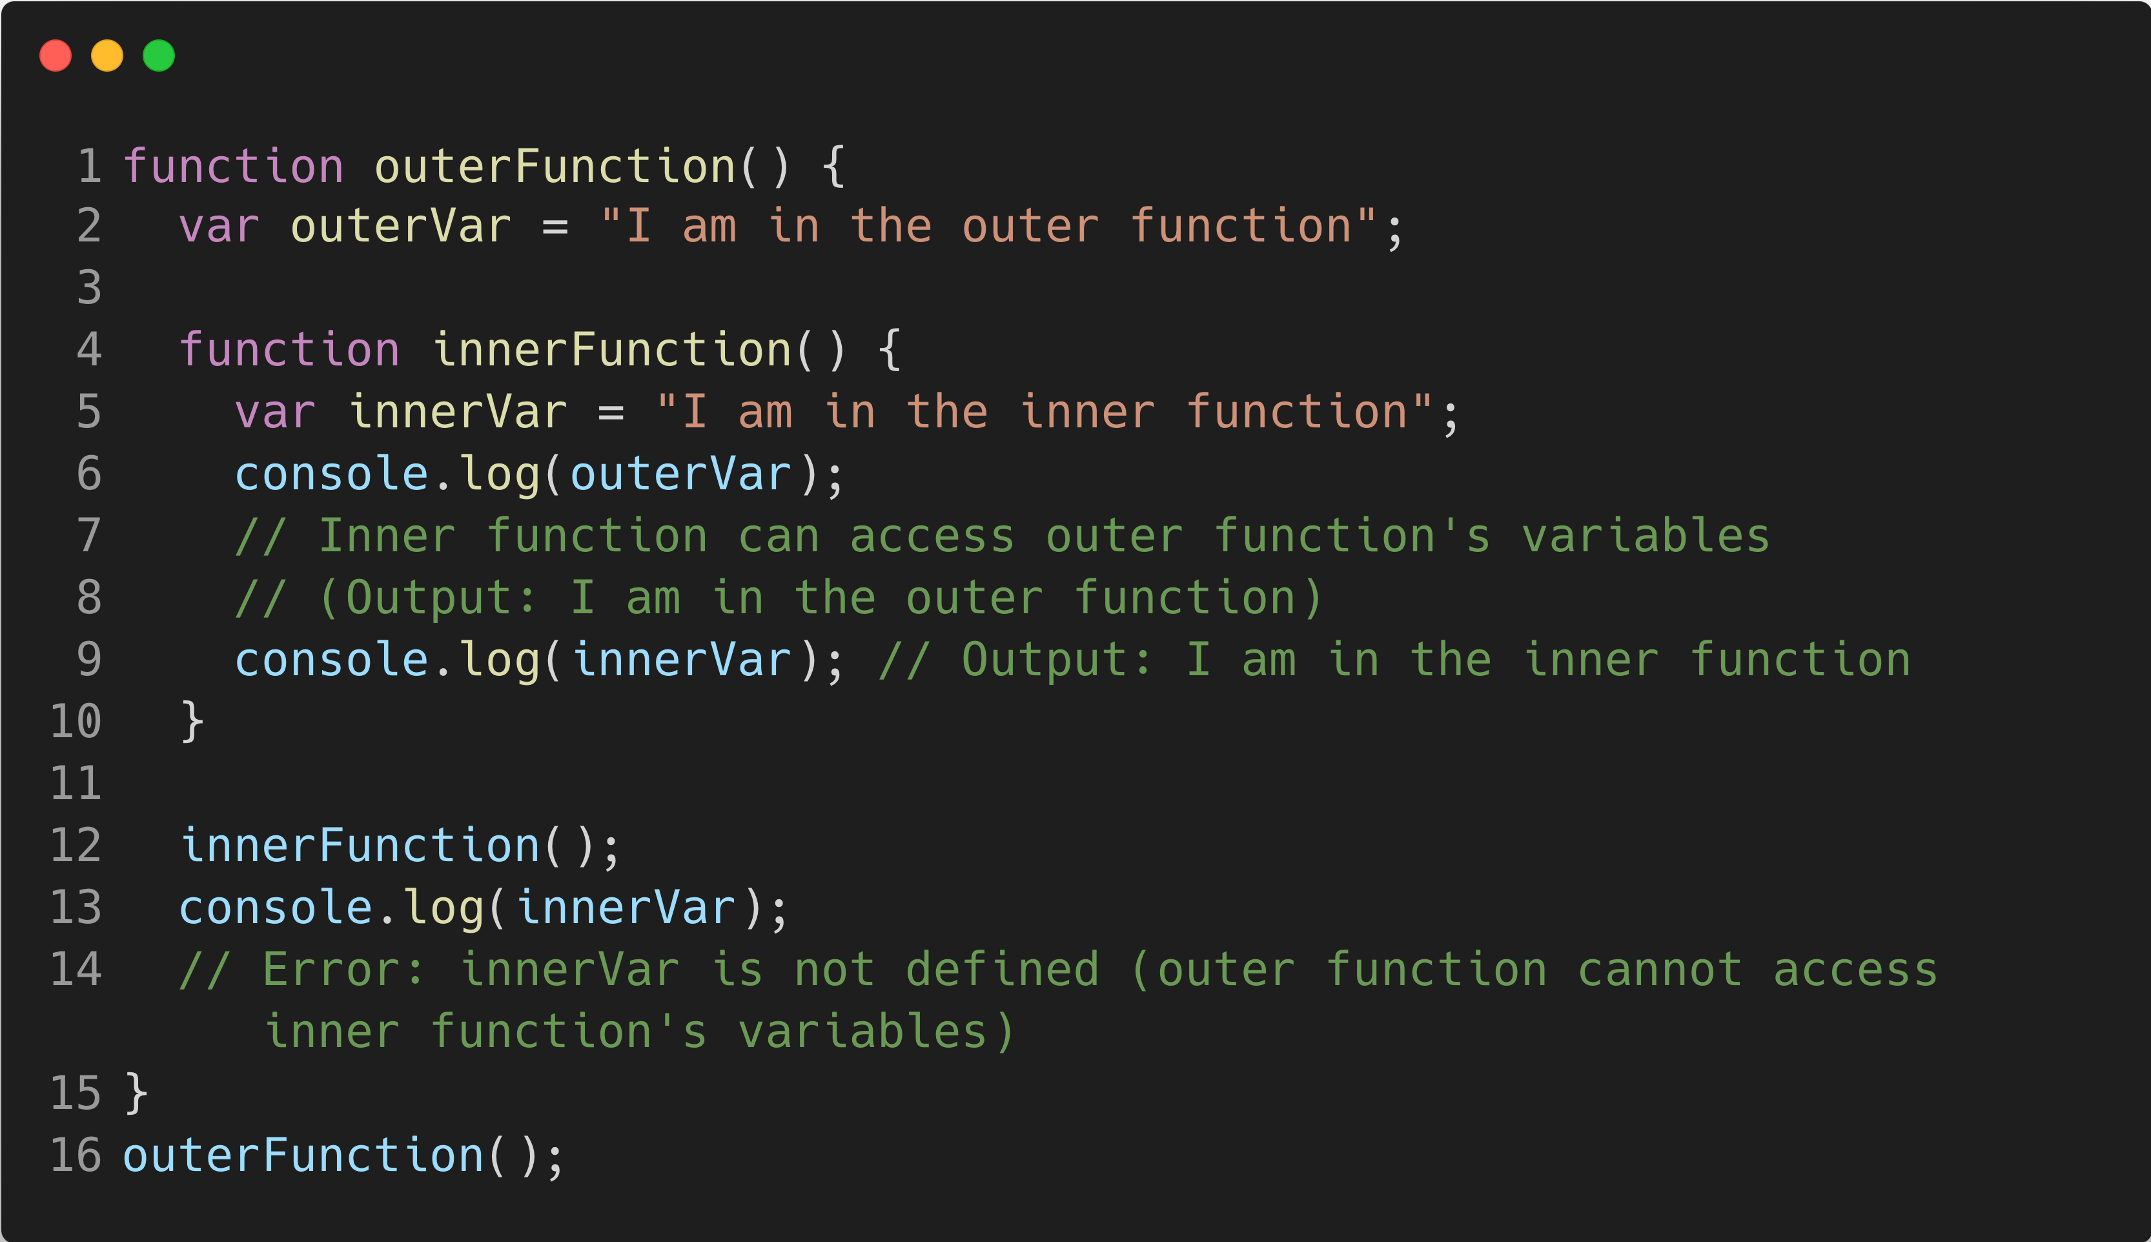
What is a Nested Scope
Nested Scope
In this code, the inner function (innerFunction) can access variables from the outer function (outerVar) due to nested scope. However, the outer function cannot access variables from the inner function (innerVar), leading to an error when trying to log innerVar outside of innerFunction. Nested scope allows inner functions to access outer function variables, but not the reverse.

