Slide 1

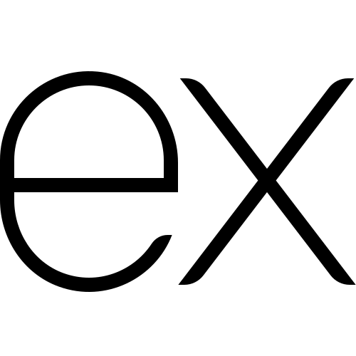
Why is Additional
Validation Needed?
Full-Stack Web Development Bootcamp

Slide 2


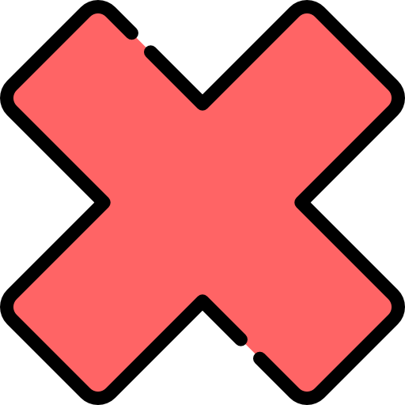

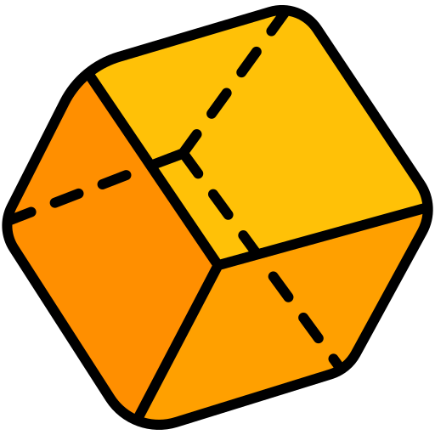
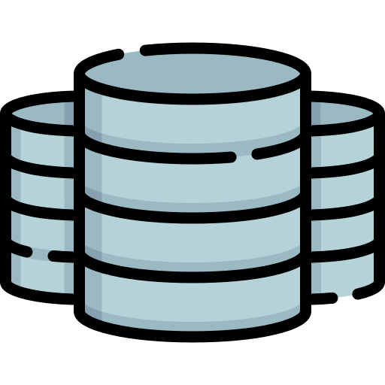

Current Flow of Request and Validation
V
A
L
I
D
A
T
I
O
N
tasksController
POST /users
usersRouter
User (model)
Database
(MongoDB)
Response
usersController

Slide 3
Problems With Current Flow
Scope Limitation: Mongoose validations only apply at the data layer, not immediately upon receiving data.
Performance: Validation delays occur right before database operations, potentially wasting resources.
Error Handling: Mongoose errors are intermixed with database errors, complicating response management.
Pre-Processing Lack: Incoming data isn't validated until it reaches the model, skipping early checks.
Customization Limits: Complex validations are hard to implement and manage with Mongoose alone.
Scalability Issues: Managing validations becomes challenging as application complexity increases.
V
A
L
I
D
A
T
I
O
N
usersRouter
usersController
User (model)
Database
(MongoDB)

Slide 4
Correct Point of Validation
V
A
L
I
D
A
T
I
O
N
V
A
L
I
D
A
T
I
O
N
tasksController
POST /users
usersRouter
User (model)
Database
(MongoDB)
Response
usersController

