Slide 1


Introducing
Node Package Manager (npm)
Full-Stack Web Development Bootcamp

Slide 2


What is Node Package Manager (npm)
NPM (Node Package Manager) is a package manager for JavaScript, facilitating the sharing and consumption of code. It provides a command-line utility for interacting with a repository of public and private packages, enabling developers to easily install, manage, and distribute packages within their software environments.

Slide 3
Use Ready Packages
Packages On npm
Your Application
body-parser
body-parser
express
express
nodemon
dotenv
NPM hosts community-created packages that act like building blocks for applications, offering reusable functionalities. These packages can be easily integrated into your projects, streamlining development by providing pre-built solutions for common programming tasks and challenges.

Slide 4
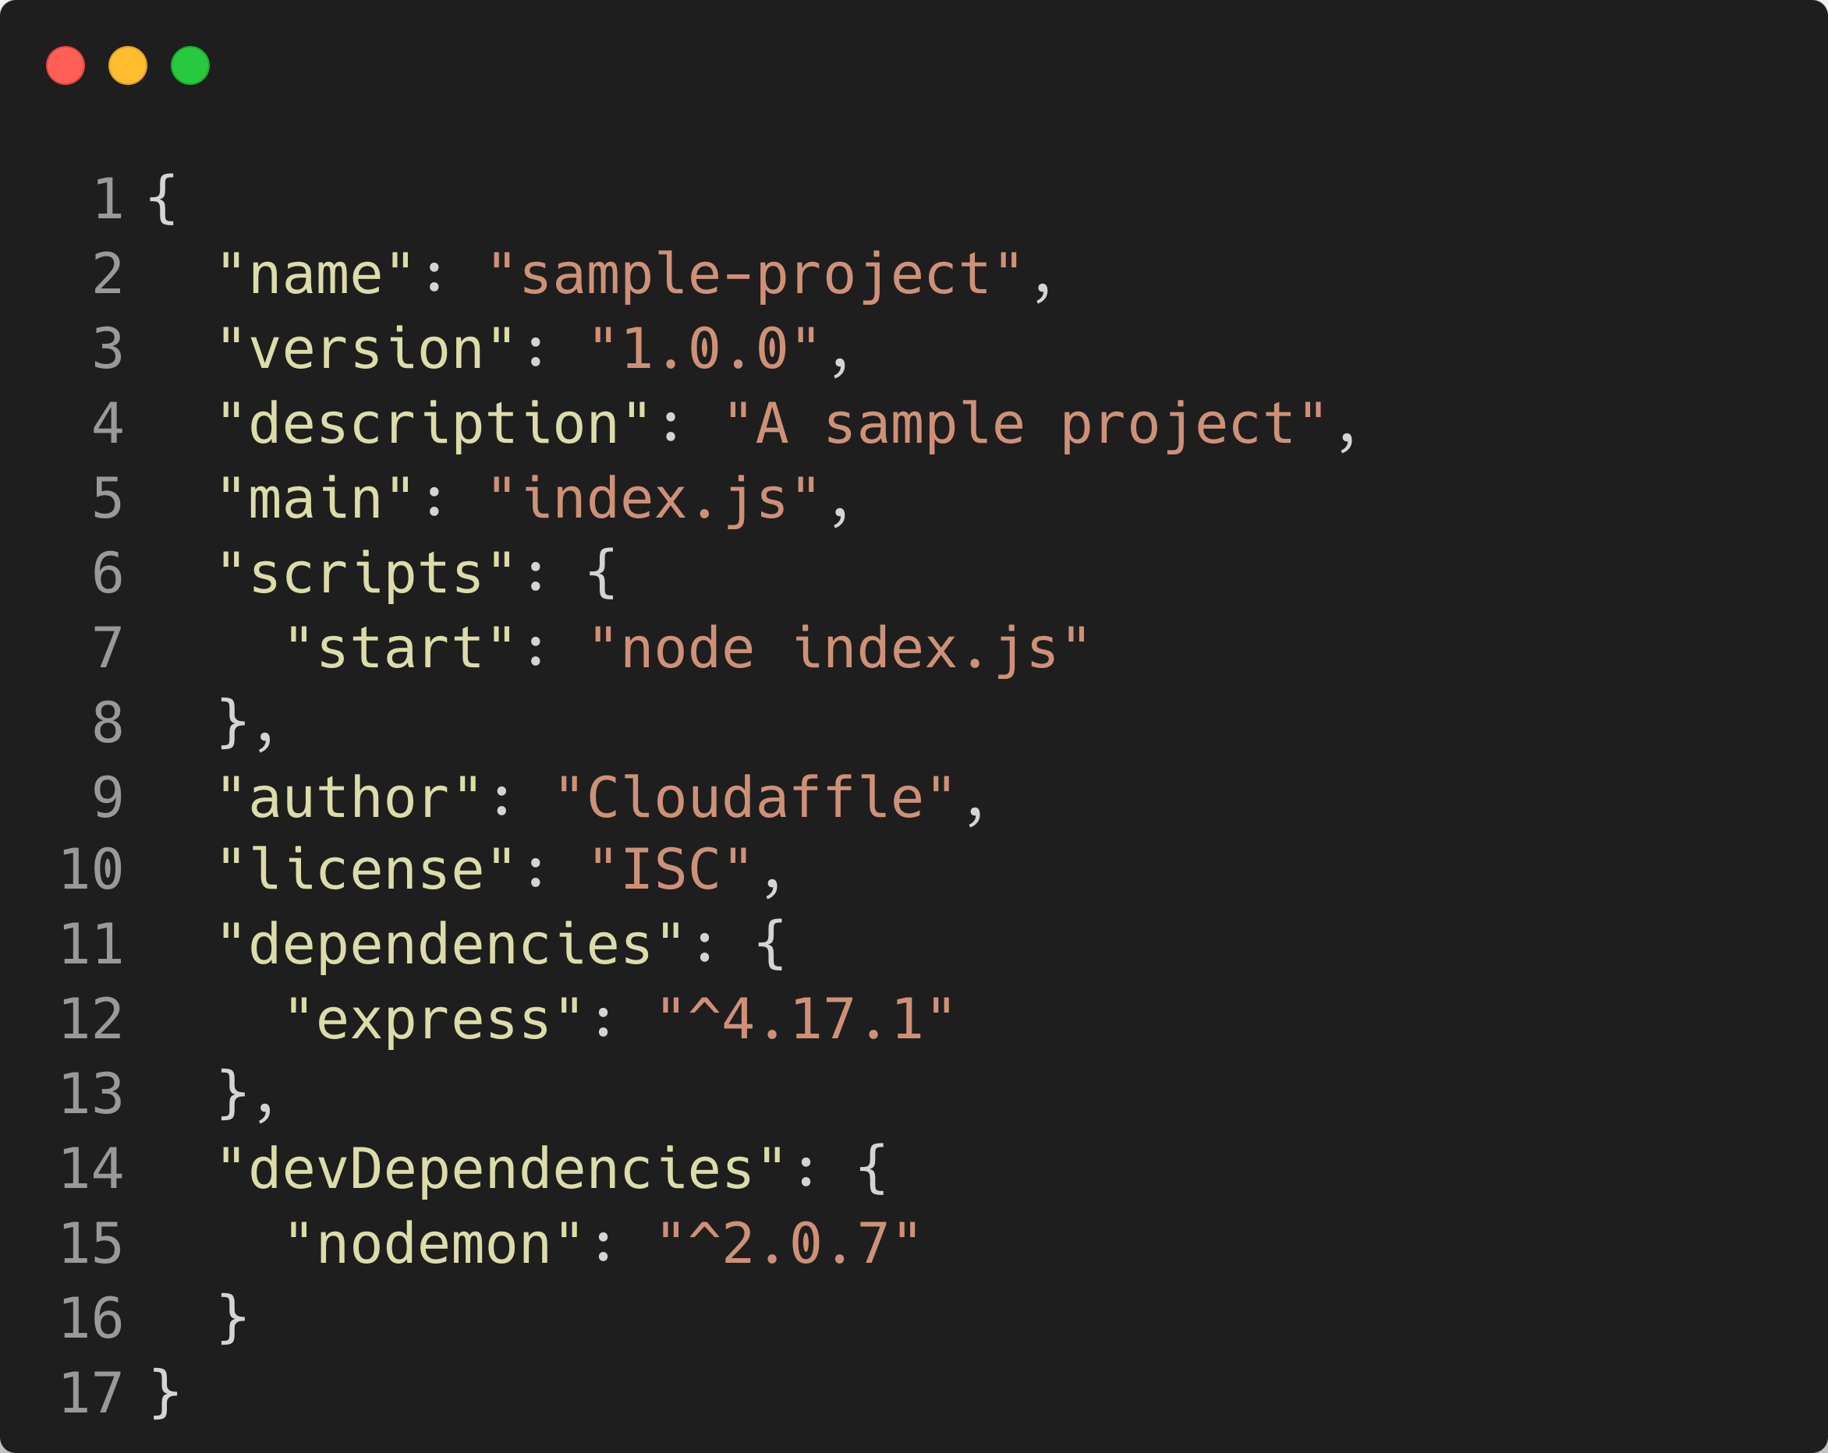
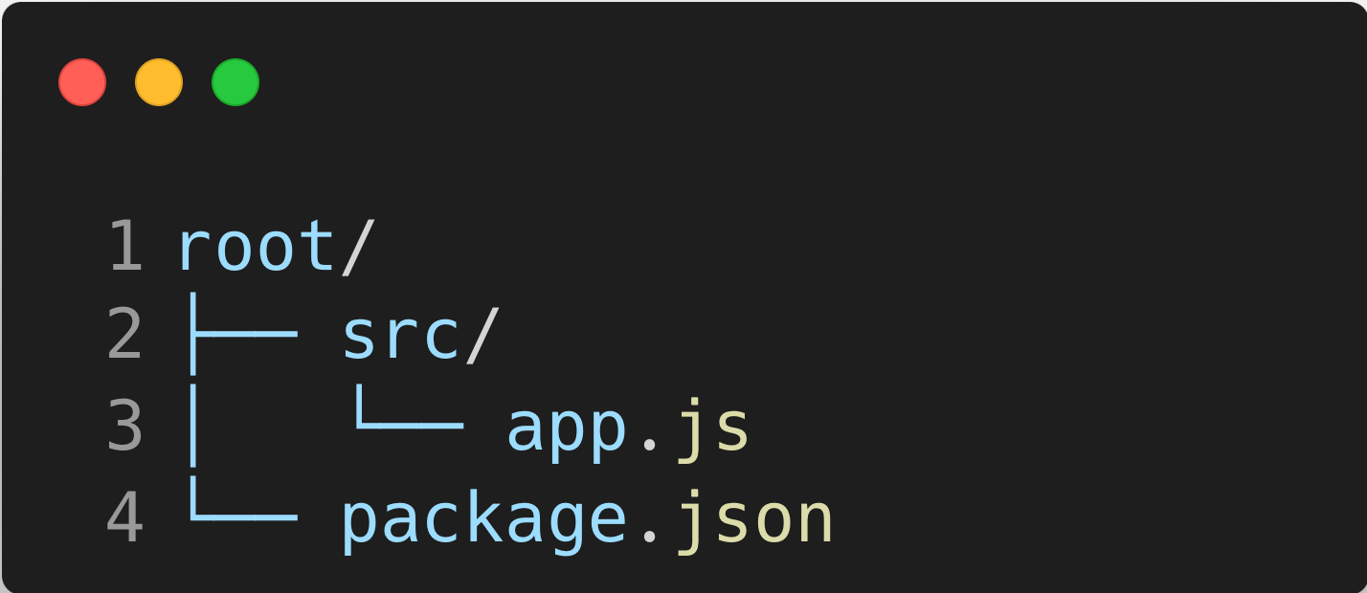
Introducing package.json
Location of package.json
Contents of package.json

Slide 5
Scope Of npm Packages
Particulars | Global Packages | Local Packages
Scope of Installation | Installed once on a system and are available across all projects. You can run them from any location in your system's command line. | Installed within a specific project directory and are only accessible within that project. They are used in the context of the project they belong to.
Usage | Typically used for command-line tools and utilities that you want to use across multiple projects, or for packages that provide commands that you run from the terminal. | Generally include libraries or frameworks that your project code depends on directly. These packages are integrated into your application's codebase.
Dependency Management | Not listed in your project’s package.json file and do not affect the project’s environment directly. They are managed separately by npm at a system level. | Automatically added to your project’s package.json file under dependencies or devDependencies, which tracks versioning and dependencies for other developers and environments.

Slide 6
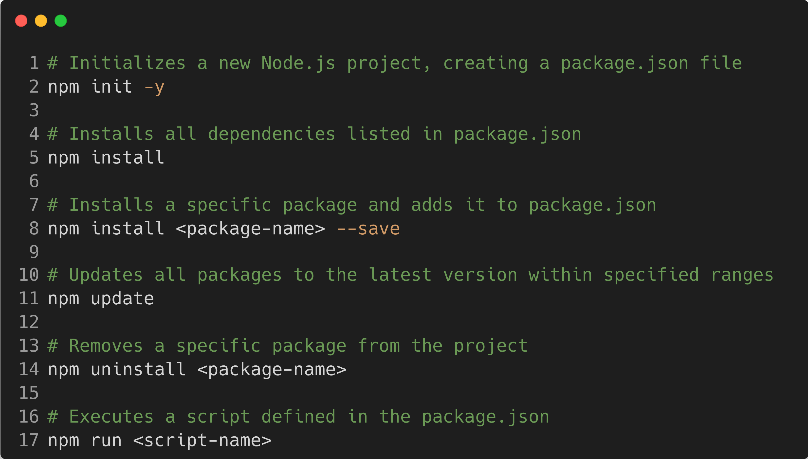
Important npm Commands

Slide 7
Understanding Semantic Versioning
Version - 2.9.1
MAJOR . MINOR . PATCH
MAJOR version when you make incompatible API changes
MINOR version when you add functionality in a backward compatible manner
PATCH version when you make backward compatible bug fixes

Slide 8
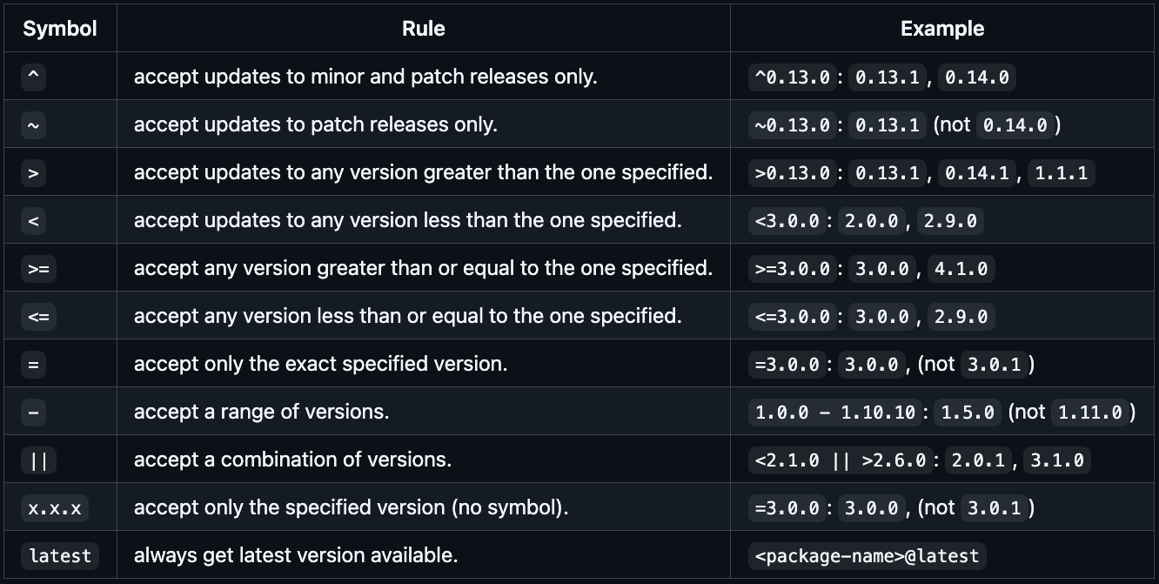
npm respects Semantic Versioning

Slide 9
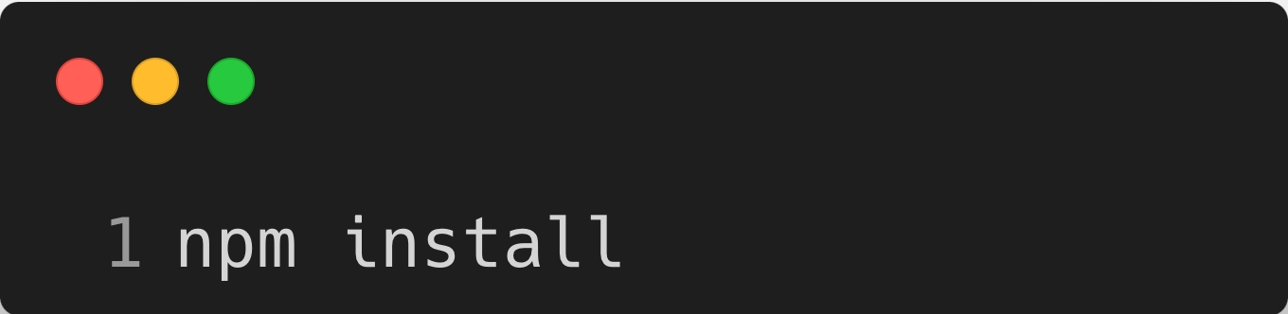


Re-Installing All Dependencies
Olivia
package.json
Sophia

Slide 10
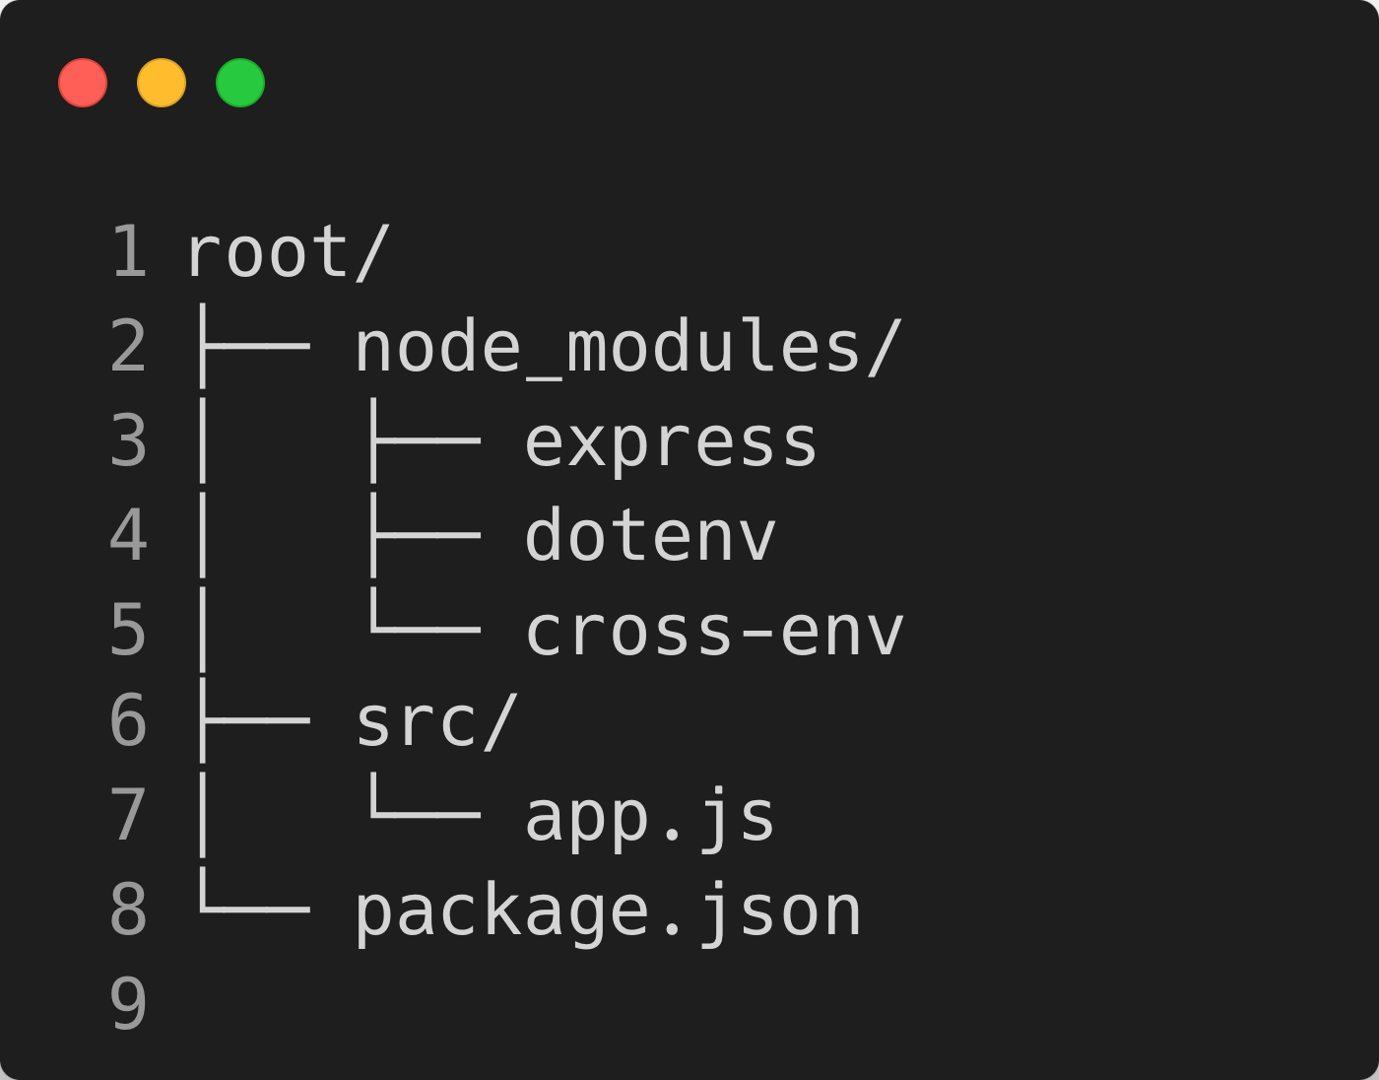
node_modules Dependencies of Dependencies
In Node.js, the node_modules directory houses all the packages your project depends on. Each package can have its own dependencies, which are also stored in node_modules within their respective package directories, creating a nested structure of dependencies and sub-dependencies.

