Slide 1


Introduction to the Document Object Model (DOM)
Full-Stack Web Development Bootcamp

Slide 2


Components Of JavaScript in Browser
Core (ECMAScript): Defines the language’s syntax, data types, statements, and operators.
DOM (Document Object Model): Represents the webpage as a tree structure, allowing JavaScript to manipulate HTML elements.
BOM (Browser Object Model): Provides access to browser features such as the window object, enabling JavaScript to control browser behavior outside of the webpage.

Slide 3
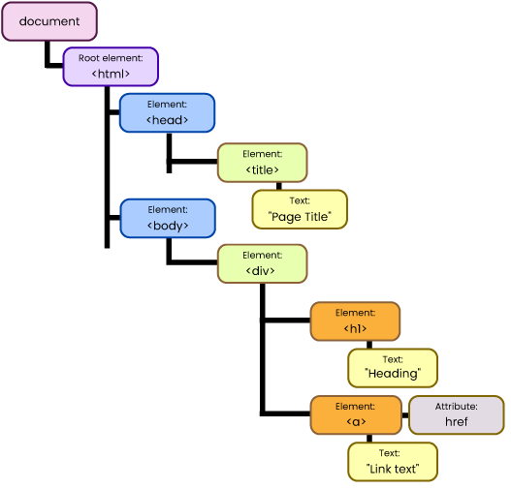
What is the DOM
Document Object Model
The DOM (Document Object Model) is a programming interface that represents the structure of HTML or XML documents as a tree of objects, allowing scripts to manipulate and modify the document's structure, content, and style.
Notes:
https://www.freecodecamp.org/news/the-javascript-dom-manipulation-handbook/ https://github.com/john-smilga/javascript-basic-projects
https://codepen.io/jacintodesign/pen/WNgLgRj
https://zerotomastery.io/blog/javascript-practice-projects/##2.-Create-a-calculator

Slide 4




What All Can Be Done With DOM?
Select Elements
Change Content
Traverse the DOM
Listen To Events
Identifies and targets specific elements in the DOM using methods like getElementById() or querySelector() to enable manipulation.
Modifies or updates the content and organization of elements in the DOM, allowing for dynamic changes like adding or removing nodes.
Navigates between elements in the DOM hierarchy using methods like parentNode or nextSibling to explore and interact with the structure.
Attaches event listeners to DOM elements to trigger actions when specified events, like clicks or key presses, occur.

Slide 5
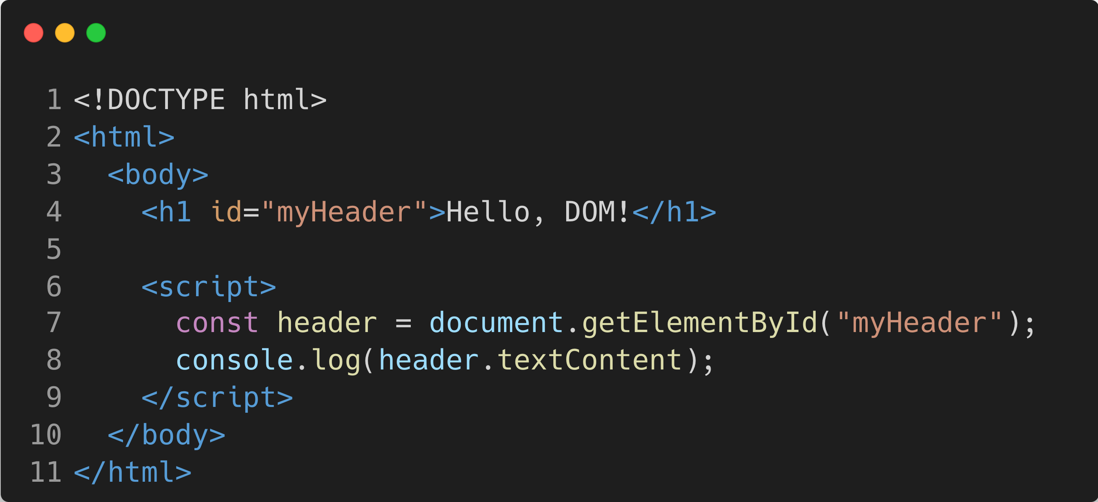
Looking at Selecting an Element
Select Elements
This code selects the <h1> element with the ID myHeader using getElementById(). It stores the element in the header variable, then logs its text content ("Hello, DOM!") to the console.

Slide 6
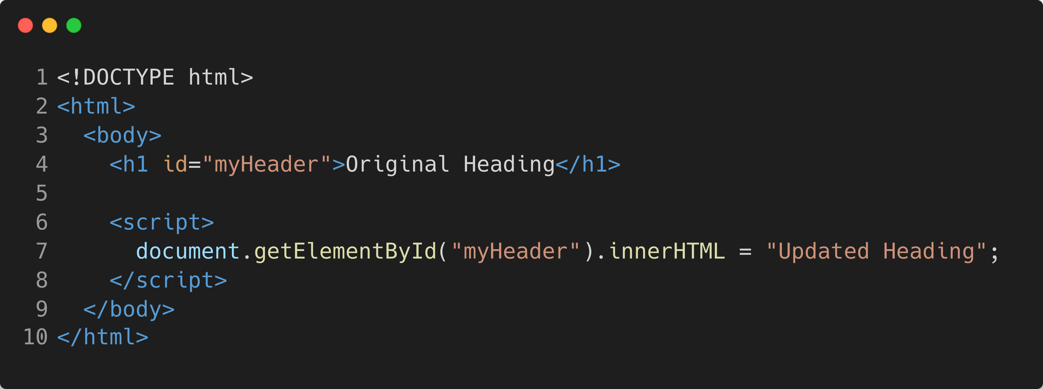
How to Change Content and Structure
Changing Content And Structure
This code changes the content of the <h1> element with the ID myHeader from "Original Heading" to "Updated Heading" using the innerHTML property.

Slide 7
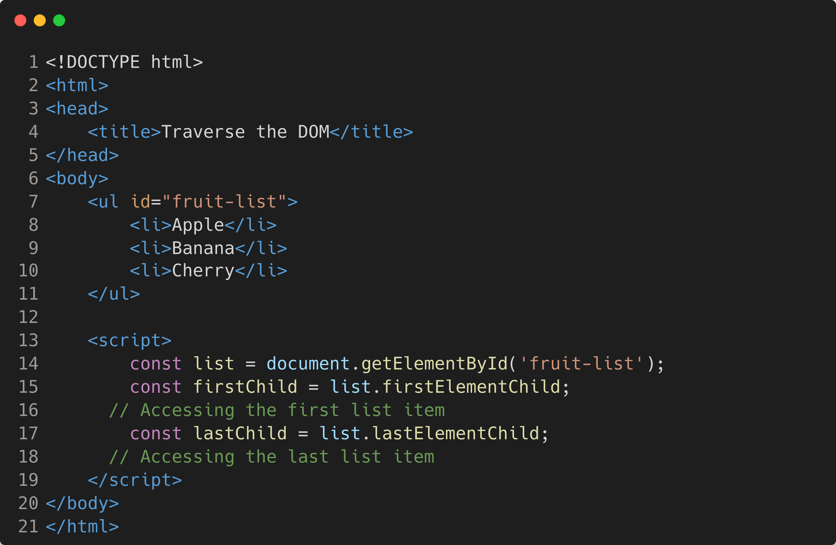
How to Traverse The DOM?
Traverse The DOM
This code selects the <h1> element with the ID myHeader using getElementById(). It stores the element in the header variable, then logs its text content ("Hello, DOM!") to the console.

Slide 8
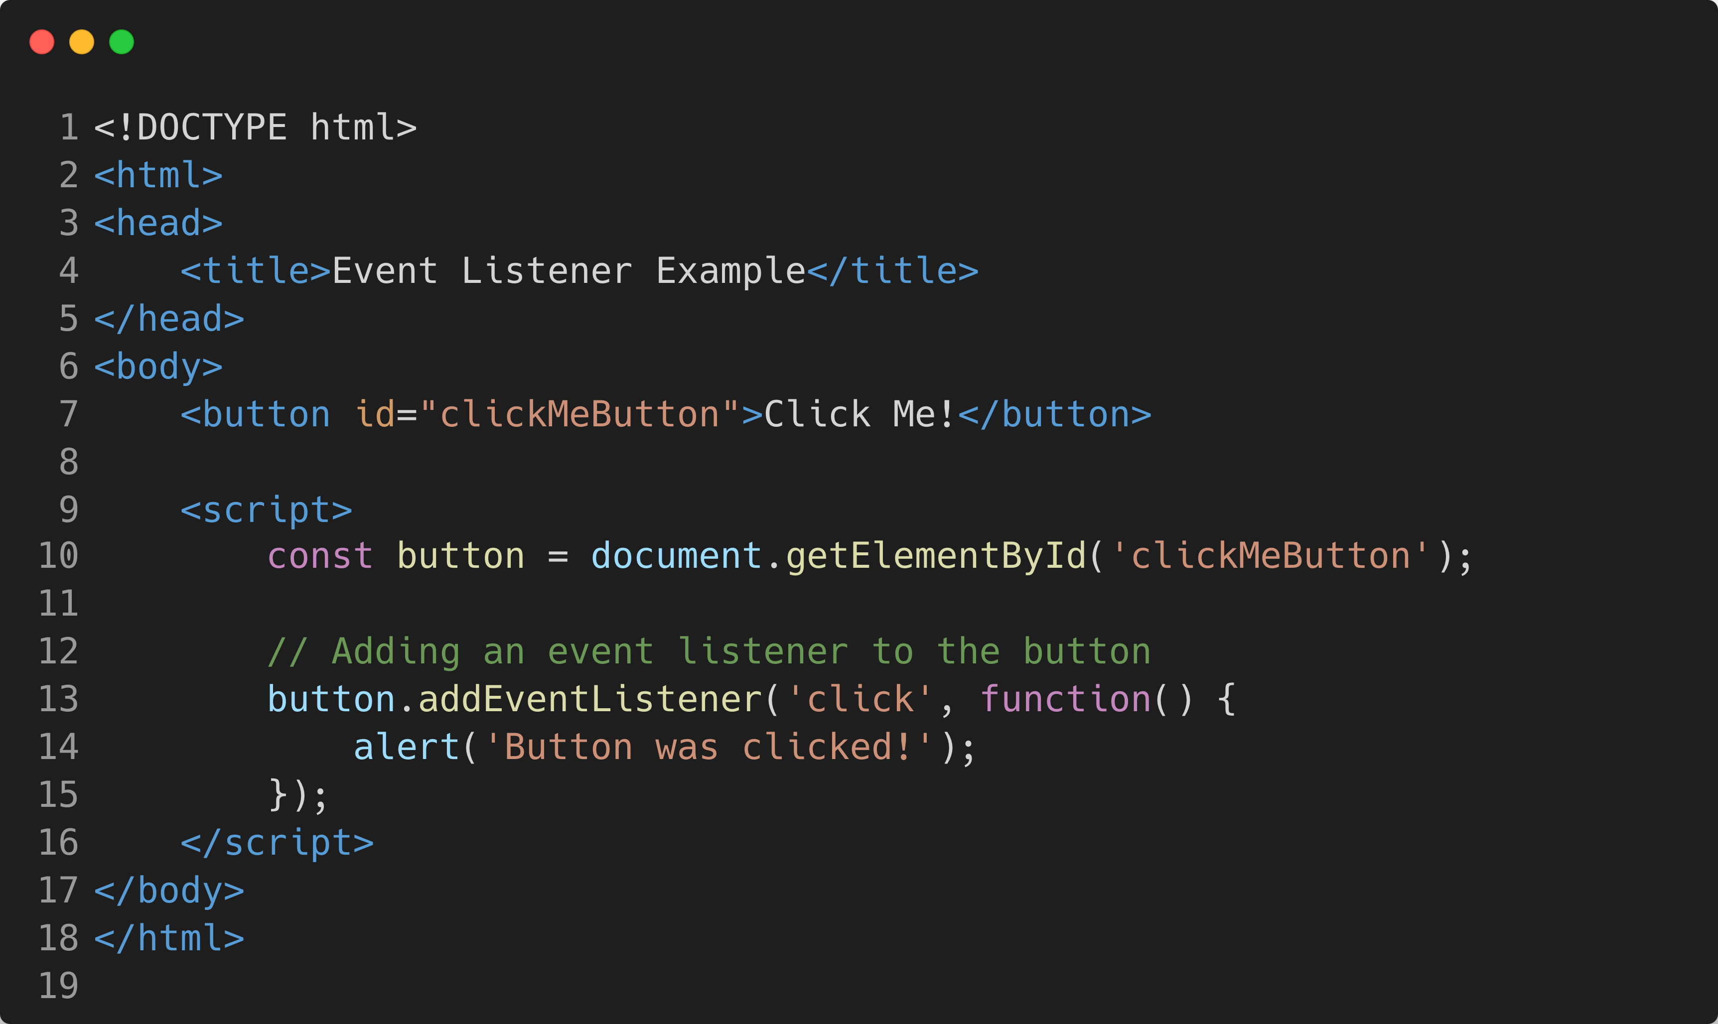
How to Listen To Events?
Listen to Events
This example demonstrates how to use the addEventListener method to listen for a "click" event on a button element. When the button is clicked, the function triggers an alert with the message "Button was clicked!"

