Slide 1


What is
REST API
Full-Stack Web Development Bootcamp

Slide 2

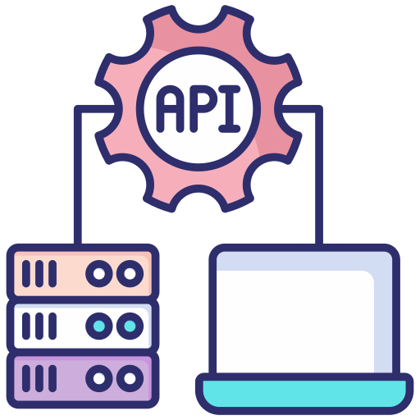
What is REST API?
REST API
A REST API (Representational State Transfer API) is a set of guidelines used for creating web services. It uses standard HTTP methods like GET, POST, PUT, and DELETE for reading, creating, updating, and deleting data, respectively. REST is designed to be stateless and utilize URLs to address resources.

Slide 3
Design Principles For REST API
Client Server Decoupling
Statelessness
Cacheability
Uniform Interface
Layered System
Code On Demand (opt)

Slide 4

Client Server Decoupling
GET
POST
DELETE
Client
PUT
Server
PATCH
Client-server decoupling refers to the separation of frontend (client) and backend (server) components of an application, allowing independent development and scaling. This architecture enhances flexibility, as clients interact with servers via APIs without depending on server-side implementation details.

Slide 5
Types Of HTTP Request Methods
GET
The GET method requests a representation of the specified resource. Requests using GET should only retrieve data.
POST
The POST method submits an entity to the specified resource, often causing a change in state or side effects on the server.
DELETE
The DELETE method deletes the specified resource.
PUT
The PUT method replaces all current representations of the target resource with the request payload.
PATCH
The PATCH method applies partial modifications to a resource.

Slide 6
Uniform Interface
GET /posts
Client One
POST /posts
DELETE /posts
Server
Client Two
https://apiurl.com/posts
A uniform interface means that REST API interactions are standardized: requests for the same resource use identical URIs and HTTP methods, regardless of the client making the request. This consistency simplifies development and integration, ensuring predictability and scalability.

Slide 7


REST is Stateless
User One
Token One
Server
User Two
Token Two
REST APIs are stateless, which means each request must contain all information necessary to understand and complete the request. This approach ensures that the server does not need to retain session or user-specific state between requests, enhancing reliability and scalability.

Slide 8
Cacheability
C
a
c
h
e
C
a
c
h
e
Request
Response
Client
Server
In RESTful architectures, both servers and clients can maintain their own independent caches. This means the server can cache common data to quickly serve multiple clients, while clients can cache server responses to reduce the number of requests sent. This dual-layer caching optimizes performance, reducing latency and server load by minimizing unnecessary data transmission.

Slide 9
Layered Architecture
Logical Layer
Request
Database
Response
Client
Middleware
REST APIs are designed within a layered system architecture, where interactions occur without the client or server knowing whether they are communicating directly with the end application or through intermediaries. This ensures that each layer can evolve independently, enhancing scalability and security.

Slide 10
Anatomy Of API Endpoint
HTTP verb: GET
domain: https://apiurl.com/
route: /posts/
GET https://apiurl.com/posts/author/?limit=10&offset=20
params: /author/
query: /?limit=10&offset=20
body: {“author”: ”John”}

Slide 11
Params Vs. Query
GET https://apiurl.com/posts/author/?limit=10&offset=20
params: /author/
Params can be thought of as categories
query: /?limit=10&offset=20
And queries can be thought of as filters

Slide 12
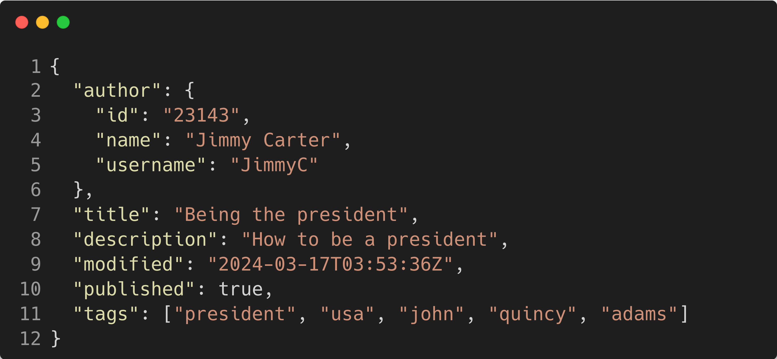
Body Object Example (JSON)
In HTTP APIs, the request body is utilized with POST, PATCH, and PUT methods for transmitting data to the server. These methods respectively create, partially update, and replace resources, allowing detailed data inclusion in the request body for processing.

Slide 13


Development Environment
Request
Response
Server
(localhost)
Client

