Slide 1


Introduction to DOM Events
Full-Stack Web Development Bootcamp

Slide 2


What Are DOM Events?
DOM Events are actions triggered by user interactions or browser behaviors, allowing JavaScript to react dynamically to these actions.
click: Triggered when an element is clicked.
mouseover: Fires when the mouse pointer moves over an element.
keydown: Activated when a key is pressed down.
submit: Occurs when a form is submitted.
focus: Fired when an element gains focus, such as an input field.
blur: Triggered when an element loses focus.
load: Fires when the entire page or a specific element finishes loading.
input: Fired when user input is detected in a form element.
Notes:
https://github.com/john-smilga/javascript-basic-projects
https://zerotomastery.io/blog/javascript-practice-projects/##2.-Create-a-calculator

Slide 3
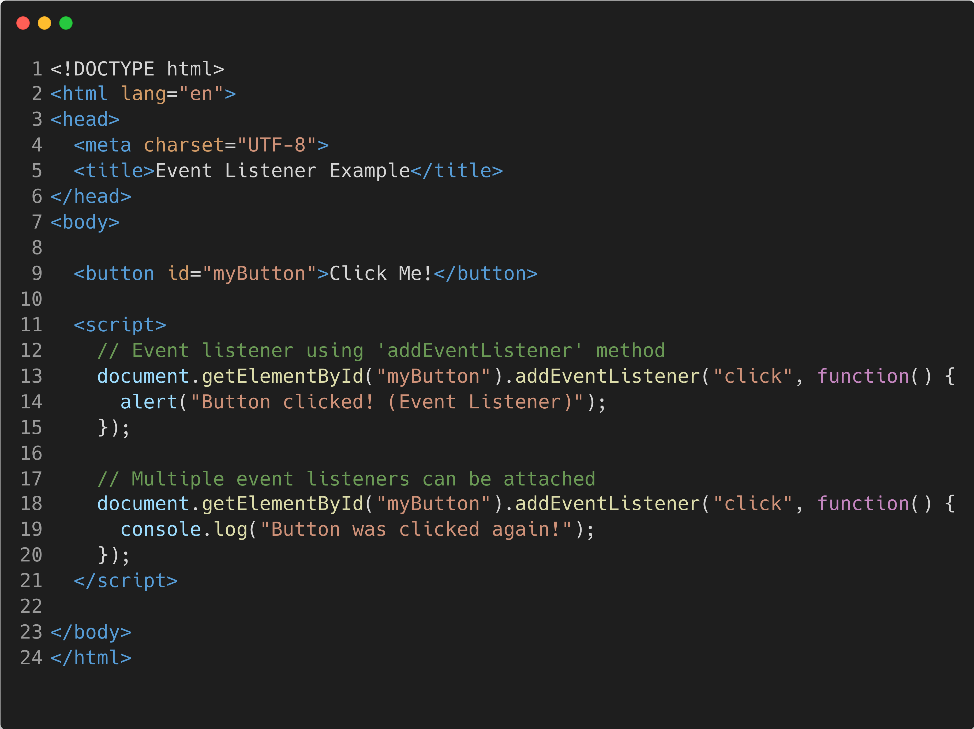
Introducing Event Listener
Event Listener
An event listener is a function attached to an event using addEventListener(). It allows multiple functions to be attached to the same event without overwriting others, providing more flexibility for handling events.

Slide 4
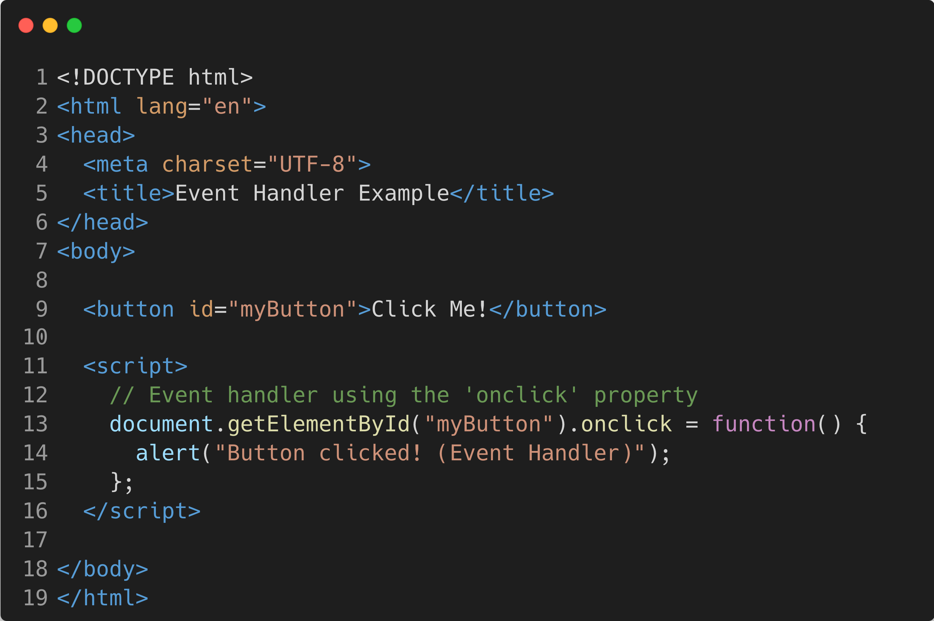
Introducing Event Handler
Event Handler
An event handler is a function assigned directly to an HTML element's event property, such as onclick. It can only handle one function at a time per event, as assigning a new handler will overwrite the previous one.

Slide 5
Type of DOM Events
1. Mouse Events
click: Fired when a mouse button is clicked.
dblclick: Triggered on double-clicking.
mouseover: Fired when the mouse hovers over an element.
2. Keyboard Events
keydown: Triggered when a key is pressed.
keyup: Fired when a pressed key is released.
3. Form Events
submit: Fired when a form is submitted.
focus: Triggered when an element gains focus.
4. Window Events
load: Triggered when a page has fully loaded.
resize: Fired when the browser window is resized.
scroll: Triggered when the page or an element is scrolled.
5. Clipboard Events
copy: Fired when content is copied.
paste: Fired when content is pasted.
6. Touch Events (for mobile devices)
touchstart: Triggered when a touch is initiated.
touchend: Fired when a touch ends.
touchmove: Fired as a touch is moved.
7. Drag & Drop Events
dragstart: Fired when the drag operation begins.
drop: Fired when a dragged item is dropped.
8. Media Events
play: Triggered when media playback starts.
pause: Fired when media playback is paused.
9. Focus Events
focusin: Triggered when an element or its descendants receives focus.
focusout: Fired when an element or its descendants lose focus.

