Slide 1

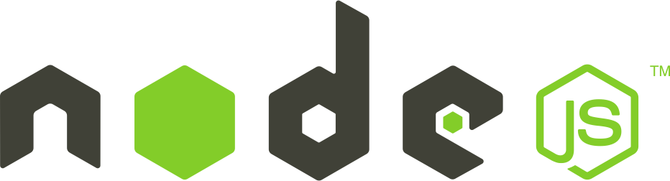
What is a
Controller
Full-Stack Web Development Bootcamp

Slide 2

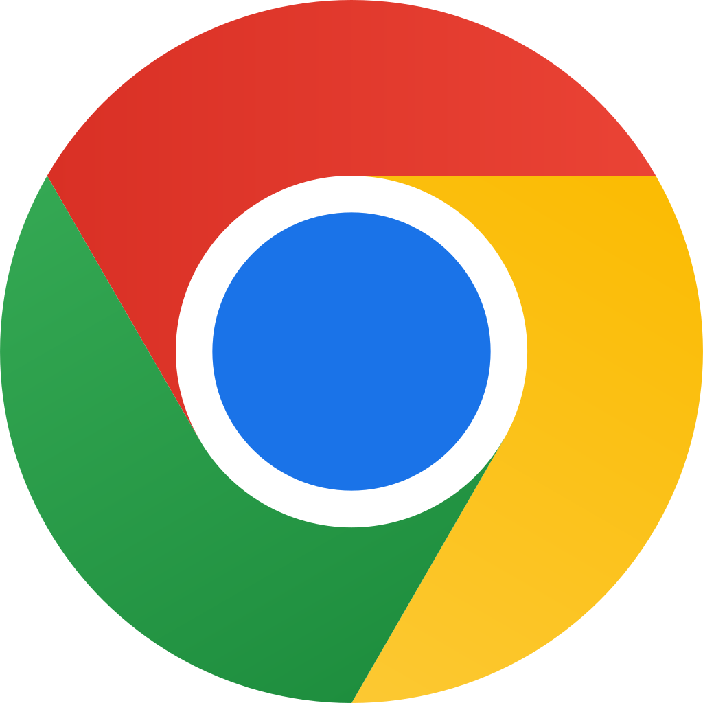
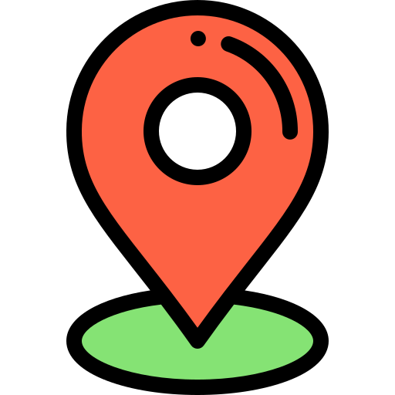
How We Process Request
Client
route
In web development, the purpose of a route is to direct incoming requests to the appropriate controller based on the URL and HTTP method. This ensures that each request is handled by the specific controller logic designed to process it, maintaining organized and efficient request management.

Slide 3

We Need Controllers
route
Client
tasksController
A controller is a specialized file designed to manage interactions for a single entity or resource. It handles business logic, orchestrates model interactions, and prepares data for the view, ensuring responsibilities are clearly separated and organized within the application.

Slide 4

A Controller For Each Entity
tasksController
GET /users
usersRouter
usersController
When a GET request targets a usersRouter, it is routed to the usersController for processing. This controller handles the request, retrieves necessary data, and sends the response, effectively managing all user-related operations within its designated scope.

