Slide 1


Understanding
HTTP Status Codes
Full-Stack Web Development Bootcamp

Slide 2


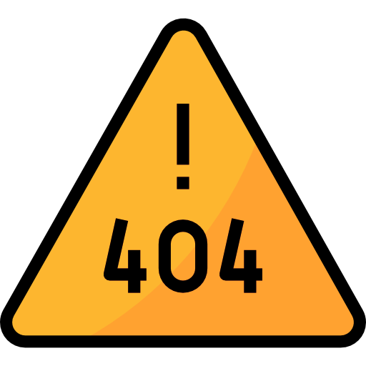
What Are HTTP Status Codes
Client
route
HTTP status codes are standardized numerical responses issued by a server to indicate the outcome of a client's request, informing about successful operations, redirections, client or server errors, and other states of the web interaction.

Slide 3
Code 2xx: Success
200 OK: The request has succeeded, and the response contains the requested data.
201 Created: The request has been fulfilled, and a new resource has been created.
204 No Content: The server successfully processed the request, but is not returning any content.

Slide 4
Code 3xx: Redirection
301 Moved Permanently: The URL of the requested resource has been changed permanently. The new URL is given in the response.
302 Found: The server is redirecting to a different URL, which is temporarily in use.
304 Not Modified: The client can use cached data; the resource has not been modified.

Slide 5
Code 4xx: Client Error
400 Bad Request: The server cannot or will not process the request due to a client error (syntax, size too large, etc.).
401 Unauthorized: Authentication is required and has failed or has not been provided.
403 Forbidden: The server understood the request but refuses to authorize it.
404 Not Found: The requested resource could not be found but may be available in the future.
409 Conflict: The request could not be completed due to a conflict with the current state of the target resource.

Slide 6
Code 5xx: Server Error
500 Internal Server Error: A generic error message when the server encounters an unexpected condition.
501 Not Implemented: The server either does not recognize the request method or lacks the ability to fulfill the request.
503 Service Unavailable: The server is currently unavailable (overloaded or down for maintenance).

