Slide 1


Introduction To Databases
SQL Vs. NoSQL
Full-Stack Web Development Bootcamp

Slide 2



We Do Not Have Data Persistence
Client
tasksController
Till now, all data is stored temporarily in JavaScript files, meaning it resides in memory and lacks permanent storage. Without a database, this data isn't persisted across sessions or after server restarts, leading to data loss and limited data management capabilities.

Slide 3

To Save Data We Use Database
Client
tasksController
Database
What is a Database?
A database is a structured system for storing, managing, and retrieving data efficiently. It supports operations such as insertion, deletion, and querying of data, facilitating organized data access for applications and users.

Slide 4



Types of Databases
SQL Databases
NoSQL
SQL databases, also known as relational databases, use Structured Query Language (SQL) for defining and manipulating data, which is stored in tables and supports ACID properties to ensure reliable transactions.
NoSQL databases are designed to handle unstructured and semi-structured data with dynamic schemas, offering scalability and flexibility in data storage and retrieval across various data models such as document, key-value, graph, and columnar.

Slide 5
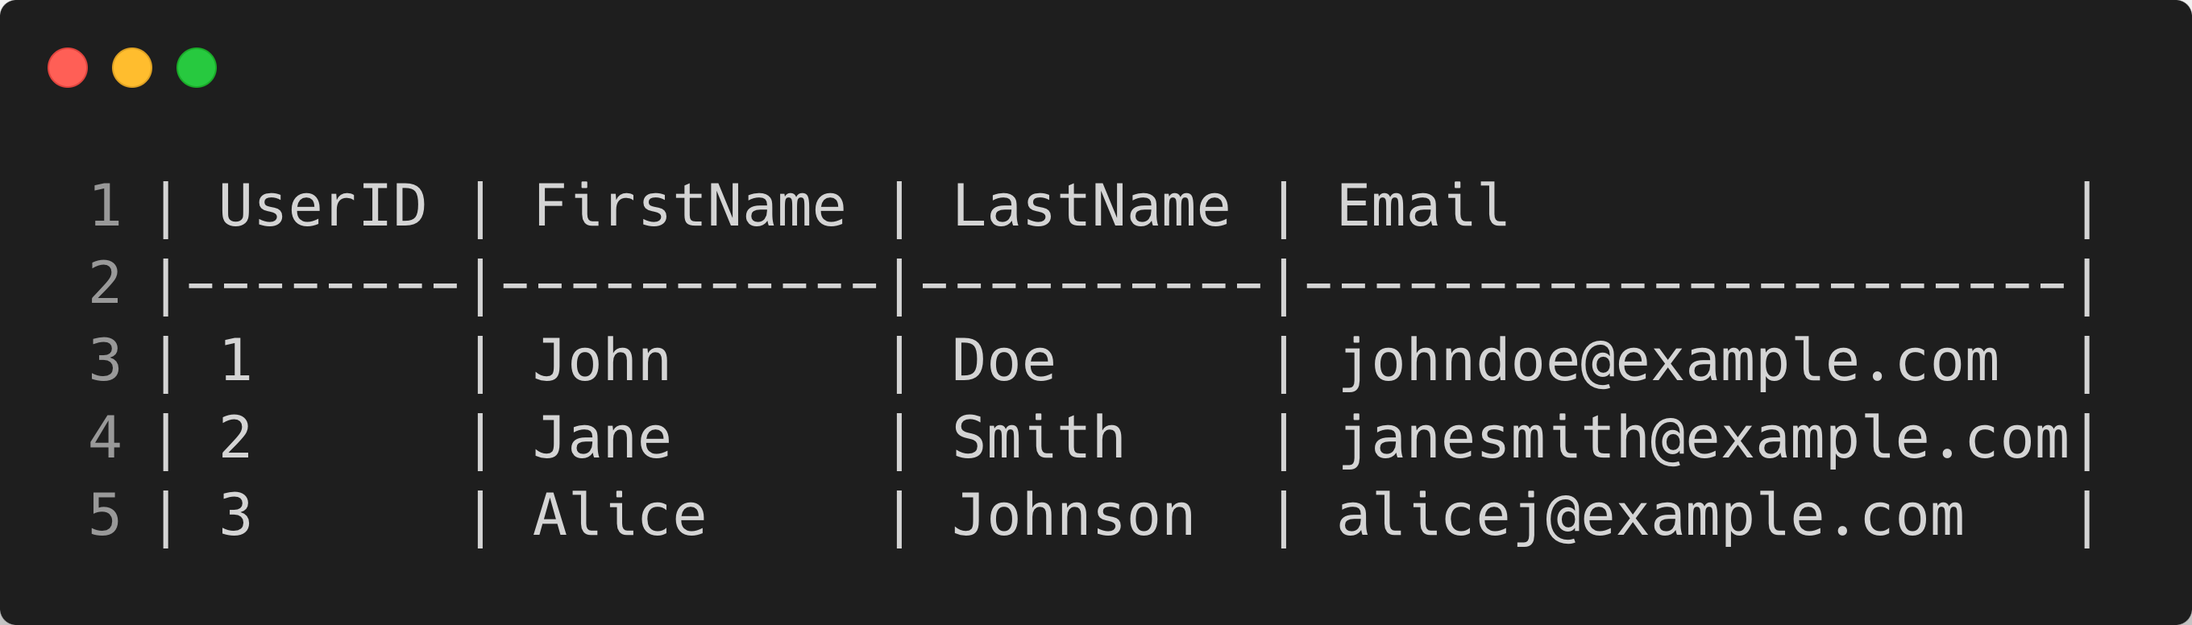
How SQL Databases Save Data
Data in a SQL Database
In SQL databases, data is stored in tables structured into rows and columns, where each table represents a specific entity and each row a unique record. Columns represent attributes of the entity, and data types are defined for each column to ensure data integrity and relational consistency.

Slide 6
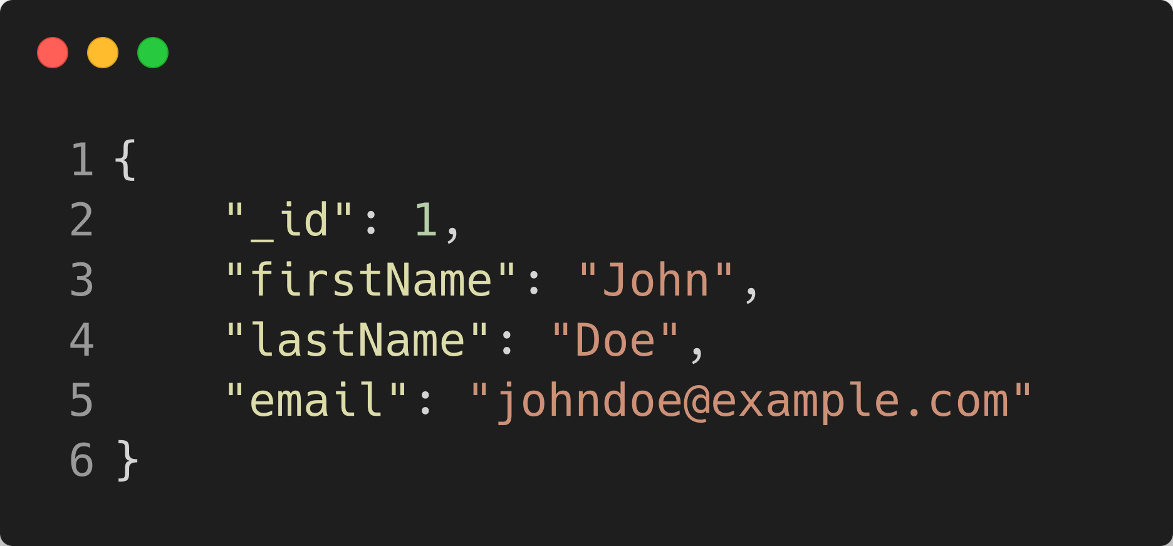
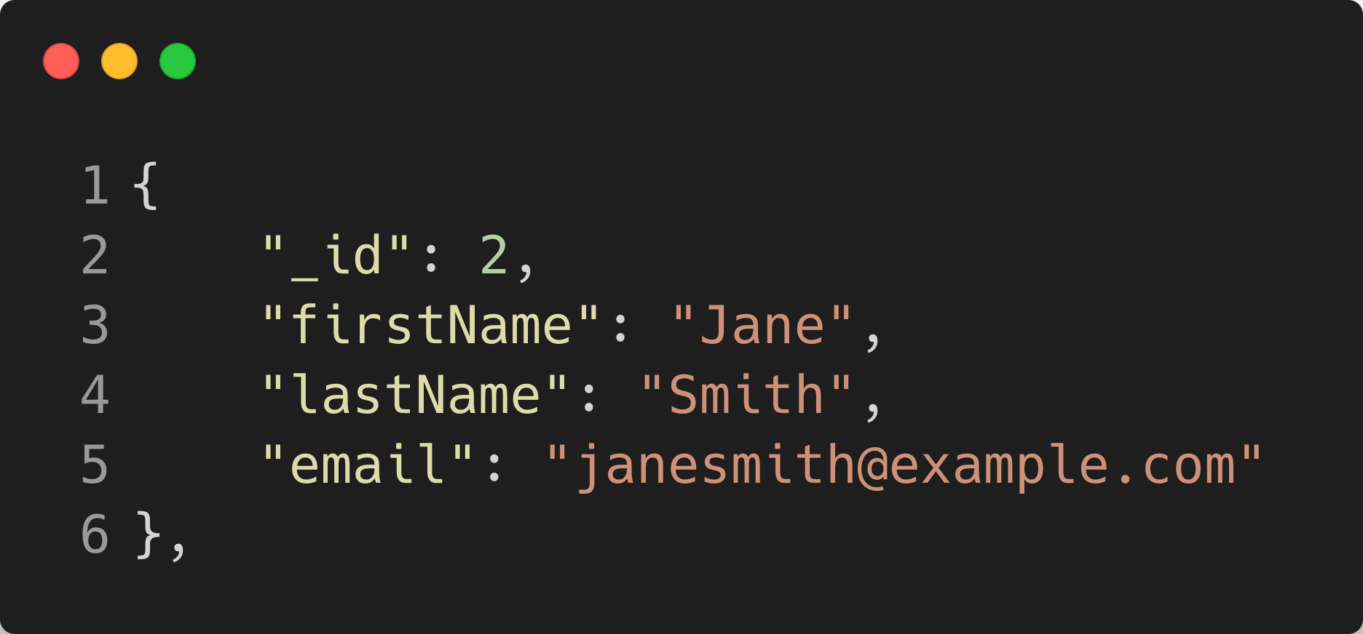
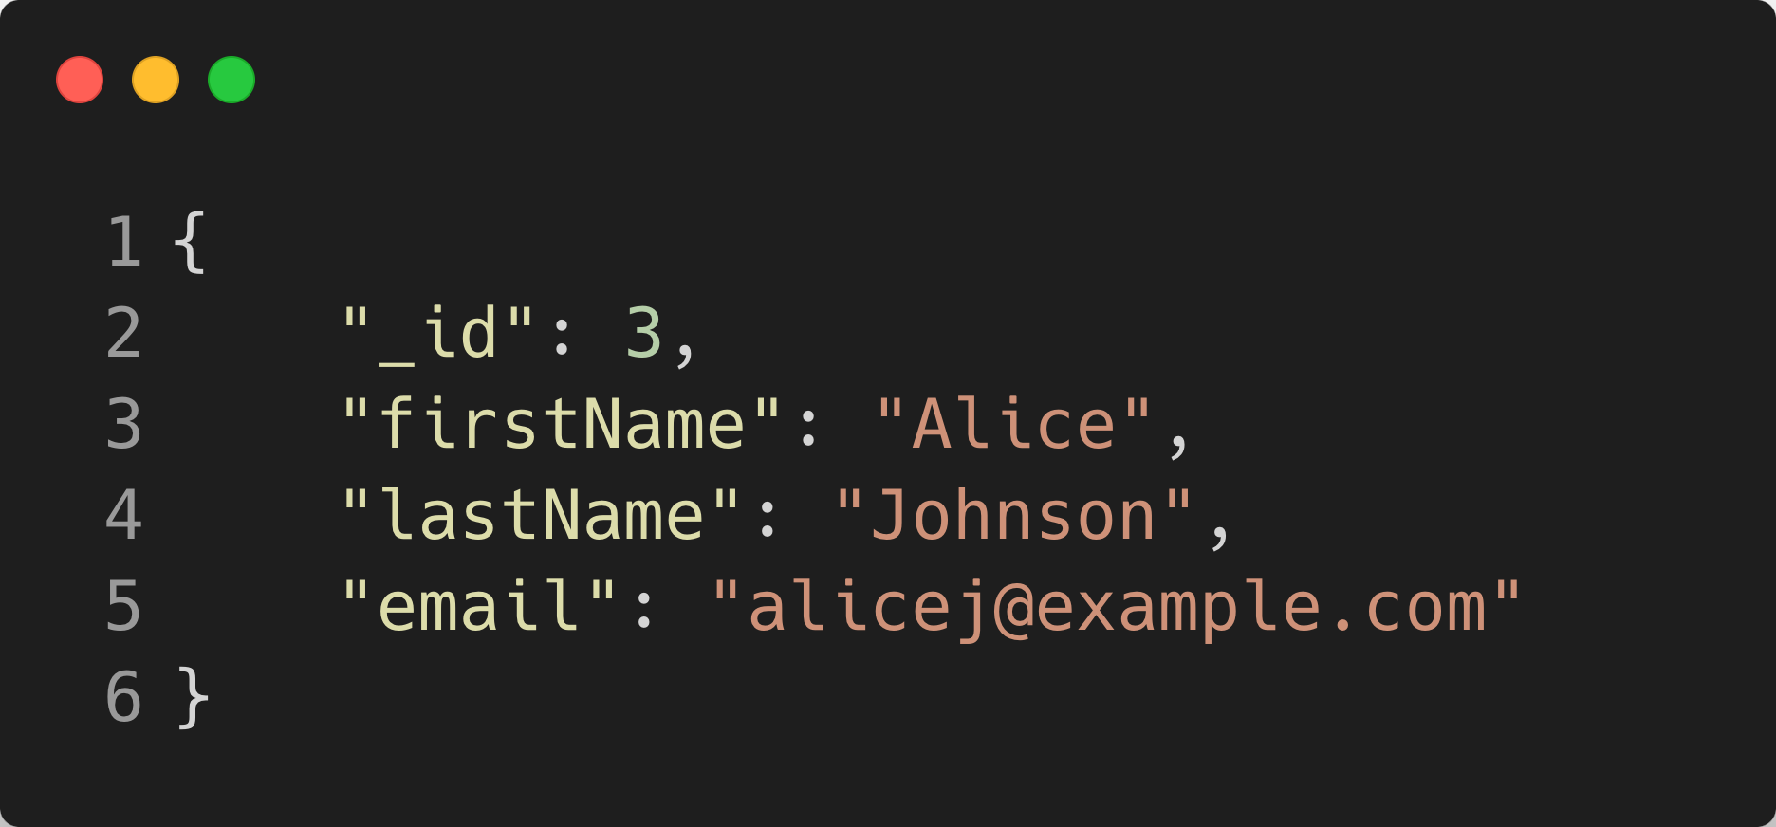
How MongoDB Saves Data
How MongoDB Stores Data
MongoDB saves data in collections of documents, each document containing key-value pairs that are more flexible and can be nested for complex data structures, offering high flexibility and scalability without predefined schemas.

