Slide 1


Advantages Of Using
MongoDB
Full-Stack Web Development Bootcamp

Slide 2

Main Advantages
Document-Oriented Storage: MongoDB uses JSON-like documents which are intuitive for developers familiar with JSON and JavaScript, making it easier to understand and use.
Schema Flexibility: Unlike SQL databases that require predefined schemas, MongoDB is schema-less. This allows developers to easily modify the data structure without migrations, which is ideal for applications with evolving data models.
Scalability: MongoDB is designed with scalability in mind, supporting horizontal scaling through sharding and replication, making it suitable for large-scale, high-volume applications.
Development Speed: MongoDB’s flexible schema model can accelerate development cycles by reducing the need for early, rigid database design decisions, facilitating agile and iterative development.

Slide 3
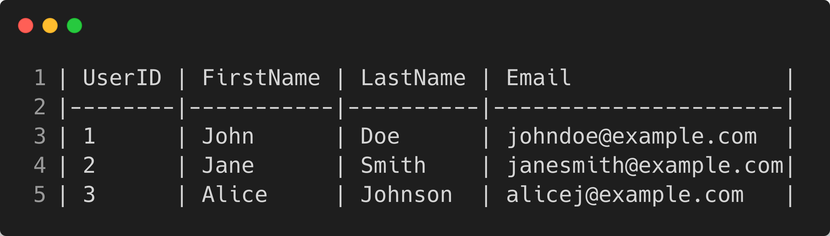
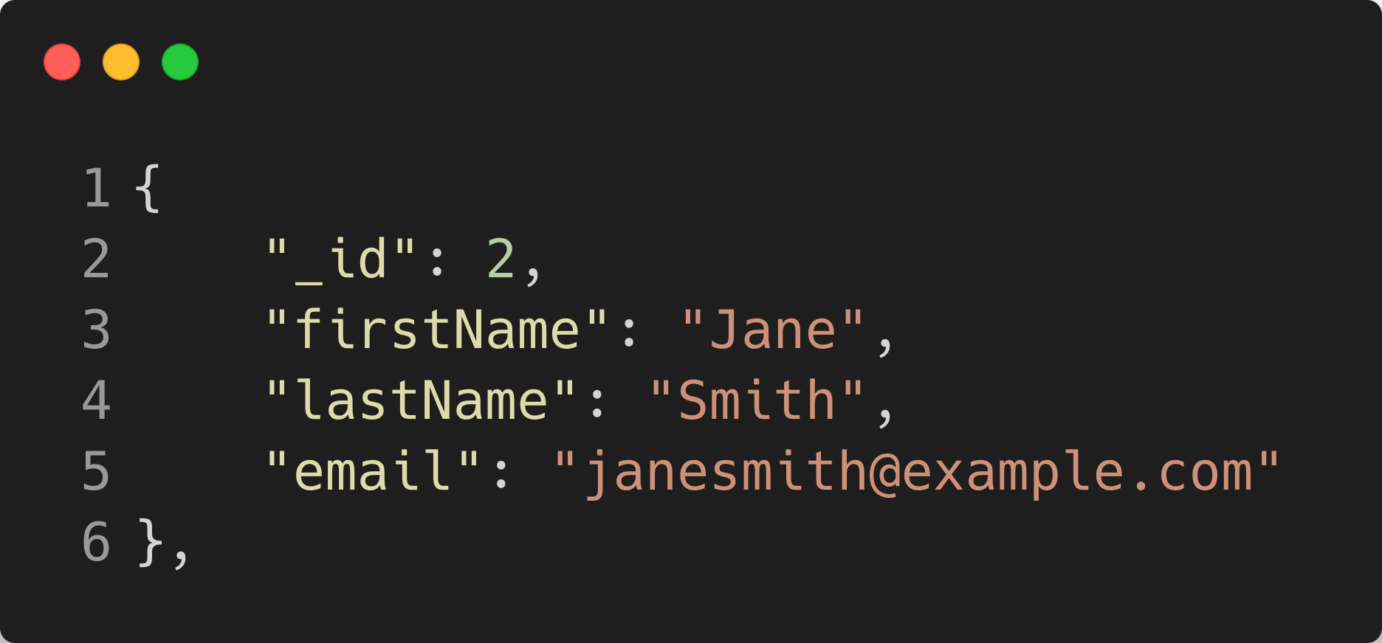
Document Oriented Storage
How MongoDB Stores Data
MongoDB saves data in collections of documents, each document containing key-value pairs that are more flexible and can be nested for complex data structures, offering high flexibility and scalability without predefined schemas.

Slide 4
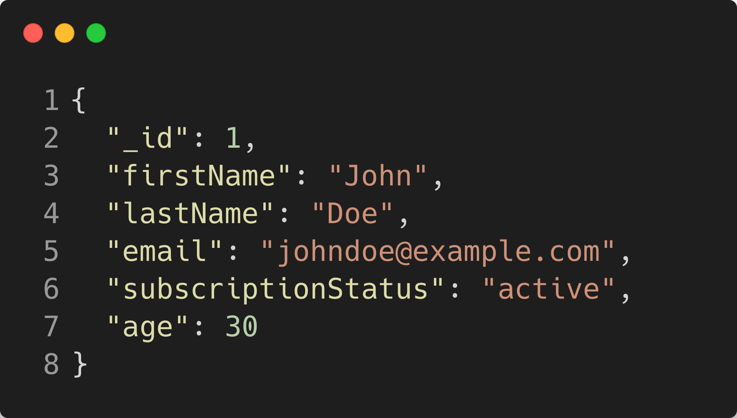
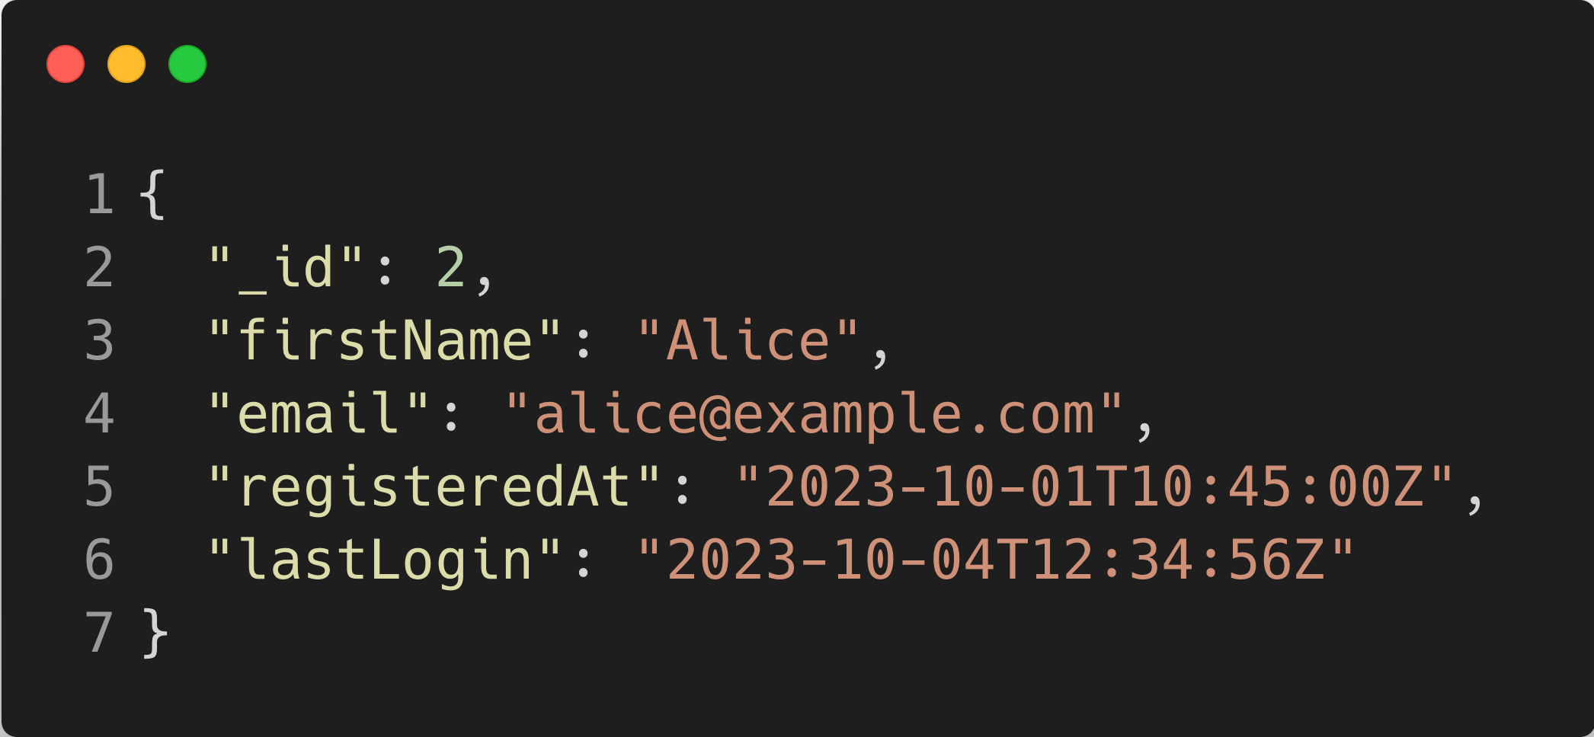
Schema Flexibility
Schema-less Design – In Same Collection
Unlike SQL databases that require predefined schemas, MongoDB is schema-less. This allows developers to easily modify the data structure without migrations, which is ideal for applications with evolving data models. This is not allowed in case of SQL Databases, each table will have a set of rules that need to be adhered to all the rows of the table.

Slide 5
Agility Brings Development Speed
Development Speed
MongoDB’s flexible schema model can accelerate development cycles by reducing the need for early, rigid database design decisions, facilitating agile and iterative development.

Slide 6

NOT a Solution For All Use Cases
Disclaimer
While MongoDB offers flexibility and scalability, it's not ideal for applications requiring complex transactions with multiple operations or strict relational data integrity. Its eventual consistency model can also be unsuitable for systems that need immediate consistency, such as financial services or booking systems.

