Slide 1

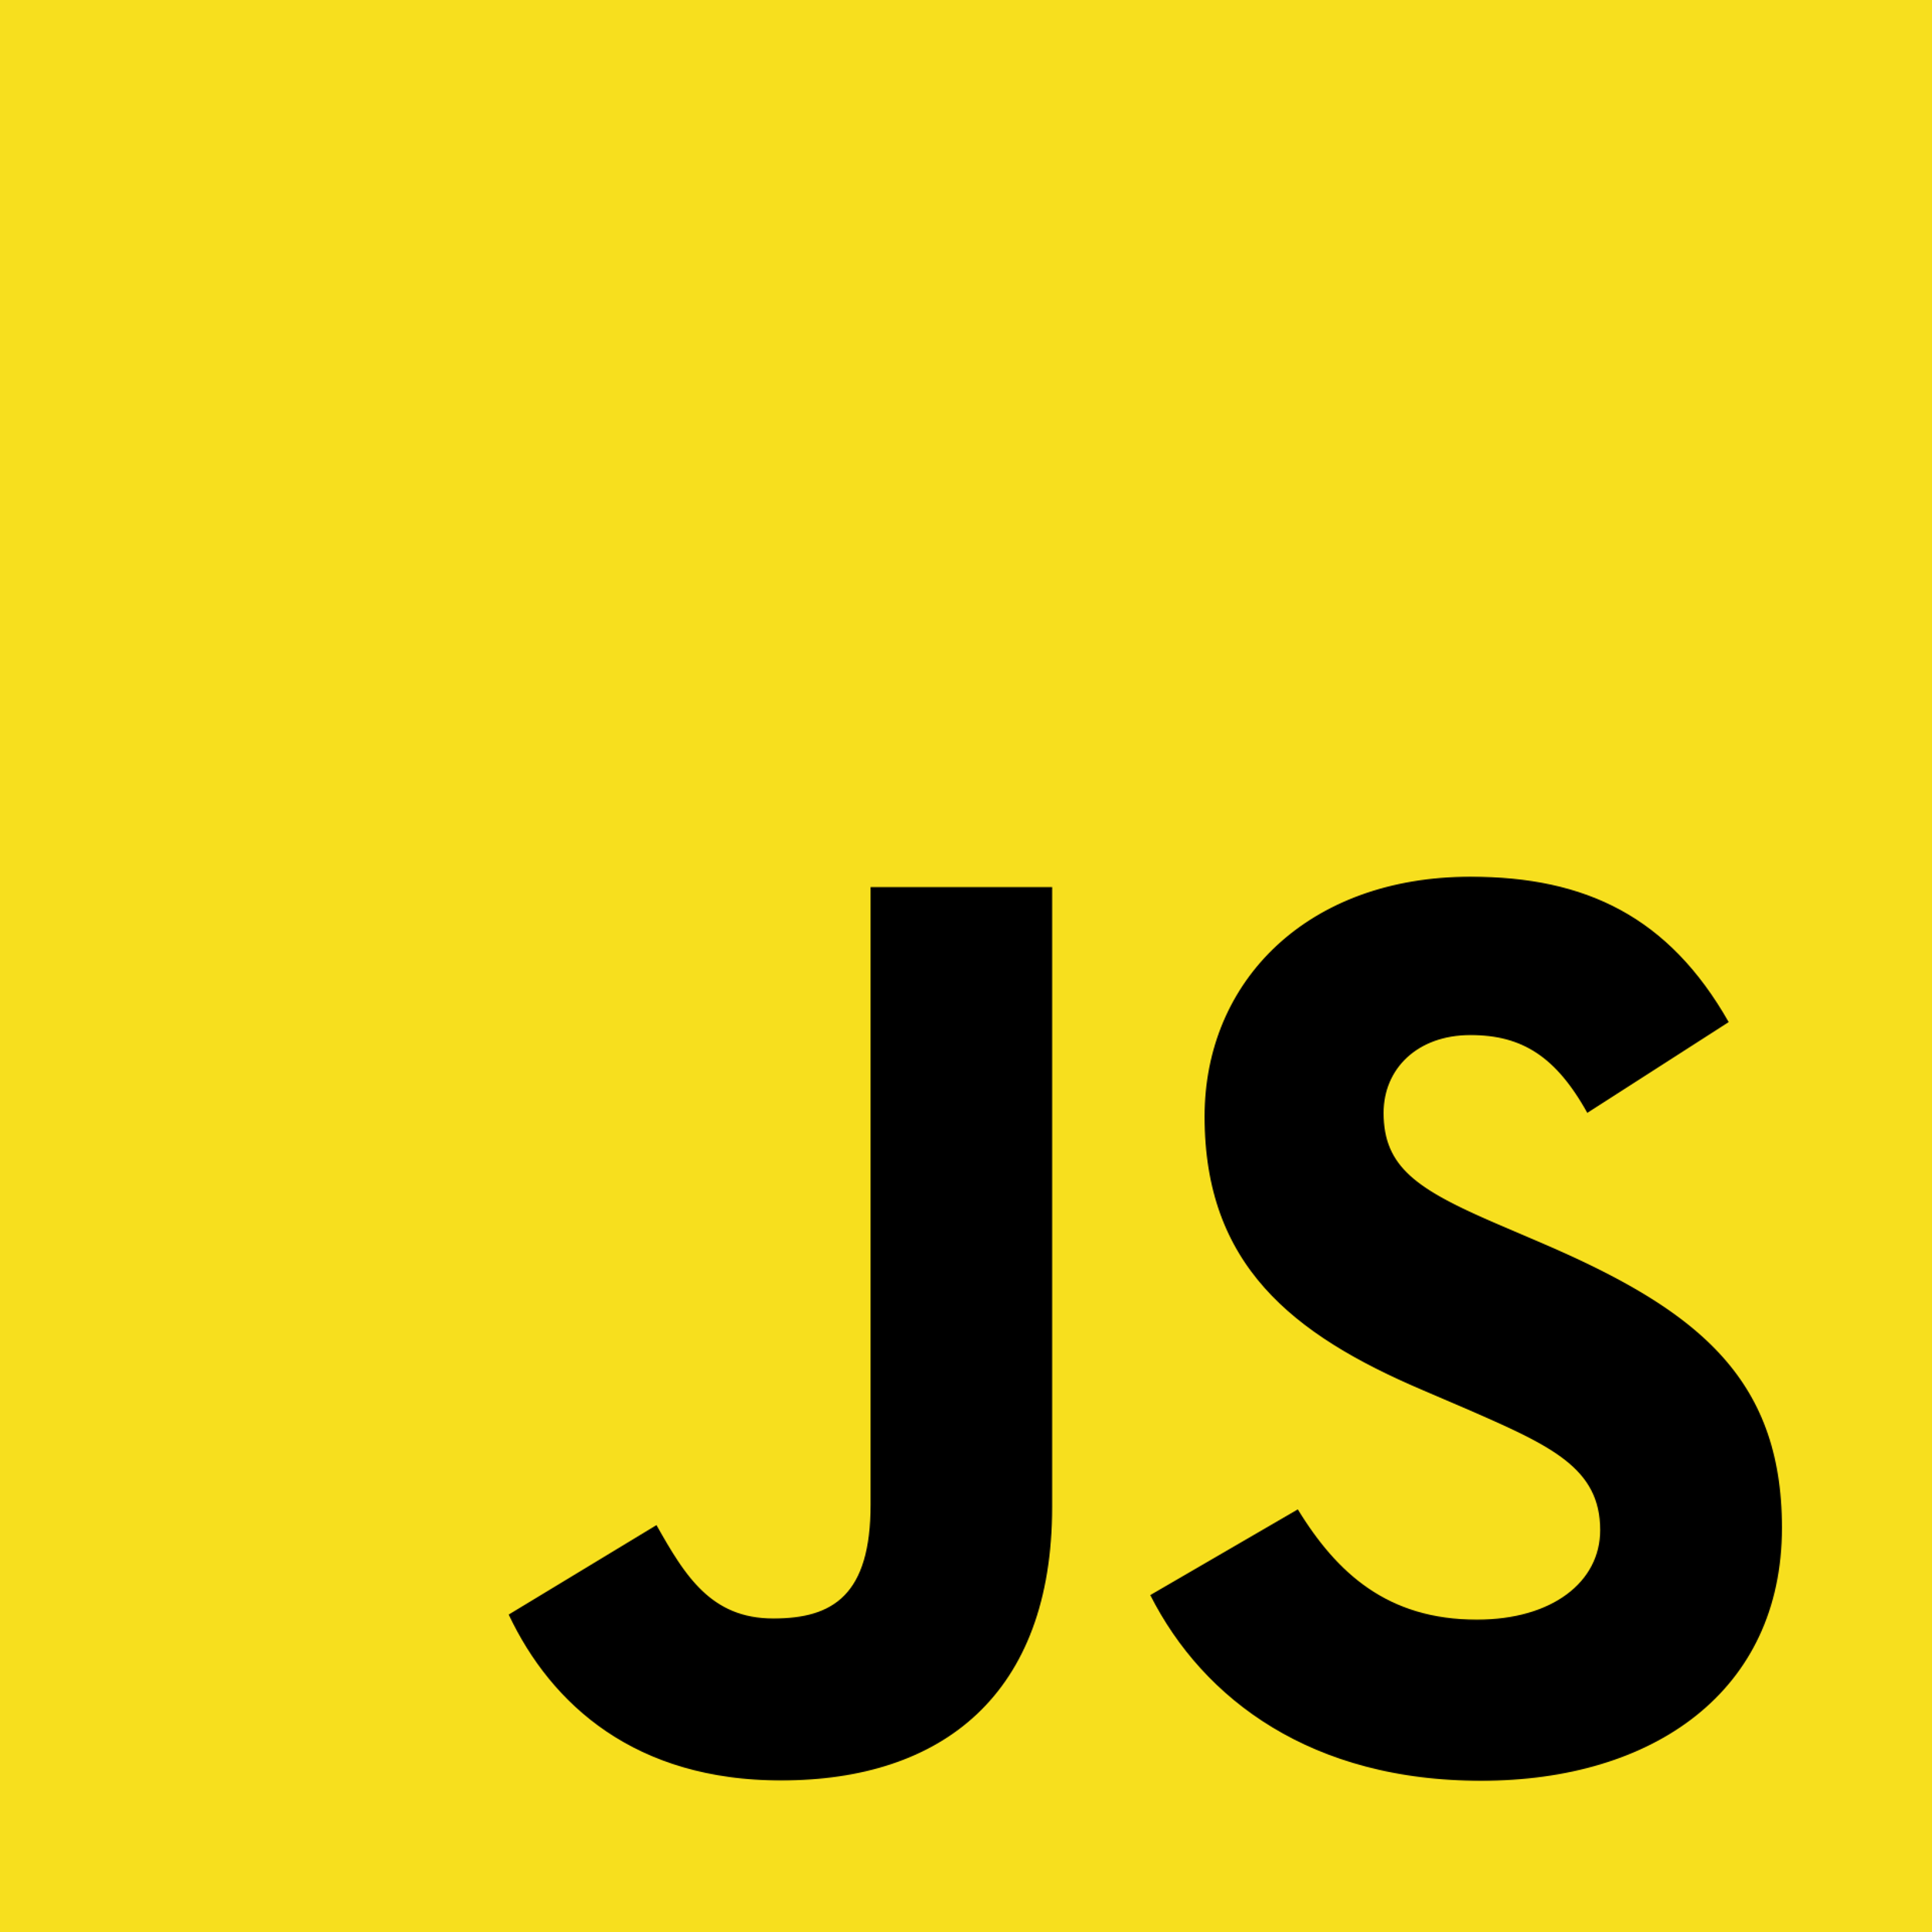
Event Bubbling, Capture
And Stopping Propagation
Full-Stack Web Development Bootcamp

Slide 2

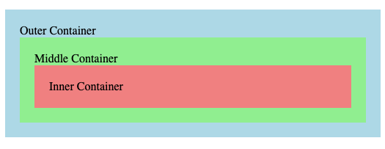
Stage1: What is Event Capture Phase
<document> …. </document>
<html> …. </html>
<body> …. </body>
<div>Outer Container</div>
<div>Middle Container</div>
<div>Inner Container</div>
Notes:
https://github.com/john-smilga/javascript-basic-projects
https://zerotomastery.io/blog/javascript-practice-projects/##2.-Create-a-calculator

Slide 3
Stage 2 + 3: Target Phase + Bubbling Phase
<document> …. </document>
<html> …. </html>
<body> …. </body>
<div>Outer Container</div>
<div>Middle Container</div>
<div>Inner Container</div>
Notes:
https://github.com/john-smilga/javascript-basic-projects
https://zerotomastery.io/blog/javascript-practice-projects/##2.-Create-a-calculator

Slide 4
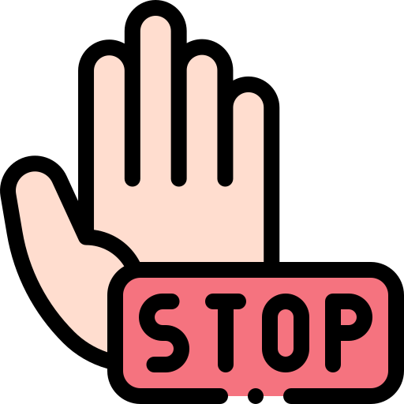
Using stopPropagation()
<div>Middle Container</div>
<div>Inner Container</div>
Notes:
https://github.com/john-smilga/javascript-basic-projects
https://zerotomastery.io/blog/javascript-practice-projects/##2.-Create-a-calculator

Slide 5
Understanding eventPhase Property
The event.eventPhase property indicates the current phase of an event's propagation in the DOM. It's crucial for managing interactions on web pages, particularly when utilizing both capturing and bubbling phases of event flow.
Value 1: Capturing Phase
Event descends from the document root to the target. Only listeners registered for capture (useCapture true) trigger.
Value 2: At Target
Event is at the target element. Listeners attached directly to the target for both capturing and bubbling trigger here.
Value 3: Bubbling Phase
Event ascends from the target to the document root. Only non-capturing listeners (useCapture false) activate.

