Slide 1


Understanding What is
Mongoose
Full-Stack Web Development Bootcamp

Slide 2

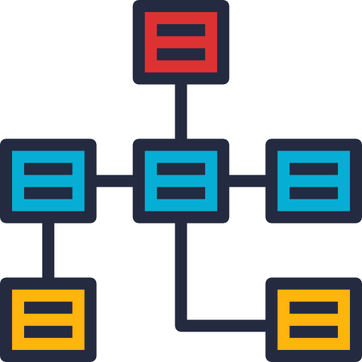


Challenges With MongoDB
Schema Management
Data Validation
Complexity in Data Handling
Even in schema-less databases like MongoDB, structured schemas via tools like Mongoose help enforce consistency and organization within the data.
Validating data prior to database insertion ensures reliability and integrity, preventing corrupt or undesirable data from being stored.
Using MongoDB’s native driver directly can result in cumbersome and verbose code, making data operations complex and error-prone.

Slide 3
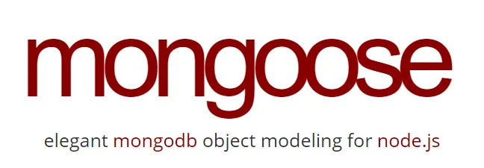
What is Mongoose
Mongoose – Object Data Modelling
Mongoose is an Object Data Modeling (ODM) library for MongoDB and Node.js that provides a schema-based solution to model your application data. It includes built-in type casting, validation, query building, and business logic hooks, simplifying the interaction with MongoDB.

Slide 4
Core Features of Mongoose
Schemas: Define the structure of documents within a collection.
Models: Create constructors compiled from Schema definitions.
Connection Management: Simplifies connecting to MongoDB.
Data Validation: Built-in validators, as well as custom validation functions.
Middleware: Hooks for logic before and after operations on documents.

Slide 5
Advantages of Using Mongoose
Simplifies Code: Reduces boilerplate, making code cleaner and easier to understand.
Schema Validation: Ensures data integrity by enforcing data types and rules.
Advanced Features: Supports population, virtuals, and methods that extend document capabilities.
Community and Support: Strong community support, well-documented, and actively maintained.

Slide 6
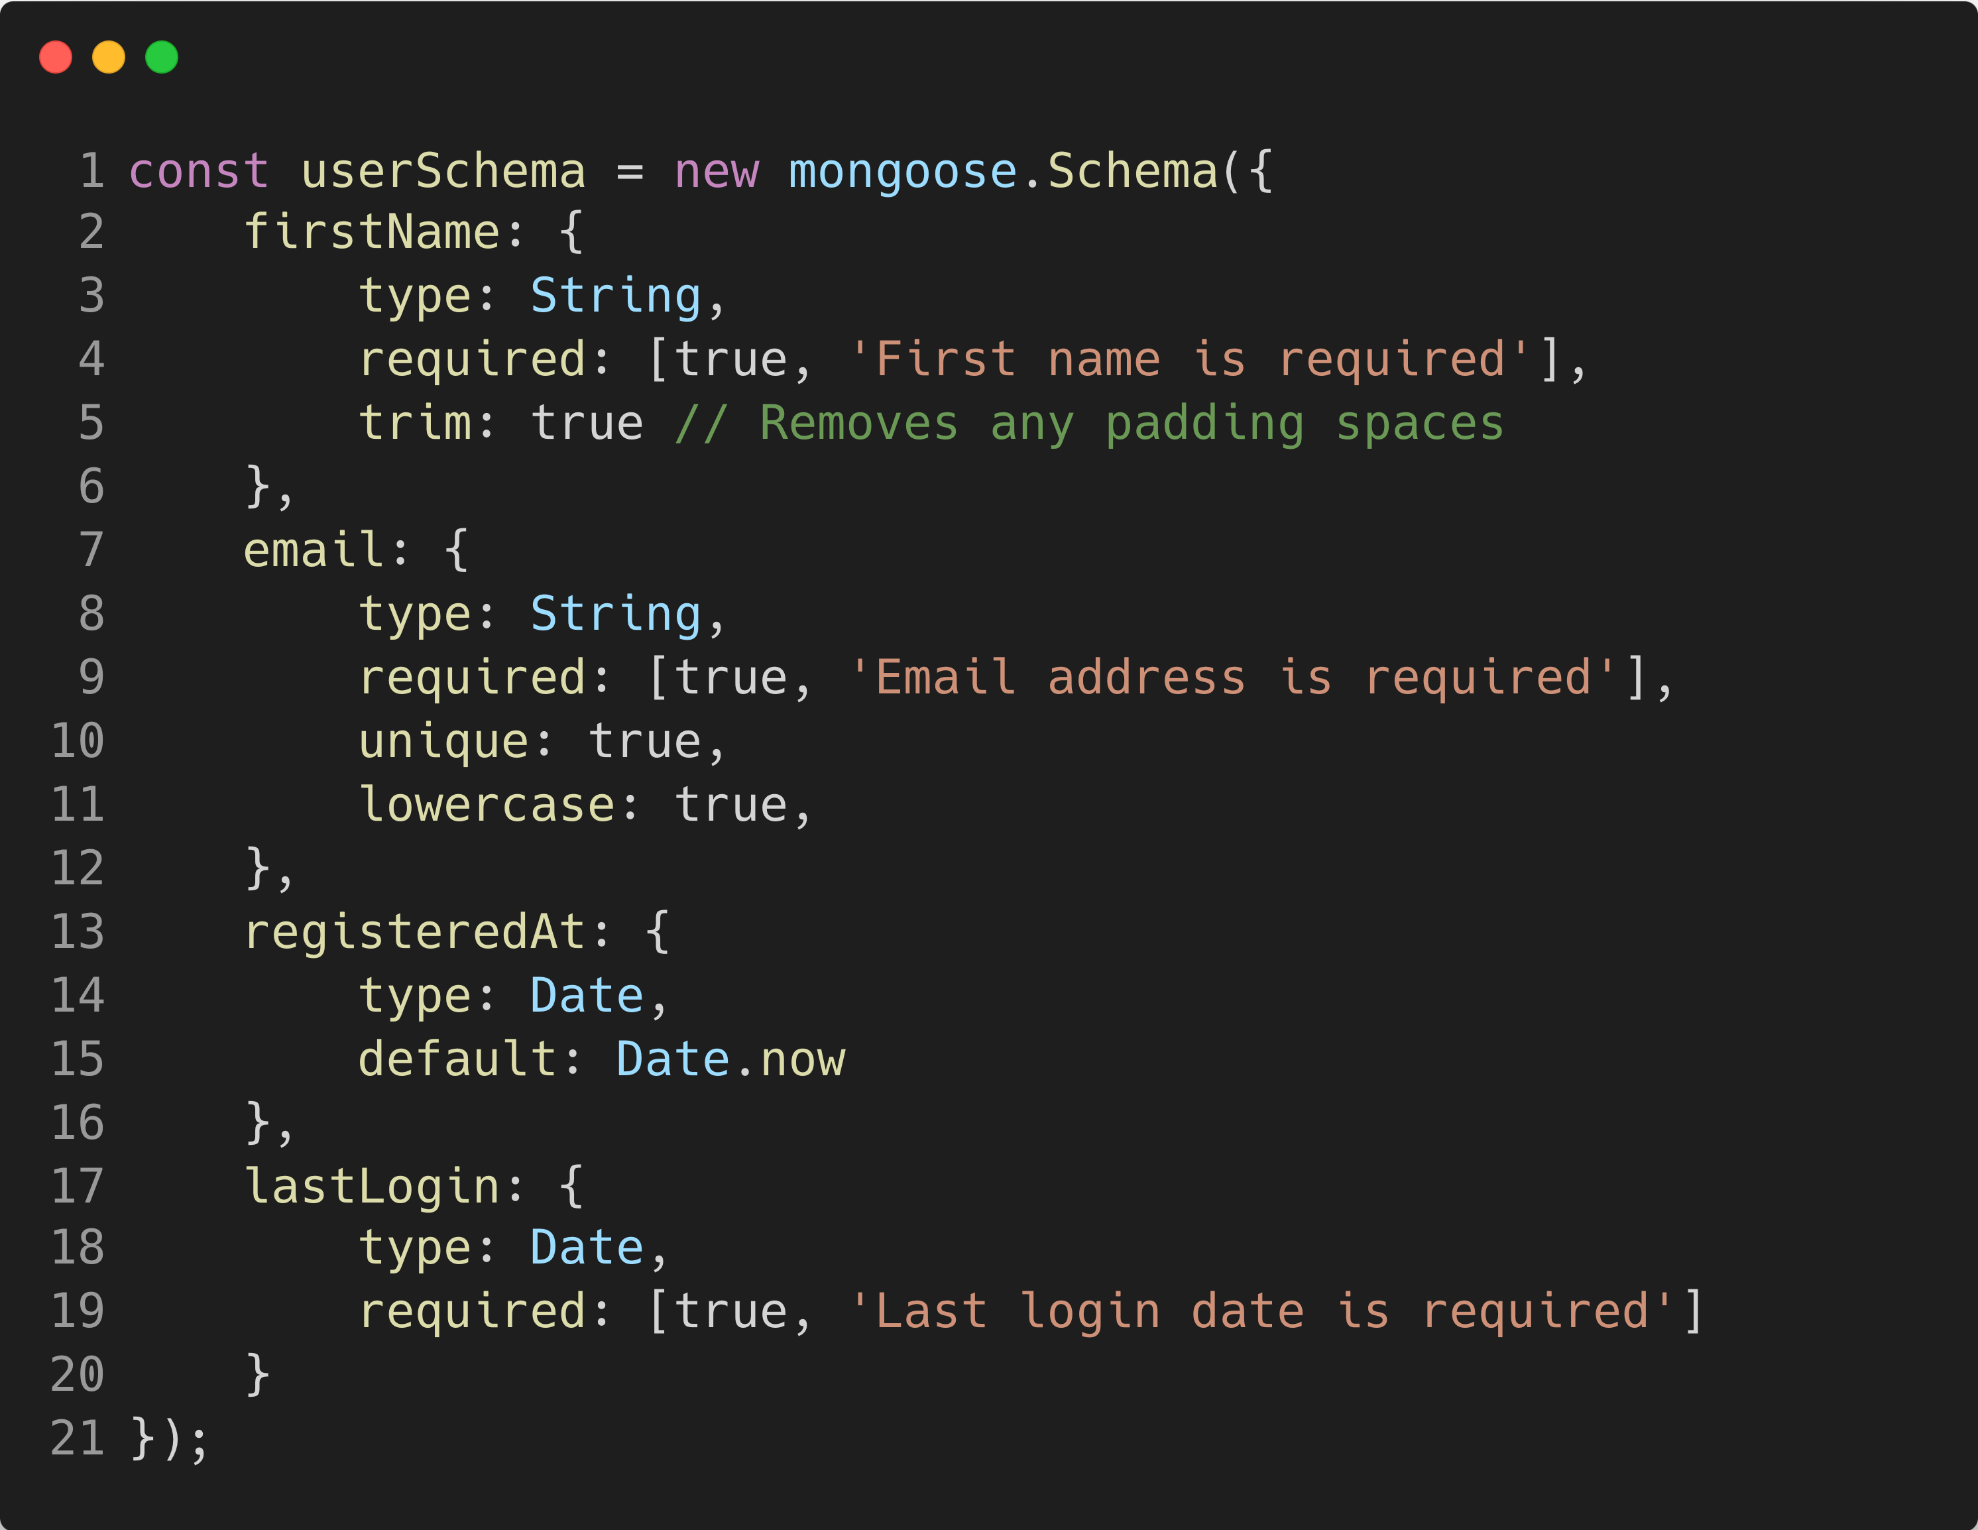
Example of Mongoose Schema

