Slide 1


Working With
Schema and Model
Full-Stack Web Development Bootcamp

Slide 2

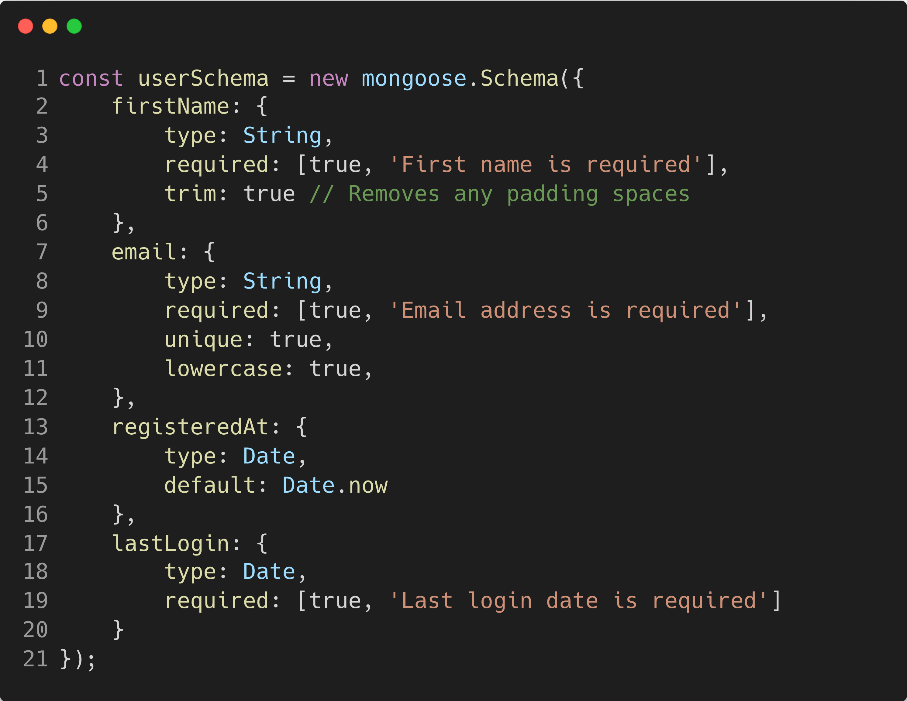
What is a Schema
Schema
A Mongoose schema defines the structure of documents within a MongoDB collection, specifying the types of data, validation rules, and default values. It serves as a blueprint for how data is organized and managed in the database, allowing developers to enforce data integrity and behaviors.

Slide 3
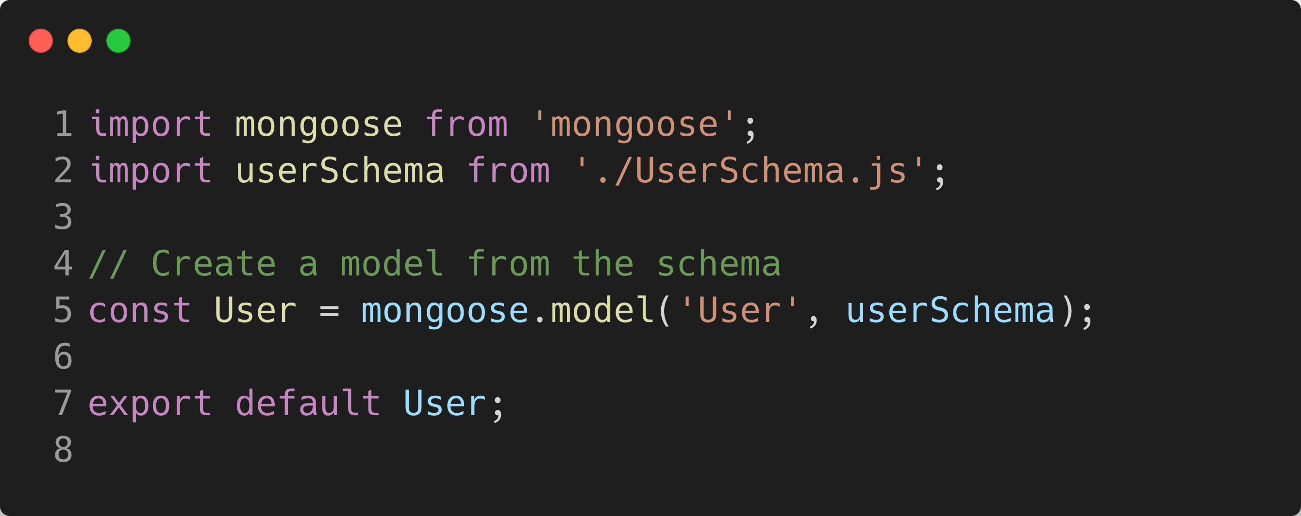
What is a Model
Model
A Mongoose model is a constructor compiled from a Schema definition. It provides an interface to the database for creating, querying, updating, and deleting records. Essentially, models are responsible for reading and writing data to the underlying MongoDB database, and they represent documents as instances of the model that can be manipulated with JavaScript.

Slide 4
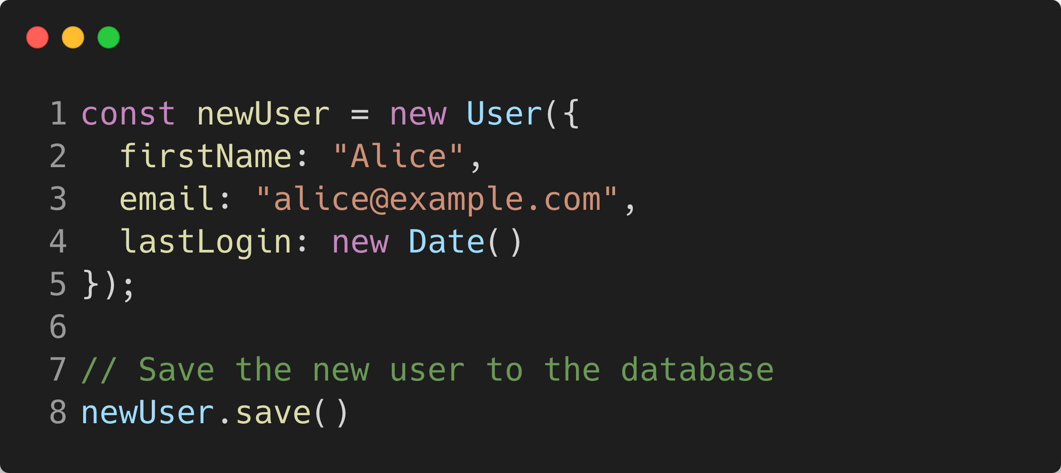
Using The Model
Model for Database Interactions
A model in Mongoose acts as an interface to the MongoDB database, allowing developers to perform CRUD (Create, Read, Update, Delete) operations on the database. It abstracts the database interaction, provides schema validation, and helps manage data relationships, significantly simplifying database programming tasks.

Slide 5
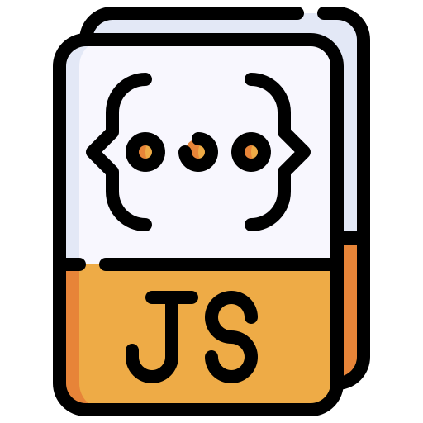
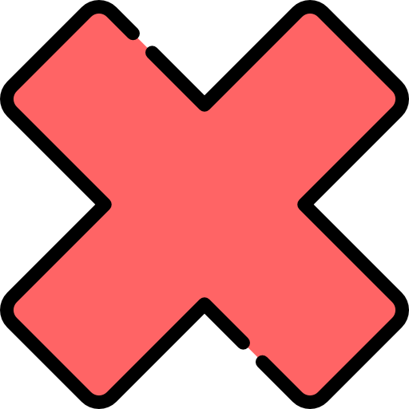

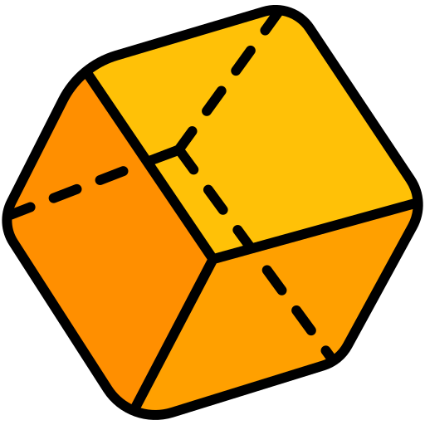
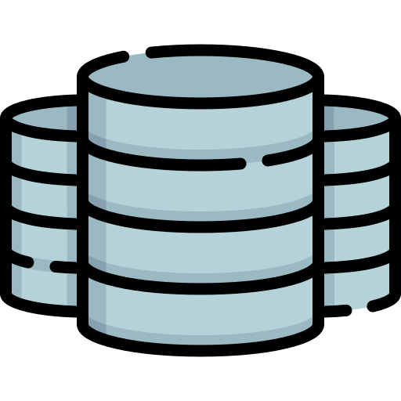

Only Model Interacts With Database
tasksController
GET /users
usersRouter
User (model)
Database
(MongoDB)
Response
usersController

