Slide 1

KINJO
Jordan’s early-childhood operations and intelligence platform
A stakeholder overview of significance, capability, evidence, and rollout
Repository snapshot • 15 July 2026

Slide 2
KINJO PROJECT OVERVIEW
Kinjo connects daily nursery activity to accountable public value
CHILDREN & FAMILIES
NURSERY OPERATIONS
GOVERNMENT & POLICY
One connected journey
Work becomes visible
Evidence reaches decisions
Enrollment, attendance, absence requests, daily reports, messaging, and portfolios stay connected around the child.
Managers and supervisors see capacity, staffing, attendance, incidents, compliance, and actions in a shared operating view.
Aggregated KPIs, heat maps, alerts, agency reports, and audit trails support intervention, resource allocation, and oversight.
The significance is the connection: one platform links service delivery, operational management, and national learning.
Sources: models.py; POLICIES.md; docs/DATA_SCIENCE_ANALYTICS_PLAN.md
02

Slide 3
KINJO PROJECT OVERVIEW
Four roles create one governed chain of responsibility
PARENT
MANAGER
SUPERVISOR
ADMIN
Initiates and follows
Runs the nursery
Reviews and intervenes
Governs the network
Enrollment • absence • messages • child reports
Classes • attendance • staffing • reports • incidents
Quality review • follow-up • escalations • action plans
Cross-network analytics • users • audit • agency reporting
Scope is enforced at the data layer: managers and supervisors are restricted to assigned kindergartens; administrators govern across the network.
Sources: models.py UserRole; dependencies.py role and kindergarten scoping
03

Slide 4
KINJO PROJECT OVERVIEW
The platform closes the loop from intake to intervention
01
Enroll and organize
02
Operate every day
Applications, decisions, children, classes, guardians, and staff establish the operational record.
Attendance, daily reporting, absence workflows, incidents, messaging, and portfolios capture what happens.
03
Detect what needs attention
04
Act, report, and learn
KPIs, thresholds, anomalies, data-quality checks, and geospatial views turn records into signals.
Escalations, recommendations, scheduled reports, exports, and audit evidence create accountable follow-through.
Operational data becomes useful only when it leads to a named decision and a tracked response.
Sources: docs/OPERATIONAL_WORKFLOWS_SPEC.md; main.py router composition
04

Slide 5
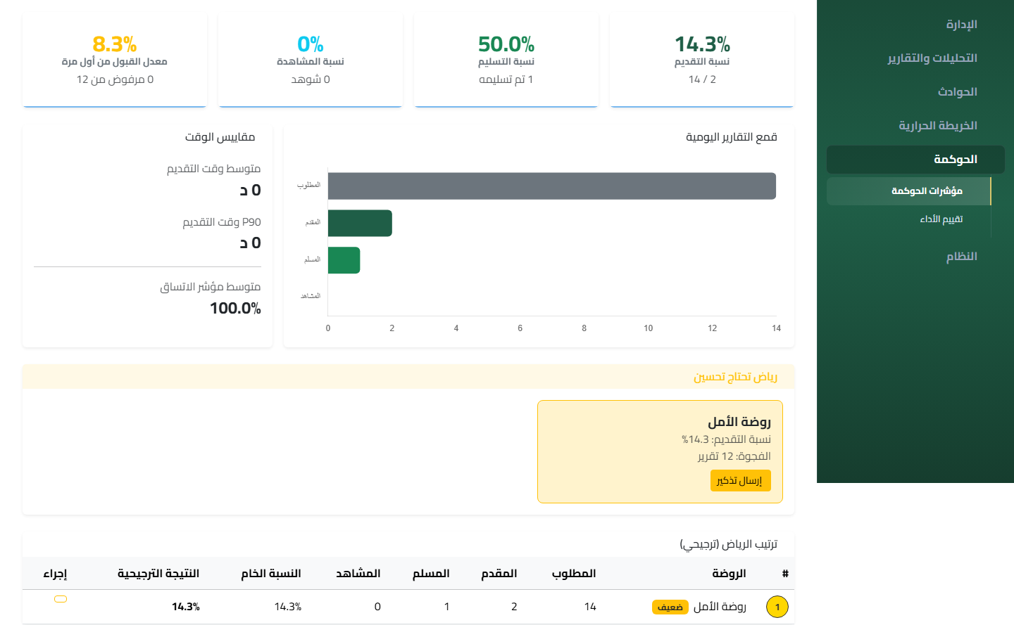
KINJO PROJECT OVERVIEW
Decision support is embedded in the operating dashboard
Measure
Submission, review, attendance, capacity, incidents, staffing, and data quality
Interpret
Trends, thresholds, anomalies, forecasts, and role-specific guidance
Respond
Reminders, action plans, escalations, exports, and scheduled reporting
Evidence: scripts/governance.png; docs/AI_ML_INTELLIGENCE_LAYER_ARCHITECTURE.md
05

Slide 6
KINJO PROJECT OVERVIEW
A national lens connects local detail to Jordan-wide oversight
Designed for
12
Network → Governorate → District / City → Nursery → Class
governorates in the national analytics design
The drill-down model makes geographic inequality, capacity pressure, attendance patterns, and intervention needs visible without losing the local operational context.
Coverage is a deployment target; insight quality depends on validated, complete data.
Sources: docs/NATIONAL_NURSERY_INTELLIGENCE_HEAT_MAP_TECHNICAL_DESIGN.md; static/data Jordan assets
06

Slide 7
KINJO PROJECT OVERVIEW
Reporting informs decisions without overstating certainty
WHAT STAKEHOLDERS RECEIVE
HOW TRUST IS PROTECTED
Bilingual, role-aware evidence
Evidence with explicit guardrails
• Agency-specific report packages • KPI and trend summaries • Heat-map and geographic filters • CSV, Excel, PDF, and image exports • Scheduled distribution and status tracking
• Admin-only agency routes • Small-cell privacy suppression • Data-quality status and notes • Backend-calculated values • Audit records for privileged changes
Important: ‘Strong alignment’ is a Kinjo product label—not an NCFA endorsement—and reports are operational evidence, not approved national statistics.
Source: docs/reports/NCFA_STRONG_ALIGNMENT_REPORTING_HUB.md
07

Slide 8
KINJO PROJECT OVERVIEW
Security controls follow the data from login to every privileged action
Protection is layered
✓
Identity
MFA for privileged roles, password policy, lockout controls, and secure recovery.
Kinjo combines preventive controls, scoped access, and traceable operations rather than relying on a single perimeter.
✓
Session
HttpOnly authentication cookie, short-lived token defaults, CSRF and origin checks.
✓
Authorization
Role-based access plus kindergarten scoping and object-level IDOR protection.
✓
Operations
Rate limits on sensitive routes and configuration validation for production.
Administrative access is explicit; managers and supervisors cannot cross assigned nursery boundaries.
✓
Accountability
Before/after audit diffs, correlation IDs, and logged privileged changes.
Sources: docs/ADMIN_SECURITY_HARDENING_REPORT.md; POLICIES.md; middleware/security.py; admin_security.py
08

Slide 9
KINJO PROJECT OVERVIEW
A modular architecture separates experience, data, and background work
Domain services
Web layer
Data layer
Users
Background
FastAPI Jinja2 REST + WebSockets
Enrollment Attendance Reports Analytics Security
PostgreSQL Alembic Redis cache
Arabic / English role-based UI
Celery jobs exports • email
Production operations
Docker Compose • health checks • structured logging • telemetry • backups • environment validation
Sources: main.py; docker-compose.prod.yml; database.py; celery_app.py; observability_endpoints.py
09

Slide 10
KINJO PROJECT OVERVIEW
Delivery evidence shows breadth and release discipline
Repository footprint
3,068
tests passed
0 failed • 1 xpassed
10 / 10
required staging-harness checks passed in the documented validation run
Readiness evidence is a snapshot—not a substitute for validating the target environment and live integrations.
Sources: repository file counts; docs/reports/ADMIN_STAGING_GATE_VALIDATION_2026-07-14.md
10

Slide 11
KINJO PROJECT OVERVIEW
A controlled rollout converts technical readiness into operational trust
PHASE 1
PHASE 2
PHASE 3
Staging + pilot
Governorate waves
National operations
Validate credentials, database, Redis/Celery, notifications, backups, and user journeys with a limited cohort.
Train roles, monitor data completeness, tune thresholds, and expand only when support and adoption indicators hold.
Institutionalize governance, agency reporting, privacy review, incident response, and continuous metric-usefulness audits.
Release gates: data quality • privacy/legal review • accessibility • support capacity • training completion • monitoring ownership
Recommended rollout informed by DEPLOYMENT_GUIDE.md, RUNBOOK.md, LIMITATIONS.md, and readiness reports
11

Slide 12
THE DECISION
Approve a controlled Kinjo deployment—then scale on evidence
1 Authorize the staging gate and limited pilot
Kinjo’s strategic value
2 Assign owners for data, security, operations, and training
A shared evidence system that connects the child, the nursery, and the national decision.
3 Expand by governorate only when adoption and quality gates hold
github.com/Wael-dot-83/kinjo_v_core

