Slide 1
Social University

Slide 2
OUR Team
Roaa
Mohammad
Motasem
Manar
Wael

Slide 3

Problem domain
01
03
Targets the community of the university because they need it.
Gather all the students in one place.
02
04
Finding easy way to communicate with university students.
Collects everything that related to the university environment.

Slide 4
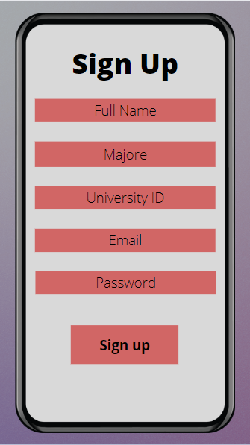
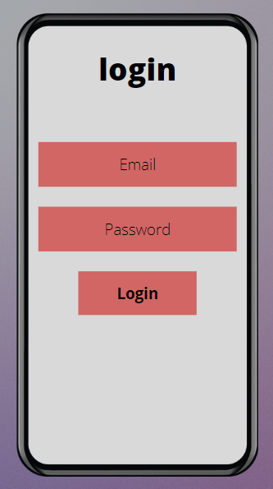
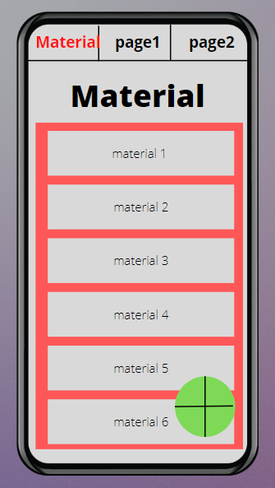
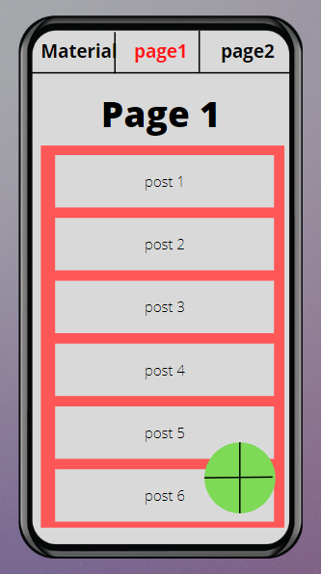
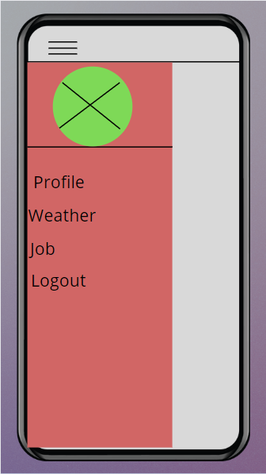
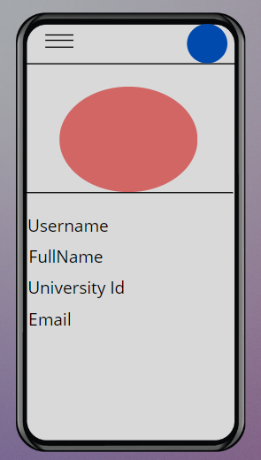
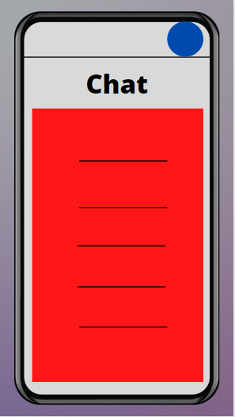
Wireframe

Slide 5
App features
01
04
Upload and download Materials .
Posting job oppertunities
05
Weather Feature
02
03
Adding posts and interacting with them.
Chatting

Slide 6


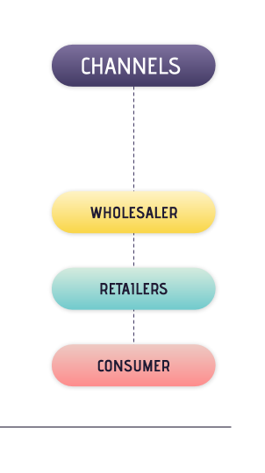
Demo

Slide 7
Futuare plans
A
C
Increse the number of users
Increes the numer of ads and get more mony from it
B
D
Add new features
Increase the number of available universities.

Slide 8
TECHNOLOGIES USED
01
03
Git/Github
Andriod Studio/ java
XML
AWS
02
04

Slide 9



challenges
AWS
Android studio
VERSION CONTROL SYSTEM

Slide 10
50,000+
Line of code

Slide 11
THANKS!
I hope you interst in this presentation, Is there any questions?

