Slide 1
TEAM MANAGEMENT SYSTEM

Slide 2
OUR IDEA
platform to organize team work

Slide 3
WHY THIS IDEA?
FLEXIBLE IDEA
PROJECT PROGRESS
DIRECTED FOR SINGLE OR GROUP
clarify your goals
Increases productivity

Slide 4
ADDITIONAL VALUES
01
02
03
REQUEST AND APPROVE
COMMUNICATION
FULL ACCESSIBLITY
FOR MEMBER

Slide 5
TEAM MEMBERS
WAEL
MOTASEM
MOHAMMAD
ROA’A

Slide 6
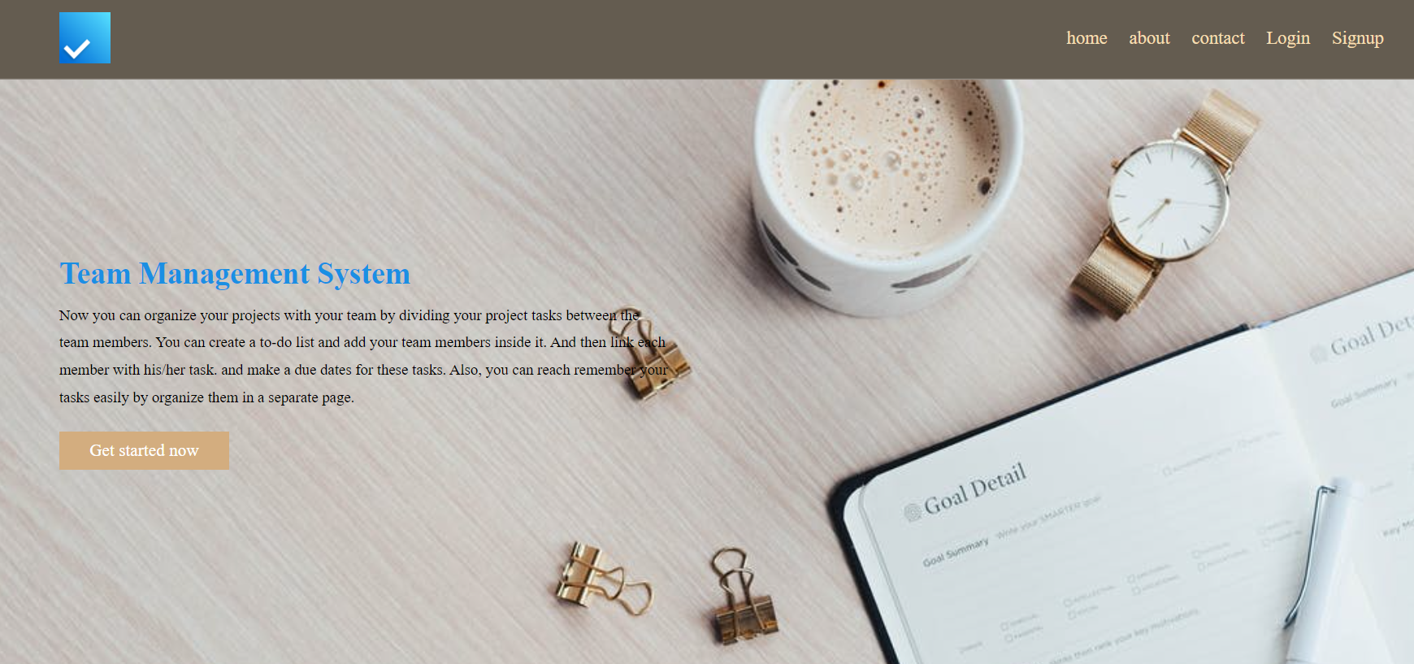
APP FEATURES

Slide 7

1- SECURE THE DATA IN APPLICATION.

Slide 8

2- simplicity:
the user can access their information quickly and easily

Slide 9

3-REQUEST APPROVE OR DENY

Slide 10
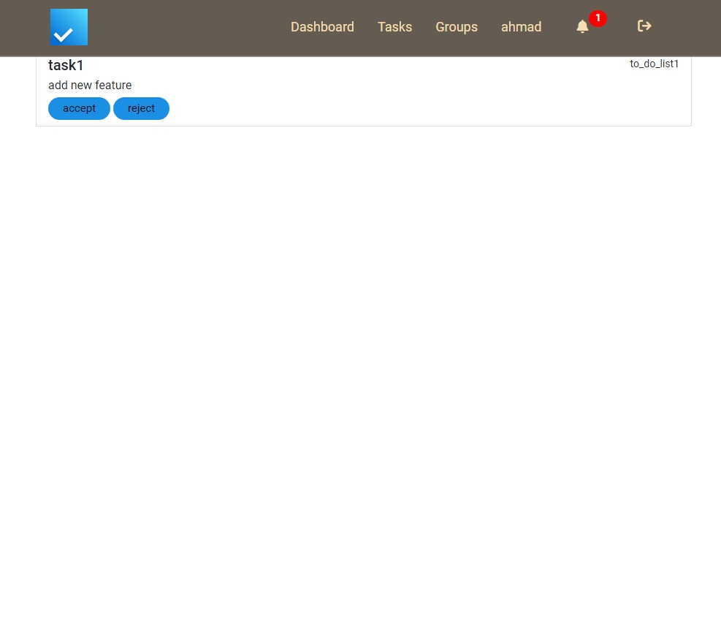
4-NOTIFICATIONS

Slide 11
5-USER TASKS SELECTED

Slide 12

6-TEAMWORK PRIVACY

Slide 13
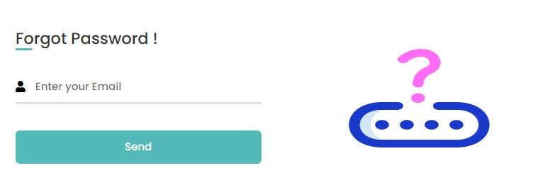
7-RESEST PASSWORD BY EMAIL

Slide 14
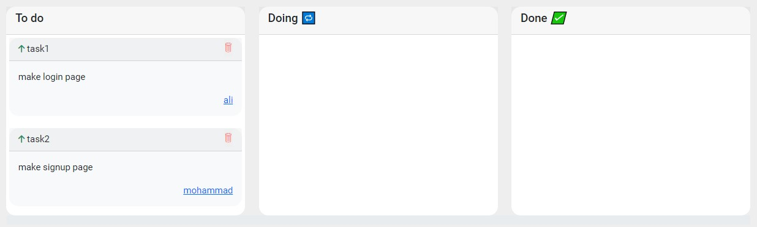
8-ROLES FOR TASK OWNER AND ADMIN

Slide 15
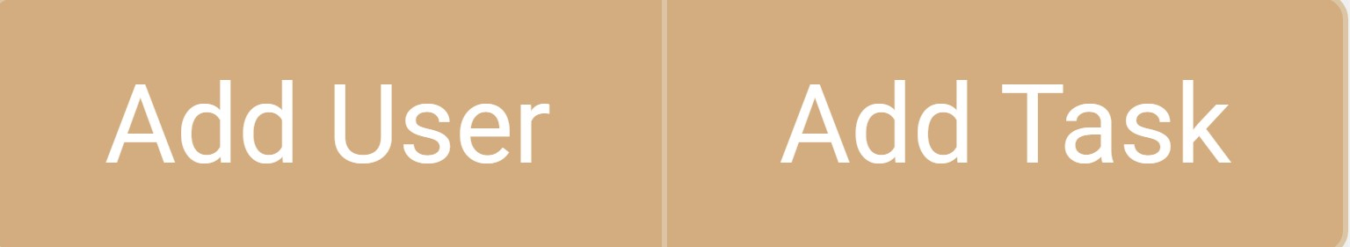
9-THE USER CAN JOIN OR ADD MANY TODOLIST.

Slide 16
FUTURE PLANS
edit the profile information Software Development free icon
chating
meeting
drop and drag the tasks
the applity to connect our app to any other app like github for example
adding additional list of tasks to the task itself.
feedback

Slide 17
TECHNOLOGIES USED
java language
spring boot
thymeleafe
postgress(DBMS)
SQL language
java script
HTML
jpa repository
CSS
intellj IDE

Slide 18




MOST IMPORTANT DIFFCULTIES
VERSION CONTROL SYSTEM
SPRING BOOT
JAVASCRIPT
THYMELEAFE

Slide 19
DEMO

Slide 20
+2500 code line

Slide 21
THANKS
Do you have any questions?

