Slide 1
My First AI Chatbot in n8n

Slide 2
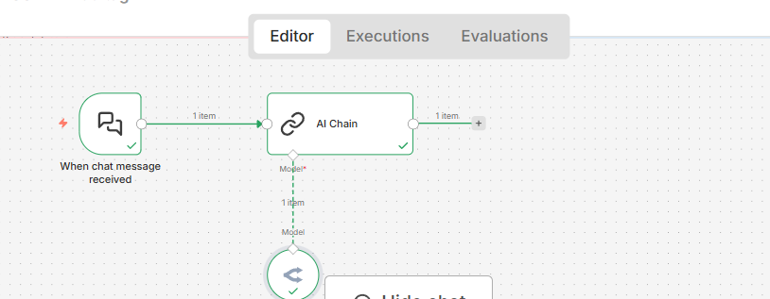
My First AI Chatbot in n8n
A beginner workflow that connects a chat window to an OpenRouter free model.
One API key
Core idea
This is the simplest AI workflow for students: one trigger, one chain, and one model. It teaches how n8n passes chat input into an LLM and returns a response.
1
Chat Trigger
Receives the student message.
What students build
2
AI Chain
The chat opens inside n8n, sends the student question to the AI Chain, and receives a clear answer from the OpenRouter model.
Combines tutor prompt + question.
3
OpenRouter Chat Model
Generates the response.
n8n beginner AI workflow: Chat Trigger → AI Chain → OpenRouter Chat Model

Slide 3
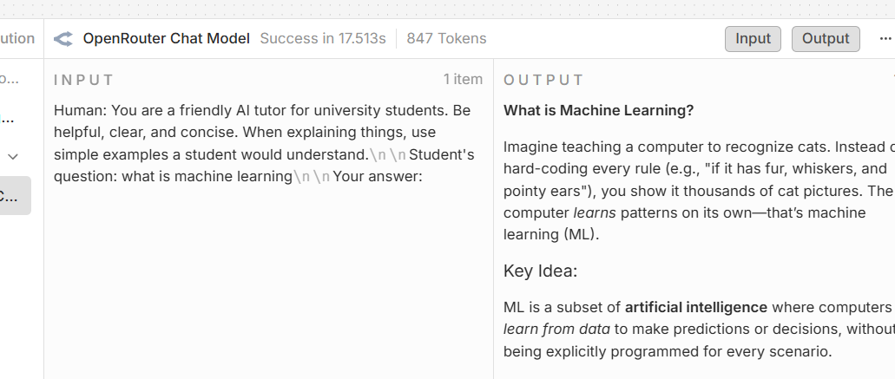
How the workflow runs
The student question moves through three simple nodes, then the answer returns to chat.
Student asks
Prompt prepared
Answer generated
Reply displayed
Chat Trigger
AI Chain
OpenRouter free model
n8n chat
Teaching focus
Students learn trigger, input, prompt, model, output, and execution logs before moving to PDF chatbots or vector stores.
Use this as the first n8n AI lesson before embeddings, RAG, or multi-step automations.

Slide 4
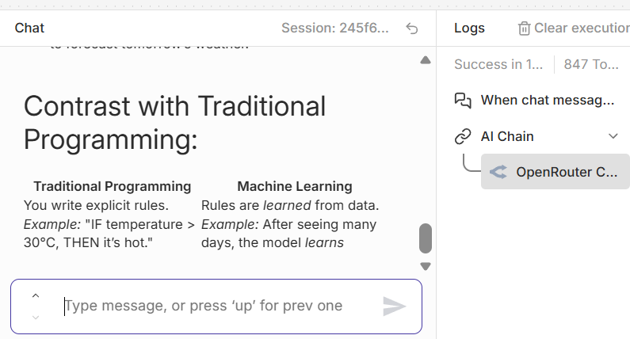
Classroom testing checklist
Free OpenRouter models work, but students should know the common limits and fixes.
Recommended settings
Model
Choose a dropdown model ending with :free.
Max tokens
300–700 for beginner exercises.
Temperature
0.2 for stable teaching examples.
Rate limit
Wait, switch model, or reduce tokens.
Good first prompts
• Explain machine learning in simple words
• Give one example from my major
• Create 3 quiz questions with answers
If the API returns “too many requests,” the workflow is fine — the free provider is rate-limiting the model.

Slide 5
Manual method: build the chatbot yourself
Students learn the core n8n ideas: trigger, chain, model connection, prompt, and test.
1
Add Chat Trigger
This creates the chat box in n8n. Students type a question and n8n starts the workflow.
2
Add AI Chain
Use a simple prompt: “You are a friendly AI tutor. Answer clearly and briefly.”
Manual canvas structure
3
Add OpenRouter Chat Model
💬 Chat Trigger
🔗 AI Chain
🧠 OpenRouter
Connect it under the AI Chain as the language model. Select a free model from the dropdown.
The model connects through the AI “Model” port, not a normal action arrow.
4
Open chat and test
Ask “What is machine learning?” and inspect the input/output panels to see how data flows.
Teaching focus
Manual build first; JSON import later. This helps students understand what the template creates automatically.
n8n beginner AI workflow • OpenRouter Free • 4

Slide 6
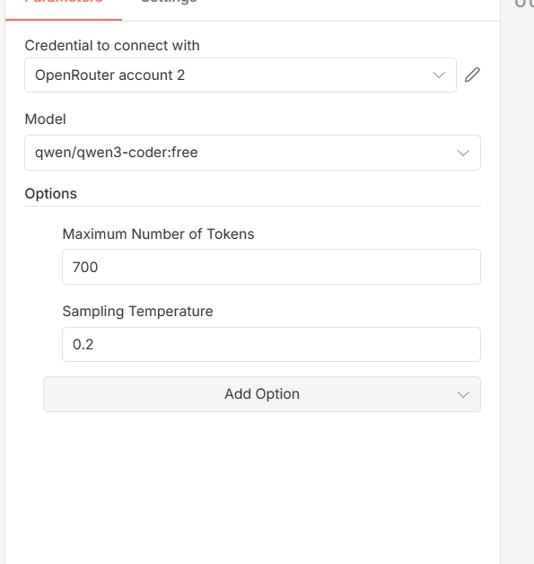
Manual setup: OpenRouter API key and free model
This is the only credential students need for the beginner chatbot.
1
Create the credential
In OpenRouter Chat Model, choose credential → create new → paste the OpenRouter API key.
2
Choose a free model
Select a model ending with :free from the dropdown. Avoid manually typing unsupported IDs.
3
Limit the output
Set Maximum Number of Tokens to 300–700 for beginner exercises. Use Temperature around 0.2–0.7.
4
Handle free-model limits
If “too many requests” appears, wait, reduce tokens, or switch to another :free model.
Suggested first classroom settings
Model: qwen/qwen3-coder:free • Max tokens: 500 • Temperature: 0.2
OpenRouter Chat Model settings
OpenRouter free models are useful for practice, but may rate-limit during a live workshop.
n8n beginner AI workflow • OpenRouter Free • 5

Slide 7
Fast method: upload the JSON template
Use this after students understand the manual version, or when class time is limited.
JSON template
{
"name": "My First AI Chatbot - OpenRouter Free",
"nodes": [Chat Trigger, AI Chain, OpenRouter],
"connections": {...}
}
Working workflow
Import
Upload steps
1
Open n8n → Workflows
2
Import from file
3
Reconnect credential
Click the three dots (…) or Import button.
Select my_first_ai_chatbot_openrouter_free.json.
Open OpenRouter Chat Model and select/create your API credential.
Then click Open chat and ask a simple question such as “What is machine learning?”
Manual build teaches concepts. JSON import saves time and helps all students start from the same working template.
n8n beginner AI workflow • OpenRouter Free • 6

Slide 8

AI TRAINING · AGENT SYSTEMS
Skywork Desktop
Agent Mode — an AI workspace that lives on your PC
A briefing for university students · Windows · 2026
Prepared by Wael · AI Training Program

Slide 9



What is Skywork Desktop?
A Windows-native AI agent that turns your local folders into a working studio.
Windows-Native
Local Files First
Multi-Step Agent
Runs as a desktop app on Windows 11 — no browser tab juggling. macOS not yet supported.
Point it at a folder and the agent reads, indexes and reasons across your PDFs, docs, slides and data — no uploads.
Designed for sustained, repeatable workflows — research, draft, analyse, generate — not single-turn chat.
Launched globally Feb 4, 2026 · Mission: an “AI version of Office”

Slide 10



From Chatbot to Agent
Why “agent mode” is a different way of using AI.
Traditional Chatbot
Agent Mode
Lives inside a browser tab
Persistent desktop workspace
Single-turn questions and answers
Multi-step, goal-driven workflows
You re-upload files every session
Reads local folders directly — no uploads
Context disappears when the tab closes
Project context survives across sessions
One model, one task at a time
Picks the right model + skill per task

Slide 11

How Agent Mode Works
Four steps from a folder full of files to a finished deliverable.
1
2
3
4
Point to a Folder
Agent Indexes
Set a Goal
Agent Executes
Pick a project folder on your PC — papers, notes, datasets, slides.
Skywork semantically indexes the contents locally, no cloud upload.
“Summarise these 12 PDFs and draft a 10-slide deck with citations.”
Runs the multi-step task in an isolated local VM and saves outputs.
Outputs are editable .docx, .pptx, .xlsx, images, web pages — generated locally.

Slide 12


Three Core Pillars
What makes Agent Mode different from a chat tab.
Local File Intelligence
The agent treats your folder as persistent context. It can read across PDFs, Word, Excel, slides and images using one unified semantic layer.
Privacy by Design
Files are processed on your machine inside an isolated virtual machine. No mass uploads to the cloud, lower risk of data leakage.
Persistent Workflows
Multi-step, repeatable tasks survive across sessions — research → analyse → draft → polish — without losing project context.

Slide 13

Pick Your Model — or Let It Pick
Agent Mode supports multiple frontier models and a smart Auto router.
ANTHROPIC
ANTHROPIC
GOOGLE
SKYWORK
Claude Opus 4.5
Claude Sonnet 4.5
Gemini 3 Pro
Auto Mode
Best for deep reasoning, long-context analysis, careful writing.
Balanced speed and quality — strong default for everyday tasks.
Strong multimodal — images, video understanding, fast generation.
The system selects the best model per task — speed, quality or modality.
Why this matters
Different parts of a project need different brains — Opus for synthesis, Gemini for multimodal output, Sonnet for fast drafts. Auto Mode routes each step to the right one so you don’t have to switch tools.

Slide 14






100+ Skills in One Workspace
Auto-recommended for the task — or pick one manually.
Documents
Presentations
Images
Reports, essays, briefs, lit reviews, tables of contents.
Lecture decks, project pitches, defense slides.
Diagrams, infographics, cover art, study visuals.
Video
Web Pages
Data & Sheets
Short explainers, animated study aids, clip edits.
Portfolios, project landing pages, study sites.
Excel models, charts, quick analyses on local CSVs.
Skills + models are paired automatically per task to balance quality and speed.

Slide 15


For University Students
Where Agent Mode genuinely changes how you study and produce work.
Literature Review
Presentation Building
Drop 20+ papers into a folder. Ask for a thematic synthesis with citations across all of them — without uploading each one.
Turn your notes and references into a draft slide deck — class talks, seminar presentations, thesis defence.
Coursework Data Work
Project Research
Run quick analyses on a local CSV: descriptive stats, charts, an Excel model — written back into your project folder.
Cross-link lab notes, PDFs, screenshots and datasets into one synthesis you can keep iterating on.
Tip · Treat Agent outputs as drafts. Always verify facts, citations and code yourself before submitting.

Slide 16
Pricing & Requirements
What it costs and what you need to run it.
Basic
Plus
System Requirements
$19.99
$49.99
Windows 11 (64-bit recommended)
per month
per month
Local storage for project folders
Access to Agent Mode
Everything in Basic
Internet for cloud model calls
Core model selection
Unlimited desktop usage*
macOS support not yet available
Standard skill library
Higher task throughput
Runs tasks in a local virtual machine
* Plus includes unlimited use of the desktop client for eligible subscribers (per Skywork press materials, Feb 2026).

Slide 17
KEY TAKEAWAYS
Three things to remember
01
Agents > Chatbots
Skywork’s agent mode is built for sustained, multi-step work on your own files — not for single-turn questions.
02
Local + Private by Default
Files stay on your PC and tasks run in an isolated VM, which matters for thesis data, lab notes, and client work.
03
The Skill Is Orchestration
Your edge as a student is choosing the right model, skill, and folder structure — not just writing prompts.
Skywork Desktop · Agent Mode · AI Training Program 2026

