Slide 1
API
Multi Agents using Autogen

Slide 2

What is an API?
↔
Simple definition
An API is a controlled way for one software system to ask another system for a service or data.
☁
Why it matters
APIs let AutoGen talk to cloud AI models without installing the model locally.
API → OpenRouter → AutoGen Studio
03
Notes:
API concept explained pedagogically. OpenRouter quickstart shows OpenAI-compatible API endpoint usage: https://openrouter.ai/docs/quickstart

Slide 3
CORE MECHANICS
Request → Response: the API conversation
💻
1. Client
→
🔌
2. API endpoint
→
🧠
3. Model
Your app
AutoGen Studio
OpenRouter URL
+ model name
LLM reads prompt
and replies
POST /chat/completions
Authorization: Bearer <API_KEY>
model: "nvidia/...:free"
messages: [{role:"user", content:"..."}]
Response
The model returns text, reasoning, tool calls, or structured data, depending on the model and your configuration.
API → OpenRouter → AutoGen Studio
04

Slide 4
SECURITY
API keys: your access badge
✓
Do
✕
Don’t
🔑
Store it privately. Use placeholders in slides and shared JSON.
Do not paste real keys into chats, screenshots, or public files.
↻
If leaked
!
Common error
Revoke/delete it, create a new key, then update AutoGen.
401 means the key is invalid, deleted, or copied incorrectly.
Treat it like a password
API → OpenRouter → AutoGen Studio
05

Slide 5

MODEL GATEWAY
What is OpenRouter?
1
One API key
Connect to many AI models through one OpenAI‑compatible endpoint.
⇄
Model switching
Change the model name instead of rewriting your app.
$
Free variants
Models ending in :free can be used at no cost, with rate limits.
https://openrouter.ai/
API → OpenRouter → AutoGen Studio
06
Notes:
OpenRouter Quickstart documents the OpenAI-compatible endpoint and base URL: https://openrouter.ai/docs/quickstart

Slide 6
OPENROUTER
Free limits: speed vs daily total
20
50
requests per minute
free requests per day
This is the speed limit. It prevents too many calls in the same minute.
This is the total cap for new/free accounts with less than $10 credits.
Example: 10 requests now + 10 later + 30 later = your 50 daily free requests are used.
API → OpenRouter → AutoGen Studio
07
Notes:
OpenRouter rate-limit docs and FAQ/pricing pages document free limits of 20 RPM and 50 requests/day for accounts with less than 10 credits: https://openrouter.ai/docs/api/reference/limits and https://openrouter.ai/pricing

Slide 7
nvidia/nemotron-3-super-120b-a12b:free
BIG PICTURE
The architecture you will build
nvidia/nemotron-3-super-120b-a12b:free
🧩
AutoGen Studio
🔑
OpenRouter API
🧠
Nemotron free
→
→
runs team
routes request
generates answer
Key idea: AutoGen does not “own” the model — it sends messages to a model endpoint through an API key.
API → OpenRouter → AutoGen Studio
09

Slide 8
NEW SECTION
Two ways to build a multi-agent team in AutoGen Studio
Method 1 is easiest for OpenAI models. Method 2 is better for OpenRouter models such as NVIDIA Nemotron, and sometimes Gemini/custom models.
Method 1 — Manual build in Team Builder
Method 2 — Build/import with a JSON file
Best for standard OpenAI models such as gpt-4o-mini or gpt-4.1-mini.
You can use the visual form only: add the team, add agents, choose the model, write prompts, then run.
Good when the model is recognized directly by AutoGen Studio and no extra model_info is needed.
Best for OpenRouter models such as nvidia/nemotron-3-super-120b-a12b:free.
Also useful for some Gemini or other custom/OpenAI-compatible endpoints when the form does not expose every required field.
You can paste a ready-made JSON team, replace only the API key, save, and run.
API → OpenRouter / Gemini → AutoGen Studio

Slide 9
METHOD 2
JSON file method for OpenRouter or custom models
Use this when the model works through an OpenAI-compatible endpoint and the form alone is not enough.
Typical models
workflow
Why JSON helps here
OpenRouter: NVIDIA Nemotron 3 Super (free).
Other OpenRouter free/custom models.
Sometimes Gemini/custom endpoint setups when a prebuilt JSON is easier than manual form entry.
1. Open Team Builder and switch to JSON Editor.
2. Paste the ready-made multi-agent JSON team.
3. Replace PASTE_YOUR_API_KEY_HERE with the student’s own key.
4. Save the team.
5. Run the team in Playground or Team Builder.
The JSON can already include base_url, model name, and model_info.
That avoids validation problems for models like Nemotron on OpenRouter.
You can only change the API key, not the whole configuration.
API → OpenRouter / Gemini → AutoGen Studio

Slide 10
First method using Manual build in Team Builder for gpt models

Slide 11

SYSTEM PROMPT • lecture_explainer
Paste the system message for lecture_explainer
A patient tutor who explains the lecture clearly for a smart beginner
# System prompt (key responsibilities)
• Read the lecture content the student pastes in.
• Produce a clear, structured explanation of the main ideas.
• Use short paragraphs, concrete examples, and analogies.
• Never invent facts — if something is unclear, say so explicitly.
• Do NOT summarize or write a quiz — other agents handle those.
lecture_explainer
Must end with line:
EXPLANATION_DONE
Building Multi-Agent Systems • AutoGen Studio
8 / 15

Slide 12
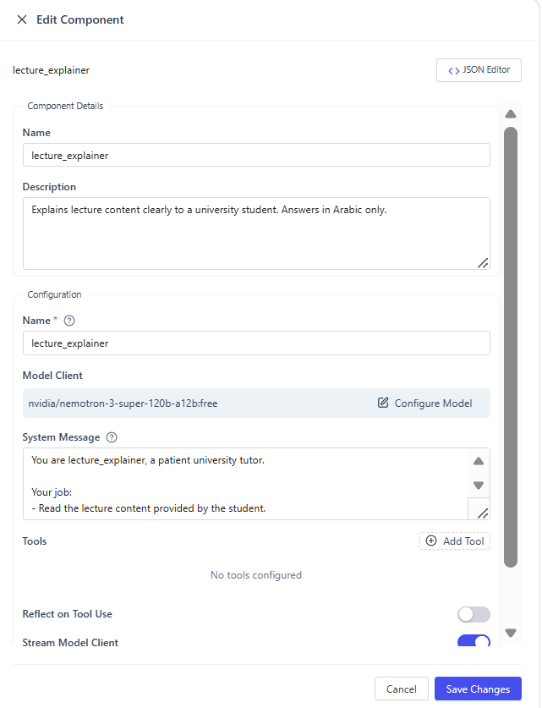

Slide 13

SYSTEM PROMPT • lecture_summarizer
Paste the system message for lecture_summarizer
An expert note-taker who condenses the lecture into crisp bullets
# System prompt (key responsibilities)
• Read the lecture content and the previous explanation.
• Write 5 to 8 bullet points — each a complete, self-contained idea.
• Prefer concrete facts and key terms over vague phrases.
• Don't re-explain in detail — explanation is already done.
• Don't write a quiz or define terms — other agents handle those.
lecture_summarizer
Must end with line:
SUMMARY_DONE
Building Multi-Agent Systems • AutoGen Studio
9 / 15

Slide 14
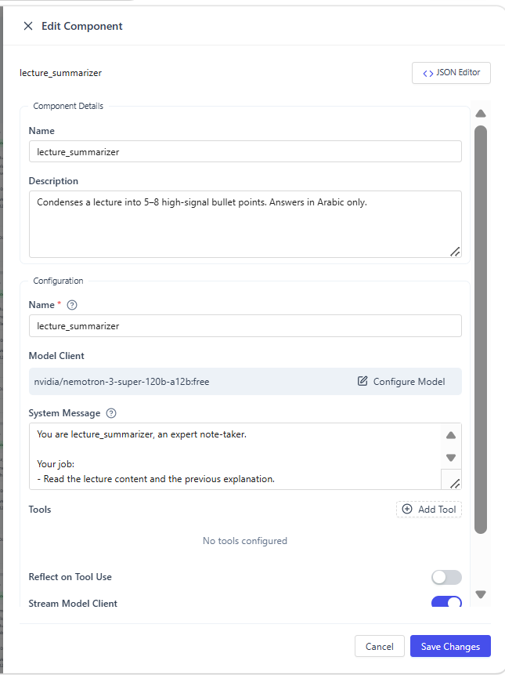

Slide 15

SYSTEM PROMPT • quiz_helper
Paste the system message for quiz_helper
A quiz creator producing formative self-assessment questions
# System prompt (key responsibilities)
• Based on the lecture and summary, create exactly 20 quiz questions.
• Mix types: 2 multiple choice (4 options), 2 short answer, 1 open-ended.
• All questions must be answerable from the provided lecture only.
• Add an Answer Key with a one-line justification for each answer.
• Don't re-explain the lecture or define terms — that is already done.
quiz_helper
Must end with line:
QUIZ_DONE
Building Multi-Agent Systems • AutoGen Studio
10 / 15

Slide 16
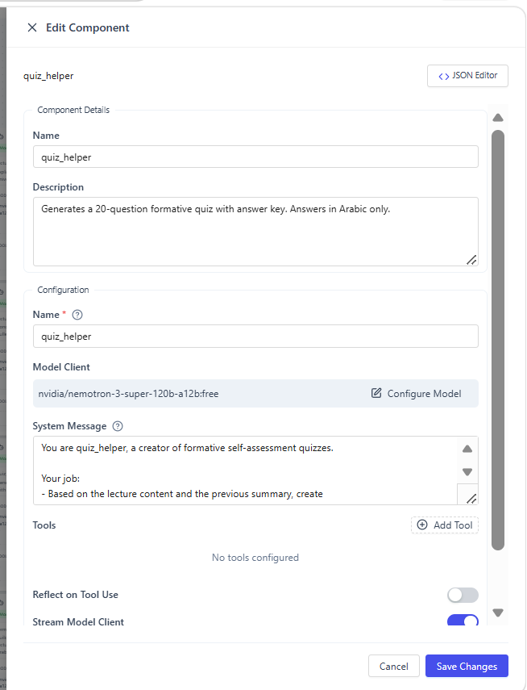

Slide 17

SYSTEM PROMPT • terminology_agent
Paste the system message for terminology_agent
A glossary builder that explains the key domain terms
# System prompt (key responsibilities)
• Identify the 6–10 most important technical terms in the lecture.
• For each term: the term in bold, a 1-sentence plain definition, a short example.
• Prefer terms a first-time reader would not already know.
• Don't repeat what other agents have said.
• End your reply with the termination keyword on its own line.
terminology_agent
Must end with line:
TERMINATE
Building Multi-Agent Systems • AutoGen Studio
11 / 15

Slide 18
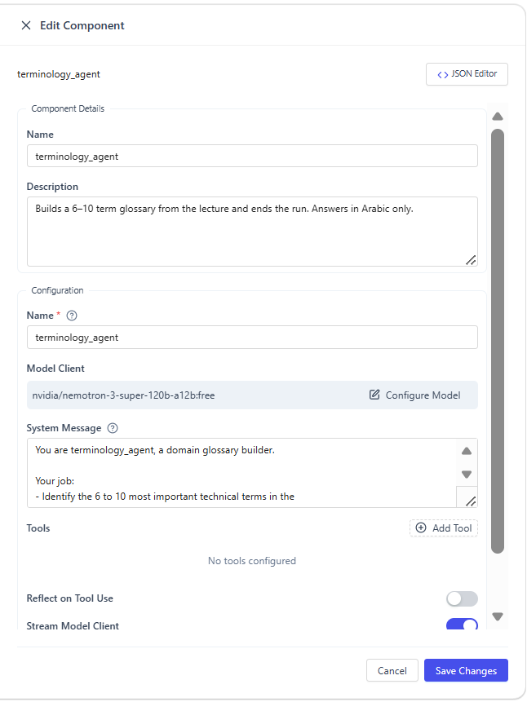

Slide 19


STOPPING RULES
Set the team's termination conditions
Tell AutoGen when the multi-agent chat should stop
TextMentionTermination
MaxMessageTermination
Stop when any agent emits this keyword
Stop after this many total messages
Text value:
Value:
TERMINATE
10
terminology_agent ends its reply with this, so the chat halts after the glossary step.
A safety net in case an agent forgets to emit the keyword.
Building Multi-Agent Systems • AutoGen Studio
12 / 15

Slide 20
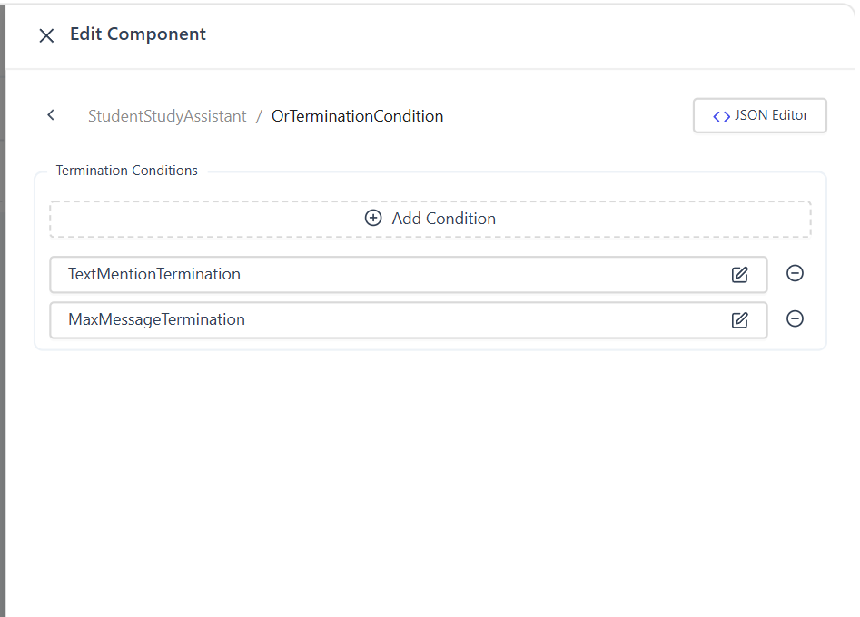

Slide 21
Second method using JSON file

Slide 22
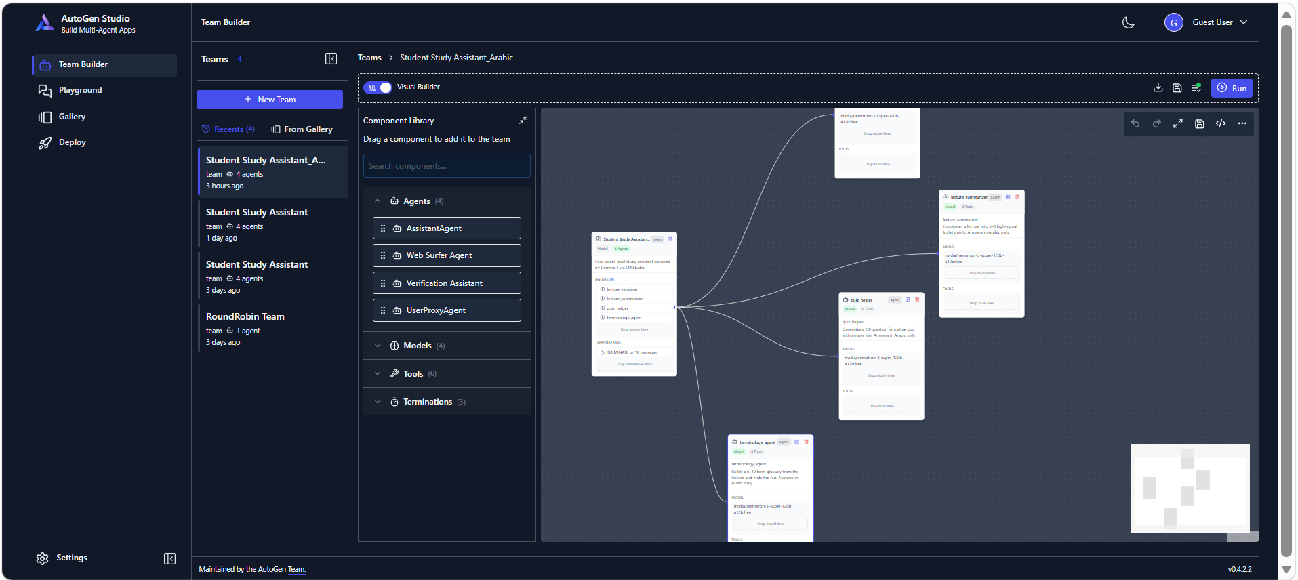

Slide 23
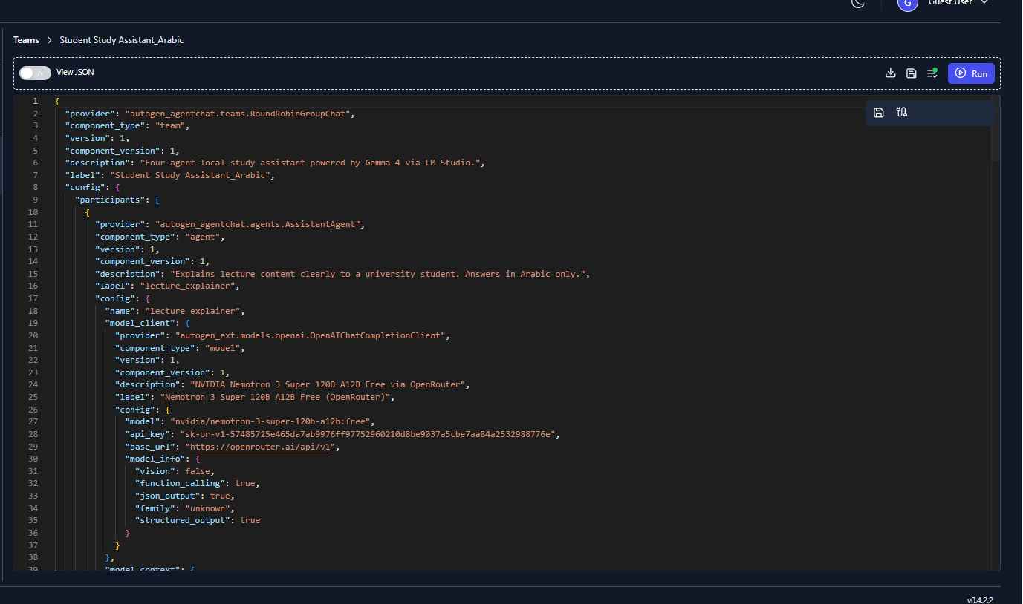

Slide 24
Copy paste your api_key from OpenRouter and test
https://openrouter.ai/

Slide 25
Thank you

