Slide 1
Context Engineering
How to give AI the right information — not just the right question
AI Training Program | Prepared by Dr. Wael Rahhal | 2026

Slide 2
Session Roadmap
01
The Eye-Opener
Why giving AI more info can make it worse
02
What is Context Engineering?
The skill that separates good AI users from great ones
03
Four Simple Strategies
Write, Select, Compress, Isolate — with everyday analogies
04
Your Academic Toolkit
Source packs, grounded prompting, and the T-C-O-Q framework
05
Hands-On Workshop
Live demos and build your own source pack

Slide 3
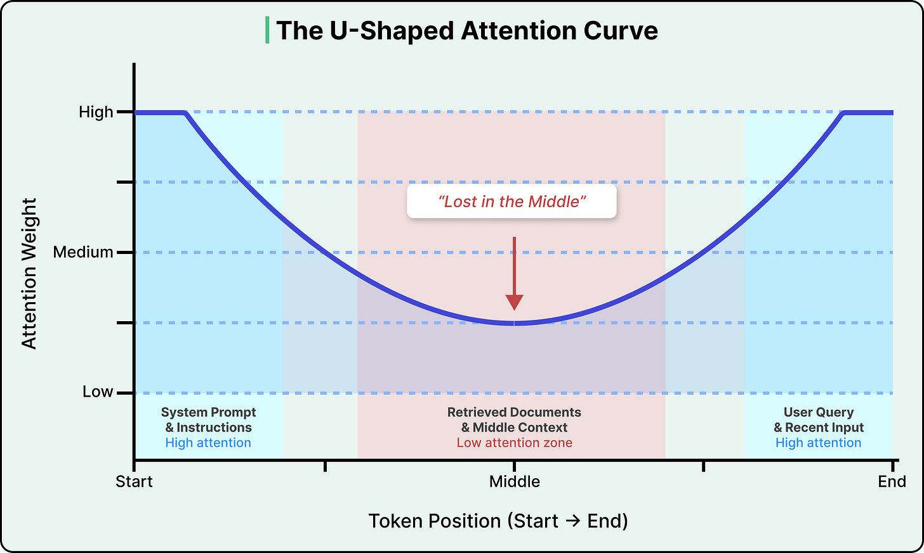
The Eye-Opener
Why giving AI more information
can actually make it perform worse

Slide 4
Same AI, Different Results — Why?
Student A
Student B
Copies an entire 30-page research paper into ChatGPT
Types: "Summarize this"
Gets a vague, generic summary with invented claims
Thinks: "AI is unreliable"
Pastes only the Results and Discussion sections
Adds: "Use ONLY these sections. Cite page numbers."
Gets a precise, source-grounded summary
Thinks: "AI is a powerful study tool"
The difference isn't the AI model — it's the context each student provided.

Slide 5
The Surprising Finding
Researchers tested 18 top AI models and found something unexpected:
18 / 18
95% → 60%
models got WORSE
with more input
accuracy cliff — sudden,
not gradual
Think of it like this:
Imagine studying for an exam with your textbook, notes, AND 10 random Wikipedia articles open. You'd actually perform worse — not because you're less capable, but because your brain is overwhelmed by irrelevant information. AI works the same way.

Slide 6
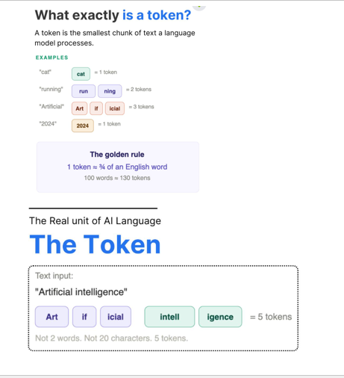
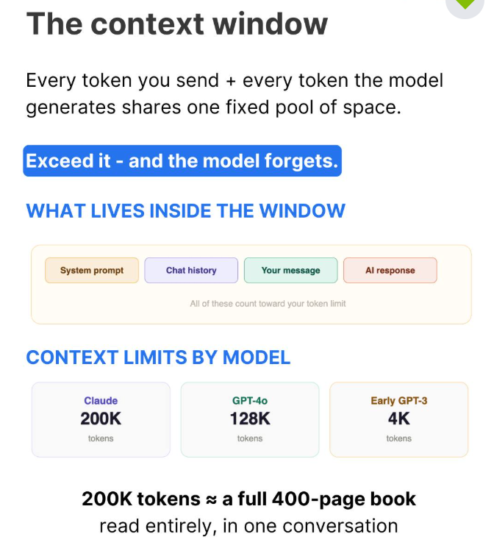
Three Terms You Need to Know
Tokens
= "Words (roughly)"
AI doesn't read words — it reads "tokens" (chunks of ~¾ of a word). Everything you type, paste, or upload gets converted into tokens.
Context Window
= "The AI's desk"
The total space the AI has to work with in one conversation. Your question, the instructions, any documents — they all share this one desk. When it's full, things fall off.
Attention
= "The AI's focus"
How the AI decides what's important. It focuses most on the beginning and end of your input. Information buried in the middle often gets ignored — just like skimming a long email.
Key insight: AI pays most attention to the START and END of your input. The middle? Often ignored.

Slide 7
What Can Go Wrong?
Four ways too much or wrong context hurts AI output:
!
Poisoning
AI makes up a fact, then treats it as true in the next paragraph — errors snowball.
You: "What's the boiling point of X?" AI invents 180°C, then uses it in calculations.
~
Distraction
Too much info overwhelms the AI — it follows irrelevant patterns instead of reasoning.
Pasting a full 200-page handbook when you only need one policy.
?
Confusion
Similar-sounding but different information creates noise.
Including info about Drug A and Drug B when you only asked about Drug A.

Slide 8
What is Context
Engineering?
The skill that separates good AI users from great ones

Slide 9
Context Engineering — Defined
The delicate art and science of filling the context window
with just the right information for the next step.
— Andrej Karpathy, AI researcher (co-founder of OpenAI)
What does “filling the context window” look like in YOUR field?
Chemistry Don’t paste the whole organic chemistry textbook — provide only the reaction mechanism, reagent properties, and conditions for your specific synthesis question.
Pharmacy Don’t upload an entire drug monograph — select only the pharmacokinetics and drug interaction sections relevant to your patient case.
Industrial Pharmacy Don’t include the entire GMP manual — provide only the formulation parameters, excipient specs, and stability data for your tablet coating problem.
Information Management Don’t dump an entire database schema — provide only the relevant tables, relationships, and sample records for your data retrieval question.
English Literature Don’t paste an entire novel — provide only the key passages, character details, and thematic excerpts relevant to your literary analysis.

Slide 10
What's on the AI's Desk?
Your question is a tiny fraction of what the AI processes:
System Instructions
Hidden rules ("be helpful", "don't make things up")
~15%
Conversation History
Everything you've said so far in this chat
~30%
Retrieved Knowledge
Documents, web results, uploaded files
~35%
Tool Info
What tools AI can use (search, calculator, etc.)
~15%
Your Actual Question
The thing you typed right now
~5%
Your question (~5%) competes with everything else for the AI's attention!

Slide 11
Four Simple Strategies
Write • Select • Compress • Isolate

Slide 12
Four Strategies to Manage AI's Desk
Write
Select
Compress
Isolate
Save it
Pick wisely
Trim it
Split it
Keep important info outside the chat so you can bring it back when needed.
Only give the AI the specific information it needs right now — not everything.
Summarize long content before giving it to the AI. Keep only what matters.
Break complex tasks into smaller chats — each focused on one thing.
Like saving notes in a folder instead of memorizing everything.
Like bringing only chapter 5 to class, not the whole textbook.
Like making bullet-point notes from a 30-page article.
Like assigning different group members to different sections.

Slide 13
Common Mistakes Students Make
X
Dumping an entire PDF into the prompt
→ Select only the relevant pages or sections
X
Asking for a summary without providing sources
→ Always paste or upload the actual text
X
Trusting AI-generated citations at face value
→ Verify every reference exists and is accurate
X
Using one long chat for everything
→ Start a new chat for each distinct task
X
Putting critical info in the middle of a long prompt
→ Put the most important info at the START or END

Slide 14
Your Academic Toolkit
Source packs, grounded prompting, and the T-C-O-Q framework

Slide 15
Source-Grounded Prompting
Golden Rule: Use ONLY provided sources. Never let the AI invent, guess, or hallucinate references.
Provide the Source
1
Paste or upload the actual text — articles, textbook excerpts, lecture notes — into the prompt.
Constrain the AI
2
Explicitly say: "Use ONLY the following sources. Do not add external information."
Verify the Output
3
Check every claim against the sources you provided. If it's not in your sources, flag it.

Slide 16
Build a Source Pack
A curated bundle of sources you give the AI for a specific task:
1
Task Definition
What you want the AI to do
e.g., "Summarize the mechanism of action of Drug X"
2
Constraint Statement
"Use ONLY the following sources.
Do not add external information."
3
Source Block
Paste each source with a label:
[Source 1: Author, Title, Year] ... text ...
4
Output Format
Specify: bullet points, paragraph,
table, or citation format
5
Verification Prompt
"For each claim, indicate which
source supports it."
This template works for ANY major — chemistry, pharmacy, literature, or information management.

Slide 17
The Complete Framework: T-C-O-Q-V-L
Build every AI prompt with these 6 layers:
T
Task
What you want the AI to do
"Create a drug interaction summary table for Aspirin."
C
Context
Background info, sources, constraints
"Use ONLY the attached clinical study excerpt below."
O
Output
Desired format and length
"Format as a table with columns: Drug Pair, Severity, Source."
Q
Quality
Tone, audience, accuracy level
"Use terminology appropriate for 2nd-year pharmacy students."
V
Verification
How to check the output
"List any claims NOT directly supported by the sources."
L
Limitations
What the AI might get wrong
"Note: AI may miss rare interactions. Cross-check with database."
V + L are what separate a responsible student from a naive one.

Slide 18
Hands-On Workshop
Live demos and build your own source pack

Slide 19
Exercise : Build Your Source Pack
Pick a topic from YOUR major — 30 minutes
Topic ideas by major:
Chemistry
Explain the mechanism of a specific reaction (e.g., esterification)
Pharmacy
Summarize drug interactions for a specific medication
Ind. Pharmacy
Compare two manufacturing methods for a tablet formulation
Info Management
Analyze a database design case study from your textbook
English Lit.
Analyze a specific theme or symbol in a novel you're studying
Steps:
Gather 2-3 sources (textbook sections, articles, lecture notes)
Fill the 5-part Source Pack template (Task, Constraint, Sources, Output, Verify)
Run it in ChatGPT or Claude — then verify the output against your sources
Share with a partner for peer review

Slide 20
Thank You!
Questions & Discussion
Want to learn more?
ByteByteGo: "A Guide to Context Engineering for LLMs"
Anthropic: "Building Effective Agents" (Dec 2024)
Stanford NLP: "Lost in the Middle" paper (2023)
Try it yourself: ChatGPT, Claude, Gemini — practice with your source packs!
Prepared by Dr. Wael Rahhal | AI Training Program | 2026

