Slide 1
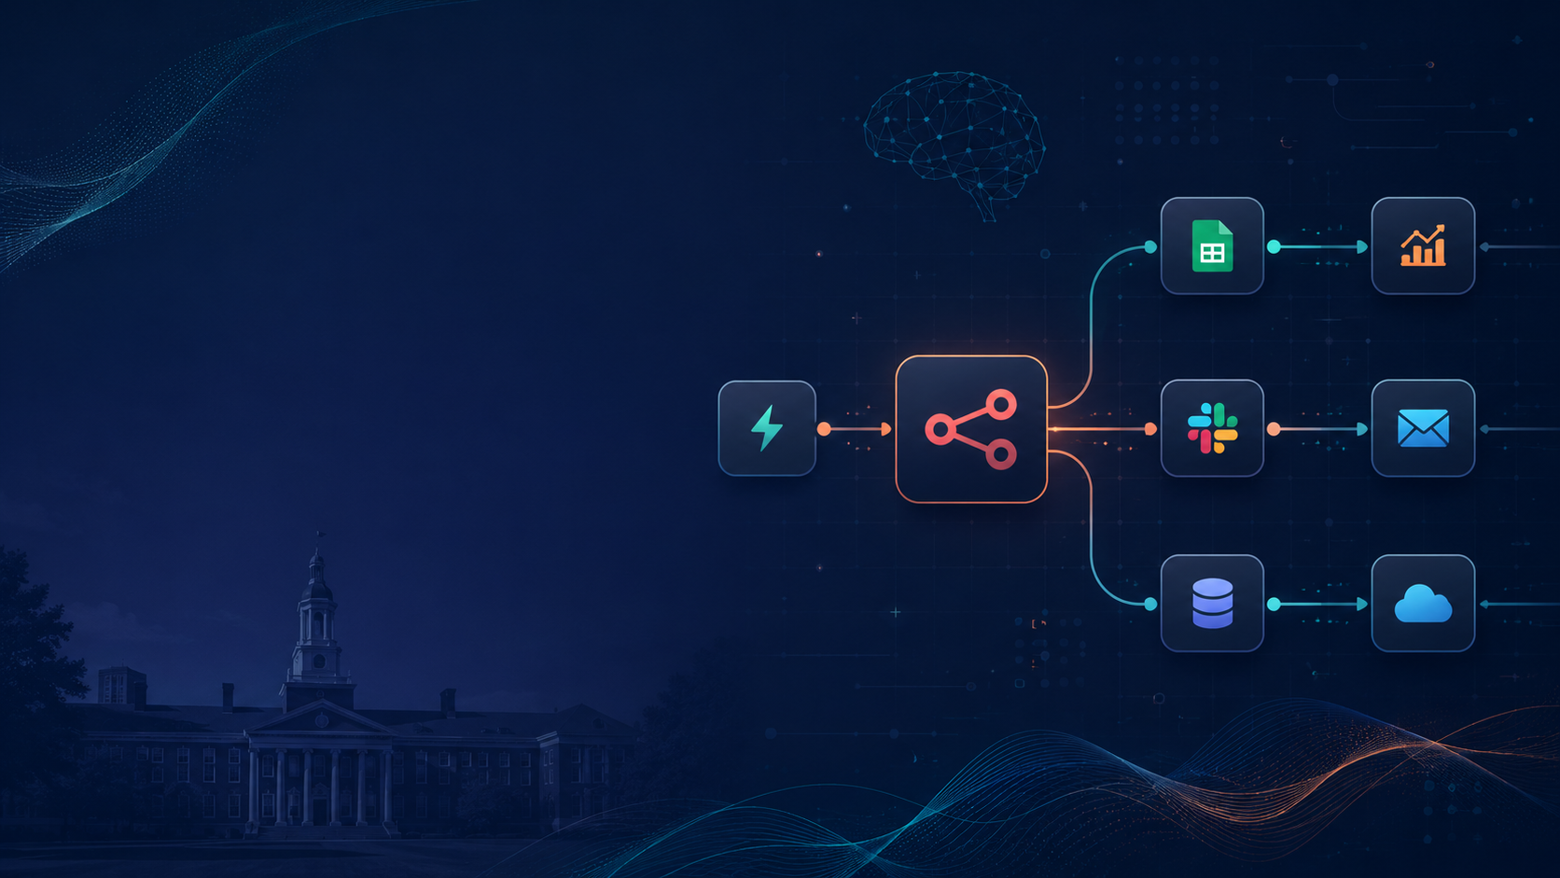
Getting Started
with n8n
Workflow Automation and AI Agents

Slide 2
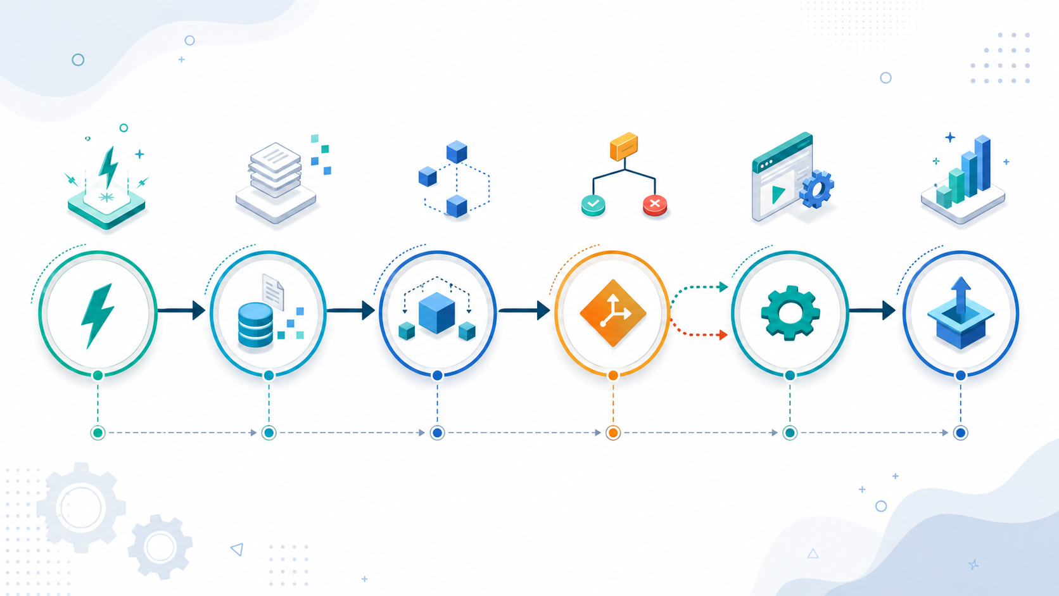
Why automation matters
The problem n8n tries to solve
Students and teams often lose time because digital work is fragmented across many tools.
Repetitive admin tasks: moving data, sending reminders, updating records
Disconnected apps: email, forms, spreadsheets, databases, and chat tools
Slow decision-making: manual follow-up creates delay and inconsistency
Growing interest in AI: users want systems that can both think and act
n8n gives a visual way to connect apps, define logic, and automate actions.
Manual → Connected → Automated
2

Slide 3
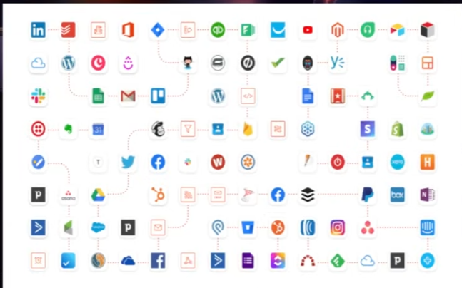
n8n-io/n8n: Fair-code workflow automation platform with native AI capabilities. Combine visual building with custom code, self-host or cloud, 400+ integrations.

Slide 4
What is n8n?
A visual workflow automation platform
Official idea
n8n combines AI capabilities with workflow and business process automation.
A workflow is a collection of connected nodes that automate a process.
Visual canvas for building logic step by step
Useful for both no-code and code-friendly users
Supports app integrations, APIs, data transformation, and AI
Can scale from one simple task to advanced automation systems
3

Slide 5
Core building blocks of a workflow
The concepts beginners should recognize first
T
D
L
A
E
→
→
→
→
Trigger
Data
Logic
Action
Execution
Starts the workflow when an event happens
Moves information from one step to the next
Adds rules, conditions, filtering, and routing
Performs an operation in another app or service
Shows results, errors, and debugging history
Simple mental model: something happens → data enters → rules decide → action is taken → results are reviewed.
4

Slide 6
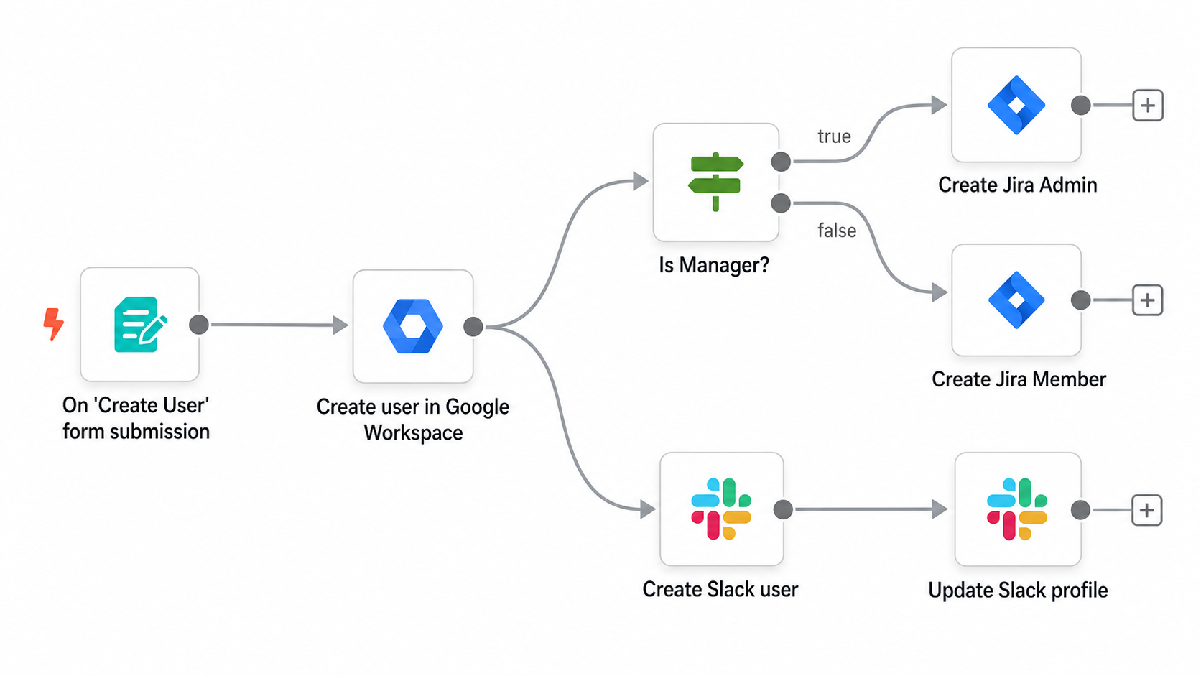

Slide 7
Anatomy of a simple workflow
A beginner-friendly sequence from event to outcome
1. Trigger
2. Get data
3. Transform
4. Decide
5. Execute
6. Output
The same design logic can power student projects, business operations, or AI-powered assistants.
5

Slide 8
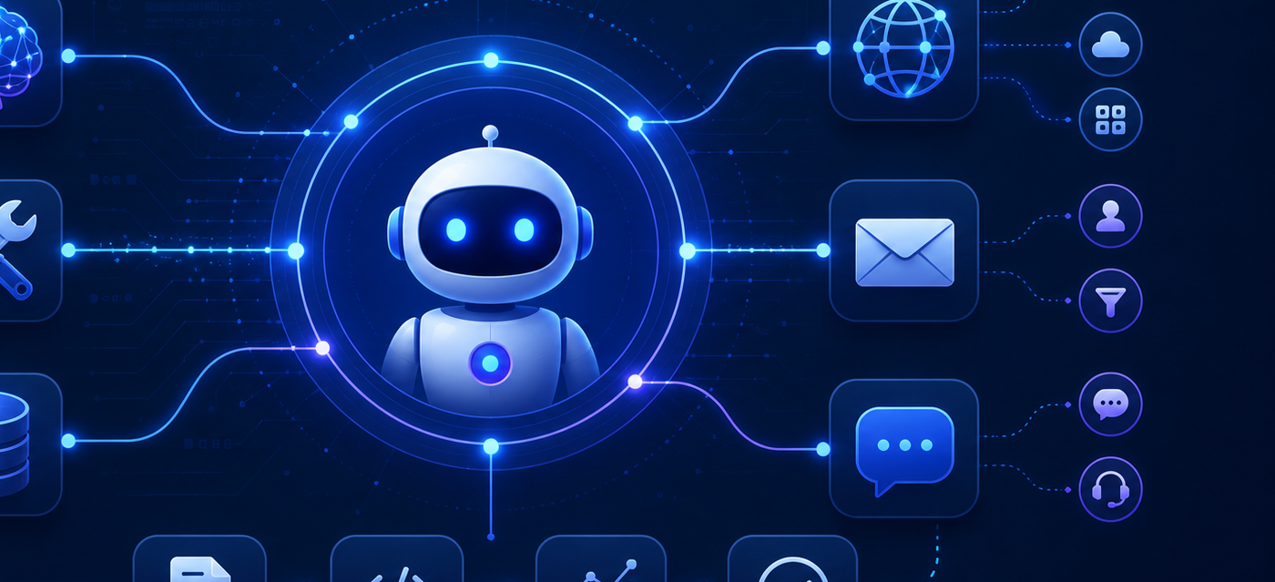
Standard automation vs AI agents
Why the topic becomes more interesting when AI is added
STANDARD WORKFLOW
AI agents
Best for fixed, repeatable logic
Same input usually leads to the same path
Strong for data transfer, notifications, updates, and rules
Highly predictable and easy to audit
Can reason, choose tools, and act toward a goal
6

Slide 9
What makes an n8n AI agent work?
Key components behind agentic automation
Goal / Prompt
Tools
Defines the task and expected behavior
Web, APIs, files, databases, email, apps
AI
Agent
Memory
Guardrails
Keeps useful context across interactions
Limits, approvals, and logging for safety
An n8n AI agent always needs tools to be useful in real workflows, not just text generation.
7

Slide 10
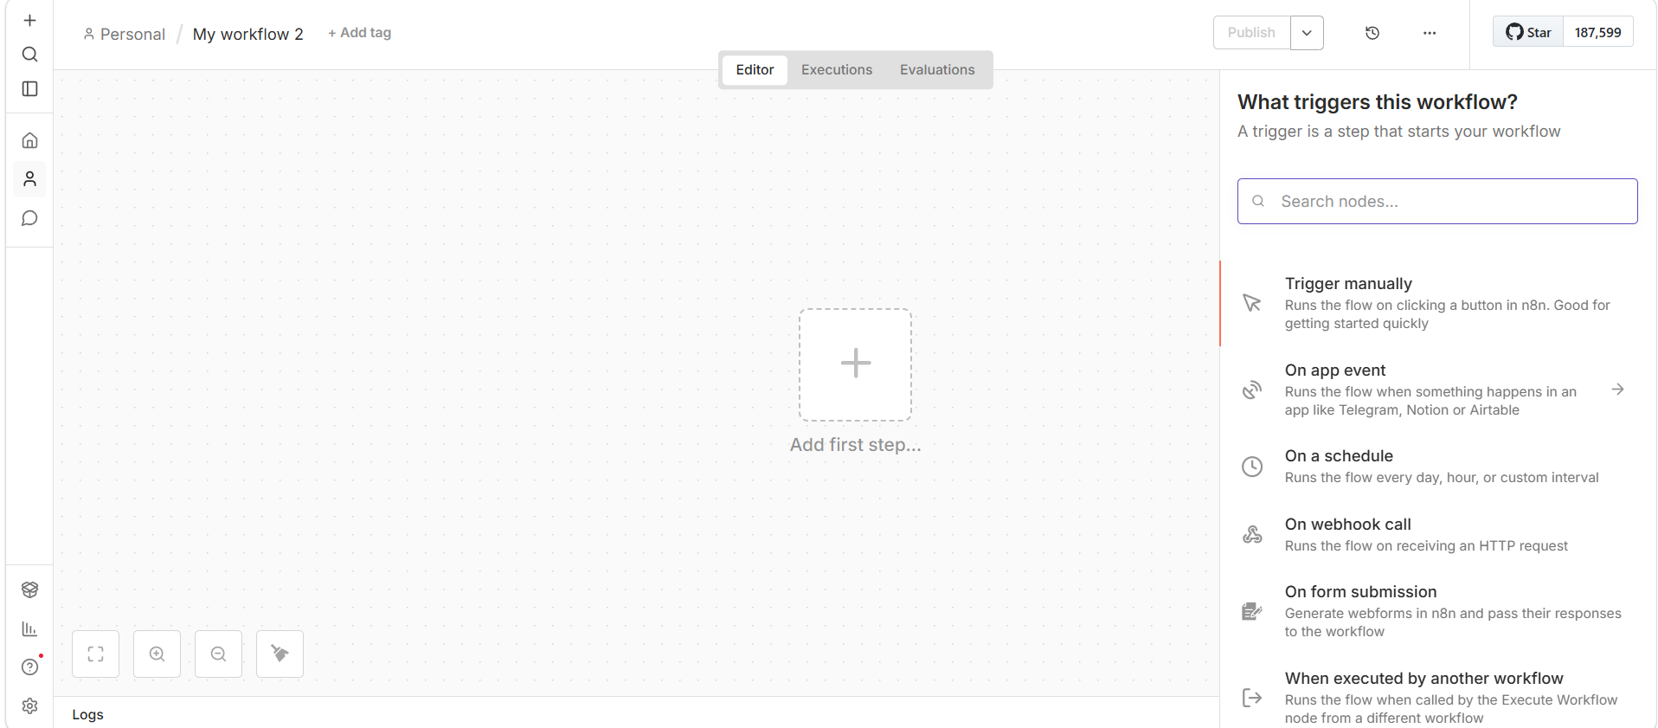
Example use cases students can relate to
Where automation and agents become practical
Research digest
Collect new articles, summarize them, and send a weekly study brief.
Course reminders
Trigger deadline alerts from a calendar, form, or spreadsheet update.
Document triage
Read files, label them, route them to folders, and notify the right person.
Feedback assistant
Analyze survey answers, group comments, and create a short report.
The same ideas can later scale into business, nonprofit, or research automation projects.
8

Slide 11
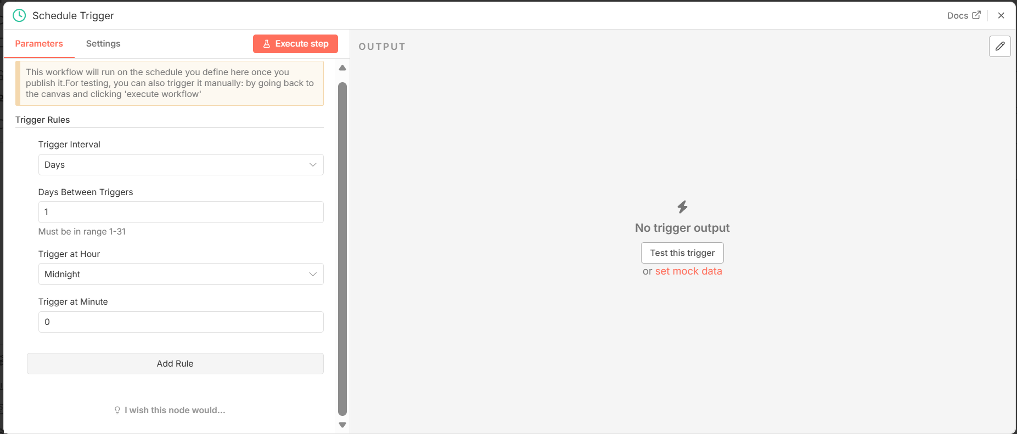

Slide 12
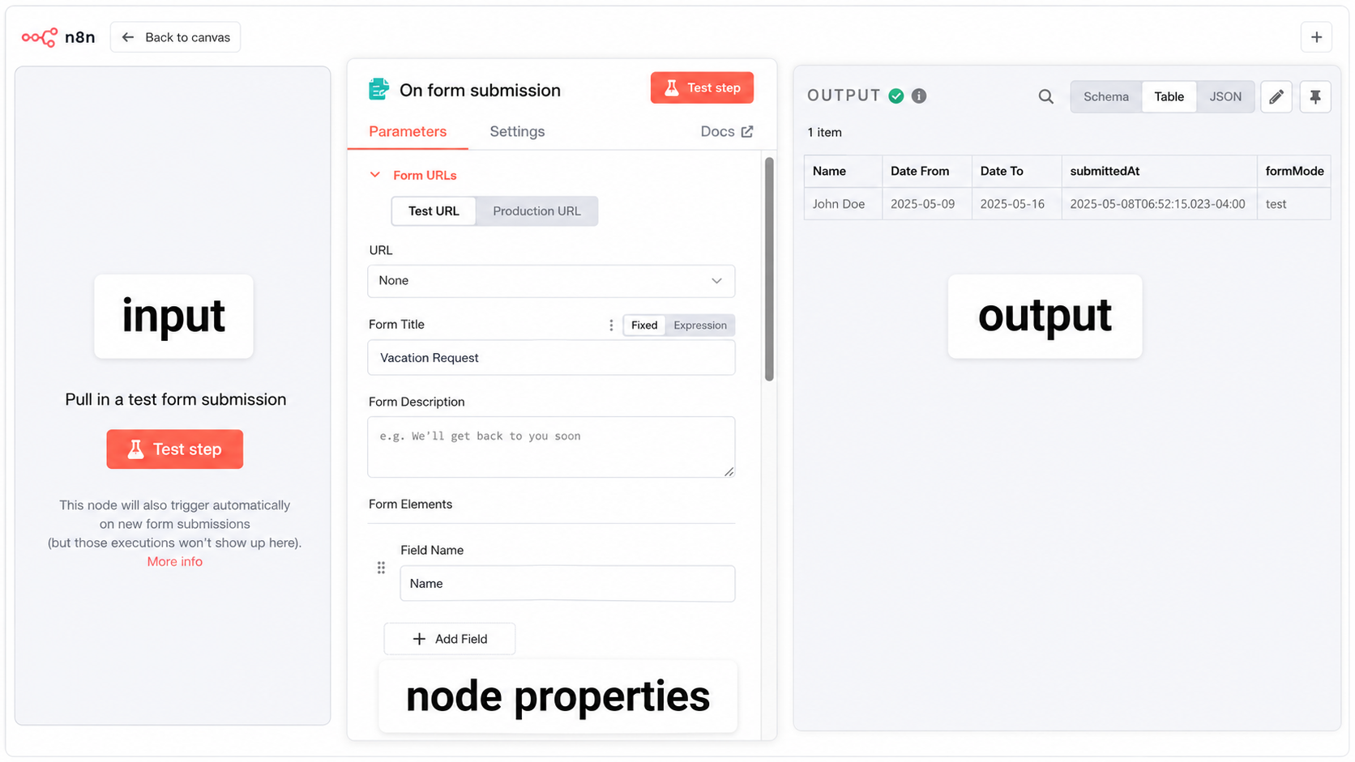

Slide 13
