Slide 1

Tweets analysis during kumbh mela festival using machine learning algorithm
Name: Wafa Faisal
Email: Wafaa.faisal.s@hotmail.com
Country: Saudi Arabia
Internship batch: LISUM01
Specialization: Natural Language Processing (NLP) Date: 15-August-2021

Slide 2

Agenda
Description
Data Pre-processing
Clustering
Visualization

Slide 3
Description:
When millions of devout Hindus gathered April 2021 in the Himalayan town of Haridwar to participate in the Kumbh Mela festival even as India battled a devastating second wave of coronavirus, many feared that it would turn out to be a "super-spreader event".

Slide 4
Data Extraction:
Twint is an advanced Twitter scraping tool written in Python that allows for scraping Tweets from Twitter profiles without using Twitter's API.
Keywords:
Coronavirus
Covid-19
Kumbh Mela
Extracted tweets:
2661 tweets
Notes:
p=['Kumbh Mela','coronavirus']

Slide 5
Data Pre-processing:
Remove:
Non-English tweets
Duplicate tweets
Nan values
Stop words
Links
Users
Symbols
Numbers

Slide 6
Data Pre-processing:
Apply the [TF-IDF] function, short for term frequency inverse document frequency, which is a numerical statistic that's intended to reflect how important a word is to a document in a corpus by giving each word in a document a score that ranges from 0 to 1.

Slide 7
Clustering:
K-means clustering is one of the simplest and popular unsupervised machine learning algorithms.
Unsupervised algorithms make inferences from datasets using only input vectors without referring to known, or labelled, outcomes.
Best number of cluster = 5

Slide 8
Clustering:
Silhouette Score:
The silhouette value is a measure of how similar an object is to its own cluster (cohesion) compared to other clusters (separation).

Slide 9
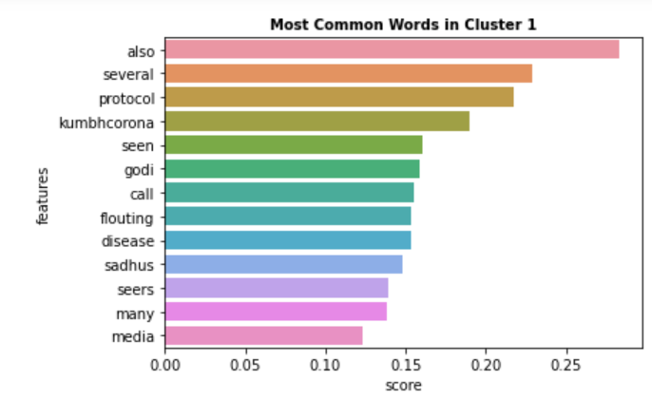
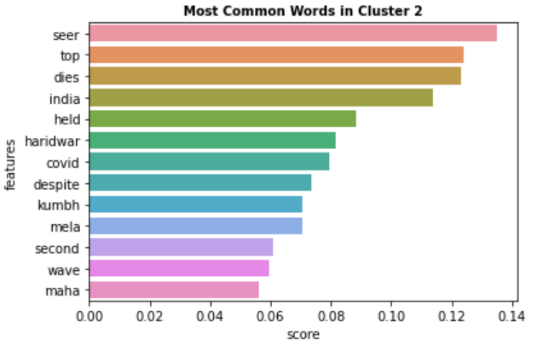
Visualization:
Most common words in cluster:

Slide 10
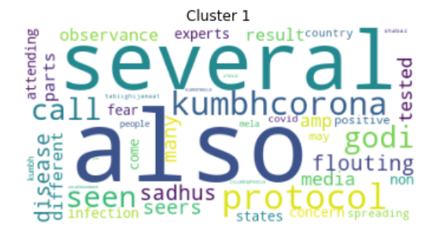
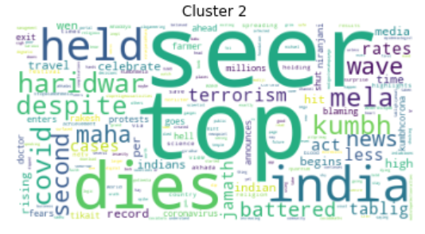
Visualization:
Word Cloud is a data visualization technique used for representing text data in which the size of each word indicates its frequency or importance.

Slide 11
.
Thank You

