Slide 1

COVID-19 predictor
Name: Wafa Hamdan Alshehri
Email: wafa.h457@gmail.com
Mobile: +966 55 966 4662

Slide 2
Tools
▪ The main tools Jupyter Notebook for writ code
▪ Pandas (pandas.read_csv) to Read a comma-separated values (csv) file into DataFrame.
▪ import matplotlib.pyplot as plt
▪ import seaborn as sns
▪ sklearn.
▪ imblearn.over_sampling to import SMOTE and RandomOverSampler.
▪ Collections to import Counter

Slide 3
Our goal
Project goal is to predict whether a person affected with Covid-19 based on their symptoms and signs or not.
Our target variable will be the COVID-19 column, which equals Yes if the person affected with Covid-19 and equals NO if it not. The other variables will be used as predictors.

Slide 4
Design
The dataset is from the Kaggle Datasets.
Data were collected from India on year 2020.
Classifying accurately via machine learning models will help the person know if he infected or not, then he\she can isolate himself to prevent the disease from spreading in the community COVID-19 is a contagious disease.

Slide 5
Data
The dataset contains 5434 rows × 21 columns
The most important elements by which we can determine whether a person will be infected or not is COVID-19 is the target.
Author is the features some of this features is symptoms like[Breathing Problem, Fever, Dry Cough, Sore throat, Running Nose] and some of it about diseases in humans such as[Asthma , Chronic Lung Disease, Headache, Heart Disease, Diabetes, Hyper Tension, Fatigue, Gastrointestinal] and the third group of features about the activities and actions of the person [Abroad travel, Contact with COVID Patient, Attended Large Gathering, Visited Public Exposed Places, Family working in Public Exposed Places, Wearing Masks, Sanitization from Market].
All of the features and target contain two values Yes or No

Slide 6
Algorithms: Feature Engineering
• data analysis our data shape is (5434, 21)
The Data type is object and by looking at the column names in our dataset, we find the trailing whitespace problem, so We remove this by calling map on the columns list and stripping the whitespace with strip.
• finding missing value there is no missing value in our dataset.
• feature transformation we convert the features into integer by using LabelEncoder to converting string labels into numbers No = 0 and Yes = 1

Slide 7
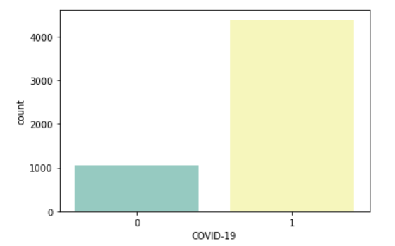
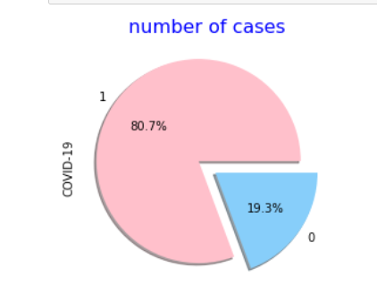
data visualization
we can see our data set imbalance because there is a big different between column [No, 1051] and column [Yes, 4383] so our dataset not very huge using over-sampling it more efficient than the under-sampling.

Slide 8
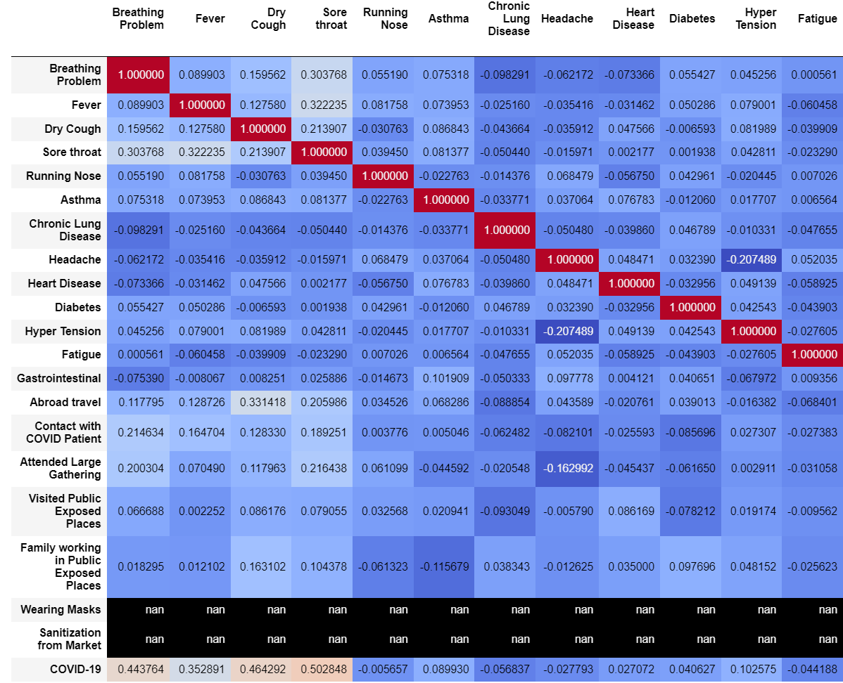
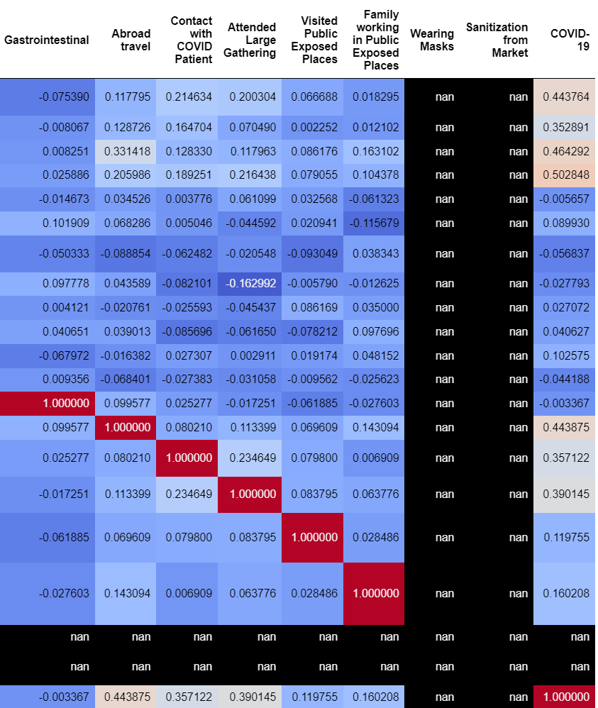
Algorithms: Feature Engineering
correlation between features: the most important symptoms and signs that refers the person has affected with Covid-19? as appear in the Correlation is Breathing Problem, Fever, Dry Cough, Sore throat. The Common reasons to get affected with Covid-19 is Contact with COVID Patient, Abroad travel and Attended Large Gathering.
Nan means there is no variation
feature selection feature that we going to delete: Running Nose / Asthma /Chronic Lung Disease / Headache / Heart Disease / Diabetes / Fatigue / Gastrointestinal / Wearing Masks / Sanitization from Market

Slide 9
SPLITTING THE DATASET
Model Evaluation and Selection
The entire training dataset was split into 80/20 train.

Slide 10
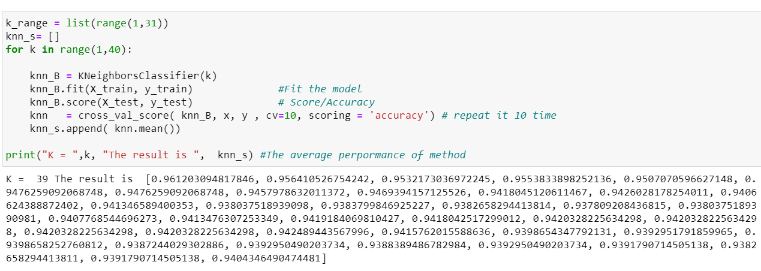
Models
Logistic regression, k-nearest neighbors, and Decision Tree classifiers were used before settling on Decision Tree as the model with strongest cross-validation performance.
Search for an optimal value of k for KNN

Slide 11
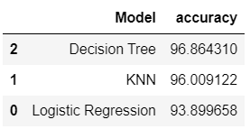
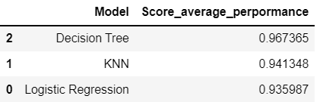
Before cross-validation vs after cross-validation
Use cross-validation to repeat the process k=10 time and take the average of testing performance.
Decision Tree have strongest cross-validation performance.

Slide 12
Predicted
Predicted if the person has Breathing Problem, Fever, Dry Cough and without Attended Large Gathering he will get affected with Covid-19?
The predict =0
Means he not affected with Covid-19.
Predicted if the person has Breathing Problem, Fever, Dry Cough and with Attended Large Gathering he will get affected with Covid-19?
The predict =1
Means he affected with Covid-19

Slide 13
conclusion
Using over-sampling to solve imbalance in our dataset.
We delete the features that have Nan or negative correlation.
Symptoms, activities and actions of the person it the reasons that will increase the possibility of he\she has COVID-19.
Performance of Decision Tree after cross-validation is get better.

Slide 14
