Slide 1
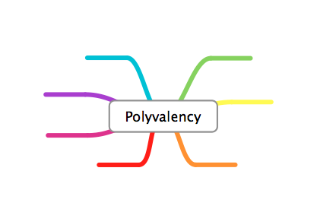







Social Role

Slide 2
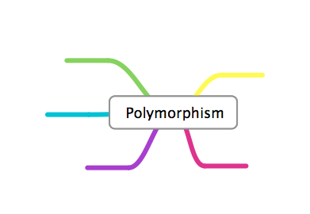

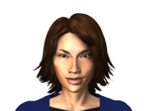


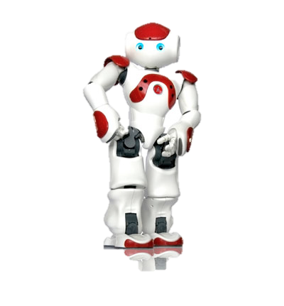

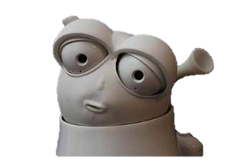
Embodiment

Slide 3
Aspects of the Artificial Companions
Social Role
Embodiment
Notes:
We define two aspects of the companions: the role that they play in a problem/situation;
A good companion would be able to play several roles according to the context
and their embodiment in the device, such as a robot or virtual agent.
The companion should be adaptable to various embodiement (accoding to what device is available at the moment)

Slide 4
Personalisation
Personification
Personalisation |  |  | Personification
 | Adaptive | Adaptable
Social
Ability/Task

Slide 5
System controls change
Social Adaptive
Ability Adaptive
Social Adaptable
Ability Adaptable
User controls change
Social change
Performance-oriented change

Slide 6
System controls change
PERMISSIVE
AUTHORITATIVE
NEGLECTFUL
AUTHORITARIAN
User controls change
Social change
Performance-oriented change

