Slide 1
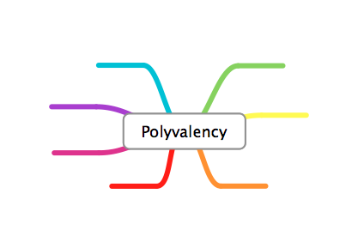






Bodyguard
Teacher
Comforter
Social Role
Buddy
Coach
Storyteller

Slide 2

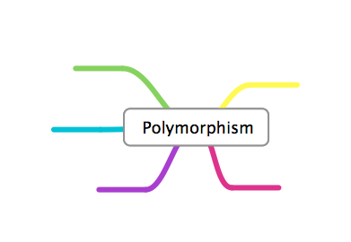

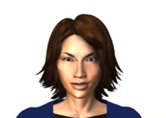
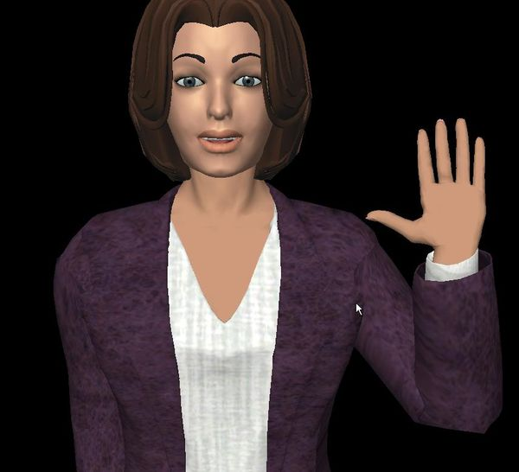
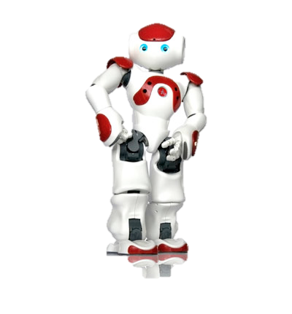
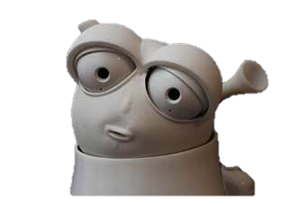
Greta
MARC
Embodiment
Reeti
Nao

Slide 3



Aspects of the Artificial Companions
Social Role
Embodiment
Notes:
We define two aspects of the companions: the role that they play in a problem/situation;
A good companion would be able to play several roles according to the context
and their embodiment in the device, such as a robot or virtual agent.
The companion should be adaptable to various embodiement (accoding to what device is available at the moment)

Slide 4
Personalisation
Personification
Personalisation |  |  | Personification
 | Adaptive | Adaptable
Social
Ability/Task

Slide 5
System controls change
Social Adaptive
Ability Adaptive
Social Adaptable
Ability Adaptable
User controls change
Social change
Performance-oriented change

Slide 6
PERMISSIVE
AUTHORITATIVE
DOMINANCE
RESPONSIVENESS
NEGLECTFUL
AUTHORITARIAN

Slide 7
Perception Bdi
Deliberation
Emotional Appraisal

Slide 9
Effort
Chapter 7
Chapter 6
Chapter 2 & 3
Chapter 4, 5
Time

Slide 10
deliberation
planning
intentions
plans
Emotion
scheduling
appraisal_emotion
appraisal
_checks
speech_acts
or action
BIGR_attitude
SECs
perception
action_render

Slide 11
appraisal emotion
appraisal secs
perception
deliberation
planning
scheduler
action renderer
Stumli(wafa,unplug,nao)

