Slide 1

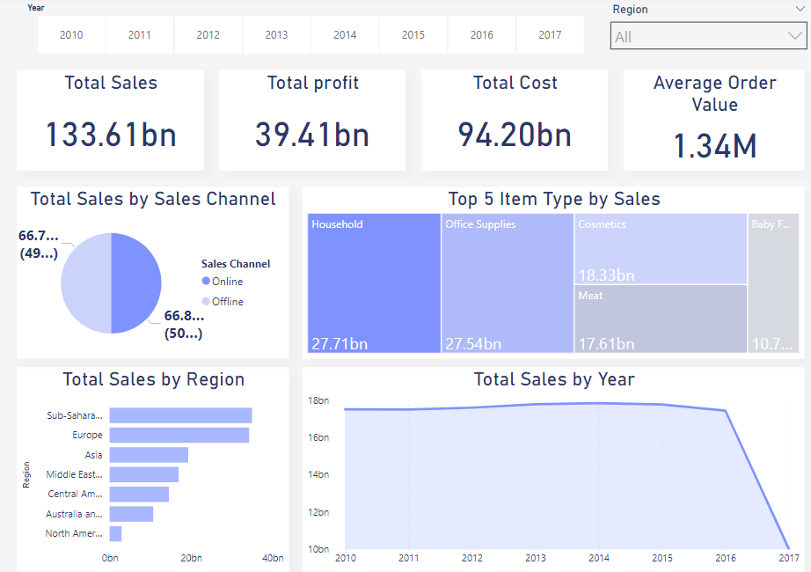
Sales Records Analysis Dashboard
This presentation explores a comprehensive analysis of a vast dataset containing 100,000 sales records, leveraging data visualization tools to extract valuable insights and uncover hidden trends.

Slide 2
Agenda
1
Dataset Overview
2
Analysis Objectives
Explore the structure and key features of the sales dataset.
Define the goals and questions driving this analysis.
3
Key Metrics and KPIs
4
Dashboard Walkthrough
Identify the critical performance indicators for evaluating sales performance.
Examine the interactive dashboard designed to visualize the data.
5
Insights & Findings
6
Conclusion
Uncover key trends, patterns, and actionable insights from the data.
Summarize the findings and discuss future applications.

Slide 3
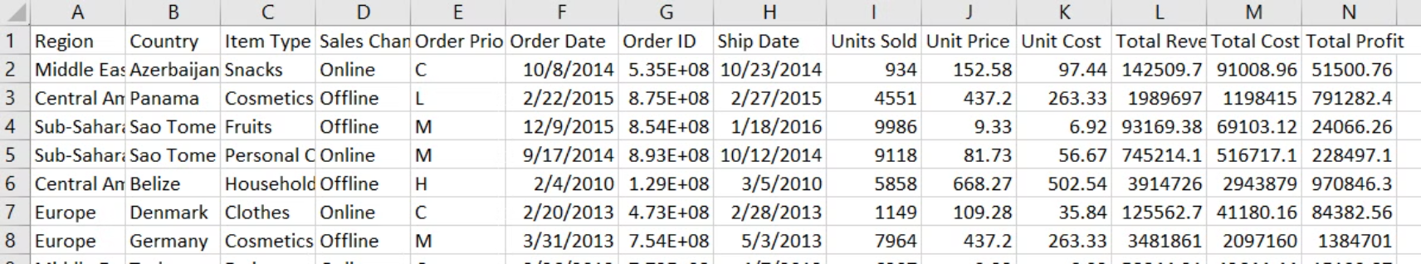
Dataset Overview
Source
Structure
Size
The dataset originates from Kaggle, a platform for data science competitions and collaboration.
The dataset comprises multiple columns(Region, Country, Item Type, Sales Channel, Order Priority, Units Sold, Total Revenue, Total Profit, etc.)
The dataset contains a substantial 100,000 sales records, providing a rich source of information for analysis.

Slide 4
Analysis Objectives
Sales Trends
Customer Segmentation
Identify patterns in sales volume, customer behavior, and product performance over time.
Which regions are most profitable?
Business Optimization
Product Performance
What sales channels perform best?
What products generate the highest revenue/profit?

Slide 5
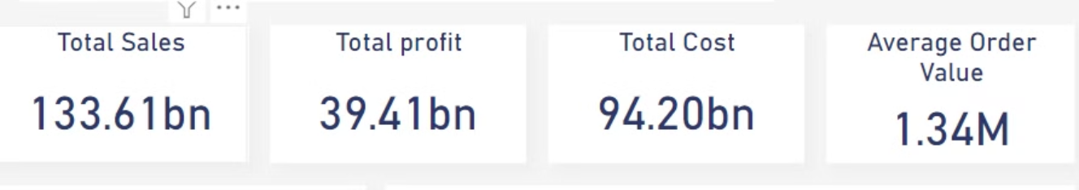
Key Metrics and KPIs
Metric
Description
Total Sales
Overall sales generated during a specific period.
Total Profit
Total Profit is the difference between Total Revenue and Total Cost, indicating the company's earnings after covering costs
Total Cost
Cost incurred to acquire a new customer.
AOV (Average Order Value)
that measures the average amount of money spent each time a customer places an order. It helps businesses understand customer spending patterns and can be used to optimize pricing strategies, upselling, and cross-selling opportunities.
Average Profit Margin
financial metric that measures the average percentage of revenue that a company retains as profit after covering its costs. It provides insight into how efficiently a company is converting revenue into profit.

Slide 6

Dashboard Walkthrough

Slide 7
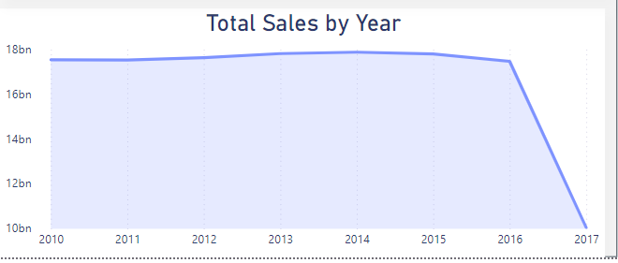
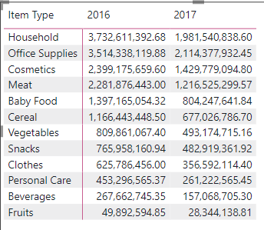
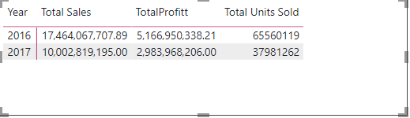
Insights & Findings
1-Seasonal Trends
Sales have a fairly consistent seasonal pattern for most years, with both total revenue and total profit dropping dramatically in 2017 compared to previous years

Slide 8
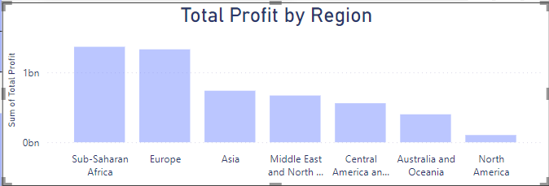
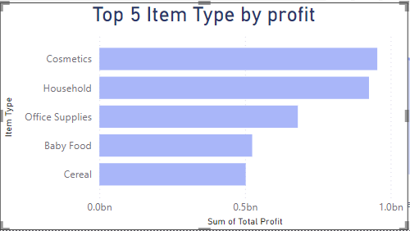
2-Which region generated the highest profit?
3-Which product category generates the highest profit?
Answer: Cosmetics
Answer: Sub-Saharan Africa

Slide 9

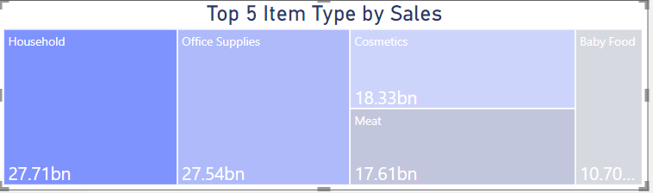
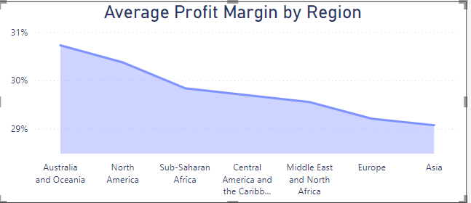
4- What is the total number of units sold for the
top 5 products (by sales)?
5-What is the average profit margin for region?
Answer:
Answer:

Slide 10
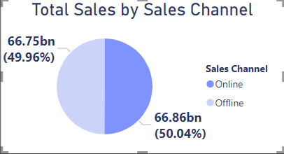
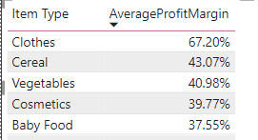
6- What sales channels perform best?
7. What is the average profit margin for the top 5 products?
Answer:
Answer: Almost equal

Slide 11



Conclusion
Actionable Insights
The dashboard analysis has yielded valuable insights into sales trends, and product performance.
Strategic Recommendations
These insights can inform strategic decisions regarding product development, marketing campaigns, and customer retention.
Continuous Improvement
Regular monitoring of the dashboard and ongoing analysis are crucial for identifying emerging trends and adapting strategies over time.

Slide 12
Our Team
Wafaa Tarek Saber
Shorouk Ibrahim Mostafa
Nada Ayman Elsayed Shady
Dina Fakhry Ali
Samaa Elsaid Abdelruhman

Slide 13
Thank You

