Slide 1
ARCH LINUX
How to Rice Arch
A dark Gruvbox walkthrough with two levels:
build your own with AI · or install binnewbs/arch-hyprland
Theme: Gruvbox Dark · Target: Hyprland on Arch · Google Slides compatible
How to Rice Arch · dark gruvbox
1 / 19

Slide 2
BASICS
What “ricing” means
Ricing is customizing your desktop until it looks intentional — colors, fonts, bar, terminal, wallpaper, and animations all speaking the same language.
Compositor
Bar + launcher
Terminal + theme
Hyprland manages windows, gaps, blur, and keybinds.
Waybar + Rofi give you status and app launch.
Kitty + Gruvbox/Matugen keep everything cohesive.
How to Rice Arch · dark gruvbox
2 / 19

Slide 3
CHOOSE YOUR PATH
Two levels, one slideshow
LEVEL 1
LEVEL 2
Make your own rice with AI
Use arch-hyprland
▸ You design the look piece by piece
▸ Cursor / chat helps write configs
▸ Learn Hyprland, Waybar, Kitty deeply
▸ Ends as your own dotfiles repo
▸ Clone binnewbs/arch-hyprland
▸ Matugen colors from wallpapers
▸ Waybar, Rofi, SwayNC, Kitty ready
▸ Tweak paths, then make it yours
How to Rice Arch · dark gruvbox
3 / 19

Slide 4
BEFORE YOU START
Prerequisites
System
Mindset
▸ Arch Linux (or Arch-based) installed
▸ A normal user with sudo
▸ Working network + graphics drivers
▸ AUR helper: yay or paru
▸ Backup of any existing ~/.config
▸ Know how to edit files in a terminal
▸ Comfortable rebooting into a TTY if needed
▸ Wallpapers folder ready (Pictures/wallpapers)
▸ Nerd Font installed (JetBrains Mono recommended)
▸ Time to iterate — rice is iterative
How to Rice Arch · dark gruvbox
4 / 19

Slide 5
THE STACK
Core pieces of a Hyprland rice
Hyprland
Wayland compositor — windows, gaps, blur, keybinds
Waybar
Top/status bar — workspaces, clock, tray, modules
Kitty
GPU terminal — fonts + Gruvbox / Matugen colors
Rofi
App launcher + wallpaper picker UI
SwayNC
Notification center / control panel
swww + Matugen
Wallpaper daemon + auto color scheme generator
hyprlock / hypridle / wlogout
Lock, idle, and logout menu
How to Rice Arch · dark gruvbox
5 / 19

Slide 6
VISUAL LANGUAGE
Dark Gruvbox palette
Keep every app on these hex values (or let Matugen derive a matching set from wallpaper).
bg0_h
bg
bg1
fg
gray
red
#1d2021
#282828
#3c3836
#ebdbb2
#928374
#fb4934
green
yellow
blue
purple
aqua
orange
#b8bb26
#fabd2f
#83a598
#d3869b
#8ec07c
#fe8019
How to Rice Arch · dark gruvbox
6 / 19

Slide 7
LEVEL 1
Make your own rice with AI
You own every config. Cursor (or any AI) writes the boring parts while you decide the look.
How to Rice Arch · dark gruvbox
7 / 19

Slide 8
LEVEL 1 · WORKFLOW
Build loop with an AI pair
01
Install base packages
hyprland waybar kitty rofi-wayland swww grim slurp wl-clipboard
02
Boot Hyprland bare
Get a terminal + keybinds working before styling
03
Lock Gruvbox early
Paste palette into kitty, waybar, hypr borders
04
Iterate with AI
Paste errors + screenshots; ask for exact config diffs
05
Commit dotfiles
Keep ~/.config/hypr waybar kitty in a git repo
How to Rice Arch · dark gruvbox
8 / 19

Slide 9
LEVEL 1 · PACKAGES
Starter pacman + AUR set
# Official repos
sudo pacman -S hyprland waybar kitty rofi-wayland swww \
hyprlock hypridle grim slurp wl-clipboard brightnessctl \
playerctl pipewire wireplumber networkmanager \
ttf-jetbrains-mono-nerd noto-fonts-emoji
# AUR (yay/paru)
yay -S swaync-git wlogout matugen-bin # optional but nice
# Then: copy a minimal hyprland.conf, open Kitty with Super+Q,
# and only then start theming.
How to Rice Arch · dark gruvbox
9 / 19

Slide 10
LEVEL 1 · AI PROMPTS
Good prompts to give Cursor
1.
“Make my Hyprland borders and Waybar use Gruvbox Dark; here is my current style.css.”
2.
“Write a dwindle layout hyprland.conf with Super+Q kitty, Super+R rofi, gaps 5/10.”
3.
“Fix this Waybar JSONC — modules-right should show pulse, network, clock.”
4.
“Generate a Kitty Gruvbox dark theme matching #282828 / #ebdbb2.”
5.
“Add a wallpaper picker script using swww + rofi.”
How to Rice Arch · dark gruvbox
10 / 19

Slide 11
LEVEL 2
Use binnewbs/arch-hyprland
Personal Hyprland rice with Matugen-driven colors, swww wallpapers,
Waybar layouts, Rofi, SwayNC, Kitty, Cava, and wlogout.
How to Rice Arch · dark gruvbox
11 / 19

Slide 12
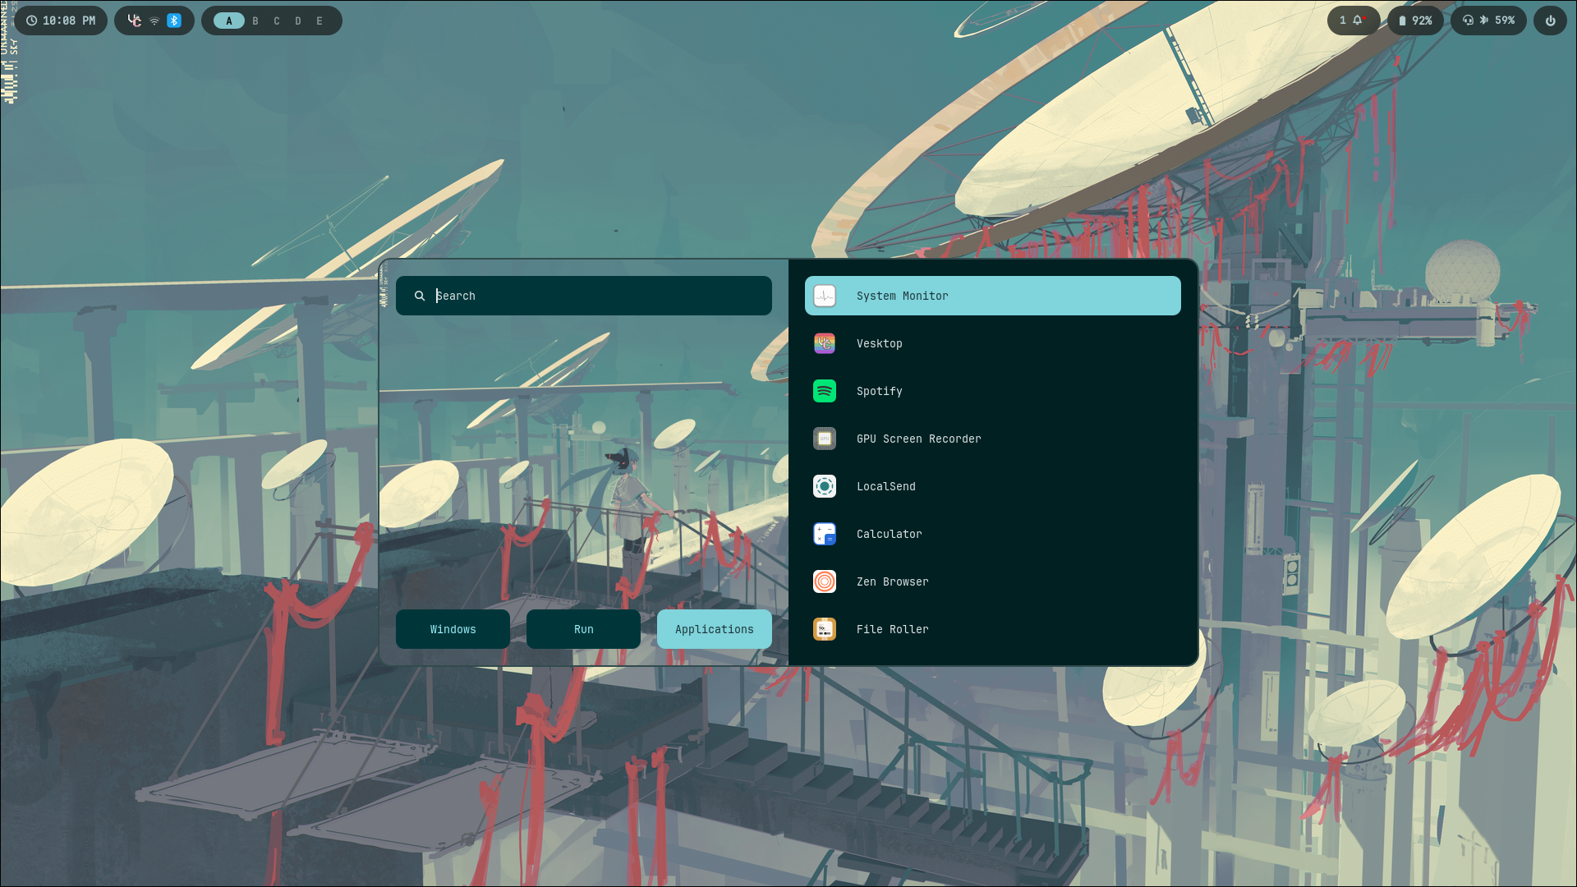
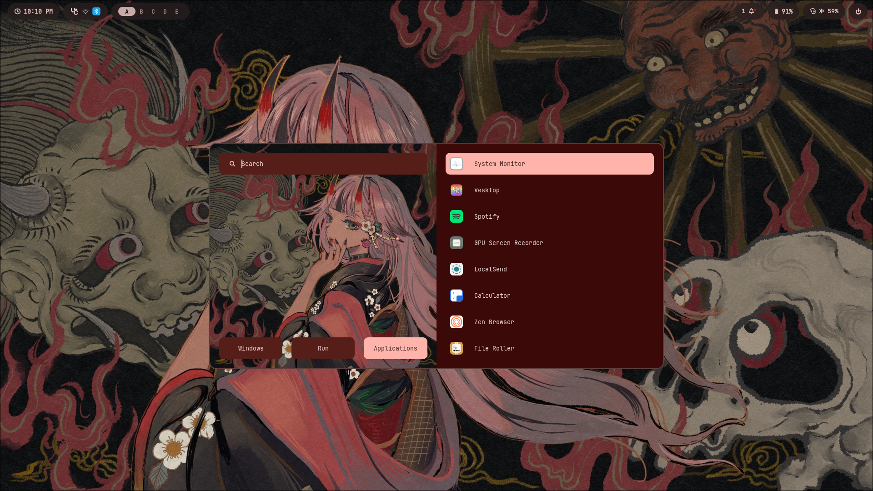
LEVEL 2 · LOOK
What this rice looks like
Screenshots from github.com/binnewbs/arch-hyprland · Matugen palette follows wallpaper
How to Rice Arch · dark gruvbox
12 / 19

Slide 13
LEVEL 2 · INSTALL
Clone and place the configs
# Backup first
cp -a ~/.config ~/.config.bak.$(date +%F)
git clone https://github.com/binnewbs/arch-hyprland.git ~/arch-hyprland
cd ~/arch-hyprland
# Merge carefully — don’t blind-overwrite paths you still need
cp -r .config/* ~/.config/
cp -r wallpapers ~/Pictures/wallpapers # or symlink
cp .zshrc ~/.zshrc # optional
▸ Install matching packages: hyprland, waybar, kitty, rofi, swww, swaync, matugen, wlogout, cava, fastfetch
▸ Edit absolute paths (the upstream rice uses /home/beentang/... in places)
▸ Reload: hyprctl reload · restart Waybar · pick a wallpaper with the wppicker script
How to Rice Arch · dark gruvbox
13 / 19

Slide 14
LEVEL 2 · SECRET SAUCE
Matugen + swww workflow
This rice regenerates theme colors from the wallpaper so you rarely hand-edit every color file.
1. Pick wallpaper
2. Matugen image
3. Live reload
4. Enjoy
wppicker.sh → Rofi preview from ~/Pictures/wallpapers
matugen image <file> writes templates for each app
hooks reload Waybar, Kitty, Hyprland, Cava
borders, bar, terminal, GTK, Rofi, Discord/Spotify templates
How to Rice Arch · dark gruvbox
14 / 19

Slide 15
LEVEL 2 · REPO MAP
Where things live
.config/hypr/ hyprland.conf + colors + scripts (wppicker, volume…)
.config/hypr/configs/ keybinds, looknfeel, windowrules, animations
.config/waybar/ layouts + style CSS + Matugen colors.css
.config/kitty/ kitty.conf + colors.conf
.config/matugen/ config.toml + templates for every themed app
.config/rofi/ launcher theme + colors.rasi
.config/swaync/ notification center style
.config/wlogout/ logout menu
.config/cava/ audio visualizer
wallpapers/ starter wallpapers for Matugen
How to Rice Arch · dark gruvbox
15 / 19

Slide 16
PICK A LANE
Level 1 vs Level 2
Level 1 · DIY + AI
Level 2 · arch-hyprland
Speed to pretty desktop
Slower
Fast
Learning depth
Highest
Medium — still tweak paths
Maintenance
You own every line
Upstream + your forks
Color system
Hand Gruvbox or Matugen
Matugen-first
Best when…
You want a signature look
You want this rice now
How to Rice Arch · dark gruvbox
16 / 19

Slide 17
FINISHING
Make it feel finished
Fonts
JetBrains Mono Nerd everywhere — bar, terminal, Rofi
GTK + icons
Match dark Gruvbox / Material; set cursor theme
Blur & gaps
rounding 10, gaps 5/10, inactive opacity ~0.8 (like this rice)
Lock screen
hyprlock wallpaper + Gruvbox text colors
Dotfiles hygiene
git init your ~/.config slices; never commit secrets
Screenshot flex
grim + slurp; keep a before/after pair
How to Rice Arch · dark gruvbox
17 / 19

Slide 18
LINKS
Resources
Level 2 rice
https://github.com/binnewbs/arch-hyprland
Hyprland wiki
https://wiki.hyprland.org
Gruvbox
https://github.com/morhetz/gruvbox
Matugen
https://github.com/InioX/matugen
Waybar
https://github.com/Alexays/Waybar
Arch Wiki · Hyprland
https://wiki.archlinux.org/title/Hyprland
How to Rice Arch · dark gruvbox
18 / 19

Slide 19
NOW GO RICE
Pick a level. Ship a desktop.
Level 1 — design with AI until it feels like yours.
Level 2 — start from arch-hyprland, then fork the look.
Import this .pptx into Google Slides: File → Import slides → Upload
How to Rice Arch · dark gruvbox
19 / 19

