Slide 1
FRAMEWORK LAPTOP 13 PRO · ARCH LINUX
How to Rice Arch
Dark Gruvbox Hyprland on the Framework 13 Pro — HiDPI, brightness,
fingerprint, and battery tuned for this machine.
Two levels: build with AI · or install binnewbs/arch-hyprland
2.8K panel · Wayland · Google Slides compatible PPTX
Rice Arch on Framework 13 Pro · dark gruvbox
1 / 20

Slide 2
THIS MACHINE
Why Framework 13 Pro needs its own rice notes
2.8K / HiDPI
Laptop power
Repairable Linux
2880×1920 (and older 2256×1504) need real Hyprland monitor scale — not “looks fine at 100%”.
brightnessctl, idle lock, and ALS quirks matter more than on a desktop rice.
fwupd BIOS, fingerprint, Wi-Fi, and expansion cards — Arch Wiki + Framework docs first.
Rice Arch on Framework 13 Pro · dark gruvbox
2 / 20

Slide 3
CHOOSE YOUR PATH
Two levels on the same Framework
LEVEL 1
LEVEL 2
Make your own rice with AI
Use arch-hyprland
▸ Tune scale, brightness, fingerprint yourself
▸ Cursor helps write Hyprland / Waybar diffs
▸ Learn the Framework ArchWiki quirks
▸ Ship your own FW13 Pro dotfiles
▸ Clone binnewbs/arch-hyprland
▸ Matugen + swww theme engine ready
▸ Then patch monitor scale for 2.8K
▸ Fix home paths + Framework scripts
Rice Arch on Framework 13 Pro · dark gruvbox
3 / 20

Slide 4
BEFORE YOU START
Framework 13 Pro prerequisites
Hardware / firmware
Software baseline
▸ Framework Laptop 13 Pro (Intel Ultra 3 or AMD AI 300)
▸ BIOS current via fwupd / LVFS
▸ Know your panel: 2.8K or 2256×1504
▸ Wi-Fi working in installer / live ISO
▸ Backup of any existing ~/.config
▸ Arch (or Arch-based) with a sudo user
▸ Kernel recent (6.19+ / preferably latest)
▸ yay or paru for AUR
▸ JetBrains Mono Nerd Font
▸ Read ArchWiki: Framework Laptop 13
Rice Arch on Framework 13 Pro · dark gruvbox
4 / 20

Slide 5
FRAMEWORK MUST-DO
HiDPI + refresh on Hyprland
Put this in ~/.config/hypr/hyprland.conf (adjust connector name with hyprctl monitors).
# 2.8K Framework 13 Pro panel — start at scale 2, or try 1.6–1.75 fractional
monitor = eDP-1, 2880x1920@120, 0x0, 1.666667
# Older 2256x1504 panel — ArchWiki suggests ~1.5
# monitor = eDP-1, 2256x1504@60, 0x0, 1.5
# Optional: sharper XWayland apps
xwayland { force_zero_scaling = true }
env = GDK_SCALE,2
Tip: if fonts look huge/tiny after Level 2, this monitor line is usually the first fix.
Rice Arch on Framework 13 Pro · dark gruvbox
5 / 20

Slide 6
FRAMEWORK MUST-DO
Brightness keys + fingerprint
Fn brightness not working?
Fingerprint login
▸ ALS can steal brightness keys
▸ Blacklist hid_sensor_hub, reboot
▸ Bind brightnessctl in Hyprland
sudo pacman -S fprintd
fprintd-enroll
fprintd-verify
# Unenroll Windows prints first
# if fprintd hangs on enroll
# /etc/modprobe.d/framework-als.conf
blacklist hid_sensor_hub
Rice Arch on Framework 13 Pro · dark gruvbox
6 / 20

Slide 7
THE STACK
Hyprland stack that fits the 13 Pro
Hyprland
Compositor — scale, gaps, blur, laptop keybinds
Waybar
Battery %, brightness, network, workspaces
Kitty
GPU terminal with Gruvbox / Matugen colors
Rofi
Launcher + wallpaper picker
SwayNC
Notifications / quick settings
swww + Matugen
Wallpaper + auto theme (Level 2 secret sauce)
hyprlock / hypridle / brightnessctl
Lock, idle, and Fn brightness on battery
Rice Arch on Framework 13 Pro · dark gruvbox
7 / 20

Slide 8
VISUAL LANGUAGE
Dark Gruvbox palette
Lock these hex values for DIY, or let Matugen derive a matching set from wallpaper (Level 2).
bg0_h
bg
bg1
fg
gray
red
#1d2021
#282828
#3c3836
#ebdbb2
#928374
#fb4934
green
yellow
blue
purple
aqua
orange
#b8bb26
#fabd2f
#83a598
#d3869b
#8ec07c
#fe8019
Rice Arch on Framework 13 Pro · dark gruvbox
8 / 20

Slide 9
LEVEL 1 · FRAMEWORK 13 PRO
Make your own rice with AI
You own every config. Cursor writes the diffs while you dial in
scale, battery, and Gruvbox for this laptop.
Rice Arch on Framework 13 Pro · dark gruvbox
9 / 20

Slide 10
LEVEL 1 · WORKFLOW
Build loop on the 13 Pro
01
Install Arch + firmware
fwupdmgr get-updates; confirm Wi-Fi + graphics
02
Hyprland bare metal
Terminal + keybinds first — then scale the eDP panel
03
Laptop controls
brightnessctl, hypridle/hyprlock, battery in Waybar
04
Lock Gruvbox
Kitty + Waybar + borders on the same palette
05
Iterate with AI
Paste hyprctl monitors, errors, screenshots to Cursor
06
Commit FW13 dots
Keep hypr / waybar / kitty in git for the next mainboard
Rice Arch on Framework 13 Pro · dark gruvbox
10 / 20

Slide 11
LEVEL 1 · PACKAGES
Starter set for Framework + Hyprland
sudo pacman -S hyprland waybar kitty rofi-wayland swww \
hyprlock hypridle grim slurp wl-clipboard brightnessctl \
playerctl pipewire wireplumber networkmanager \
fprintd power-profiles-daemon fwupd \
ttf-jetbrains-mono-nerd noto-fonts-emoji
yay -S swaync-git wlogout matugen-bin # optional polish
# Then: set eDP-1 scale, bind brightnessctl, enroll fingerprint,
# and only after that chase the Gruvbox look.
Rice Arch on Framework 13 Pro · dark gruvbox
11 / 20

Slide 12
LEVEL 1 · AI PROMPTS
Prompts that mention the Framework
1.
“Framework 13 Pro 2.8K — write a Hyprland monitor line for 2880x1920@120 with ~1.67 scale.”
2.
“Bind XF86MonBrightnessUp/Down to brightnessctl on Hyprland; Waybar show battery + backlight.”
3.
“Gruvbox Dark for kitty + waybar; laptop rice, not desktop — keep contrast readable outdoors.”
4.
“Add hypridle + hyprlock using my current wallpaper symlink; lock after 5 min on battery.”
5.
“Here’s hyprctl monitors and my config — fix blurry XWayland apps after fractional scaling.”
Rice Arch on Framework 13 Pro · dark gruvbox
12 / 20

Slide 13
LEVEL 2 · FRAMEWORK 13 PRO
Use binnewbs/arch-hyprland
Drop in the Matugen rice, then patch it for Framework HiDPI,
home paths, brightness, and fingerprint.
Rice Arch on Framework 13 Pro · dark gruvbox
13 / 20

Slide 14
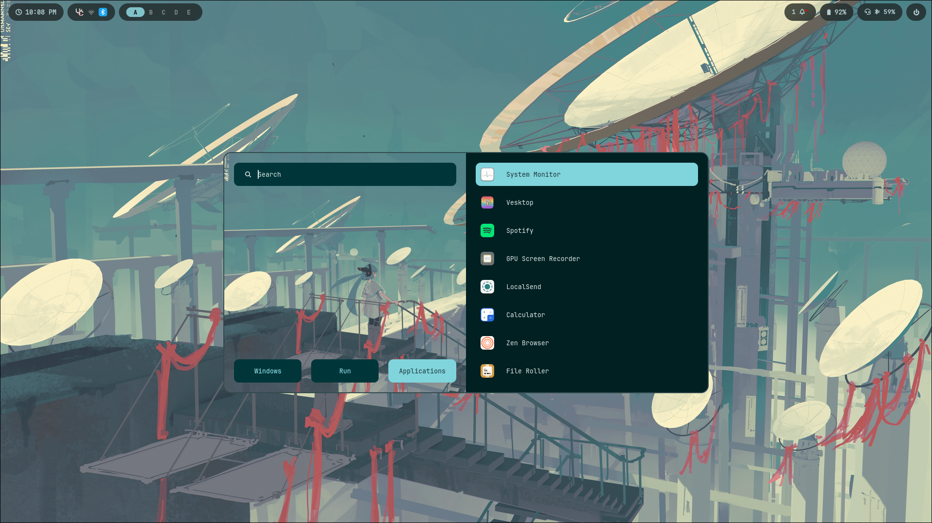
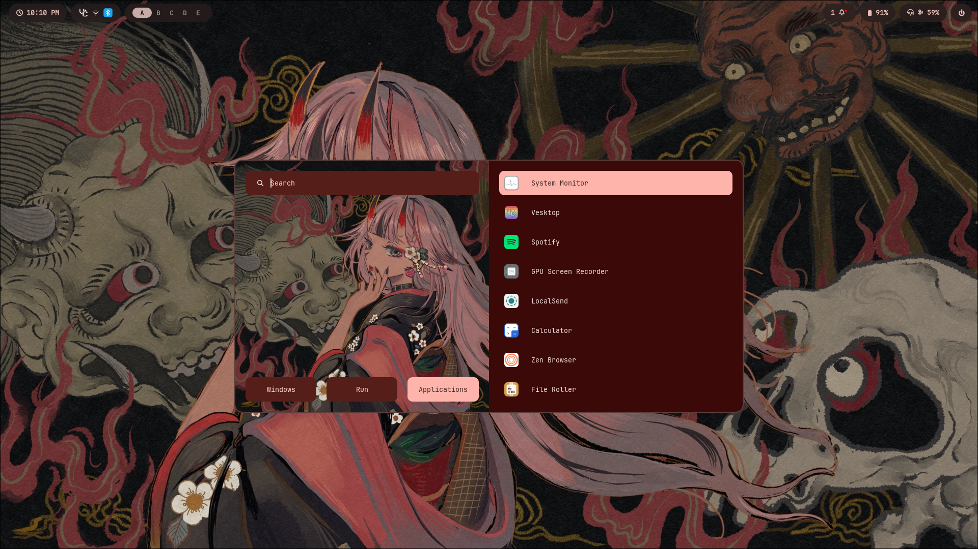
LEVEL 2 · LOOK
What you’re installing (then adapting)
github.com/binnewbs/arch-hyprland · on FW13 Pro, fix eDP scale before judging fonts
Rice Arch on Framework 13 Pro · dark gruvbox
14 / 20

Slide 15
LEVEL 2 · INSTALL
Clone, then Framework-patch
cp -a ~/.config ~/.config.bak.$(date +%F)
git clone https://github.com/binnewbs/arch-hyprland.git ~/arch-hyprland
cd ~/arch-hyprland && cp -r .config/* ~/.config/
mkdir -p ~/Pictures && cp -r wallpapers ~/Pictures/wallpapers
▸ Replace /home/beentang/... paths with your username
▸ Set monitor = eDP-1,2880x1920@120,0x0,<scale> for the 13 Pro panel
▸ Wire brightnessctl into existing keybinds; enroll fprintd
▸ Run wppicker / matugen image after packages are installed
Rice Arch on Framework 13 Pro · dark gruvbox
15 / 20

Slide 16
LEVEL 2 · SECRET SAUCE
Matugen + swww on a laptop
Colors follow wallpaper — great for Gruvbox-ish vibes without hand-editing every CSS file.
1. Pick wallpaper
2. Matugen image
3. Live reload
4. FW13 check
wppicker.sh → Rofi from ~/Pictures/wallpapers
Writes Waybar, Kitty, Hypr, Rofi, GTK…
Hooks restart bar / terminal / hyprctl
Re-check scale + battery modules still show
Rice Arch on Framework 13 Pro · dark gruvbox
16 / 20

Slide 17
PICK A LANE
Level 1 vs Level 2 on Framework 13 Pro
Level 1 · DIY + AI
Level 2 · arch-hyprland
Speed to pretty UI
Slower
Fast — then patch scale
FW13 Pro quirks
You wire them first
Must add after clone
Learning
Highest
Medium
Best when…
You want a signature FW rice
You want this look tonight
Rice Arch on Framework 13 Pro · dark gruvbox
17 / 20

Slide 18
SHIP IT
Framework 13 Pro rice checklist
Display
eDP scale set; external monitor rule ready if you dock
Input
Touchpad tap-to-click; natural scroll preference
Power
power-profiles-daemon or TLP; hypridle on battery
Brightness
Fn keys via brightnessctl (ALS blacklisted if needed)
Fingerprint
fprintd enrolled; works at login / sudo if you want
Firmware
fwupdmgr refresh && fwupdmgr update
Theme
Gruvbox locked OR Matugen regenerates cleanly
Backup
Dotfiles in git — Framework boards get upgraded
Rice Arch on Framework 13 Pro · dark gruvbox
18 / 20

Slide 19
LINKS
Resources
Framework 13 Pro
https://frame.work/laptop13pro
ArchWiki · Framework 13
https://wiki.archlinux.org/title/Framework_Laptop_13
Level 2 rice
https://github.com/binnewbs/arch-hyprland
Hyprland wiki
https://wiki.hyprland.org
Gruvbox
https://github.com/morhetz/gruvbox
Matugen
https://github.com/InioX/matugen
Rice Arch on Framework 13 Pro · dark gruvbox
19 / 20

Slide 20
FRAMEWORK 13 PRO
Pick a level. Rice the laptop.
Level 1 — design with AI until scale, power, and Gruvbox feel native.
Level 2 — start from arch-hyprland, then patch for this Framework.
Open this .pptx in Google Slides: Drive → Open with Google Slides
Rice Arch on Framework 13 Pro · dark gruvbox
20 / 20

