Slide 1
STROKE PREDICTION AND SUPPORT SYSTEM
NAME:NIMROD WAFULA WAMALWA.
REGNO:EBI/56390/21
COURSE:COSC 483

Slide 2
PROBLEM STATEMENT
Stroke remains a significant public health challenge, being one of the leading causes of disability and mortality worldwide. The sudden onset and often severe consequences of stroke necessitate urgent medical attention and can result in long-term physical, cognitive, and emotional impairments. Despite advancements in medical science, the ability to predict and prevent strokes effectively remains limited, posing a critical need for improved methods of risk assessment and early intervention.
Currently, the healthcare system faces several challenges in addressing stroke prevention and management:

Slide 3
PROBLEM STATEMENT
Inadequate Early Prediction
Lack of Emotional and Social Support:
Limited Access to Information:
Data Gaps for Research and Improvement
Concerns About Data Security:

Slide 4
OBJECTIVES
The Stroke Prediction and Support System aims to:
Develop stroke prediction system: Leverage machine learning algorithms to analyze health data and assess an individual's risk of experiencing a stroke.
Provide an Emotional Support Network Through a web Chat Application: Implement a group chat feature where users can share experiences, discuss stroke-related concerns, and receive emotional support from peers.
Develop an Educational Chatbot: Develop an AI-powered chatbot to provide accurate, user-friendly stroke-related information and answer frequently asked questions.
Develop a Medical Data Integration Platform: Facilitate secure data recording by doctors and hospitals for test results and patient histories, contributing to enhanced predictive accuracy and research.
Develop a secure System for medical data: Ensure the confidentiality and integrity of medical records through robust encryption and compliance with healthcare privacy regulations

Slide 5
System Requirements 1.Functional Requirements
Predictive Model
The system collects and analyzes data to predict the likelihood of an individual experiencing a stroke.
It provides personalized risk assessments based on demographic, medical history, lifestyle, and genetic data.
The predictive model updates in real-time with new data inputs.
Group Chat Application
The system includes a group chat application to offer emotional support to users.
It allows users to join support groups.
The chat application enables text communication.

Slide 6
SYSTEM REQUIREMENTS 1.Functional Requirements
Chatbot Integration
The system integrates an AI-driven chatbot capable of answering user questions about stroke.
The chatbot provides educational resources and guidance on stroke prevention and post-stroke care.
It supports natural language processing to understand and respond to user queries accurately.
Data Recording and Management
The system enables doctors and hospitals to record data on individuals tested for stroke risk.
It allows secure access and updating of patient records.
The data management module facilitates easy retrieval and reporting of data for research purposes.

Slide 7
SYSTEM REQUIREMENTS Non-Functional Requirements
Performance
The system handles up to 1,000 concurrent users without performance degradation.
The predictive model generates risk assessments within seconds of data input.
Scalability
The system architecture supports scalability to accommodate increasing amounts of data and users.
It allows easy integration of additional features and modules in the future.

Slide 8
SYSTEM REQUIREMENTS Non-Functional Requirements
Security
The system implements robust encryption protocols (e.g., AES, RSA) to protect sensitive medical data.
Secure authentication mechanisms (e.g., OAuth 2.0, multi-factor authentication) prevent unauthorized access.
The system complies with relevant data protection regulations such as GDPR and HIPAA.
Reliability
The system ensures high availability with minimal downtime, targeting 99.9% uptime.
It includes failover mechanisms and regular data backups to prevent data loss.

Slide 9
SYSTEM REQUIREMENTS Non-Functional Requirements
Usability
The user interface is designed for ease of use, minimizing the learning curve for users.
The system provides clear and concise error messages and support to guide users in case of issues.
Maintainability
The system is designed with modularity to facilitate easy maintenance and updates.
It includes comprehensive documentation for developers and users.

Slide 10
SYSTEM REQUIREMENTS 1.Functional Requirements
User Interface
The system provides intuitive and accessible interfaces for patients, healthcare providers, and administrators.
It includes dashboards for visualizing risk assessments and other relevant information, another for chatbot and for chat application.
The user interface is responsive and user-friendly across different devices.

Slide 11
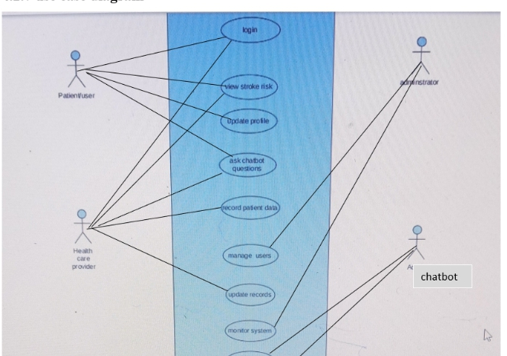
SYSTEM DESIGN use-case diagram

Slide 12
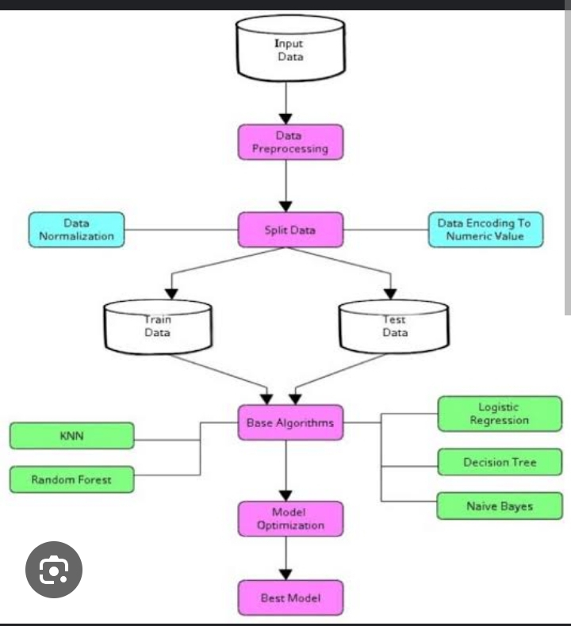
SYSTEM DESIGN Stroke prediction architecture

Slide 13
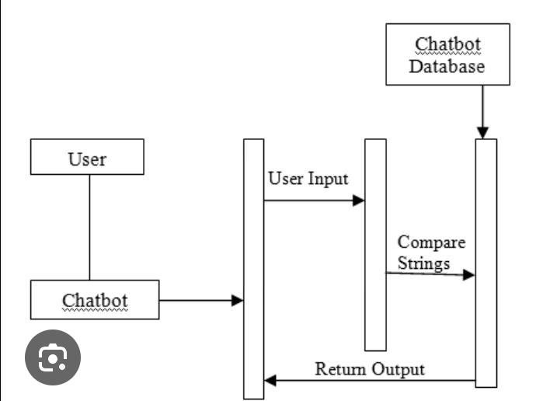
SYSTEM DESIGN Chatbot Architecture

Slide 14
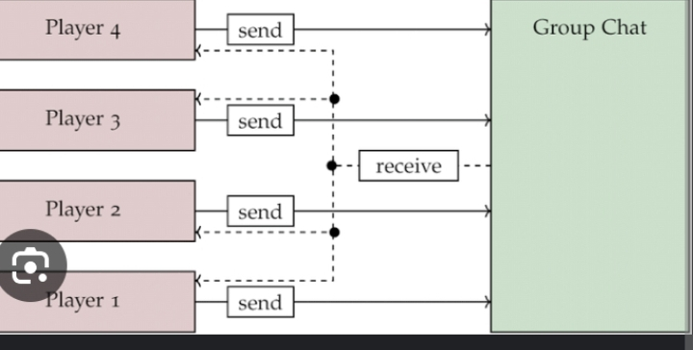
SYSTEM DESIGN Group chat web application Architecture

