Slide 1
ENHANCED RECOVERY AFTER SURGERY (ERAS)
PRESENTER: AMINA NURA YAKASAI
MODERATOR: DR BELLO
DATE: 04/09/2026

Slide 2
OUTLINE
INTRODUCTION
PRINCIPLES
AIMS AND BENEFITS
PREOPERATIVE
INTRAOPERATIVE
POSTOPERATIVE
LIMITATION
CONCLUSION
REFERENCES

Slide 3
INTRODUCTION
Enhanced recovery after surgery (ERAS) is a systematic multimodal perioperative care aimed at reducing the immense surgical stress of the patient and thereby facilitating early recovery.
Shift from reactive to proactive patient management

Slide 4


History
Pioneered by Prof. Kehlet and Wilmore.
ERAS study group ERAS society (2010).
First consensus guidelines
Colorectal surgeries- 2005
Radical cystectomy- 2013
Gynecological & bariatric surgery- 2016

Slide 5
Principles
The patient is a partner in their own care (where possible)
The patient is in the best possible
condition perioperatively.
The patient has the best possible evidence-based management during peri-operative care that minimizes surgical & anaesthetic harm.
The patient experiences the best
possible care and rehabilitation enabling them to return to their normal level of activity as soon as possible.

Slide 6
AIMS OF ERAS
Enhanced recovery is a combination of elements of care for elective surgery which aims to:
• Optimise pre-operative preparation for surgery
• Avoid iatrogenic problems such as postoperative ileus
• Minimise the stress response to surgery
• Speed recovery and return to normal function
• Early recognition of abnormal recovery and intervention if necessary

Slide 7
BENEFITS OF ERAS
Patients
Better experience for patients as they are empowered to be partners in their own care.
Doctors & Staffs
Improved inter-disciplinary working leading to stronger & safer working relationships.
Emphasis on education & training
Value added benefits
Quality of service & productivity is improved
Reduced exposure to hospital associated morbidity.
Early return to normal activity
Improved clinical outcomes.
Increased hospital capacity due to reduction in length of stay
Effective utilization of resources.

Slide 8
ENHANCED RECOVERY PATHWAY
The pathway starts with – the decision to seek surgical opinion and
continues through follow-up of the patient after discharge
Preparing for surgery
Intra-operative
Immediate post-operative
Pre-operative
Late post-operative
Recovery at home

Slide 9
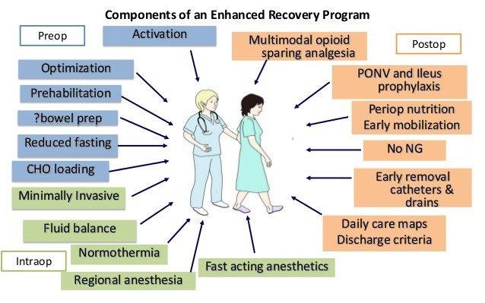

Slide 10
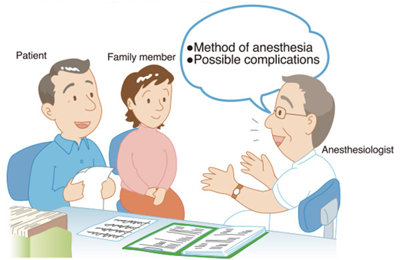
Enhanced recovery pathway
Aims at identifying & managing risk factors and comorbidities.
Patient counselling & involvement in decision making.(Verbal , written pamphlets , on-line websites)
Check understanding of expectations of post-operative recovery. (Joint responsibility)
Correction of nutritional deficiencies (Anemia). In malnourished patients start T/t 7-10 days before and enteral solutions to continue atleast 8 weeks postop.
Exercise Training ,Relaxation strategies , Sleep hygiene
PREHABILITATION
Preparing for surgery
Pre-operative
Intra-operative
Immediate post-operative
Late post-operative
Recovery at home

Slide 11
Cessation of smoking at least 1 month
Reduce the incidence of postoperative pulmonary complication
Cessation of alcohol intake at least 1 month
Reduce postoperative complications (Bleeding, wound infection)
Preparing for surgery
Pre-operative
Intra-operative
Immediate post-operative
Late post-operative
Recovery at home

Slide 12


Fasting guideline (NPO time)
Solid food : up to 6 hours before induction of anesthesia
Clear liquid : up to 2 hours before induction of anesthesia-
Helps to prevent the catabolic sate
Carbohydrate loading-
Oral complex carbohydrates (maltodextrin) with high concentration (12.5%)
100 gm (800 ml) administered the night before surgery
50 gm (400 ml) 2-3 hours before induction of anesthesia- Lessen the discomfort and anxiety ,maintain lean body mass and muscle strength , accelerate return of bowel function , reduce insulin resistance
Selective mechanical bowel preparation
Side effects-
Dehydration
Electrolyte disturbances
Unpleasant for the patient
PAC
Pre-operative
Intra-operative
Immediate post-operative
Late post-operative
Recovery at home

Slide 13
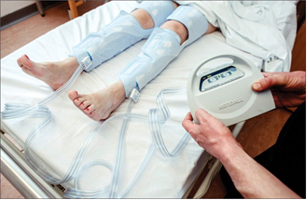
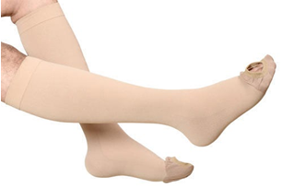
Thromboprophylaxis : significant morbidity and mortality.
Prophylaxis-
Mechanical devices : compressive stocking, intermittent pneumatic compression devices
Anticoagulants : LMWH, unfragmented heparin
Preparing for surgery
Pre-operative
Intra-operative
Immediate post-operative
Late post-operative
Recovery at home

Slide 14
Premedicant as per the requirement-
Aim is to reduce surgical stress response.
Without any sedative properties (or short acting)
To allay Pain- Acetaminophen , NSAIDs , Gabapentanoids , Dexamethasone
Shorter acting pre-medications .(α2 agonists , Beta blockers)- improve pain relief , anticatabolic, reduce blood loss and PONV.
Avoid Hyperglycaemia
Hypermetabolic stress response
Risk of infection and Cardiovascular morbidity
Avoid Hypoglycemia.
Preparing for surgery
Pre-operative
Intra-operative
Immediate post-operative
Late post-operative
Recovery at home

Slide 15

Antibiotic prophylaxis
A single dose of antibiotic covering both aerobes and anaerobes is recommended for infection prophylaxis.( Local Guidelines)
Administered just before the surgical incision(30-60 minutes before).
A second dose is administered for procedures lasting > 4 hrs or blood loss > 1500 ml
Use of chlorohexidine alcohol skin wipes pre-incision , bowel preparation with antibiotics , glove/instrument change as well as antibiotic irrigation prior to closure
SSI’s 34%
Improves immune function and reduces inflammatory markers.
Preparing for surgery
Pre-operative
Intra-operative
Immediate post-operative
Late post-operative
Recovery at home

Slide 16
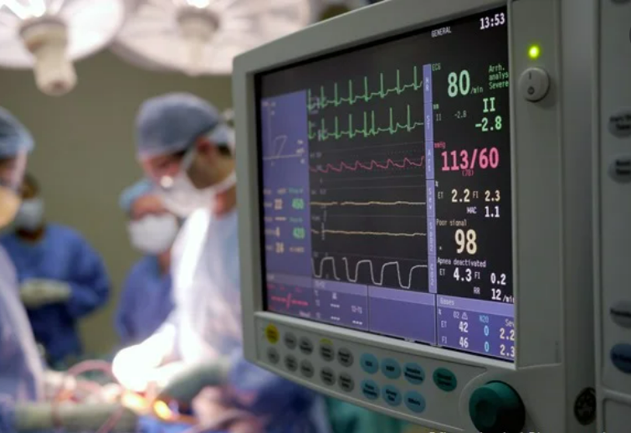
Fluid management plan
Pain management plan
Minimizing risk of PONV and hypothermia
Minimize complications
Minimize use of drains
Preparing for surgery
Pre-operative
Intra-operative
Immediate post-operative
Late post-operative
Recovery at home

Slide 17
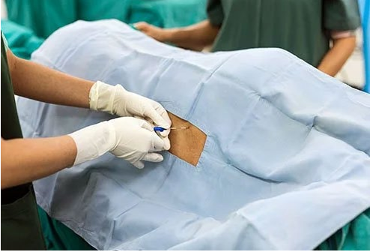
Pre-emptive analgesia- Modify nociception and maximize physiological and pharmacological benefits to promote quick recovery.
Titration of the inspired fractional concentration of oxygen to maintain PaO2 level ( Avoid hyperoxia)
Lung protective mechanical ventilation.
Reducing levels of volatile anesthetics(0.7-1.3MAC) (Monitoring the depth BIS 40-60 , End tidal concentration of anesthetics)
Avoid Nitrous Oxide( PONV, Accumulates in third cavities , increases thrombotic morbidity)
Short and Medium acting neuromuscular agent
Use of Anaesthetic drugs with minimal
post-operative hangover
effect on gastric motility.
Preparing for surgery
Pre-operative
Intra-operative
Immediate post-operative
Late post-operative
Recovery at home

Slide 18
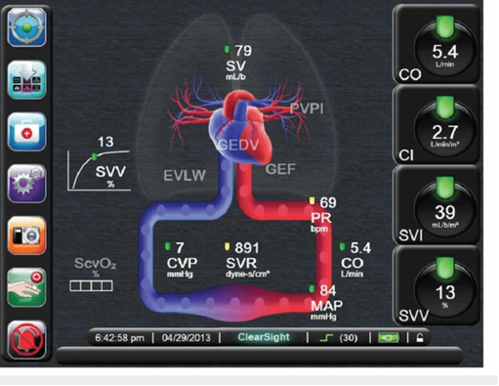
INTRAVASCULAR STATUS-
Optimize fluid M/M-
Maintain central euvolemia (Avoid interstitium shift)
Minimize salt & water excess.(Vasopressors to be used)
Balanced crystalloids are recommended.
Approach to fluid M/M-( Return of bowel function ,lowers urinary tract infections and SSIs)
Zero-balance fluid therapy –
Low risk patient undergoing low risk surgery.
1-3ml/kg/hr of balanced salt solution (maintain preop body weight, > 2.5kg)
Goal-directed fluid therapy (GDFT)-
Using minimally invasive cardiac output monitor, esophageal doppler
Judicious use of colloids
High risk patient, patient undergoing surgery with large intravascular volume loss
Inotropes if Cardiac index< 2.5l/min)
Preparing for surgery
Pre-operative
Intra-operative
Immediate post-operative
Late post-operative
Recovery at home

Slide 19
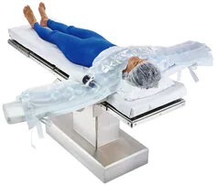
Hypothermia –Avoid
Delayed wound healing , increase infection , increase blood loss, increase cortisol levels , increased oxygen consumption , extends action of anesthetic drugs
Use of active warming devices in all cases lasting > 30 mins (Under GA the core temp.<0.5-1.5 ˚C )
Forced air warming systems
Warmed IV solution , Warmed irrigated solution
Avoid shivering by using pethidine 0.25-0.5 mg/kg, , tramadol, clonidine, dextomidn, magnesium sulphate.
Preparing for surgery
Pre-operative
Intra-operative
Immediate post-operative
Late post-operative
Recovery at home

Slide 20
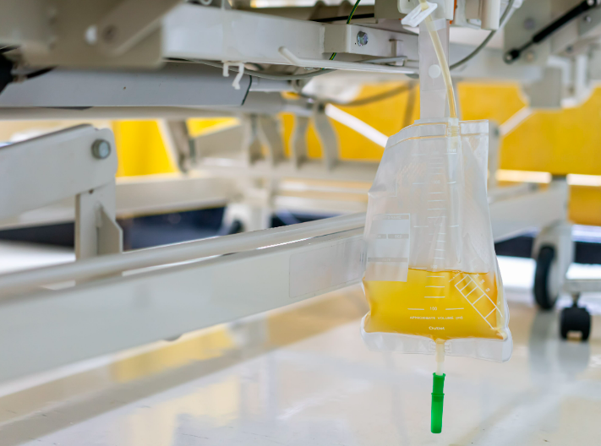
Minimize use of surgical drains and catheters
Nasogastric tube- prolonging paralytic ileus , predisposing to pulmonary aspiration.
Urinary catheters- are to be removed as early as possible irrespective of epidural catheter
• Lower abdominal-pelvic surgeries : within 72 hrs of surgery
• Most of the other surgeries : within 24 hrs
( Increase in CAUTI risk by 5% per day)
Preparing for surgery
Pre-operative
Intra-operative
Immediate post-operative
Late post-operative
Recovery at home

Slide 21

Early and Adequate nutrition- Decreased ileus , enhance wound healing,reduce infection,maintain muscle strength.
Early enteral nutrition
Return to normal fluids and diets as soon as tolerated.(Maintain hydration)
Discontinue IV fluids when drinking.(1.5l/day)
High protein diet(>50% of protein/kcal)
Benefit of immunonutrition - arginine, glutamine, omega-3 fatty acids and nucleotides.
Preparing for surgery
Pre-operative
Intra-operative
Immediate post-operative
Post-operative
Recovery at home

Slide 22
Early mobility-
Patient empowerment(written target,preop physical activity, record keeping)
Reduce skeletal muscle loss
Improve respiratory function
Decrease in pulmonary and thromboembolic complications.
Sit out of bed for 2 hours on the day of surgery and 6 hours a day until D/C.
Daily procedure specific goal.
Physiotherapy and rehabilitation is vital to help.
Discharge, when criteria met.
Preparing for surgery
Pre-operative
Intra-operative
Immediate post-operative
Post-operative
Recovery at home

Slide 23
LIMITATIONS
FEAR OF COMPLICATIONS ( Eg. Aspiration risk)
LOGISTIC ISSUES
ILLITERACY
INABILITY TO RECOGNISE EARLY WARNING SIGNS
LACK OF TRAINED PERSONNEL
POOR TELECOMMUNICTAIONS
LACK OF COORDINATION AMONG MULTISPECIALITY
INFRASCTRUCTURE RELATED ISSUE

Slide 24
CONCLUSION
The application of ERAS has certainly changed the perioperative practice to have a smoother ride for the patients throughout the perioperative period of stress.
ERAS is simply a careful coordinated multidisciplinary approach, adherence to which has better clinical outcome.
In patients undergoing craniotomy considerations such as techniques for scalp blocks, non‑opioid alternatives for pain control and improved outcomes with minimally invasive surgery are little different from the traditional ERAS concept.

Slide 25
REFERENCE
Moningi, Srilata et al. “Enhanced recovery after surgery: An anesthesiologist's perspective.” Journal of anaesthesiology, clinical pharmacology vol. 35,Suppl 1 (2019): S5-S13
Feldheiser A, Aziz O, Baldini G, et al. Enhanced Recovery After Surgery (ERAS) for gastrointestinal surgery, part 2: consensus statement for anaesthesia practice. Acta Anaesthesiol Scand. 2016;60(3):289-334
About [Internet]. ERAS® Society. [cited 2022 Oct 2]. Available from: https://erassociety.org/about/
History [Internet]. ERAS® Society. [cited 2022 Oct 2]. Available from: https://erassociety.org/about/history/

