Slide 1

Funding in Startups
Data analysis

Slide 2
Title and Introduction
Title
Introduction
Startup Funding Analysis: Insights, Trends, and Strategic Recommendations
In the dynamic world of startups, funding plays a pivotal role in driving innovation, scaling businesses, and shaping industry trends. This analysis delves into the patterns of startup funding across different regions, sectors, and funding types.
The objective of this study is to uncover key insights into:
Funding Distribution: Examining how resources are allocated across geographies and industries.
Trends Over Time: Identifying emerging markets and sectors.
Performance Metrics: Understanding the impact of funding on startup growth and sustainability.
By leveraging comprehensive data and visualization tools, this analysis aims to provide actionable recommendations for investors, policymakers, and entrepreneurs looking to navigate the competitive startup ecosystem effectively.

Slide 3
Data Overview & Key Insights
Data Overview:
Key Insights:
The dataset includes funding data for over 49,000 startups across 100+ countries. Key variables include funding amount, sector, funding round, startup status, and country of origin, covering a period from 1960 to 2014.
1. Funding Trends by Country.
2. Sector-Specific Investment Growth.
3. Funding Rounds and Startup Growth.
4. Startup Status Distribution.

Slide 4
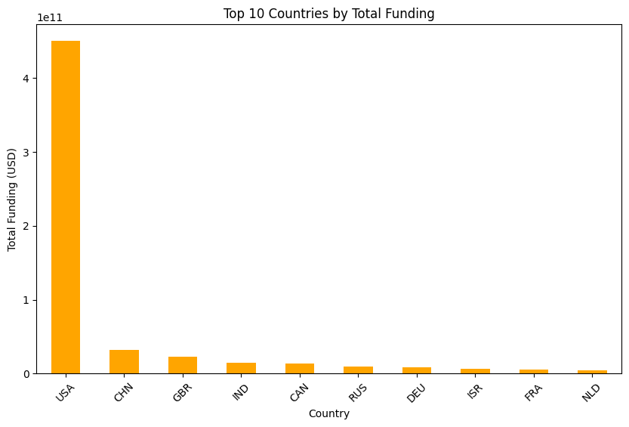
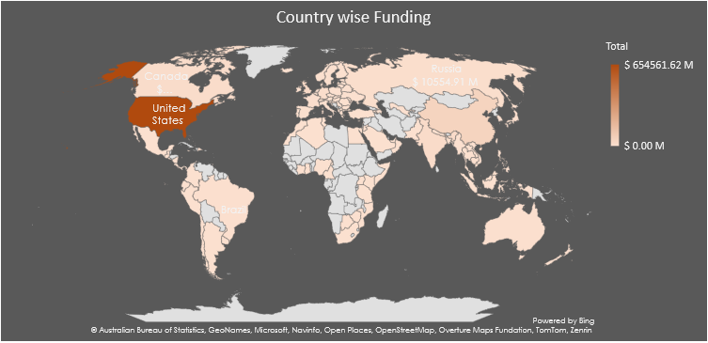
Detailed Key Insights
Funding Trends by Country :
The USA leads in total funding, contributing over $450 billion, followed by China ($32 billion) and the UK ($22 billion).
This indicates that developed markets, especially the USA, continue to dominate the startup funding landscape, with emerging markets like China gaining significant traction.

Slide 5
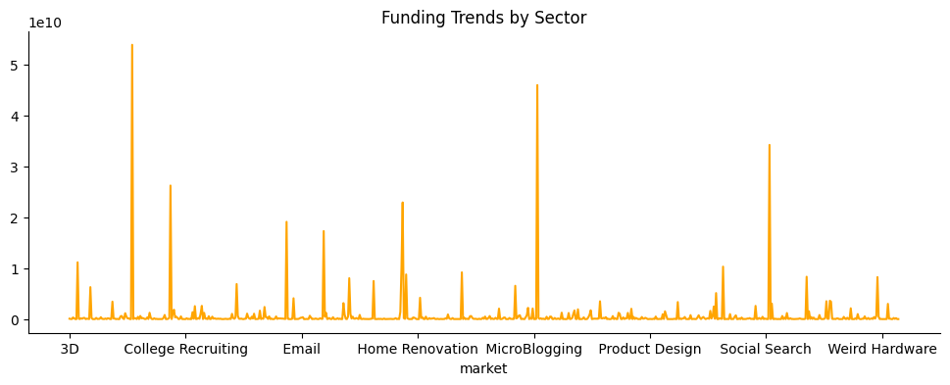
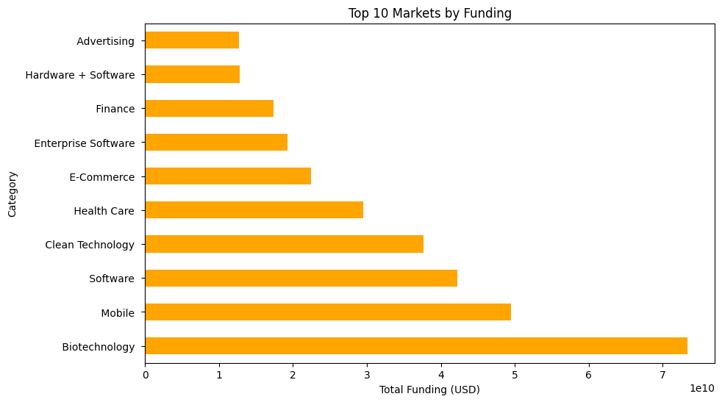
Detailed Key Insights
Sector-Specific Investment Growth:
The tech sector continues to receive the highest share of funding, with notable spikes in funding from 2010 onwards
Tech startups, particularly in software, AI, and fintech, have attracted significant investment. Investors should consider focusing on emerging tech startups in these sectors.

Slide 6
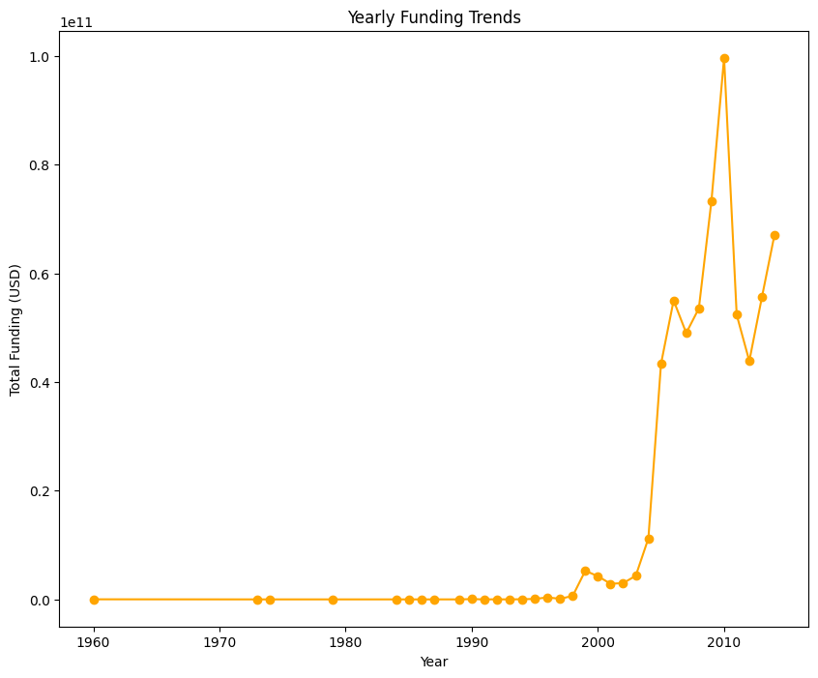
Detailed Key Insights
Funding Rounds and Startup Growth:
Startups receiving Series A funding have higher success rates in terms of long-term funding, with a sharp increase in Series A rounds from 2010 onward.
Series A funding serves as a key indicator of startup maturity and investor confidence. This data highlights the importance of early-stage investment in high-potential startups.

Slide 7
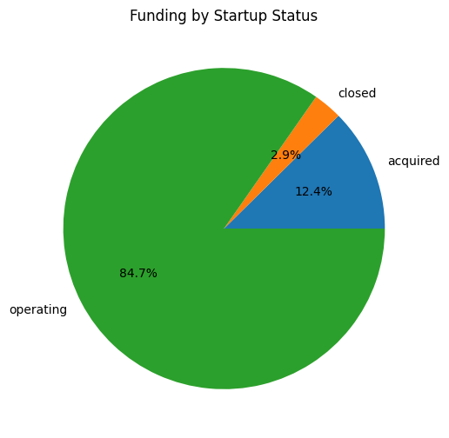
Detailed Key Insights
Startup Status Distribution :-
A large portion of startups are operational (over 84.7%), indicating a healthy startup ecosystem. However, a notable number are closed (around 2.9%).
Operational startups represent ongoing investment opportunities, but it's important to account for the risks of failure or closure, especially in volatile markets.

Slide 8
Insights & Recommendations
Insights :-
Based on the analysis of above data, below points identified:
By Focusing on operational startups their significant share of funding suggests investors prioritize ongoing ventures.
By Monitoring acquisition trends highlight successful exits and market consolidation opportunities.
By Minimizing exposure to closed startups, The low proportion of funding here signals reduced risk, though it's important to further analyze why some startups fail.
The venture capital market was still developing, with relatively few large investments. Funding trends reflect the nascent state of the startup ecosystem during this period.
The late 1990s saw an unprecedented surge in funding during the dot-com boom. Investors were eager to fund technology and internet-based startups, leading to massive capital inflows.
This period (2001–2009) reflects market adjustment and stabilization, with steady but cautious investments.
This period (2010–2014) marks the maturation of the startup ecosystem, with increasing capital availability and investor confidence.
While the USA remains the epicenter of global funding, other countries, particularly China, UK, and India, show a growing share.
Known as the "Startup Nation," Israel’s funding reflects its focus on cybersecurity, AI, and defense technologies.
Germany and France stand out as hubs for automotive tech, clean energy, and AI.
USA startups received $450.29 billion, significantly higher than any other country, accounting for a majority share.
Recommendations :-
For Investors :-
Prioritize Investments in the USA:
With $450.29 billion in funding, the USA dominates global startup ecosystems.
Sectors like technology (AI, SaaS), fintech, and life sciences are particularly promising.
Venture opportunities in emerging markets within the USA (e.g., Midwest, South) could yield high returns.
Capitalize on China's Growth:
China is the second-largest recipient of funding, with $32.08 billion.
Focus on sectors like e-commerce, fintech, and green energy, where China's market is rapidly expanding.
Be mindful of regulatory changes and government influence in the startup ecosystem.
Explore European Startups:
The UK ( 22.77billion),Germany( 7.99 billion), France ( 5.05billion),and the Netherlands( 4.02 billion) demonstrate strong ecosystems.
Invest in clean energy, AI, and advanced manufacturing, areas where European startups excel.
Leverage the European Union's favorable policies for cross-border investments.
For Entrepreneurs :-
Leverage Regional Strengths:
Startups in the USA and China should capitalize on their respective innovation hubs and large consumer bases.
European startups should focus on sustainability, clean energy, and advanced technology sectors to attract funding.
Position for Global Investors:
Entrepreneurs in smaller ecosystems (e.g., Israel, Canada) should emphasize scalability and global market potential to attract international investors.
Adapt to Market Dynamics:
In China and India, entrepreneurs should tailor their offerings to local consumer needs and navigate regulatory landscapes effectively.

Slide 9


THE END

