Slide 1
RPART Political Party Prediction
By: Tanvi Wagle

Slide 2
Basic Idea
I did the summary command and played around with some “freestyle” predictors”, but the rpart was easier to get a better accuracy for the training data.
I tried the “Brute force” method to see what combination of parameters would result in the least rpart error.

Slide 3
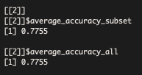
RPART WITHOUT CONTROLS
DEFAULT VALUES:
MINSPLIT = 20,
minbucket = round(minsplit/3)
cp = 0.01
AVERAGE ACCURACY SUBSET AND AVERAGE ACCURACY ALL WERE LOW.

Slide 4

RPART WITH ALL CONTROLS SET TO ZERO
SETTING MINSPLIT, MINBUCKET AND CP TO ZERO RESULTED IN A MUCH BETTER ACCURACY SUSBET.
THE SUBSET ACCURACY WAS GREATER THAN THE ALL ACCURACY WHICH MEANS THE CHANCE FOR OVERFITTING IS LOW.

Slide 5


PERFECT SET OF CONTROLS
WITH MULTPLE FOR LOOPS, I BEGAN FORMING PATTERNS FOR THE BEST SET OF CONTROLS
KEEPING CP AND MINBUCKET CONSTANT, I TRIED DIFFERENT VALUES OF MINSPLIT AND FOUND THAT BETWEEN 1 AND 9 THE ACCURACY SUBSET WAS ABOUT 96% AND THE BEST ACCURACY CAME WHEN MINSPLIT = 2
I FOLLOWED THE SAME TECHNIQUE FOR MINBUCKET AND MINBUCKET PERFECT CONTROL WAS = 0.
HOPEFULLY THE RISK OF OVERFITTING THE DATA IS LOW, BECAUSE THE SUSBET ACCURACY > ALL ACCURACY
I USED SAM’S ADVICE FROM LAST PRESENTATION TO SET CP = 0.0001.

Slide 6
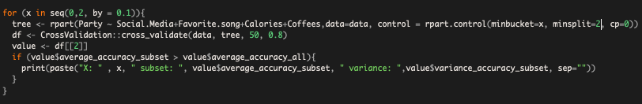
CODE: FOR LOOPS AND IF STATEMENTS

