Slide 1
The Human Freedom Index
Data measuring the relative freedom of 169 countries to each other
By: Tanvi Wagle

Slide 2
The Data
Source of Data: Kaggle
This data contains 169 countries with rankings from 2008 to 2016
Using factors such as freedom of speech and religion, crime and violence, access to money, the data ranks the human, economic and personal freedom of the countries.
Examples of the Columns:
pf_ss_disappearances = terrorism fatalities
pf_rank = personal freedom rank
Ef_trade = freedom to trade internationally
Ef_rank = economic freedom rank

Slide 3
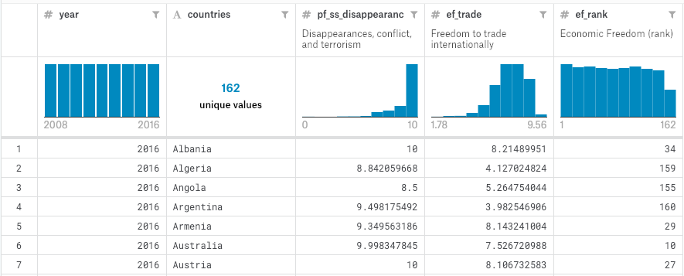
Data Snapshot

Slide 4
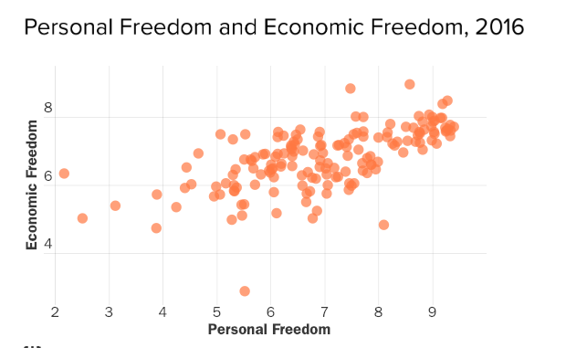
Possible Interesting Plots
Scatterplots:
The personal freedom rank of a country over time
Economic Freedom rank vs Personal Freedom rank vs Human Freedom rank

Slide 5
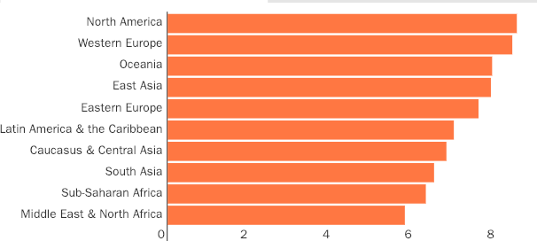
Possible Interesting Plots
Bar Graphs:
Human Freedom by Region
Human Freedom by Income

Slide 6
What interesting questions could the data answer?
Although an abstract concept, HFI provides a standardized method of ranking countries and helps answer many questions:
How effective have policies/politics in the country been in increasing personal freedom of the people?
Do the foreign policies of countries like the Unites States actually impact the freedom of the people in other countries?
What factors significantly impacts human freedom?
Is there a correlation between democracy and human freedom?
Do countries need to have a democracy to have a high HFI?

