Slide 1
W.H.O. Suicide Statistics
By Tanvi Wagle

Slide 2
About The Data
Source: https://www.kaggle.com/szamil/who-suicide-statistics
WHO = A world health organization that collects data regarding international public health
What does it contain?
Country
Year
Gender
Age Group
Number of Suicides

Slide 3
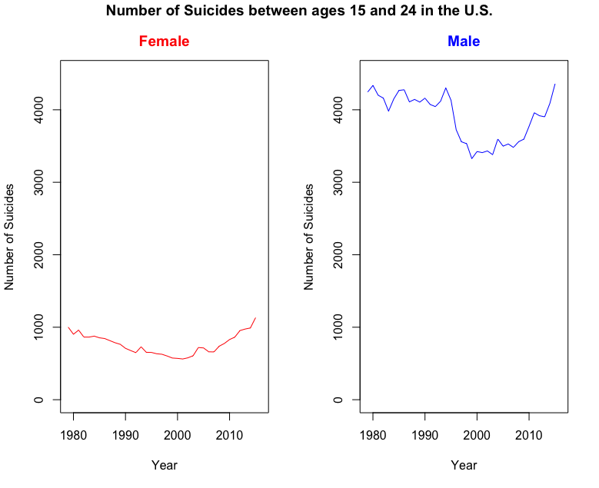
plot(unitedStatesFemale$year,unitedStatesFemale$suicides_no, type="l", xlab = "Year", ylab = "Number of Suicides", col="red", ylim = range(c(0,4500)))
plot(unitedStatesFemale$year,unitedStatesMale$suicides_no, type="l", col="blue", xlab = "Year", ylab = "Number of Suicides", ylim = range(c(0,4500)) )
Key Observation:
Male number of suicides is significantly greater than Female suicides.

Slide 4
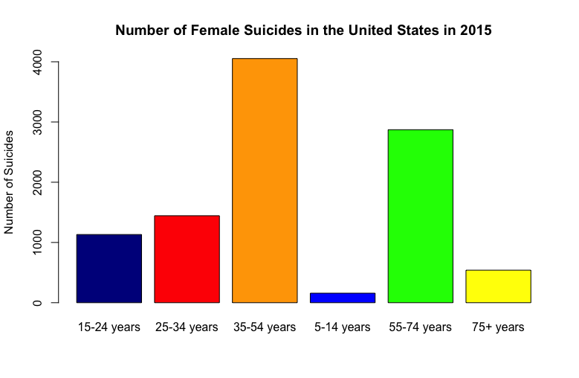
barplot(unitedStatesAgeFemale$suicides_no, names.arg = c("15-24 years", "25-34 years","35-54 years", "5-14 years", "55-74 years", "75+ years"), col=c("darkblue","red", "orange", "blue", "green", "yellow"), main= "Number of Female Suicides in the United States in 2015", ylab = "Number of Suicides")
Key Observations:
Middle Aged People (35-54 years) have the largest suicide numbers
Children and elderly have the smallest suicide numbers

Slide 5
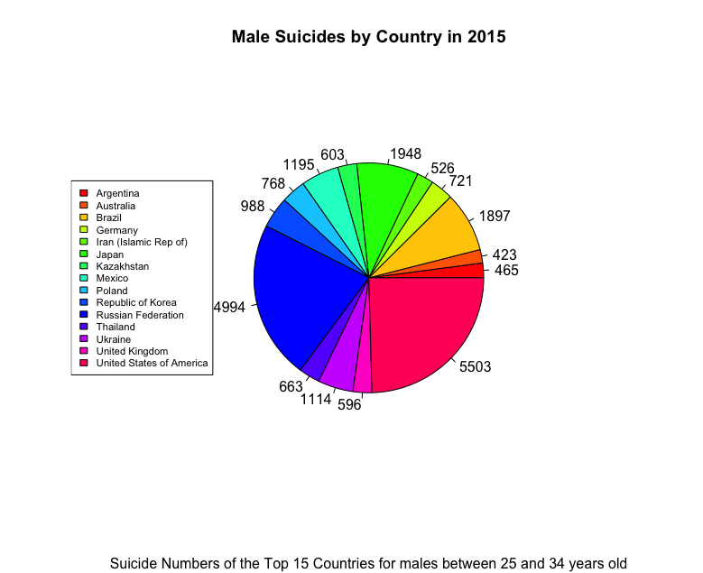
pie(year2015$suicides_no, labels = label, col = rainbow(length(year2015$suicides_no)), main = "Male Suicides by Country in 2015", sub = "Suicide Numbers of the Top 15 Countries for males between 25 and 34 years old")
Key Observations:
United States has the largest number of suicides.
Russian Federation, Japan and Brazil have large suicide numbers

Slide 6
Why is this data Important/Interesting?
Suicide prevention is a major issue in the health industry.
This data can assist in suicide prevention.
Knowing the age group for the largest amount of suicides, prevention specialists can direct their efforts more effectively
The graph that show shows number of suicides over time can help specialists determine if suicide prevention strategies have been more effective.
This data can also highlight different areas of research in the future.
Why is the United States where the largest amount of suicides occur?
Why is suicide more prevalent in middle aged people?

