Slide 1

Uncovering the Secret Behind Professor Moody’s Grading
Analysis By: Tanvi Wagle

Slide 2
OVErview: A TA’s General ADVIce
Your score is the most important factor in determining your grade
ALWAYS asking questions lowers your grade
FREQUENTLY go on your smartphone
Do not NEVER go on your smartphone
Do not ALWAYS leave early
Coming late to class does not affect your grade significantly.

Slide 3
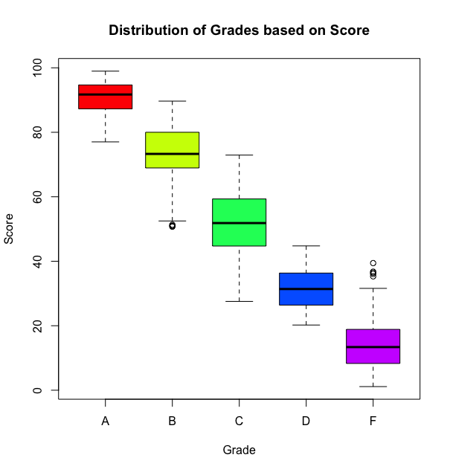

Score Significantly Affects Grade
boxplot(moody2019$SCORE~moody2019$GRADE, main="Distribution of Grades based on Score", xlab="Grade", ylab="Score", col=rainbow(5))

Slide 4
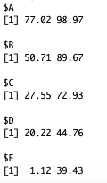
RAnGE OF SCORES FOR EACH GRADE
range <- tapply(moody2019$SCORE, moody2019$GRADE, range)
Observations:
Absolutes:
If you get a score > 89.67 you get an A
If you get a score between 72.93 to 89.67 you get an B
If you get a score between 44.76 to 72.93 you get an C
If you get a score < 20.22 you get an F
Uncertainties:
There is an OVERLAP in the ranges of the scores which means a person with a higher score can get a lower grade. For example: If a student gets between a 77.02 and 89.67 they can get either an A or a B.
How is this possible?
Professor Moody uses other information in addition to the score to determine the grade.

Slide 5
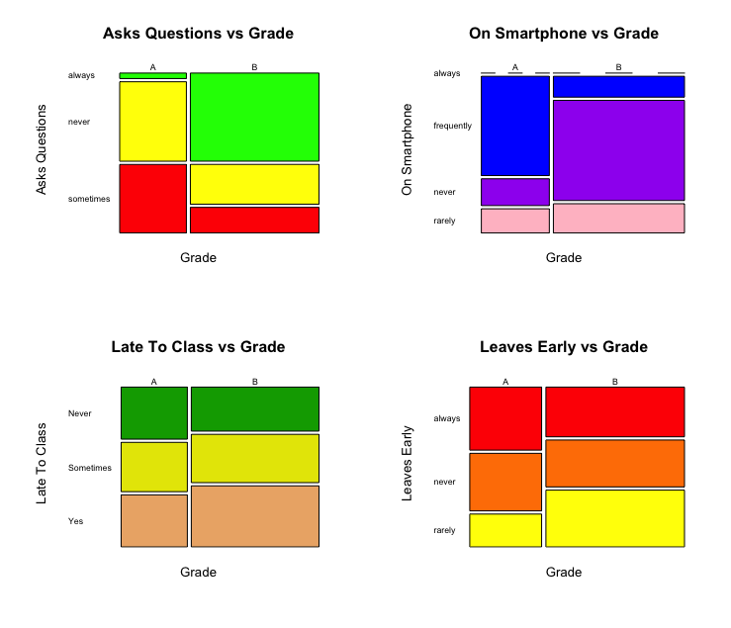

Categorical Data Comparison For A-B Range
Mosaic Plots help show the relationship between two categorical variables.
Between 77.02 and 89.67, the grade can be A or B.
I plotted the data for the uncertain range to see which variable had effects on which grade was assigned.
Predictions:
If you have a score between 77.02 and 89.67…
If you are “sometimes” or ”never” asking questions you are more likely to get an A.
If you are “frequently” on your smartphone you are more likely to get an A. If you are “never” on your smartphone you are more likely to get an B.
You can repeat this process for the other uncertain grade ranges to determine whether the grade is a B or C, C or D or F etc.
Asks Questions and On Smartphone are the categorical variables that have significant frequency differences between getting an A vs B.

Slide 6
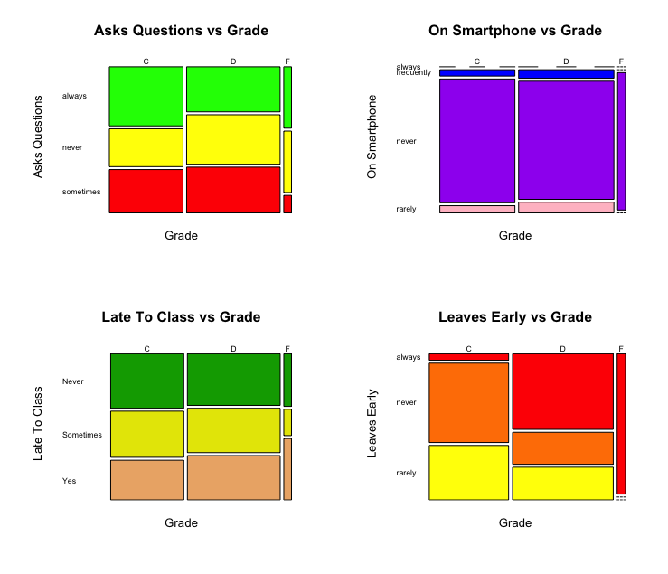

Categorical Data Comparison For C,D,F Range
overlapCDF <- moody2019[moody2019$SCORE >= 20.22 & moody2019$SCORE <= 44.76,]
Between 20.22 and 44.76, the grade can be C,D,F.
The large frequency of ”never” in C,D,F supports the conclusion that “never” being on smartphone reduces grade.
We can also deduce that “always” leaving early can also reduce grade.
Being late to class does not affect grade much.
Leaves Early is the categorical variable that has significant frequency differences between getting an C,D,F

Slide 7
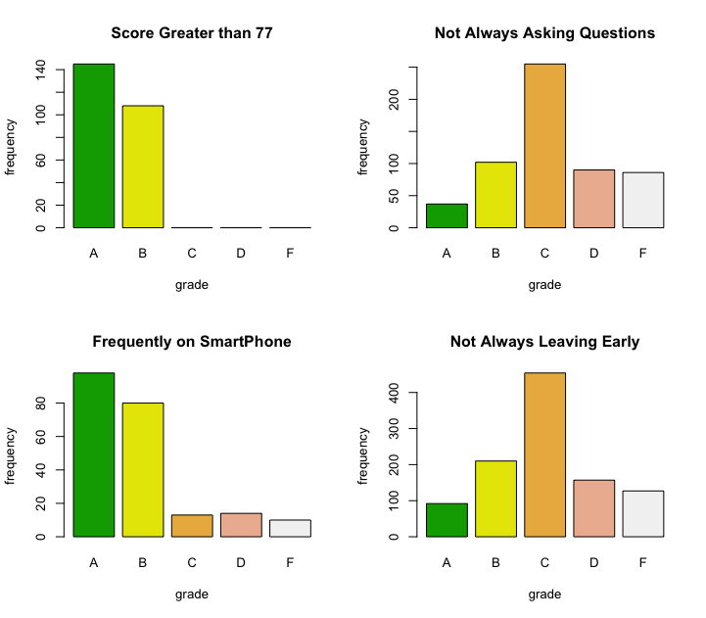
Seeing THOSE OBSERVATIONS on ALL GRADES…
A Score Greater than 77 and being Frequently on Smartphone has the largest effect on getting an A.
On the other hand, Not Always Asking Questions and Not Always Leaving Early does not have that much effect on getting an A.
Therefore, the right categorical variables are probably used to determine the grade when the score is in an uncertain range.
E.g. might help determine an A vs B.

Slide 8
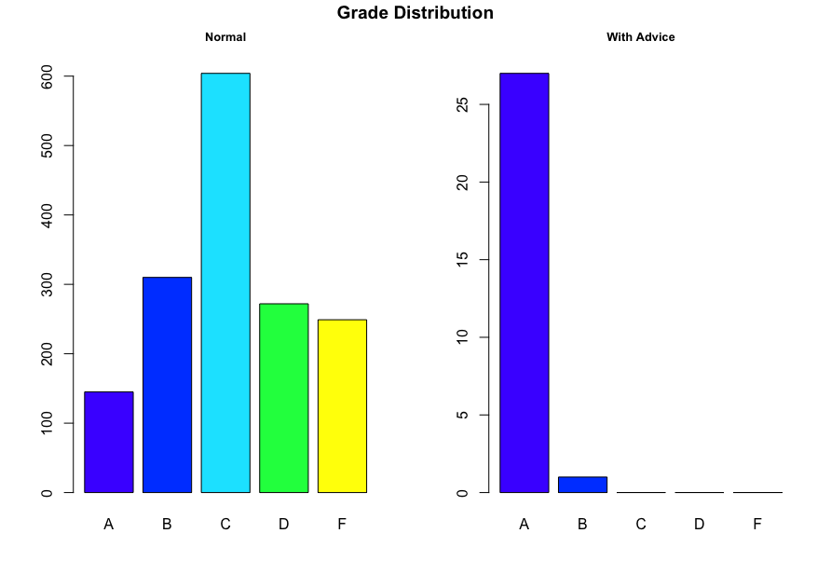
GUIDE TO GETTING AN A: (in order of Importance)
Get a Score Greater than 77
Frequently go on your smartphone
Do not always ask questions
Do not always leave early
All <- moody2019[moody2019$asks_questions != "always" & moody2019$on_smartphone == "frequently" & moody2019$leaves_early == "always" & moody2019$score > 77 ,]

