Slide 1

Census Data Patterns
By: Tanvi Wagle

Slide 2
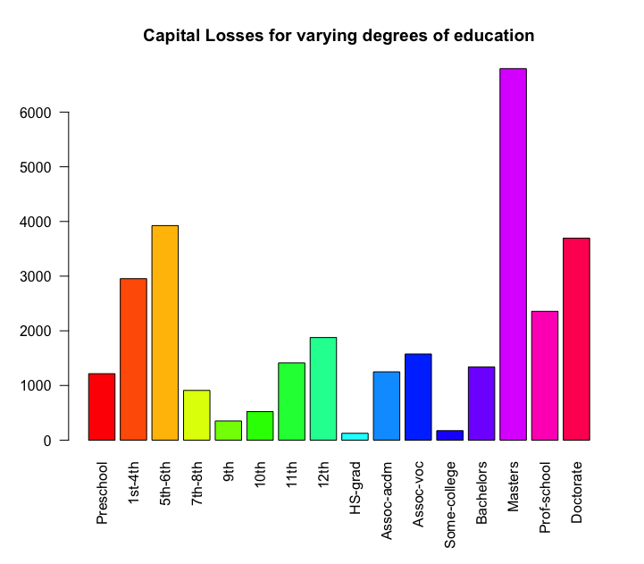
HYPOTHESIS:
Mean of Capital Loss of People with Master’s Degrees > Mean of Capital Loss of People with High School Degrees
average <- tapply(census$CAPITALLOSS,census$EDUCATION,mean)
barplot(average, las=2, col=rainbow(16), main="Capital Losses for varying degrees of education")

Slide 3
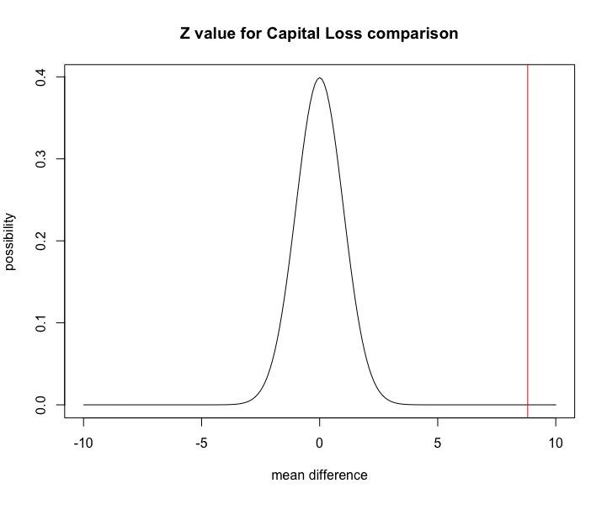
Z Score = 8.81 P value = 0
We can conclude that this a reasonable hypothesis because the p value is less than 0.05.

Slide 4

Why is this Interesting?
The results of the data are counterintuitive! Generally, many would think that with higher education degrees like a Master’s degree a person would be able to handle money more effectively. With more knowledge, losses would be less.
However, as the hypothesis states, we found that a person with a master’s degree has significantly more capital loss than a person with a high school degree.
I considered that the results could be because of a possible large discrepancy between the amount of data of high school students vs master students. However, the lengths of the capital loss data is similar.
Also, the p-value for this hypothesis is ZERO. Therefore, the correlation has a high degree of certainty.

Slide 5
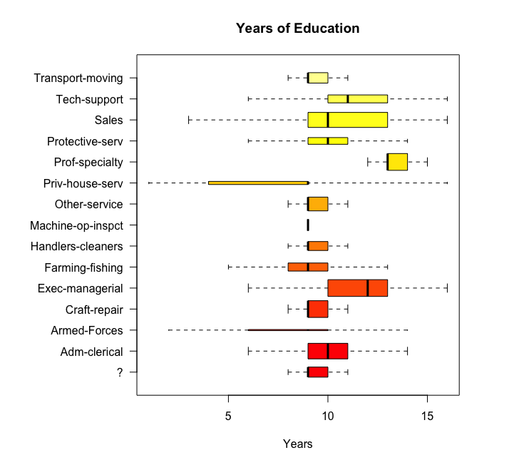
HYPOTHESIS:
Mean years of Education for an Exec-Managerial Position > Mean years of education for a Tech-support position
boxplot(census$YEARS~census$PROFESSION, horizontal = TRUE, las=1, varwidth=TRUE, outline=FALSE, cex=0.8, col=heat.colors(16), main="Years of Education", xlab="Years")

Slide 6
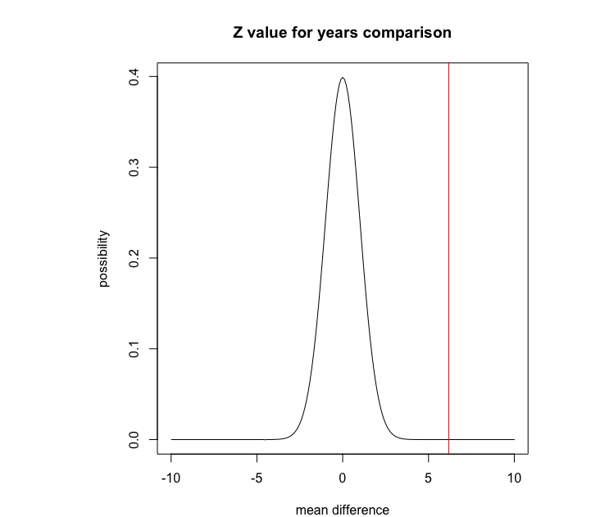
Z Score = 6.18 P value = 3.19*10⁻¹⁰
We can conclude that this a reasonable hypothesis because the p value is less than 0.05.

Slide 7
Why is this Actionable?
This conclusion seems reasonable as the more education you receive the better job you are able to get.
This specific conclusion can be used for students who do not want to pursue many years of education and therefore go into tech support instead of a managing position. On the other hand, students who would managing position should get more years of education.

