Slide 1
Gun control is Effective …and here is the data to support it
By: Tanvi Wagle

Slide 2
Let us see how Gun Control has Affected robberies…
The data Includes:
Type of weapon
Monetary Damage
Gun Laws
Moon Phase
Weather

Slide 3
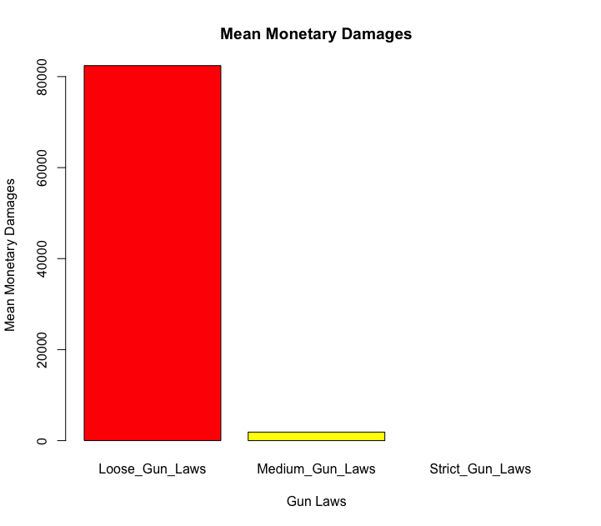

Observation: The mean Monetary Damages in Loose Gun Control Areas are greater than Mean Monetary Damages in Medium Gun Control States

Slide 4
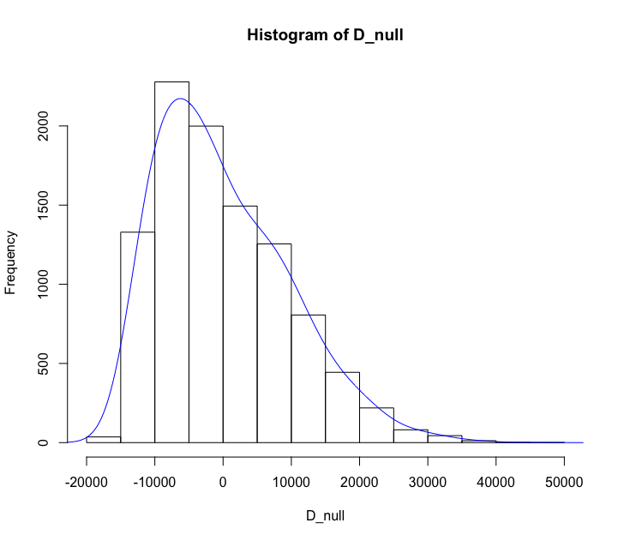
Permutation Test and P-Value
Null Hypothesis: There is no difference between the means of areas with Medium Gun Laws vs. Loose Gun Laws
P VALUE = 0
Therefore, we reject the null hypothesis.
This data indicates that monetary damages is significantly less in states with medium gun control laws. This means that gun control has been effective as it has reduced monetary damages.

Slide 5
Opponents who say Gun Control is not effective Claim…
Opponents could claim that there is a stronger correlation that weather affects monetary damages.
Clearly, some weather such as a Lightning Storm does have an effect on monetary damages. It is also possible that the weather in medium gun controlled areas is different than loose gun controlled states.

Slide 6
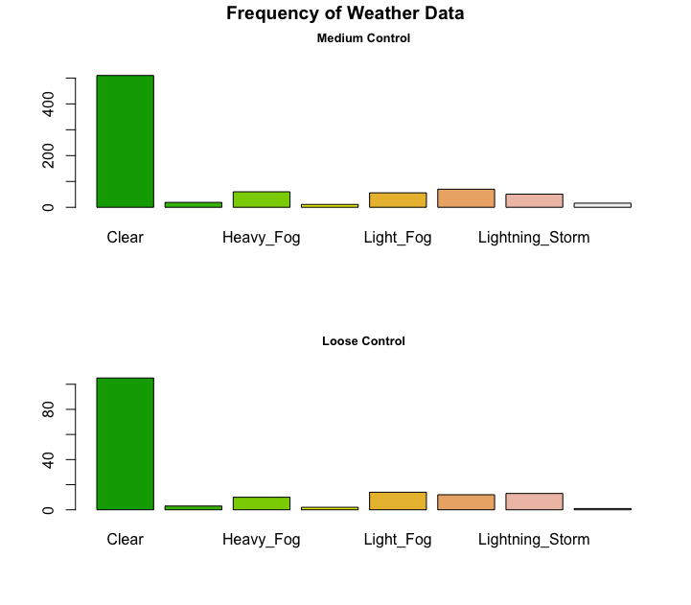
Rebuttal Part 1
The frequency of data points for each sub sample (medium gun control, loose gun control) is the same.
Therefore, the argument that the weather for medium gun control states is not the same as loose gun controlled states cannot be made.

Slide 7
Rebuttal Part 2
Also, the mean of monetary damages for each type of weather in medium control states is significantly less than loose gun control states.
Loose Gun control States:
Medium Gun Control States:

Slide 8
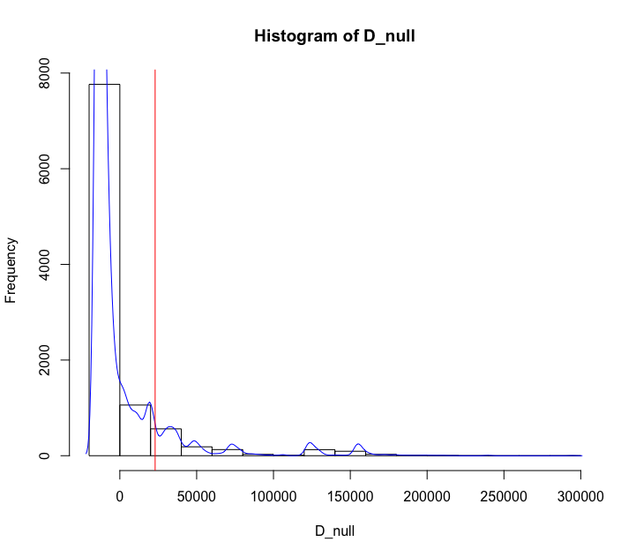
Rebuttal Part 3
There is not a strong correlation between weather and monetary damages!
If you choose the largest monetary damage weather (Lightning storm) and smallest monetary damage weather (Hurricane) to achieve a small p-value, the alternative hypothesis becomes Mean of Monetary Damages of Lighting Storm > Mean of Monetary Damages of Hurricane.
However, upon calculating the p-value you get: 0.1057. This suggests that there is not a strong correlation between monetary damages and weather (definitely not stronger than monetary damages and gun control).

