Slide 1
Walmart
items frequently bought together

Slide 2
Hypothesis
Null hypothesis:
The items do not sell together (it is random).
Alternative Hypothesis:
Items do sell together.

Slide 3


Intuitive Patterns?
Hard to determine intuitively because the frequency numbers for the different combinations of ones and zeros are very similar.
For example, when using the R function table() this is the output:
Clearly, the numbers are close to each other.
I found a possible relationship between BUTTER and COOKIES because they have a large frequency of (one, one) which means they are bought together. However, the difference between the frequencies of when they are bought together and when they are not is 2% or less. Therefore, it likely that that this pattern is random. Let’s see which goods are actually bought together using PERMUTATION TEST.

Slide 4
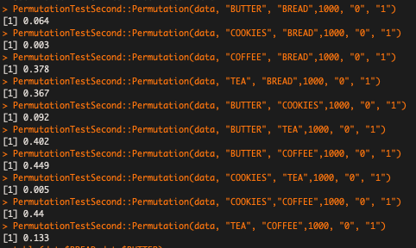
Permutation Test Results

Slide 5
Ideal P-value/ Bonferroni Correction
In order to be NOT accused of p-value hunting, Bonferroni coefficient is necessary to calculate the ideal p-value.
Bonferroni: 0.05 / ₅C₂ = 0.005
Ideal p-value is less than 0.005

Slide 6
Cookies and bread
Cookies and Bread is the only combination that has a p-value < 0.005.
Therefore, we can reject the null hypothesis for these goods; cookies and bread sell together

Slide 7
Conclusion
Using Bonferroni coefficient, the ideal p-value is less than 0.005.
I found that cookies and bread sell together because the p-value is 0.003. We can reject the null hypothesis.
For other combinations of foods we fail to reject the null hypothesis.

