Slide 1
RNA-seq – to get qualitative and quantitative biological insights
•Qualitative: identifying (annotating) expressed transcripts, exon/intron boundaries, transcriptional start sites (TSS), and poly-A sites.
•Quantitative: measuring differences in expression, alternative splicing, alternative TSS, and alternative polyadenylation between two or more treatments or groups.
(i.e. experiment to measure differential gene expression - DGE)
https://rnaseq.uoregon.edu/#table1.1

Slide 2
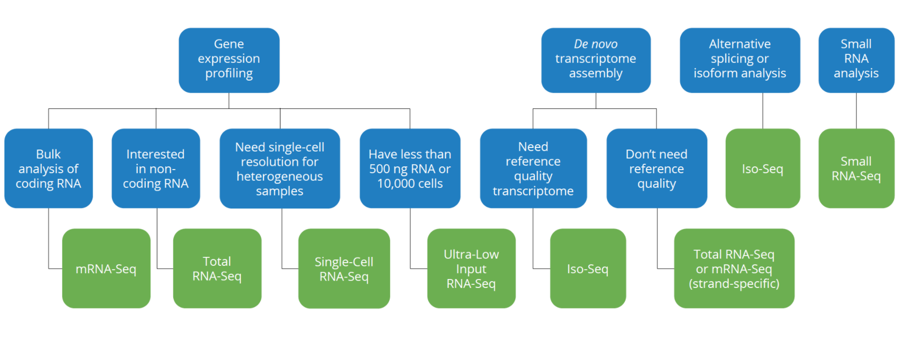
Which RNA-seq assay should I use?
From: Genewiz

Slide 3
Bulk RNA-seq - advantages and limitations
A major breakthrough - replaced microarrays
Measures the average expression level for each gene across a large population of input cells
To quantify expression signatures in disease studies
Insufficient for studying heterogeneous or dynamic systems, e.g. early development studies, complex tissues (brain)

Slide 4
scRNA-seq - advantages and limitations
First publication by (Tang et al. 2009)
From ~2014 new protocols and lower sequencing costs made it more accessible
Measures the distribution of expression levels for each gene across a population of cells
Allows cell type identification, studying the heterogeneity of cell responses
Currently there are several different protocols in use and commercial platforms available
Still expensive, not a gold standard as RNA-seq, small amount of material, uncertainty

Slide 5
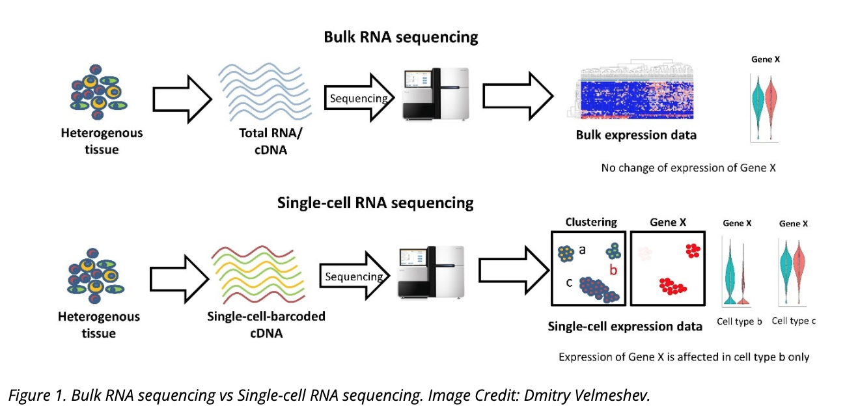
Bulk RNA-seq vs single cell (sc) RNA-seq
Single Cell RNA-seq workshop
October 22-26, 2021
Please register!
From: https://www.technologynetworks.com/genomics/articles/recent-advances-in-single-cell-genomics-techniques-324695
Notes:
There is another new technology called spatial transcriptomics which is somewhere in the middle of RNA-seq and single-cell RNA-seq when it comes to cellular resolution.
https://www.genengnews.com/commentary/point-of-view/single-cell-explorations-are-underway-and-spatial-is-the-next-frontier/

Slide 6
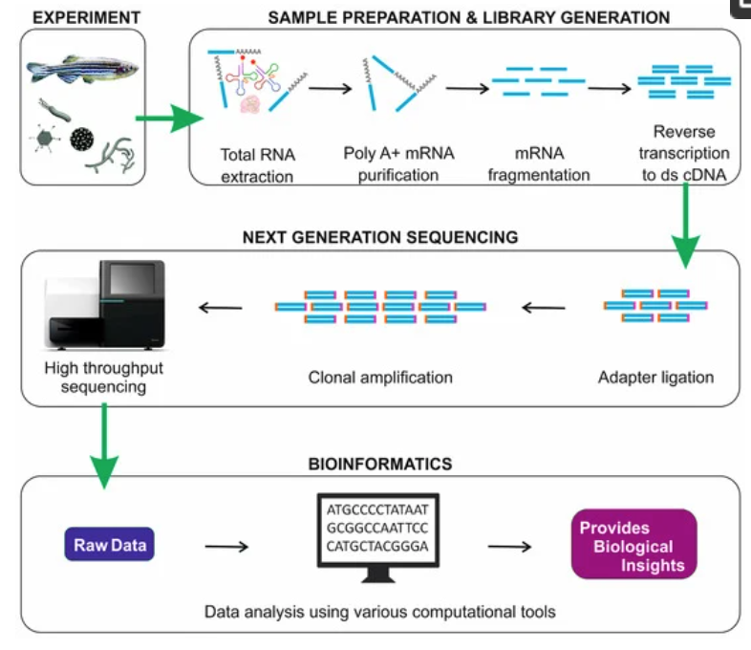
RNA-seq - overview
From https://doi.org/10.3390/ijms19010245

Slide 7
RNA-seq - analysis workflow
Biological samples
Library preparation
Sequencer: Reads Fastq
Quality check
FastQC
Trimming
cutadapt
Quality check
Alignment/Mapping
STAR
Quality check
Counting Reads
featureCounts
Quality check
DGE

Slide 8
RNA-seq resources (notes)
RNA-seq protocol (see footnotes)
Detailed steps: https://rnaseq.uoregon.edu/
Notes:
http://cshprotocols.cshlp.org/content/early/2015/04/11/pdb.top084970.full.pdf+html

