Slide 1
Statistical Hypothesis Testing Basics
Gladstone Institutes
Reuben Thomas
Associate Core Director @ Bioinformatics Core @ GIDB
08/12/2022

Slide 2
Leading the discussion today…
Reuben Thomas – Associate Core Director
Ayushi Agrawal – Bioinformatician II

Slide 3
About me
Have been at Gladstone for over 8 years
Led statistical analysis covering a wide range of models on various data sets
Have a engineering and computational/statistical background via IIT Bombay, Northwestern University, NIH and Cal, Berkeley.

Slide 4
This workshop
Very basic introduction to the concepts and terminology of hypothesis testing
Some guidance on choosing tests in relatively simple situations
Hands-on training on implementing statistical tests in R, requires some basic familiarity in working with R/Rstudio
Two days: 8/15-8/16 @1PM for 2 hours
Today: Mostly concepts and some practical implementation
Tomorrow: Mostly hands-on plus some concepts
Both days: Your specific problems

Slide 5
Poll: Why do we perform statistical hypothesis testing?
It allows us to make claims claims that are reproducible and generalizable with limited resources

Slide 6
Poll: What hypothesis tests have you used?

Slide 7
Terms one commonly encounters in hypothesis testing
Null hypothesis versus Alternative hypothesis
P-values
Two-sided test versus One-sided test
Test statistic
Sampling distribution
Type I and Type II errors (Power)
Multiple testing
Assumptions of different tests
Linear models
ANOVA

Slide 8
Typical scenario
Setting: I have generated data from very cool experiment that I hope would resolve a long standing question
Problem: I don’t know how to use my data to conclude in a convincing manner one way or other
Possible solution: Pose the problem as a statistical association problem
Changing something has a consequence on something else of biological relevance
E.g.: Change dose of drug treatment and phenotype changes

Slide 9
Outline
Introduction to hypothesis testing
Define variables
Choosing the right test
Basic concepts in hypothesis testing
Hands-on

Slide 10
Introduction to Hypothesis Testing
We would like to make generalizable claims about an entire target population with data from only a random subset of this population.
Random sampling, appropriate experimental design and Central Limit Theorem allows us to make generalizable claims
Hypothesis testing rests on assuming the skeptical point of view and testing for deviations from this assumption – Null versus Alternative Assumption
Equally relevant to Hypothesis Testing is the idea of measuring the strength of association/effect size

Slide 11
Outline
Introduction to hypothesis testing
Define variables
Choosing the right test
Basic concepts in hypothesis testing
Hands-on

Slide 12
Variables
Response: Gene expression, Chicken weight
Predictor: Genotype, treatment, chicken feed
Types: Categorical or Continuous
Categorical – genotype (mutant versus wild-type), disease vs normal
Continuous – age, dose of drug treatment

Slide 13
Outline
Introduction to hypothesis testing
Define variables
Choosing the right test
Basic concepts in hypothesis testing
Hands-on

Slide 14
How do I choose which statistical test to use?
Response variable
Categorical
X
X
Continuous
X
X
Continuous
Categorical/Factor
Predictor variable

Slide 15
Response:Continuous Predictor: Continuous
Linear regression
Parameter/effect size: slope

Slide 16
How do I choose which statistical test to use?
Response variable
Categorical
X
X
Continuous
X
Continuous
Categorical
Predictor variable

Slide 17
Response:Continuous Predictor: Categorical
T-tests, ANOVA
Parameter/effect size: difference of
means

Slide 18
How do I choose which statistical test to use?
Response variable
Categorical
X
X
Continuous
Continuous
Categorical
Predictor variable

Slide 19
Response:Categorical Predictor: Categorical
Fisher’s test, Chiq-square test, 2x2 tables
Parameter/effect size: odds ratio

Slide 20
How do I choose which statistical test to use?
Response variable
Categorical
X
Continuous
Continuous
Categorical
Predictor variable

Slide 21
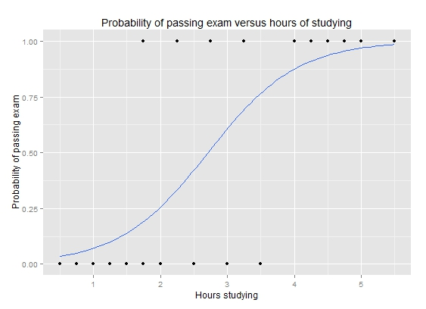
Response:Categorical Predictor: Continuous
Logistic regression
Parameter/effect size: odds ratio
https://upload.wikimedia.org/wikipedia/commons/6/6d/Exam_pass_logistic_curve.jpeg

Slide 22
How do I choose which statistical test to use?
Response variable
Categorical
Continuous
Continuous
Categorical
Predictor variable

Slide 23
Outline
Introduction to hypothesis testing
Define variables
Choosing the right test
Basic concepts in hypothesis testing
Hands-on

Slide 24
Is gene differentially expressed between the two developmental time-points?

Slide 25
Convince a skeptic: Repeat this experiment 1000 times

Slide 26
Central limit theorem allows us to estimate the variation of the location of the distribution

Slide 27
Theoretical distribution of difference in means under Null Hypothesis
Observed difference
Type I error and p-value

Slide 28
Alter underlying variation
sd=14
sd=24
sd=4

Slide 29
Alter the number of replicates
n=4
n=3
n=15

Slide 30
Power to detect a difference of means of -15
You are willing to be mistaken that there is a true difference Type I error fraction of time you repeat this experiment
You are mistaken that there is no difference Type II error fraction of time you repeat this experiment
Power = 1 – Type II error
You correctly say that there is a difference Power fraction of time you repeat this experiment
Type I and Type II error

Slide 31
Poll: What are the factors that affect Power or the fraction of time you claim that there is a real difference when there is actually a difference?

Slide 32
Power to detect varying levels of difference in mean differences
Mean diff = -15
Mean diff = -25
Mean diff = -5
Type II error smaller for larger effect sizes
Larger effect sizes are easier to estimate compared to smaller effect sizes

Slide 33
Poll: If Type II error for a given hypothesis test is zero then what is its statistical power?

Slide 34
Z/T-statistic (Two-sample t-test)

Slide 35
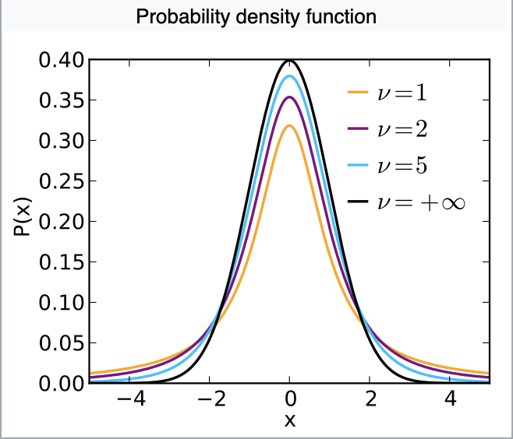
Sampling distribution of T-statistic under the Null hypothesis
Notes:
https://en.wikipedia.org/wiki/Student%27s_t-distribution

Slide 36
T-tests requires assumptions of…
Normality of the responses
Equal variance of the two groups being compared

Slide 37
Parametric versus non-parametric tests
Parametric tests make distributional assumptions about the response variables (Example: Normal probability distribution for the t-test)
Non-parametric tests do not make such assumptions (Example: Mann-Whitney test (next))

Slide 38

U-statistic (Mann Whitney test, two sample test)
Two groups
Rank all observations across both groups, smallest observation given rank 1.
The sum of ranks of observations within group 1 with n1 observations is R1

Slide 39
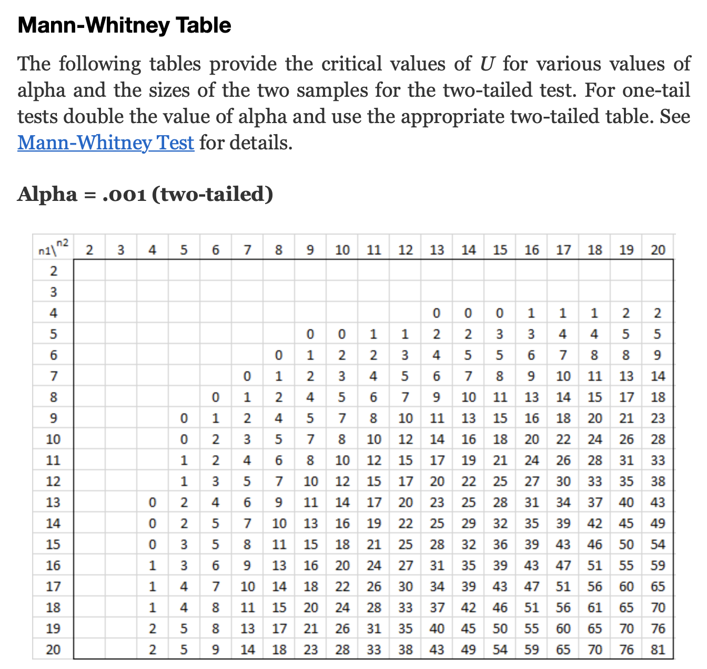
U-statistic sampling distribution in terms of tables
Critical value of statistic
Area of red shaded part=0.001
Notes:
http://www.real-statistics.com/statistics-tables/mann-whitney-table/

Slide 40
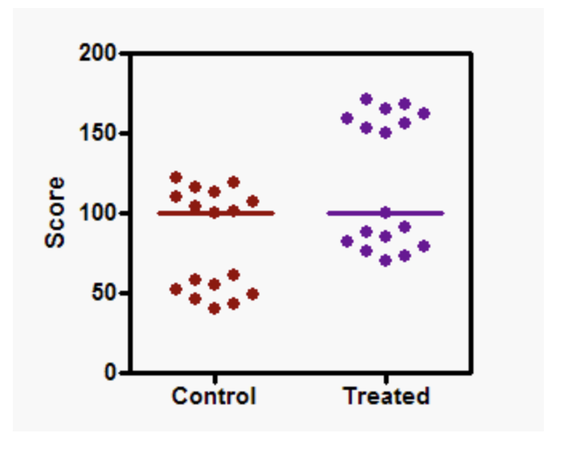
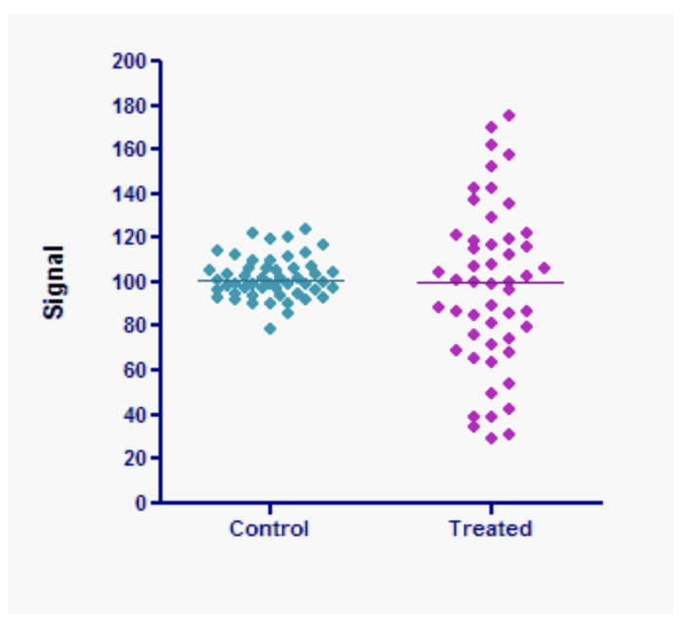
Mann-Whitney test valid as a comparison of location only if…
The two distributions have the same underlying shape, variance
Same location, significant p-value
Same location, non-significant p-value
Notes:
https://www.tandfonline.com/doi/pdf/10.1080/00031305.2017.1305291?needAccess=true
https://www.graphpad.com/guides/prism/5/user-guide/prism5help.html?stat_nonparametric_tests_dont_compa.htm

Slide 41

F-statistic (ANOVA)

Slide 42
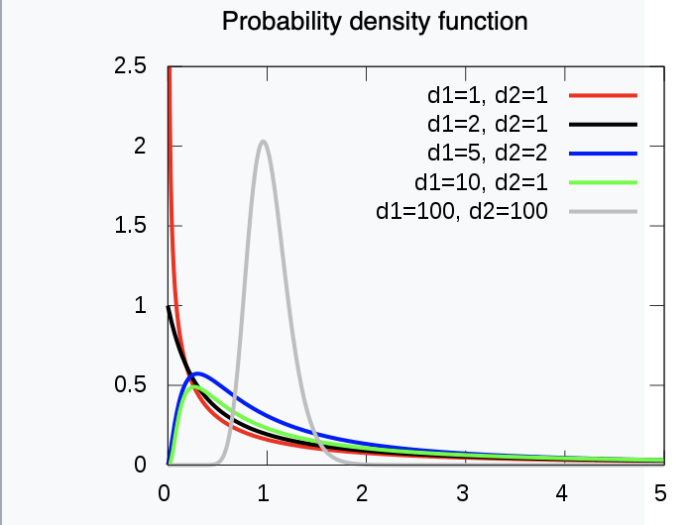
Sampling distribution of the F-statistic
Notes:
https://en.wikipedia.org/wiki/F-distribution

Slide 43
1-way ANOVA requires assumptions of…
Normality of the responses
Equal variance of the responses with each of the groups being compared

Slide 44
Poll: Are you aware of the difference between the t-test, Welch t-test, Mann-Whitney test?

Slide 45
Why do we have so many different tests?
Sampling distribution derived via Central Limit Theorem only valid only if certain assumptions met with underlying data
E.g. of assumptions could be Normality, Equality of variances etc.

Slide 46
Every hypothesis test requires…
Test statistic
Sampling distribution of test statistic under the null hypothesis
A Type I error that will be allowable – fraction of times you are willing to accept a false-positive as a real result
Note: Use of test statistic and associated sampling distribution depends on your data meeting certain assumptions
A Type II error given the effect size of the association you are expect to estimate

Slide 47
Outline
Introduction to hypothesis testing
Define variables
Choosing the right test
Basic concepts in hypothesis testing
Hands-on

Slide 48
Repeated measures experimental design
Designs where multiple responses from the same biological unit are assessed
Examples include measuring changes in biomarker levels (e.g. CD4 counts) in subjects over time

Slide 49
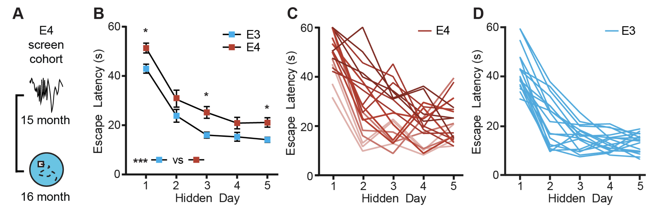
Learning in Alzheimer’s Disease mice assayed in the Morris-Water Maze
Jones et al. 2019

Slide 50
Comparing every feed to every other one
There are 15 possible comparisons

Slide 51
Why do we need multiple testing?
We have 15 possible comparisons between feeds
Assume no. of true associations = 8
We set Type I error = 0.05
Assume statistical power to detect differences = 0.8
We will detect 8x0.8 ~ 6 true differences
#false positives = 15x0.05~1
False Discovery Rate = #false positives/(# false positives + #true positives) = 1/(1+6) ~ 14% - pretty high!

Slide 52
Interpret parameters from linear model to estimate slope
Slope ~ 20/5 = 4
20
5

Slide 53

Interpret parameters from linear model implementation of one-way ANOVA
330
50
100
160

Slide 54



Interpret parameters from linear model implementation of two-way ANOVA

Slide 55

Interpret the main effect

Slide 56

Interpret the interaction term

Slide 59
Please fill-out survey
https://www.surveymonkey.com/r/F75J6VZ
~ 3min

Slide 60
Multiple tests

Slide 61
Outline for this workshop

