Slide 1
Introduction to Statistics and Experimental Design
Reuben Thomas
Gladstone Bioinformatics Core
2/23/2021

Slide 2

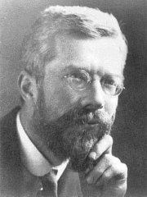
Historical figures
Ibn Sina
Ronald Fisher
1000 C.E., Cannon of Medicine
1920 CE, Design of Experiments
http://www.newworldencyclopedia.org/entry/Ronald_Fisher
https://en.wikipedia.org/wiki/Avicenna#/media/File:Avicenna_Portrait_on_Silver_Vase_-_Museum_at_BuAli_Sina_(Avicenna)_Mausoleum_-_Hamadan_-_Western_Iran_(7423560860).jpg

Slide 3
Motivation for use of Statistics
We would like to make scientific claims that are as generalizable as possible
However,
Empirical data are inherently noisy
Resources are limited
Enter Statistics!

Slide 4
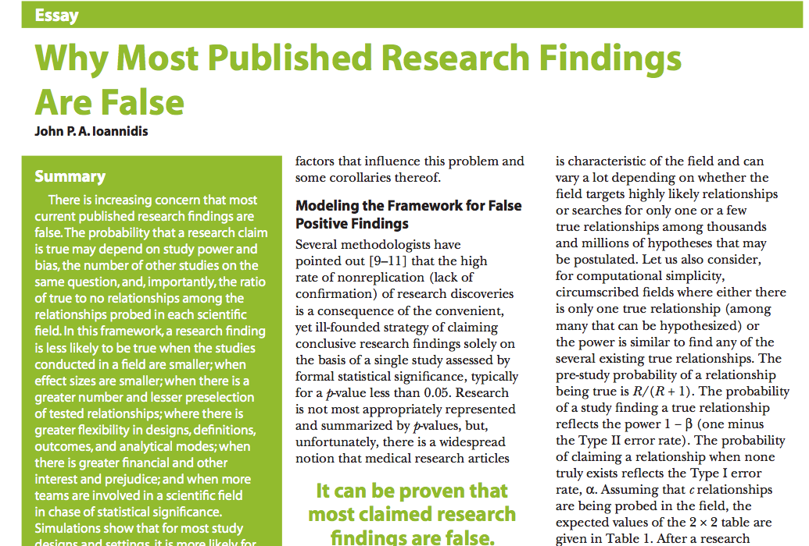


Slide 5

Thanks: Kevin Mullane
Director, Corporate Liaison & Ventures
Corporate Ventures and Translation
Gladstone Institutes

Slide 6
About this course
Very basic introduction to concepts underpinning statistics and experimental design
Goal is to get you thinking a little deeper about the data you want to generate and use to make claims about
No prerequisites
Please interrupt with questions and comments!

Slide 7
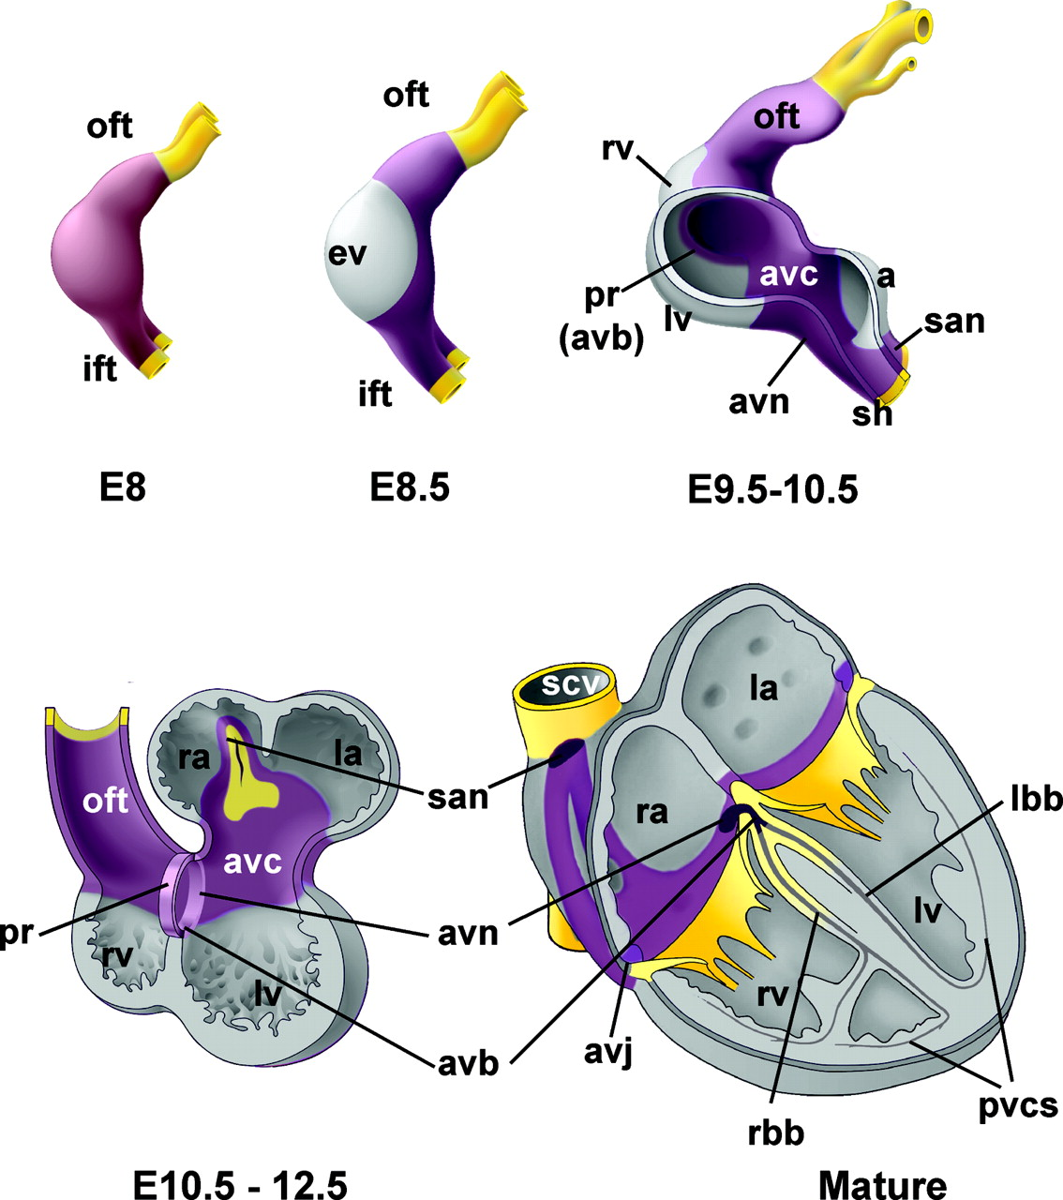
Experiment: Gene controlling developing heart
Notes:
https://www.ahajournals.org/doi/epub/10.1161/CIRCEP.108.829341

Slide 8

Seven pillars of statistical wisdom
Aggregation
Information
Inter-comparison
Likelihood
Regression
Residuals
Experimental design
https://commons.wikimedia.org/wiki/File:Seven_Pillars_2008_e5.jpg
Stephen M. Stigler. 2016. Seven Pillars of Statistical Wisdom. Harvard University Press

Slide 9
1. Aggregation: one number to capture an entire distribution

Slide 10
Target population
All subjects/units that we want base our claims/conclusions on
The cardiac tissue of all mice at embryonic stage E9.5
All children below 5 years old who are diagnosed with autism

Slide 11
Seven pillars of statistical wisdom
Aggregation
Information
Inter-comparison
Likelihood
Regression
Residuals
Experimental design
https://commons.wikimedia.org/wiki/File:Seven_Pillars_2008_e5.jpg
Stephen M. Stigler. 2016. Seven Pillars of Statistical Wisdom. Harvard University Press

Slide 12
2. Information on aggregate measure: rate of gain decreases with increasing sample size

Slide 13
Seven pillars of statistical wisdom
Aggregation
Information
Inter-comparison
Likelihood
Regression
Residuals
Experimental design
https://commons.wikimedia.org/wiki/File:Seven_Pillars_2008_e5.jpg
Stephen M. Stigler. 2016. Seven Pillars of Statistical Wisdom. Harvard University Press

Slide 14
3. Inter-comparison: with limited data can make conclusions applicable to larger target population

Slide 15
Is gene differentially expressed between the two developmental time-points?

Slide 16
Convince a skeptic: Repeat this experiment 1000 times

Slide 17
Central limit theorem allows us to estimate the variation of the location of the distribution

Slide 18
Two conclusions from the data
Conclusion 1: The difference is interesting, biologically meaningful – PI happy, start writing manuscript, plan further experiments.
Conclusion 2: Skeptical viewpoint, there is no difference, or unable to conclude that there is one – back to the drawing board.
All statistical hypothesis testing is based on the latter the skeptical viewpoint

Slide 19
Theoretical distribution of difference in means under the skeptical view-point/Null hypothesis
Type I error and p-value

Slide 20
Alter underlying variation
sd=14
sd=24
sd=4

Slide 21
Alter the number of replicates
n=4
n=3
n=15

Slide 22
Power to detect a difference of means of -15
Type I and Type II error

Slide 23
Power to detect varying levels of difference in mean differences
Mean diff = -15
Mean diff = -25
Mean diff = -5

Slide 24
Terminology for Hypothesis Testing
Response variables, predictor variables
Type of variable: Continuous and categorical
What are the variables whose association we are interested in estimating?
What types are these variables?

Slide 25
Z/T-statistic

Slide 26
T-statistic and sampling distribution

Slide 27
Continuous response and categorical predictor
Y: gene expression
X: development time
One-way ANOVA – F-statistics

Slide 28
Two categorical variables
 | In TGF-b signaling pathway | Not in TGF-b signaling pathway
Differentially expressed | 20 | 980
Not differential expressed | 80 | 18920
Y1: gene differentially expressed or not
Y2: gene in TGF-b signaling pathway or not
Odds ratio, Chi-square statistics

Slide 29
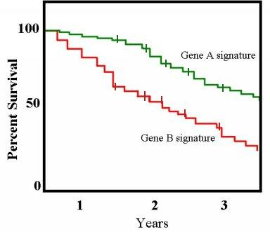
Continuous response with a categorical variable
https://commons.wikimedia.org/wiki/File:Km_plot.jpg
Y: survival time in years
X: Gene signature
Hazard ratio, logrank test

Slide 30
Continuous response against a continuous variable
Y: Child’s height
X: Parent’s height
Slope, linear regression

Slide 31
Seven pillars of statistical wisdom
Aggregation
Information
Inter-comparison
Likelihood
Regression
Residuals
Experimental design
https://commons.wikimedia.org/wiki/File:Seven_Pillars_2008_e5.jpg
Stephen M. Stigler. 2016. Seven Pillars of Statistical Wisdom. Harvard University Press

Slide 32
4. Likelihood: model variation in the location of data using probability

Slide 33
Testing for differences in expression of multiple genes

Slide 34
Density
Distribution

Slide 35
Look at distribution of p-values
No real differences
Possible differences
Multiple testing procedures: Holm, Benjamini-Hochberg

Slide 36
Seven pillars of statistical wisdom
Aggregation
Information
Inter-comparison
Likelihood
Regression
Residuals
Experimental design
https://commons.wikimedia.org/wiki/File:Seven_Pillars_2008_e5.jpg
Stephen M. Stigler. 2016. Seven Pillars of Statistical Wisdom. Harvard University Press

Slide 37
I have no faith in anything short of actual measurement and the Rule of Three
– Charles Darwin

Slide 38
Rule of three

Slide 39
5. Regression: associate multiple (noisy) factors with each other
Tall parents tend to have shorter children while tall children tend to have shorter parents

Slide 40
Seven pillars of statistical wisdom
Aggregation
Information
Inter-comparison
Likelihood
Regression
Residuals
Experimental design
https://commons.wikimedia.org/wiki/File:Seven_Pillars_2008_e5.jpg
Stephen M. Stigler. 2016. Seven Pillars of Statistical Wisdom. Harvard University Press

Slide 41
7. Residual: Variation left over after we have captured the known effects

Slide 42
Residual: Predicted - Observed
Full model
Mean model

Slide 43
Predict child’s height from parent’s height

Slide 44
Distribution of error in predicting child’s height

Slide 45
Seven pillars of statistical wisdom
Aggregation
Information
Inter-comparison
Likelihood
Regression
Residuals
Experimental design
https://commons.wikimedia.org/wiki/File:Seven_Pillars_2008_e5.jpg
Stephen M. Stigler. 2016. Seven Pillars of Statistical Wisdom. Harvard University Press

Slide 46
7. Design: Capture effects of interest and avoid unwanted variation
Identify the response and variable(S) of interest
Identify target population that you want to base your claims on
Identify factors that affect the response of interest
Choose samples from target population
Randomly assign samples across different levels of factors affecting response
Block out variation that is not of interest by randomly assigning to levels of factors within a block

Slide 47
Which is better? Design 1 or Design 2?
 | Design 1 – Sample prep date | Design 2 – Sample prep date
Sample_1_E9.5 | Jan 9th, 2019 | Jan 11th, 2019
Sample_2_E9.5 | Jan 9th, 2019 | Jan 9th, 2019
Sample_3_E9.5 | Jan 9th, 2019 | Jan 11th, 2019
Sample_4_E9.5 | Jan 9th, 2019 | Jan 9th, 2019
Sample_1_E11.5 | Jan 11th, 2019 | Jan 11th, 2019
Sample_2_E11.5 | Jan 11th, 2019 | Jan 9th, 2019
Sample_3_E11.5 | Jan 11th, 2019 | Jan 11th, 2019
Sample_4_E11.5 | Jan 11th, 2019 | Jan 9th, 2019

Slide 48
Which is better? Design 1 or Design 2?
 | Design 1 – Gender | Design 2 - Gender
Sample_1_E9.5 | Male | Male
Sample_2_E9.5 | Male | Female
Sample_3_E9.5 | Male | Male
Sample_4_E9.5 | Male | Female
Sample_1_E11.5 | Female | Male
Sample_2_E11.5 | Female | Female
Sample_3_E11.5 | Female | Male
Sample_4_E11.5 | Female | Female

Slide 49
Which is better? Design 1 or Design 2?
 | Design 1 – Sample prep date and Gender | Design 2 – Sample prep date and Gender
Sample_1_E9.5 | Jan 11th, Male | Jan 11th, Male
Sample_2_E9.5 | Jan 9th, Female | Jan 9th, Male
Sample_3_E9.5 | Jan 11th, Female | Jan 11th, Female
Sample_4_E9.5 | Jan 9th, Male | Jan 9th, Female
Sample_1_E11.5 | Jan 11th, Male | Jan 11th, Male
Sample_2_E11.5 | Jan 9th, Female | Jan 9th, Male
Sample_3_E11.5 | Jan 11th, Male | Jan 11th, Female
Sample_4_E11.5 | Jan 9th, Female | Jan 9th, Female

Slide 50
How many n? What do we need to perform statistical power calculations?
What is the experimental design?
Identify parameters of interest given experimental design – two variables models to more complex multivariate designs
Test statistic for the parameters of interest
Estimates of variation and correlation between variables of interest – use pilot data or publicly available data
Sampling distribution of this test statistic
Check assumptions for the validity of the sampling distributions

Slide 51
Genotype and development time effect on gene expression
E11.5
E9.5
KO
WT

Slide 52
Cellular reprogramming efficiency as a function of Wnt and Bmp levels

Slide 53
Genotype effect on gene expression

Slide 54
Litter effect dominates the variation

Slide 55
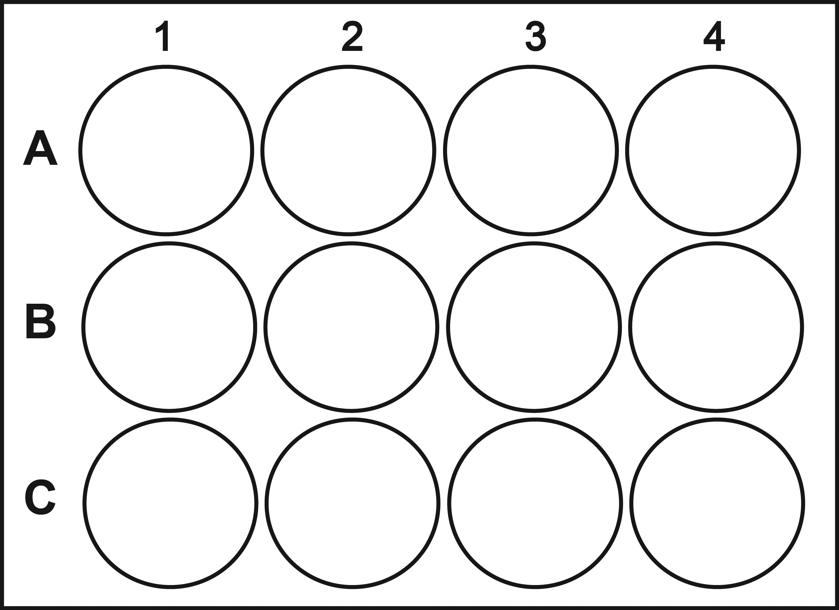
Plate design: Response over time
Before treatment with drug
After treatment with drug
No drug
Low dose
High dose
http://www.cellsignet.com/media/plates/12.jpg

Slide 56
Gene expression association: smaller effect size

Slide 57
Longitudinal data design

Slide 58
scRNA-seq data for 3 conditions

Slide 59
scRNA-seq data for 3 conditions
Mut
WT
WT

Slide 60
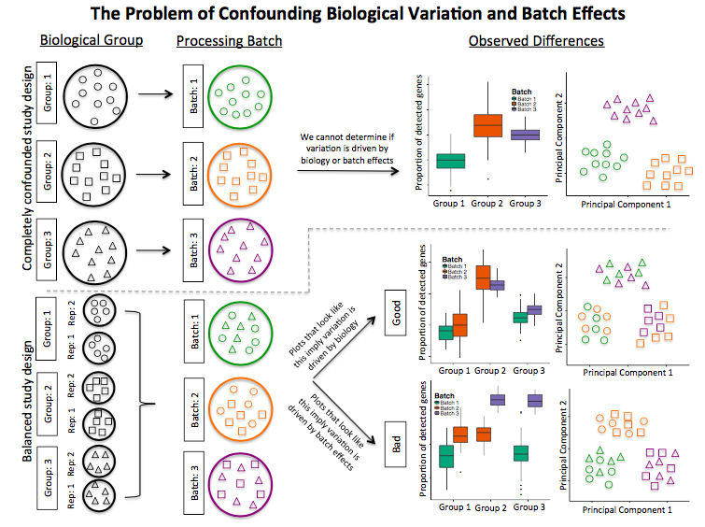

Slide 61
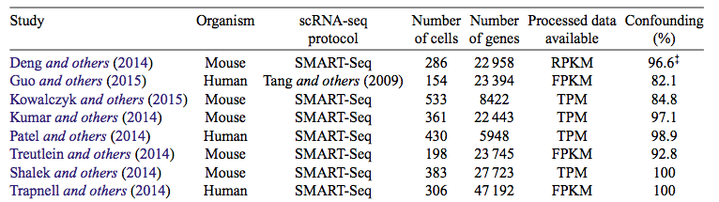
Confounding in scRNA-seq data is a big problem
Hicks, S. C., Townes, F. W., Teng, M. & Irizarry, R. A. Missing data and technical variability in single-cell
RNA-sequencing experiments. Preprint available from:https://doi.org/10.1093/biostatistics/kxx053 (2017).

Slide 62
Seven pillars of statistical wisdom
Aggregation
Information
Inter-comparison
Likelihood
Regression
Residuals
Experimental design
https://commons.wikimedia.org/wiki/File:Seven_Pillars_2008_e5.jpg
Stephen M. Stigler. 2016. Seven Pillars of Statistical Wisdom. Harvard University Press

Slide 63
Please give us feedback
https://www.surveymonkey.com/r/RRTZPTC
~3 min

