Slide 1
Statistical Hypothesis Testing Basics
Gladstone Institutes
Reuben Thomas & Michela Traglia
Associate Core Director @ Bioinformatics Core @ GIDB
01/18/2023

Slide 2
Leading the discussion today…
Reuben Thomas – Associate Core Director
Michela Traglia– Biostatistician

Slide 3
Days 2 and 3
Very basic introduction to the concepts and terminology of hypothesis testing
Some guidance on choosing tests in relatively simple situations
Hands-on training on implementing statistical tests in R, requires some basic familiarity in working with R/Rstudio
Two days: 1/18-1/19 @1PM for 2 hours
Today: Mostly concepts and some practical implementation
Tomorrow: Mostly hands-on plus some concepts
Both days: Your specific problems

Slide 4
Poll: Why do we perform statistical hypothesis testing?
It allows us to make claims claims that are reproducible and generalizable with limited resources

Slide 5
Poll: What hypothesis tests have you used?

Slide 6
Terms one commonly encounters in hypothesis testing
Null hypothesis versus Alternative hypothesis
P-values
Two-sided test versus One-sided test
Test statistic
Sampling distribution
Type I and Type II errors (Power)
Multiple testing
Assumptions of different tests
Linear models
ANOVA

Slide 7
Typical scenario
Setting: I have generated data from very cool experiment that I hope would resolve a long standing question
Problem: I don’t know how to use my data to conclude in a convincing manner one way or other
Possible solution: Pose the problem as a statistical association problem
Changing something has a consequence on something else of biological relevance
E.g.: Change dose of drug treatment and phenotype changes

Slide 8
Outline
Introduction to hypothesis testing
Define variables
Choosing the right test
Basic concepts in hypothesis testing
Demo

Slide 9
Introduction to Hypothesis Testing
We would like to make generalizable claims about an entire target population with data from only a random subset of this population.
Random sampling, appropriate experimental design and Central Limit Theorem allows us to make generalizable claims
Hypothesis testing rests on assuming the skeptical point of view and testing for deviations from this assumption – Null versus Alternative Assumption
Equally relevant to Hypothesis Testing is the idea of measuring the strength of association/effect size

Slide 10
Outline
Introduction to hypothesis testing
Define variables
Choosing the right test
Basic concepts in hypothesis testing
Hands-on

Slide 11
Variables
Response: Gene expression, Chicken weight
Predictor: Genotype, treatment, chicken feed
Types: Categorical or Continuous
Categorical – genotype (mutant versus wild-type), disease vs normal
Continuous – age, dose of drug treatment

Slide 12
Outline
Introduction to hypothesis testing
Define variables
Choosing the right test
Basic concepts in hypothesis testing
Hands-on

Slide 13
How do I choose which statistical test to use?
Response variable
Categorical
X
X
Continuous
X
X
Continuous
Categorical/Factor
Predictor variable

Slide 14
Response:Continuous Predictor: Continuous
Linear regression
Parameter/effect size: slope

Slide 15
How do I choose which statistical test to use?
Response variable
Categorical
X
X
Continuous
X
Continuous
Categorical
Predictor variable

Slide 16
Response:Continuous Predictor: Categorical
T-tests, ANOVA
Parameter/effect size: difference of
means

Slide 17
How do I choose which statistical test to use?
Response variable
Categorical
X
X
Continuous
Continuous
Categorical
Predictor variable

Slide 18
Response:Categorical Predictor: Categorical
Fisher’s test, Chiq-square test, 2x2 tables
Parameter/effect size: odds ratio

Slide 19
How do I choose which statistical test to use?
Response variable
Categorical
X
Continuous
Continuous
Categorical
Predictor variable

Slide 20
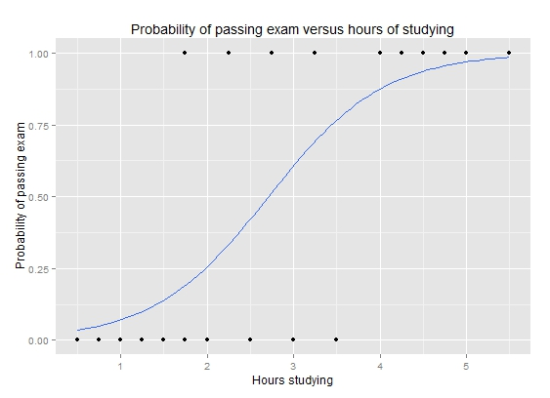
Response:Categorical Predictor: Continuous
Logistic regression
Parameter/effect size: odds ratio
https://upload.wikimedia.org/wikipedia/commons/6/6d/Exam_pass_logistic_curve.jpeg

Slide 21
How do I choose which statistical test to use?
Response variable
Categorical
Continuous
Continuous
Categorical
Predictor variable

Slide 22
Outline
Introduction to hypothesis testing
Define variables
Choosing the right test
Basic concepts in hypothesis testing
Hands-on

Slide 23
Is gene differentially expressed between the two developmental time-points?

Slide 24
Convince a skeptic: Repeat this experiment 1000 times

Slide 25
Central limit theorem allows us to estimate the variation of the location of the distribution

Slide 26
Theoretical distribution of difference in means under Null Hypothesis
Observed difference
Type I error and p-value

Slide 27
Alter underlying variation
sd=14
sd=24
sd=4

Slide 28
Alter the number of replicates
n=4
n=3
n=15

Slide 29
Power to detect a difference of means of -15
You are willing to be mistaken that there is a true difference Type I error fraction of time you repeat this experiment
You are mistaken that there is no difference Type II error fraction of time you repeat this experiment
Power = 1 – Type II error
You correctly say that there is a difference Power fraction of time you repeat this experiment
Type I and Type II error

Slide 30
Poll: What are the factors that affect Power or the fraction of time you claim that there is a real difference when there is actually a difference?

Slide 31
Power to detect varying levels of difference in mean differences
Mean diff = -15
Mean diff = -25
Mean diff = -5
Type II error smaller for larger effect sizes
Larger effect sizes are easier to estimate compared to smaller effect sizes

Slide 32
Poll: If Type II error for a given hypothesis test is zero then what is its statistical power?

Slide 33
Z/T-statistic (Two-sample t-test)

Slide 34
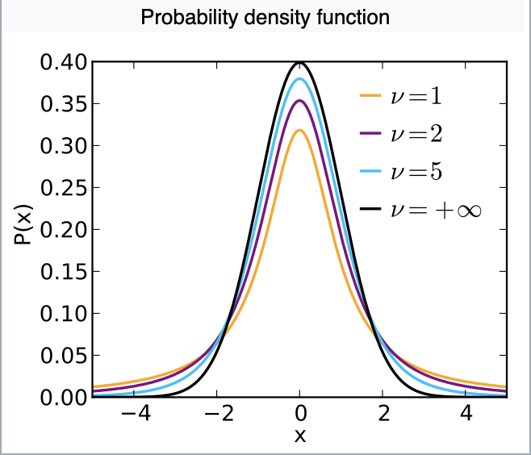
Sampling distribution of T-statistic under the Null hypothesis
Notes:
https://en.wikipedia.org/wiki/Student%27s_t-distribution

Slide 35
T-tests requires assumptions of…
Normality of the responses
Equal variance of the two groups being compared

Slide 36
Parametric versus non-parametric tests
Parametric tests make distributional assumptions about the response variables (Example: Normal probability distribution for the t-test)
Non-parametric tests do not make such assumptions (Example: Mann-Whitney test (next))

Slide 37

U-statistic (Mann Whitney test, two sample test)
Two groups
Rank all observations across both groups, smallest observation given rank 1.
The sum of ranks of observations within group 1 with n1 observations is R1

Slide 38
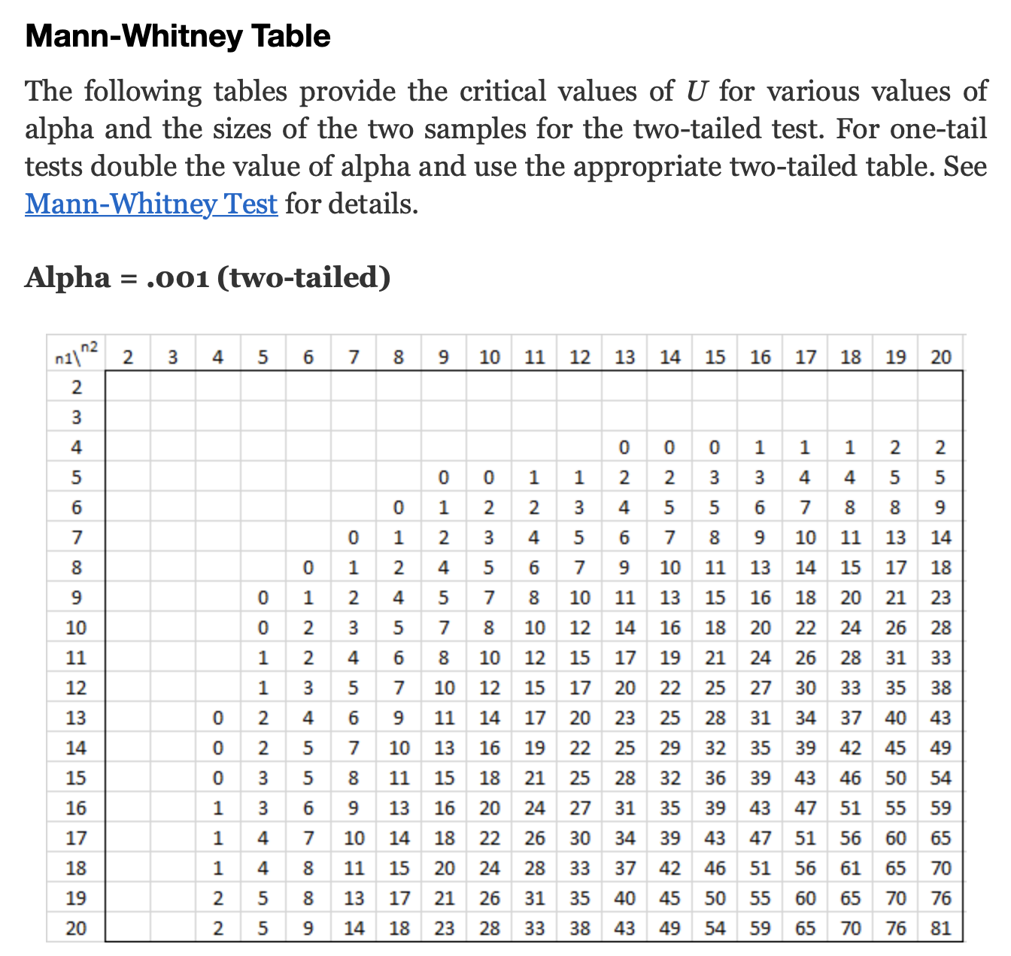
U-statistic sampling distribution in terms of tables
Critical value of statistic
Area of red shaded part=0.001
Notes:
http://www.real-statistics.com/statistics-tables/mann-whitney-table/

Slide 39
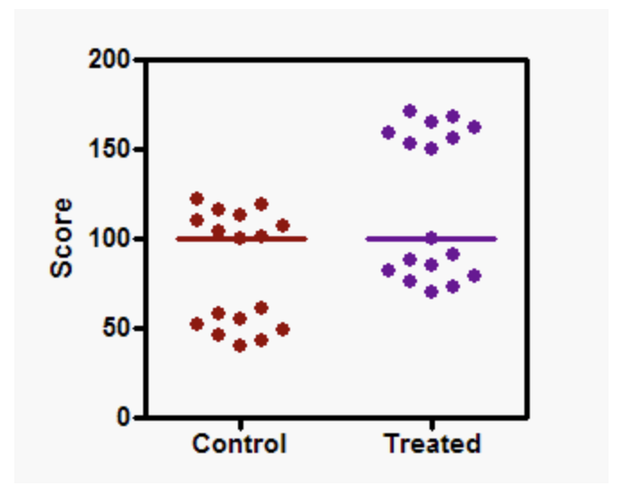
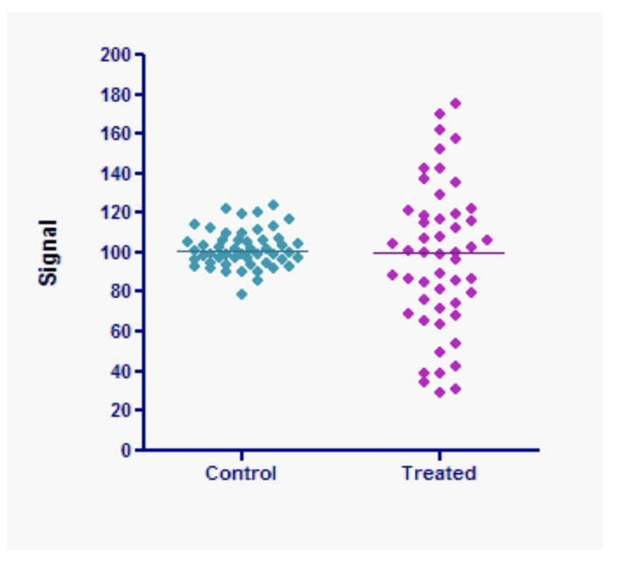
Mann-Whitney test valid as a comparison of location only if…
The two distributions have the same underlying shape, variance
Same location, significant p-value
Same location, non-significant p-value
Notes:
https://www.tandfonline.com/doi/pdf/10.1080/00031305.2017.1305291?needAccess=true
https://www.graphpad.com/guides/prism/5/user-guide/prism5help.html?stat_nonparametric_tests_dont_compa.htm

Slide 40

F-statistic (ANOVA)

Slide 41
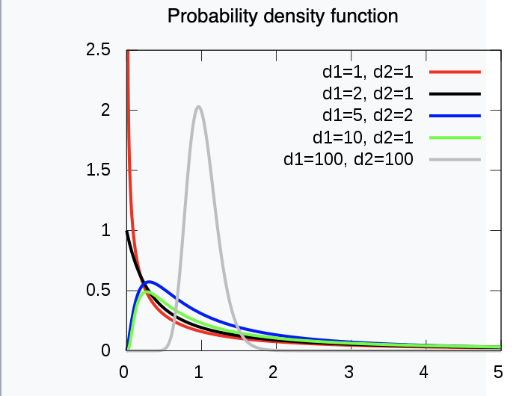
Sampling distribution of the F-statistic
Notes:
https://en.wikipedia.org/wiki/F-distribution

Slide 42
1-way ANOVA requires assumptions of…
Normality of the responses
Equal variance of the responses with each of the groups being compared

Slide 43
Poll: Are you aware of the difference between the t-test, Welch t-test, Mann-Whitney test?

Slide 44
Why do we have so many different tests?
Sampling distribution derived via Central Limit Theorem only valid only if certain assumptions met with underlying data
E.g. of assumptions could be Normality, Equality of variances etc.

Slide 45
Every hypothesis test requires…
Test statistic
Sampling distribution of test statistic under the null hypothesis
A Type I error that will be allowable – fraction of times you are willing to accept a false-positive as a real result
Note: Use of test statistic and associated sampling distribution depends on your data meeting certain assumptions
A Type II error given the effect size of the association you are expect to estimate

Slide 46
Outline
Introduction to hypothesis testing
Define variables
Choosing the right test
Basic concepts in hypothesis testing
Hands-on

Slide 47
Repeated measures experimental design
Designs where multiple responses from the same biological unit are assessed
Examples include measuring changes in biomarker levels (e.g. CD4 counts) in subjects over time

Slide 48
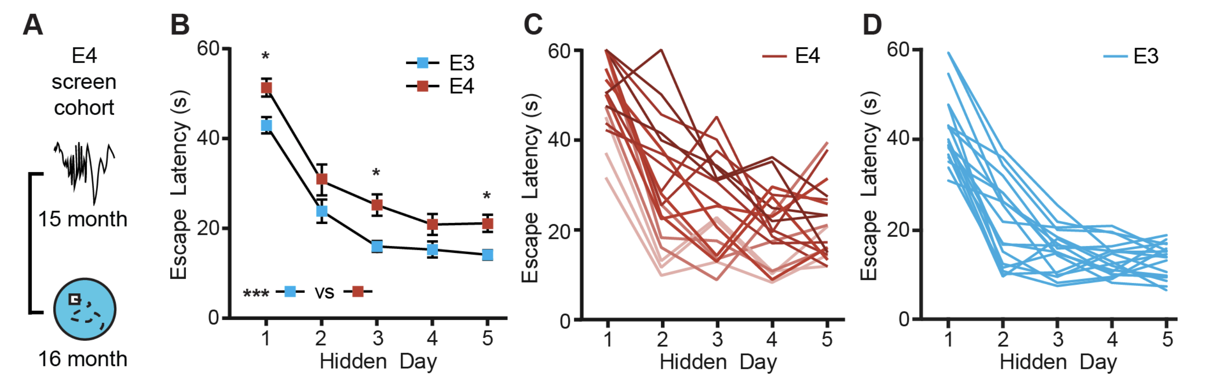
Learning in Alzheimer’s Disease mice assayed in the Morris-Water Maze
Jones et al. 2019

Slide 49
Comparing every feed to every other one
There are 15 possible comparisons

Slide 50
Why do we need multiple testing?
We have 15 possible comparisons between feeds
Assume no. of true associations = 8
We set Type I error = 0.05
Assume statistical power to detect differences = 0.8
We will detect 8x0.8 ~ 6 true differences
#false positives = 15x0.05~1
False Discovery Rate = #false positives/(# false positives + #true positives) = 1/(1+6) ~ 14% - pretty high!

Slide 51
Interpret parameters from linear model to estimate slope
Slope ~ 20/5 = 4
20
5

Slide 52

Interpret parameters from linear model implementation of one-way ANOVA
330
50
100
160

Slide 53



Interpret parameters from linear model implementation of two-way ANOVA

Slide 54

Interpret the main effect

Slide 55

Interpret the interaction term

Slide 58
Please fill-out survey
https://www.surveymonkey.com/r/F75J6VZ
~ 3min

Slide 59
Multiple tests

Slide 60
Outline for this workshop

