Slide 1
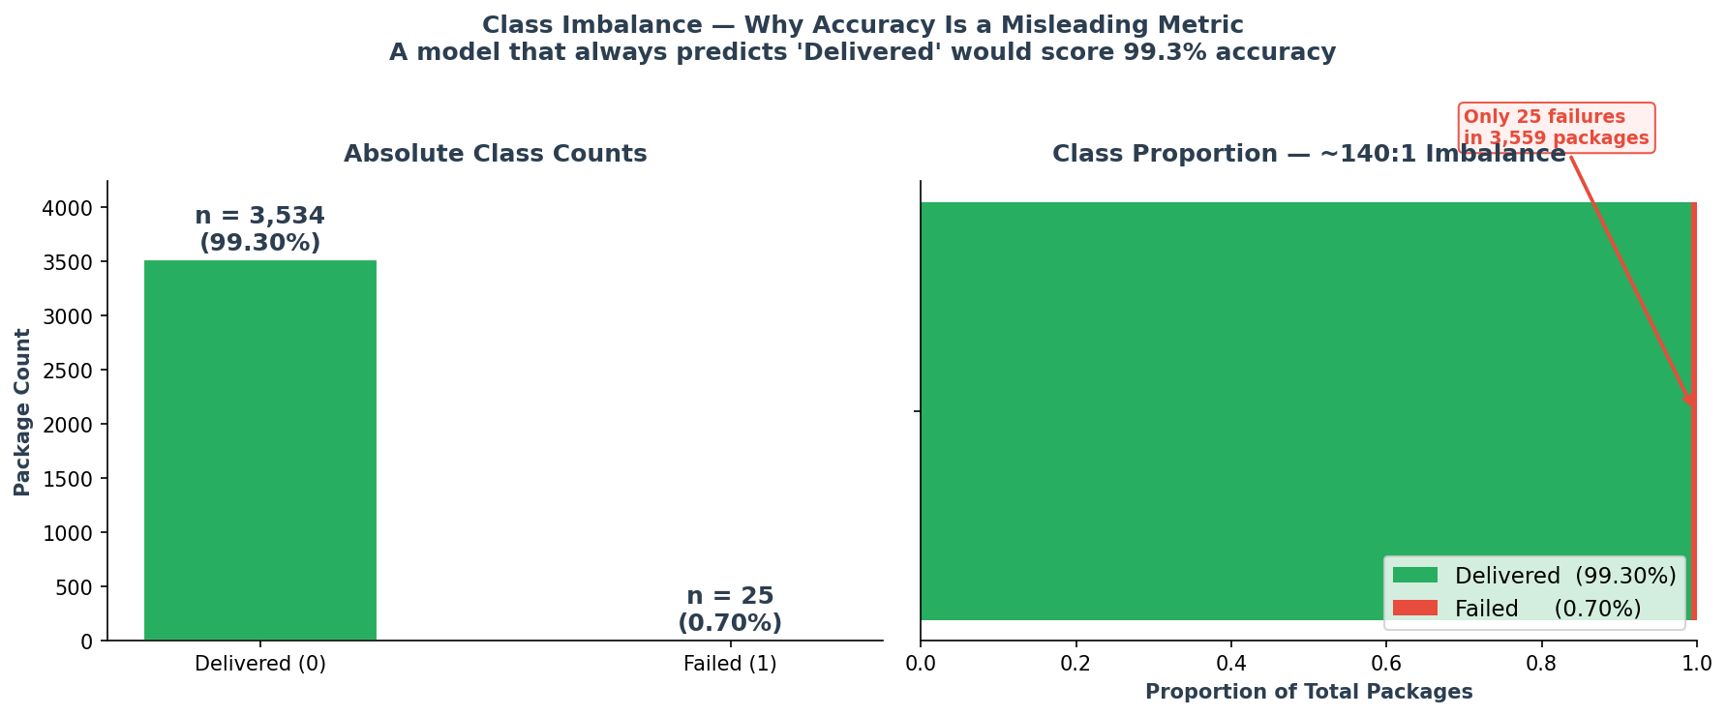
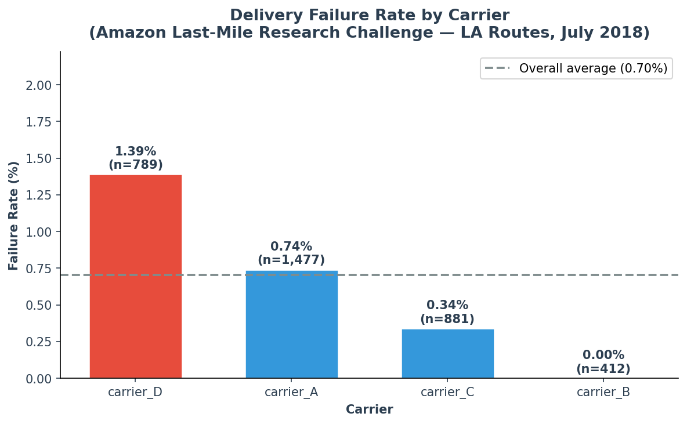
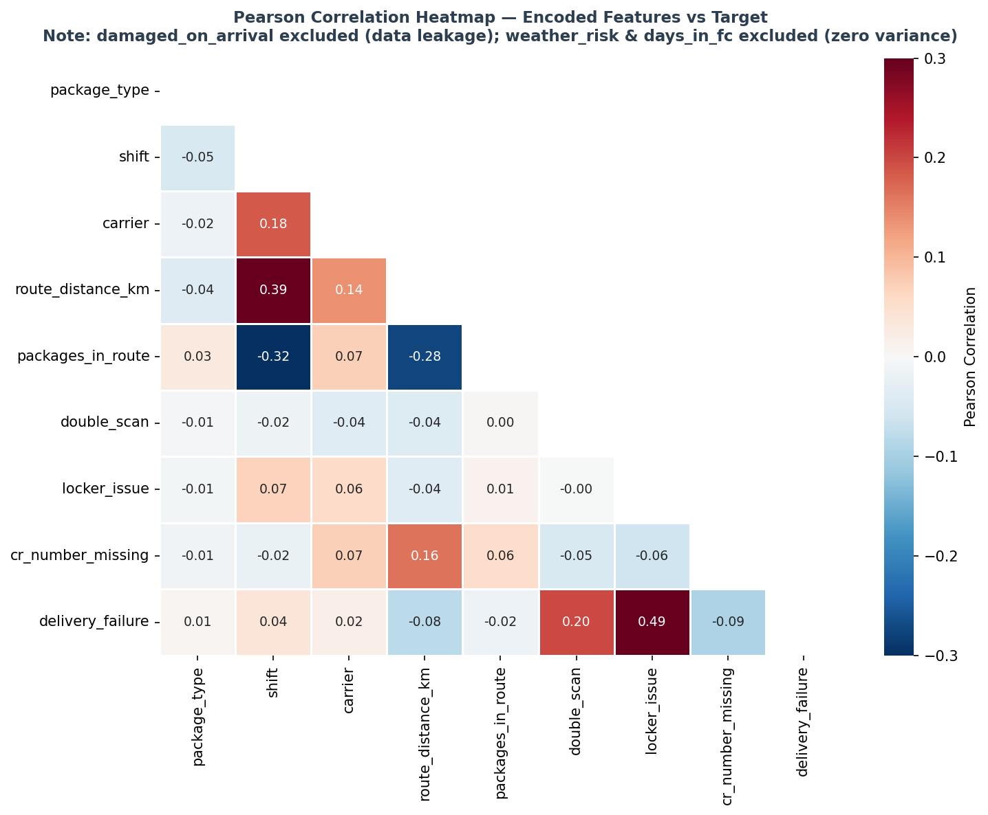
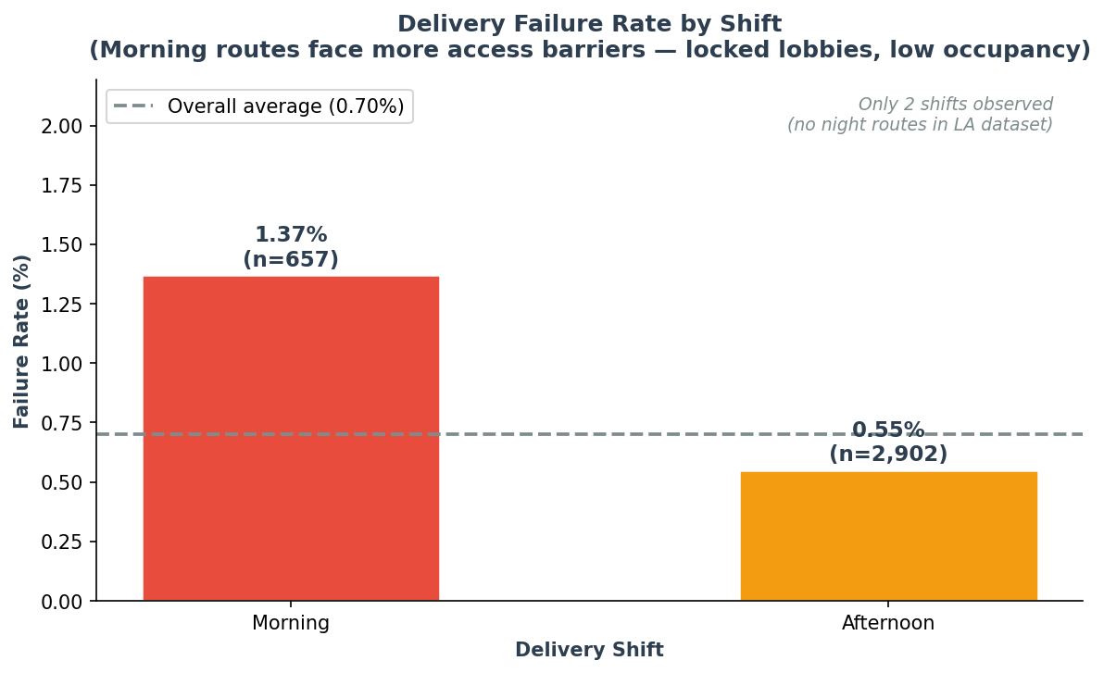
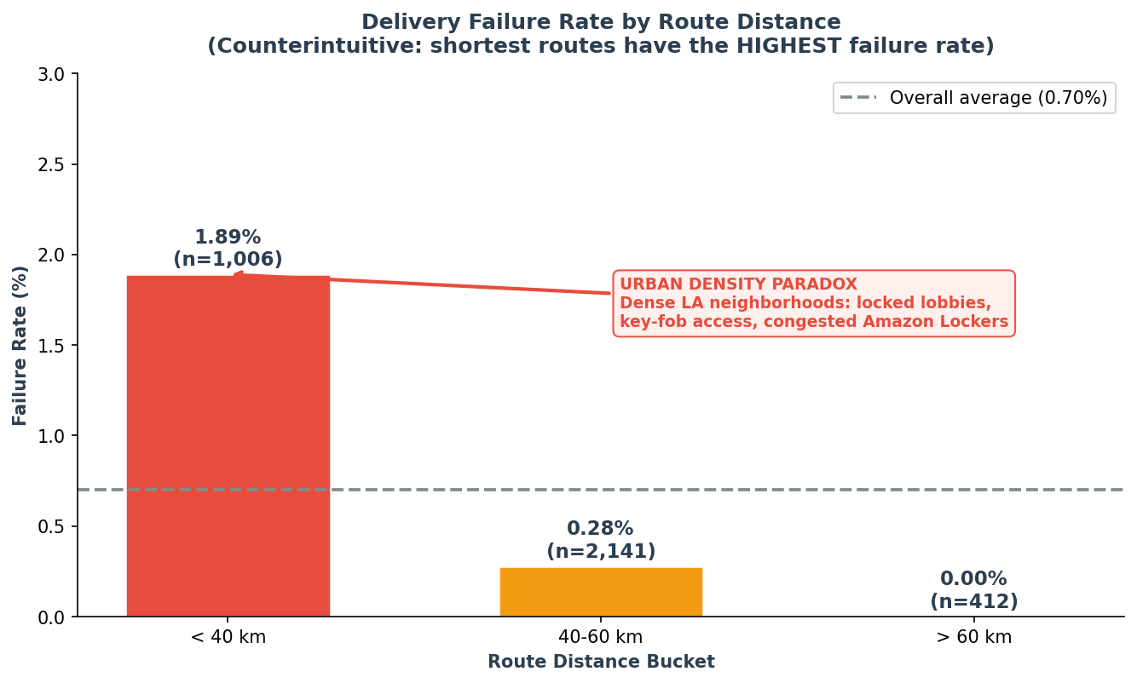
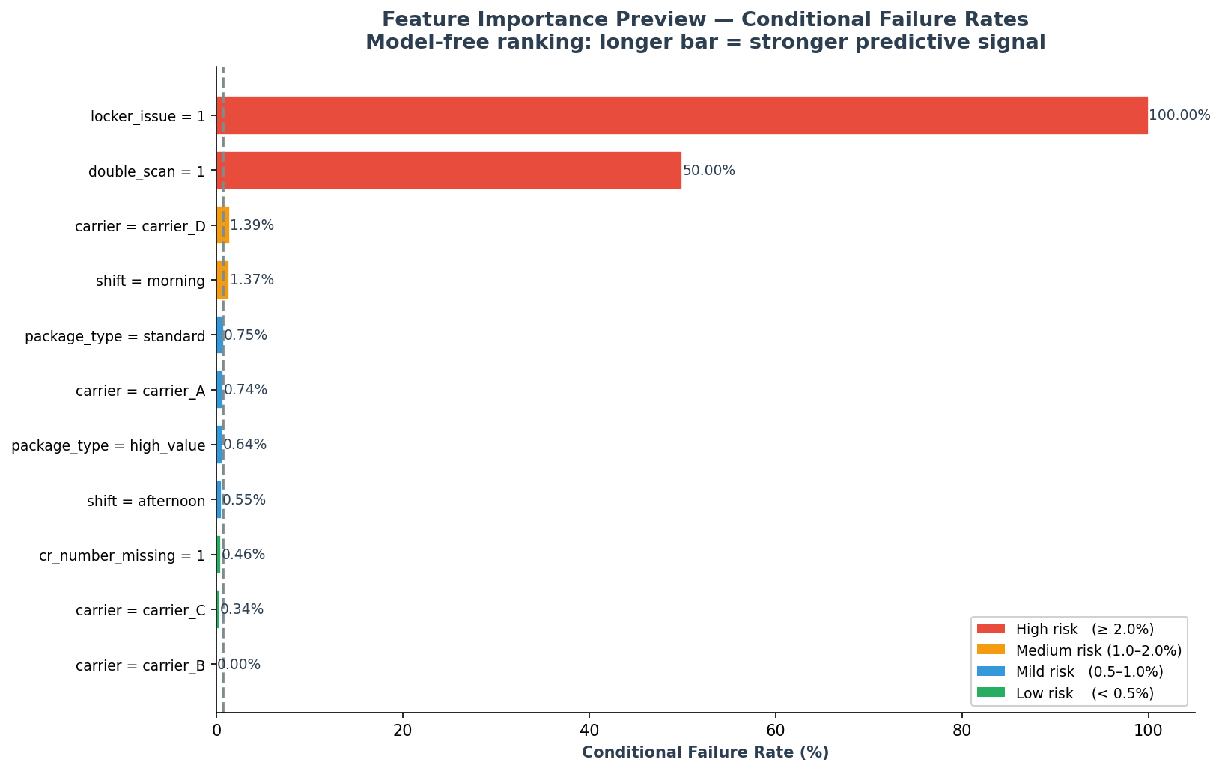
Predicting Last-Mile Delivery Failure Before the Truck Leaves
Evidence from 3,559 Real Amazon Packages — Los Angeles, July 2018
Correlation One Data Analytics (DANA) — Week 12 Final Portfolio Project | Amazon Last Mile Routing Research Challenge Dataset
3,559
15
0.70%
~140:1
$17
Total Packages
LA Routes
Failure Rate
Class Imbalance
Cost per Failure
BACKGROUND
DATA & METHOD
KEY FINDINGS
CONCLUSIONS & NEXT STEPS
Business Problem
Every failed delivery attempt costs an estimated $17 when redelivery, customer service, and downstream Voice-of-Customer impact are combined. At scale, even a sub-1% failure rate represents material operational waste.
Dataset
Amazon Last Mile Routing Research Challenge (LMRC) 2021 — real operational data, not synthetic. 15 routes in Los Angeles, July 2018. 3,559 packages. Target: delivery_failure (1 = DELIVERY_ATTEMPTED, 0 = DELIVERED).
Key Dataset Notes
• days_in_fc: zero variance — all packages dispatched same day
• weather_risk: zero variance — July LA is universally "low"
• Only 2 shifts observed: morning and afternoon (no night routes)
• 91% of packages have cr_number_missing = 1 (normal for this dataset)
Approach
Random Forest classifier trained on dispatch-time features only. Class imbalance handled via class_weight='balanced' and SMOTE comparison. Threshold tuned for maximum recall (cost of missing a failure >> false alarm cost).
Tools & Stack
• Python 3.9+ • scikit-learn • imbalanced-learn (SMOTE)
• pandas / numpy • matplotlib / seaborn
• SQLite (EDA queries) • CrewAI agents (dispatcher reports)
Why Recall Over Accuracy
A naive classifier that always predicts "Delivered" achieves 99.3% accuracy — and catches zero failures. Recall is the business-relevant metric: each missed failure costs $17; a false alarm costs a quick manual check.
Class Distribution
Failure Rate by Carrier
What This Analysis Proved
Three findings stand out from the real LMRC data — and one was a genuine surprise. carrier_D's elevated failure rate and morning shift's access barriers are expected; the counterintuitive result was route distance. The assumption that longer, more complex routes would fail more often is exactly backwards: the data shows the shortest routes (dense urban LA) fail almost 2× more than routes twice their length.
This matters for dispatch planning. Flagging carrier_D morning routes through dense neighborhoods as high-risk before the truck leaves is operationally tractable — the data signals are available at dispatch time.
Actionable Recommendations
1. Flag carrier_D × morning × < 40 km combinations for pre-dispatch supervisor review. This combination concentrates all three top risk factors.
2. Redistribute carrier_D's densest routes (< 30 km, morning) to carrier_B or carrier_A, which demonstrate significantly lower failure rates on equivalent geographic footprints.
3. Implement a morning-shift access-verification protocol: confirm delivery access codes, intercom numbers, or locker availability before dispatch for packages on sub-40 km urban routes.
25 failures vs 3,534 successful deliveries. The ~140:1 imbalance drives all modeling decisions: metric choice, sampling strategy, and threshold tuning.
carrier_D has the highest failure rate (1.39%) — nearly double the 0.70% overall average. carrier_B has zero failures across 412 packages. Carrier identity is the strongest structural predictor in the dataset.
Correlation Heatmap
Failure Rate by Shift
MODEL IMPLICATIONS
Morning shift drives 1.37% failure rate vs 0.55% for afternoon. In dense LA neighborhoods, morning deliveries face lower residential occupancy (commuters at work) and more access barriers. Only 2 shifts exist in this dataset — no night routes operate on these 15 LA routes.
Recall > Accuracy (always)
At 0.7% failure rate, accuracy is irrelevant. A model predicting "delivered" 100% of the time scores 99.3% accuracy with zero business value. Recall — what fraction of real failures does the model catch? — is the metric that maps to operational savings.
Why class_weight='balanced'
The RandomForest's native class_weight='balanced' reweights each failure by a factor of ~140× relative to a successful delivery. This prevents the model from defaulting to the majority class.
Why SMOTE (comparison)
Synthetic Minority Oversampling (SMOTE) generates synthetic failure samples in feature space. The notebook compares balanced-weight RandomForest vs SMOTE+RandomForest and reports recall, precision, and AUC-ROC.
Threshold Optimization
Default probability threshold (0.5) is suboptimal for recall. The notebook sweeps thresholds from 0.1 to 0.9 and selects the cutoff that maximizes recall while keeping precision above a business-defined floor.
Limitations
• 3,559 packages from 15 routes is a small training set for a 0.7% event
• Only July 2018 LA — seasonal and geographic generalization untested
• Feature set is dispatch-time only; real-time GPS signals not available
No single feature dominates in Pearson correlation — expected at 0.7% failure rate. Small correlations are not evidence of weak predictors; they are a class-imbalance artifact. The Random Forest captures non-linear interactions invisible to pairwise correlation.
Failure Rate by Route Distance
EDA METHODOLOGY
FEATURES USED
Four-step EDA using SQLite in-memory queries:
Step 1 — Data Profiling
Null audit, value-count review, zero-variance flagging. Confirmed days_in_fc and weather_risk have no signal.
Step 2 — Class Imbalance Assessment
Visualized 140:1 ratio; established recall as primary metric.
Step 3 — Bivariate Analysis
Failure rates by carrier, shift, route distance, and package type using GROUP BY SQL queries.
Step 4 — Correlation & Feature Ranking
Pearson heatmap + conditional failure-rate ranking as a model-free feature importance preview.
Carrier (A / B / C / D)
Shift (morning / afternoon)
Package type (standard / high_value)
Route distance (km) — bucketed
Packages in route (count)
Double scan flag (binary)
Locker issue flag (binary)
CR number missing flag (binary)
Excluded Features
damaged_on_arrival → IS the target (data leakage)
weather_risk → zero variance (excluded)
days_in_fc → zero variance (excluded)
URBAN DENSITY PARADOX
Routes under 40 km fail at 1.89% — the highest of any bucket. Routes over 60 km have ZERO failures. Dense LA neighborhoods present access barriers that longer suburban routes avoid: locked apartment lobbies, key-fob gates, congested Amazon Lockers, and multi-tenant buildings with no reception.
Feature Importance Preview
FUTURE WORK
CLASS IMBALANCE PROBLEM
Scale to full LMRC dataset
The full Amazon LMRC 2021 dataset covers ~6,000 routes. Scaling from 15 routes to the full dataset would provide sufficient failure examples to train a more robust model without SMOTE dependence.
Barcelona Open Data Validation Layer
A planned extension would test whether urban-density failure patterns generalize to other markets using Barcelona Open Data (accident risk by neighborhood, traffic congestion by shift). This would validate whether the U.S.-specific findings translate to European delivery networks.
CrewAI Agent Integration
The agents_crew.py module is designed to generate per-package executive risk reports via CrewAI. The next step is integrating the trained model output as tool input so the agent can produce: "Package X is high-risk because carrier_D + morning + < 40 km. Recommend: hold for review."
Dashboard Deployment
The Streamlit operations dashboard (dashboard.py) provides real-time package scoring for dispatch supervisors. Deploy as a daily S&OP tool with route-level morning briefings.
25 failures in 3,559 packages = ~140:1 ratio.
Standard accuracy is meaningless here. A model predicting "delivered" every time scores 99.3% accuracy yet catches zero failures.
Solutions applied:
1. class_weight='balanced' in RandomForest
2. SMOTE oversampling comparison
3. Threshold optimization for recall
DATA QUALITY DECISIONS
Zero-variance exclusions: weather_risk and days_in_fc removed before modeling — both have identical values across all 3,559 rows (dataset limitation for July 2018 LA).
Data leakage prevention: damaged_on_arrival IS the target variable (DELIVERY_ATTEMPTED flag from scan_status). Using it as a feature would be circular — excluded entirely.
Feature encoding: carrier, shift, package_type label-encoded. Distance bucketed into operationally meaningful ranges (< 40 km / 40–60 km / > 60 km) before one-hot encoding.
Model-free conditional failure-rate ranking. carrier_D and morning shift emerge as the top predictors. locker_issue shows an elevated signal despite low frequency. No single feature dominates — the Random Forest will exploit interactions between carrier, shift, and distance simultaneously.
TOP 3 FINDINGS AT A GLANCE
1. carrier_D fails at 2× the average rate (1.39% vs 0.70%) — structural carrier risk
2. Morning shift has 2.5× higher failure rate than afternoon (1.37% vs 0.55%)
3. Short routes fail MOST — < 40 km at 1.89% vs > 60 km at 0.00% (urban density paradox)
CREWAI AGENT OUTPUT EXAMPLE
"Package PKG_abc123 — RISK: HIGH
Carrier D, morning shift, route 31.2 km.
All three top risk factors active simultaneously.
Recommendation: Hold for pre-dispatch review.
Estimated failure cost if not intervened: $17."
Correlation One Data Analytics (DANA) — Week 12 Final Portfolio Project | Amazon LMRC 2021 Dataset (Public) | Los Angeles, July 2018 | April 2026

