Slide 1
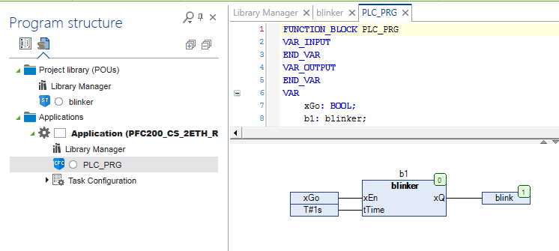
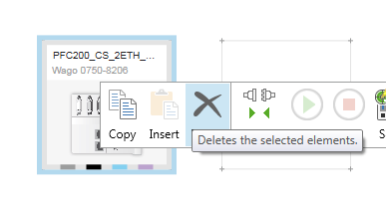
How to Create a Library
Write your FB in the
Project library section
Insert a Library Manager
Into the Project library
Section
Test your Function
Block in an application
After testing the FB,
Delete the device from
your project.
Notes:
‹#›

Slide 2
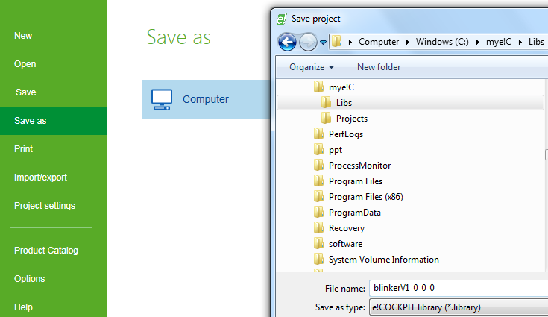
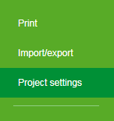
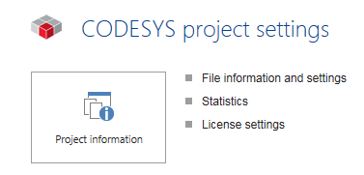
How to Create a Library
Save your project as
Library
Open the Project information
at Project settings/
Project Information
Notes:
‹#›

Slide 3
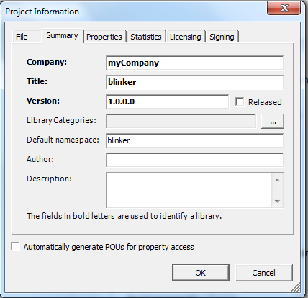

How to Create a Library
Project Information is mandatory to integrate the library in the library database (repository)
Released flag enables write protection
Recommendations
Title=namespace
Version:
V1. <sub version>. <service pack version>. <patch version>
Sub = lib incompatible, Interface incompatible
Service Pack = lib incompatible, Interface compatible
Patch = compatible modification
Filename = title + version
Notes:
‹#›

Slide 4
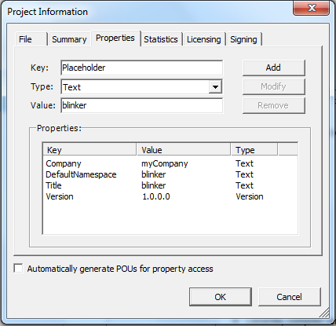
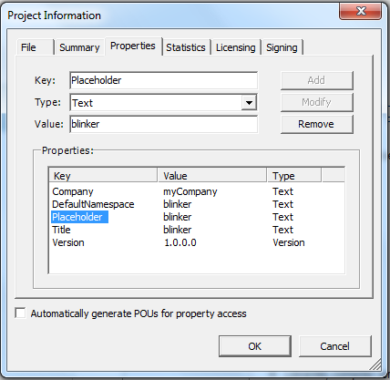
How to Create a Library
Go to Project Information/ Properties and Type in manually
Key: Placeholder
Value: (Title of the library)
Click on Add
Notes:
‹#›

Slide 5
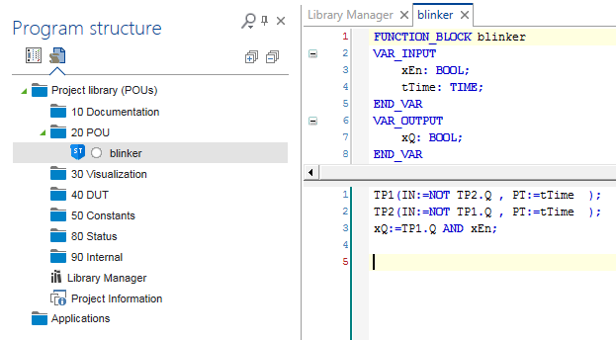
How to Create a Library
Recommendation:
Organize your library in a uniform structure
Alternatively you can create an empty structured library template and copy/ paste the library elements directly from the project between to e!COCKPIT instances
Notes:
‹#›

Slide 6
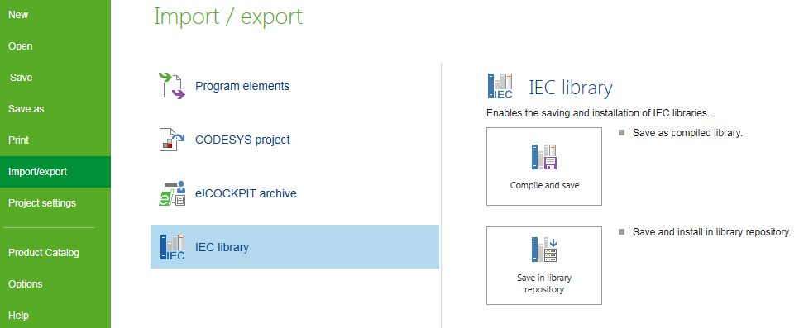
How to Create a Library
Compile and save:
e!COCKPIT generates a pre compiled library, which can not be edited nor saved. The generated Code is target independent.
Save in lbrary repository:
The library is directly installed into the e!COCKPIT library database (library repository)
Notes:
‹#›

Slide 7
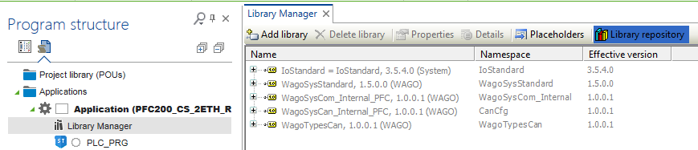
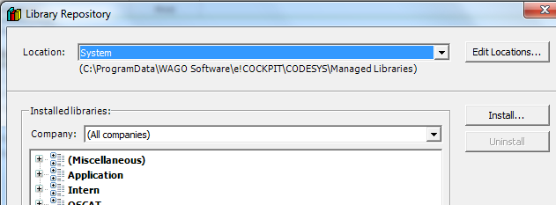
How to use the Library
Alternatively, create a project and go to Library Manager/ Library repository
Go to Install and
Install the library into the
Library repository
Notes:
‹#›

Slide 8
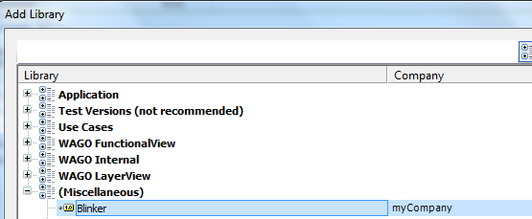
How to use the Library
As Default you can find the library in the library repositoryat the Category (Miscellaneous)
Add the library into the library manager and use it in your project.
Notes:
‹#›

Slide 9
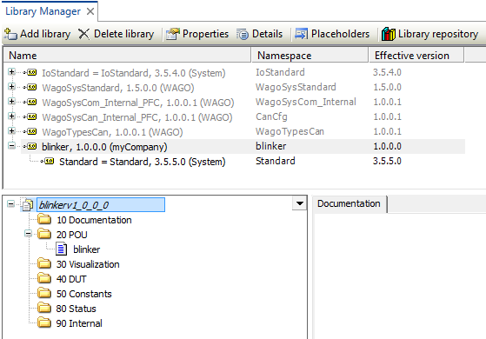
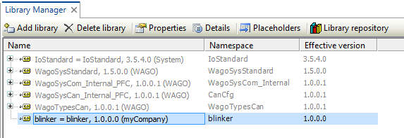
How to use the Library
Library Manager Project Information
Name = Title
Namespace = Default namespace
Version = Effective Version
The filename is visible in italics above the library structure (blinkerv1_0_0_0)
Notes:
‹#›

