Slide 1
e!COCKPIT
OOP extensions

Slide 2
New Programming Options in CODESYS 3 / WAC3
Overview:
Method
POU similar to functions, which can work with variables of a hosting function block.
Allows to create and call Function Blocks mor modular.
Interface
Defines Methods and ist input variables and retunrn types. Interfaces can be implemented into FB‘s, interpreted diifferently by each FB, but treated in a uniform way.
Property
Special Method (Get/ Set) to read and write variables of a FB variable
Allows to call and set variables in different scalings
Inheritance
With the keyword EXTENDS a function block can „learn“ methods, interfaces and properties from another function block (child class, mother class)
=> Allows to save work and error sources.

Slide 3
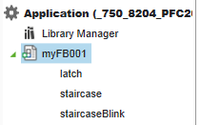
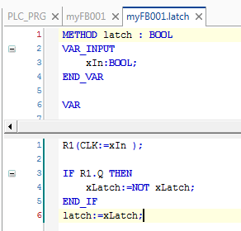
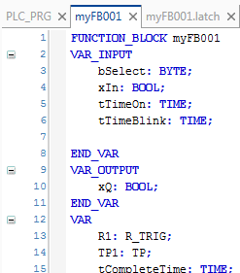
Method
The method is very similar to the function. It can be called in a function block as sub element. All internal variables of a method do not survive a program cycle.
I opposite to a function the method can work with variables of the containing function block. These variables will retain a cycle.
With methods the function block can be called modular.

Slide 4
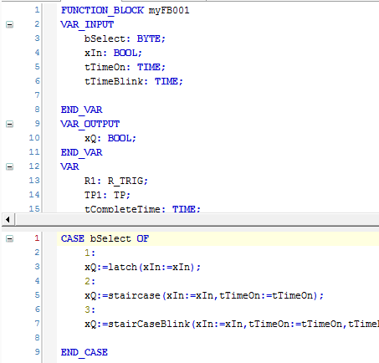
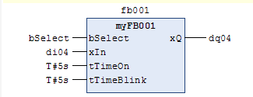
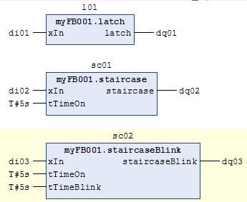
Method
Calling the method of a function block, only the input variables of the resp. Method appear in the graphical representation.

Slide 5
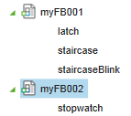
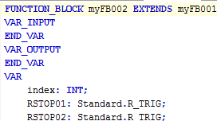
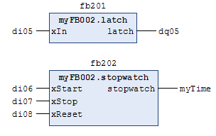
Method- Inheritance
myFB002 extends myFB001. This means myFB002 owns the method stopwatch and all the methods from myFB001 as well.
The variables of the myFB001 methods may not be declared again.
The unit of functionality (method) and data (variables) is called „class“ in other oop programming concepts

Slide 6
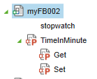





Property
A property is a set of methods to get or set variables. The variable is defined in the containing function block.
The property can be used to access the variable in a scaled way.
Properties can also be inherited with the EXTENDS keyword.

Slide 7
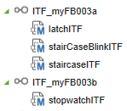
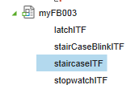

Interface
Interfaces define the Input Variables and the return type of methods.
Functionblocks implementing an interface „promise“ that the methods of the interface are implemented.
Different Fubctionblocks implementing the same interface can interpret the methods in different ways.
Interfaces can be inherited
Notes:
The name of the methods in the interface may not be used in other function blocks
That is why the name latch has been chenged to latchITF

Slide 8
Interface and FB Instance
Interface01 Functionblock01 IMPLEMENTS Interface01
Method1 (no code) Method01 (with code)
Method2 (no code) Method02 (with code)
Method3 (no code) Method03 (with code)
Functionblock02 IMPLEMENTS Interface01
Method01 (with other code)
Var: myIF :Interface01; Method02 (with other code)
myFB01 :Fuctionblock01; Method03 (with other code)
myFB02:Functionblock02
CODE
IF xSelect THEN
myIF:=myFB01;
ELSE
myIF:=myFB02
END_IF
myIF.Method01();
Notes:
The name of the methods in the interface may not be used in other function blocks
That is why the name latch has been chenged to latchITF

Slide 9
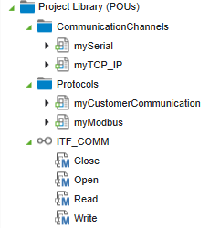
Using Interfaces – Example -1
All function blocks implement the same interface.
The Interface is the link between protocol and communication technology.
The Interface defines the basic functionality of communication
The implementation of the Interface method is different in the function block mySerial and myTCP_IP.
Notes:
The name of the methods in the interface may not be used in other function blocks
That is why the name latch has been chenged to latchITF

Slide 10
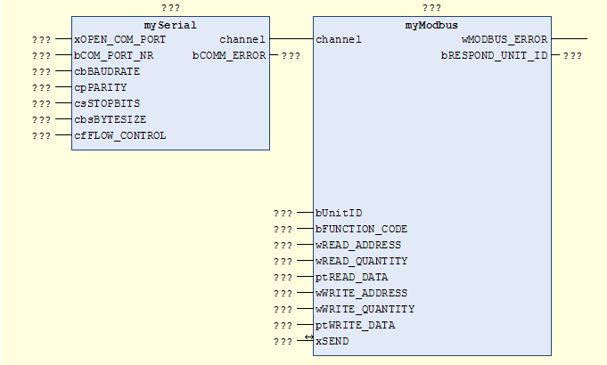
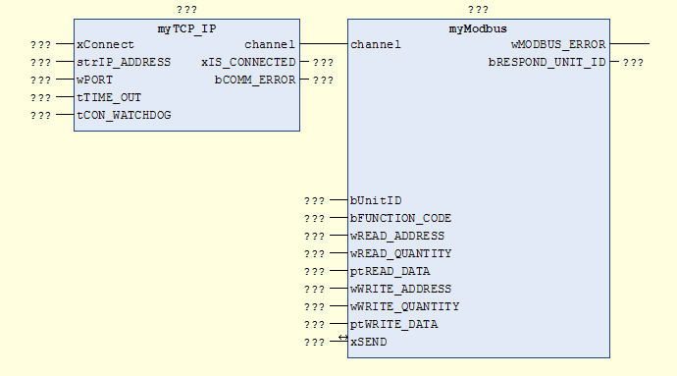
Using Interfaces – Example -1
Notes:
The name of the methods in the interface may not be used in other function blocks
That is why the name latch has been chenged to latchITF

Slide 11
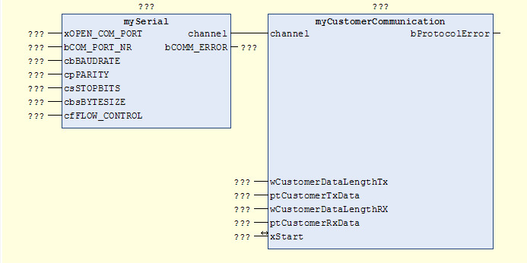
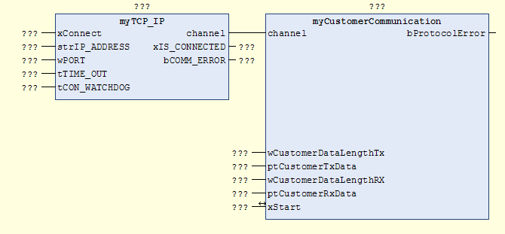
Using Interfaces – Example -1
Notes:
The name of the methods in the interface may not be used in other function blocks
That is why the name latch has been chenged to latchITF

Slide 12
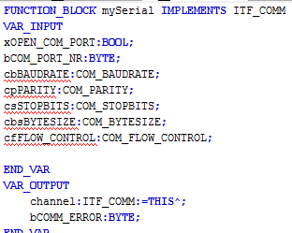
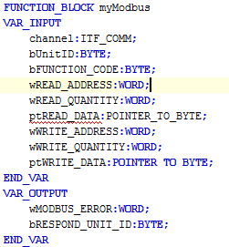
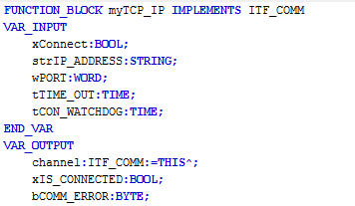
Using Interfaces – Example -1
The Functionblock with the ITF
output implements the ITF.
:=This^ copies the methods to the output.
Notes:
The name of the methods in the interface may not be used in other function blocks
That is why the name latch has been chenged to latchITF

Slide 13
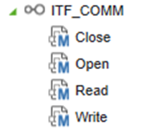
Using Interfaces – Example -1
The Functionblock with the ITF
output implements the ITF.
The ITF Methods can
be executed by the second
Functionblock.
Alternatively the instance of the
FB with the implemented Methods can be assigned to the ITF input of the second FB
Notes:
The name of the methods in the interface may not be used in other function blocks
That is why the name latch has been chenged to latchITF

Slide 14

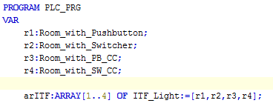


Using Interfaces – Example -2
All function blocks implement the same interface ITF_LIGHT. To process the light method in an array it is necessary to define it by an Interface.
The Interface Array elements are initialized with the instances of the function blocks
The Method Light is implemented as switcher or as pushbutton differently.
Different Interfaces of a function block can work on the same instance
Notes:
The name of the methods in the interface may not be used in other function blocks
That is why the name latch has been chenged to latchITF

Slide 15

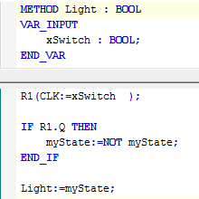

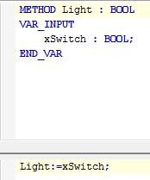
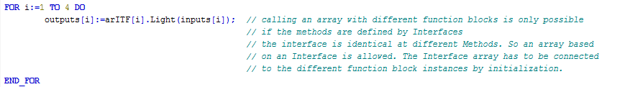
Using Interfaces – Example -2
The Method Light is implemented as switcher or as pushbutton differently.
Independed on the different implementations, the light method can be processed in a FOR loop using the Interface declaration.
Notes:
The name of the methods in the interface may not be used in other function blocks
That is why the name latch has been chenged to latchITF

Slide 16
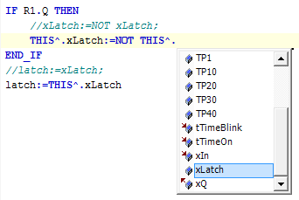
THIS^.
The operator THIS^. defines, that the variable behind the operator points on the variable or method, which is declared in the hosting function block.
Just using the variable name is normally doing the same. So the out-commented program line will have the same result.

Slide 17
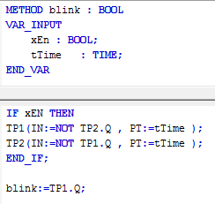

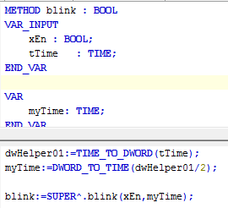
SUPER^.

Slide 18
SUPER^.
FunctionBlock_1
METHOD myMethod
FunctionBlock_2 extends FunctionBlock_1
Method myMethod
SUPER^.myMethod
THIS^.myMethod will work on an instance of FunctionBlock_2
SUPER^.myMethod will work on an instance of FunctionBlock_1.

Slide 19
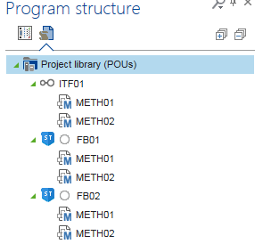
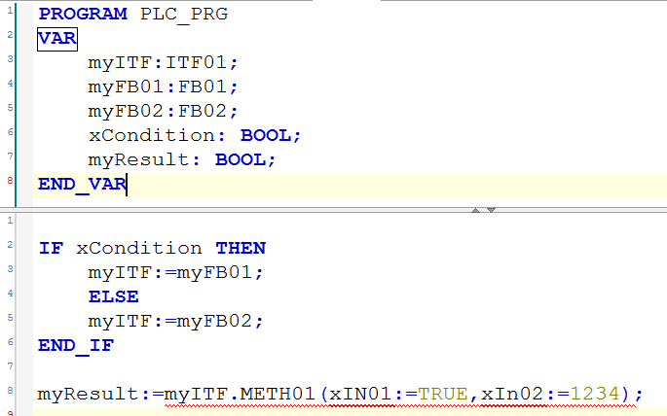
Loading Interfaces with Method Implementation
Notes:
The name of the methods in the interface may not be used in other function blocks
That is why the name latch has been chenged to latchITF

Slide 20
Exercise 01
Create a Functionblock with a Method Latch and StaircaseLighting
Notes:
The name of the methods in the interface may not be used in other function blocks
That is why the name latch has been chenged to latchITF

Slide 21
Exercise 02
Extend the Functionblock from Exercise01 wit a Method DirectSwitcher
Notes:
The name of the methods in the interface may not be used in other function blocks
That is why the name latch has been chenged to latchITF

Slide 22
Exercise 03
Create a uniform Interface ITFlight for a direct switcher or latched switcher (Pushbutton)
Create a Functionblock, which implements ITFlight with the Method LatchedSwitcher
Create a second Functionblock, which implements ITFlight with the Method DirectSwitcher
Create a third Functionblock, which extends LatchedSwitcher and overwrite the Method with a directSwitcher
Notes:
The name of the methods in the interface may not be used in other function blocks
That is why the name latch has been chenged to latchITF

Slide 23
Exercise 04
Create a Variable from type ITFLight and load it with the latching or direct switching functionality
Notes:
The name of the methods in the interface may not be used in other function blocks
That is why the name latch has been chenged to latchITF

Slide 24
Exercise 05
Create a Variable from type ITFLight and load it with the latching or direct switching functionality
Copy the Methods on the Variable with THIS^
Use the Functionblock with an XOR Trigger in CFC
Notes:
The name of the methods in the interface may not be used in other function blocks
That is why the name latch has been chenged to latchITF

Slide 25
Exercise 06
Create a Functionblock with an Internal Variable rTemperatureKelvin
Read and Write to this Variable with Properties rTemperatureInCelsius
Limit the Wirte Operation to the Range 0..100°C
Notes:
The name of the methods in the interface may not be used in other function blocks
That is why the name latch has been chenged to latchITF

