Slide 1
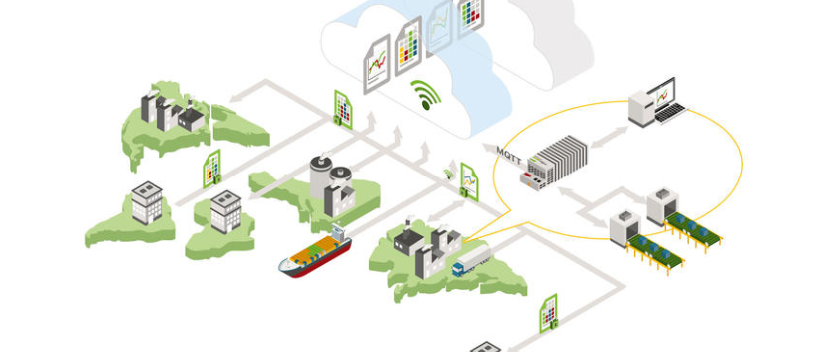

Telecontrol WORKSHOP
TCP dump and Wireshark

Slide 2
TCP dump and Wireshark
Create tcpdump on the device
Open ssh connection with putty as root user (root / wago)
Change directory to home “cd /home”
Start capturing: “tcpdump -i br0 -w test.pcap port 2404“ (2404 default port for IEC 60870-5-104 communication)
Stop capturing: „Ctrl + C“
Create tcpdump on SD card
Open ssh connection with putty as root user (root / wago)
Start capturing: “tcpdump -i br0 -w /media/sd/test.pcap port 102 (102 default port for IEC 61850 communication)
Stop capturing: „Ctrl + C“
Note: The capture stops automatically if ssh connection is disconnect

Slide 3
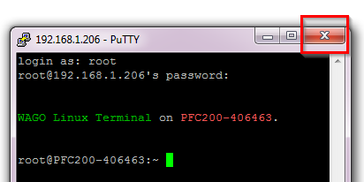
TCP dump and Wireshark
Start tcpdump with nohup
Open ssh connection with putty as root user (root / wago)
Start capturing with nohup: “nohup tcpdump -i br0 -w test.pcap port 2404“
Close ssh connection with the red cross so that the tcpdump continuous the capture
Stop the capture after start tcpdump with nohup
Open ssh connection with putty as root user (root / wago)
Stop tcpdump: “killall tcpdump”
Further details and explanations for tcpdump you find here https://www.tcpdump.org/manpages/tcpdump.1.html

Slide 4
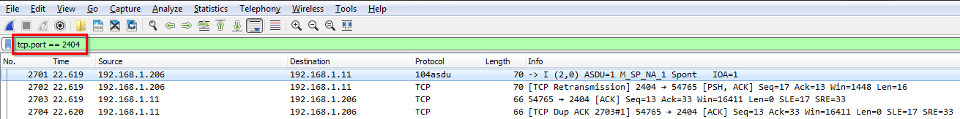
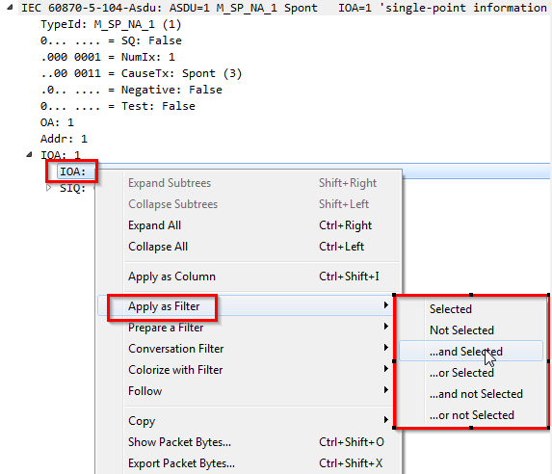
TCP dump and Wireshark
Analyze capture file with Wireshark with filters
Save capture file with (s)ftp from device to your PC
Open the capture file with Wireshark
Set a filter (set port filter e. g. 2404 if tcpdump captured without filter)
Combine filters by selecting a part of the frame, right click and “apply as filter and Selected”

Slide 5
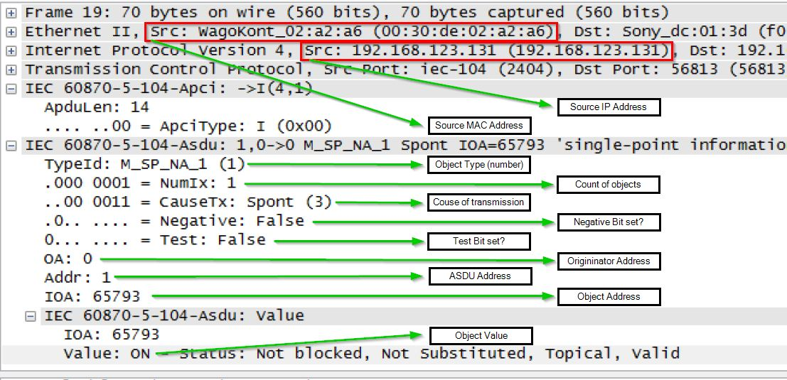
TCP dump and Wireshark
Important details of a IEC60870-5-104 frame
Further details and explanations for Wireshark and filters you find here: https://wiki.wireshark.org/CaptureFilters

Slide 6
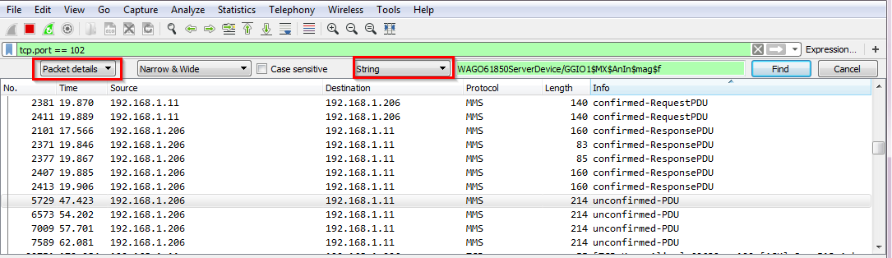
TCP dump and Wireshark
Important filters and settings for telecontrol
tcp.port == 2404 (IEC6087-5-104 communication)
tcp.port == 102 (IEC61850 communication)
dnp3 (Distributed Network Protocol communication)
goose (Generic Object Oriented Substation Events communication)
ip.src == 192.168.1.206 (source ip = 192.168.1.206)
ip.dsr == 192.168.1.206 (destination ip = 192.168.1.206)
Ctrl + f opens a additional search option especially for IEC61850

Slide 7
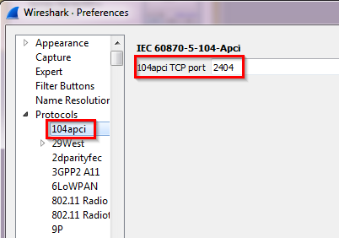
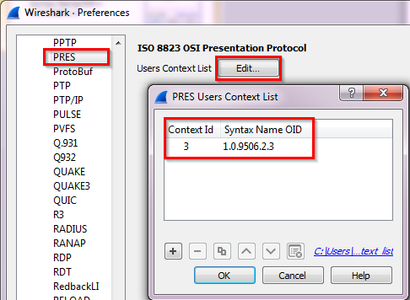
TCP dump and Wireshark
IEC60870-5-104 decoding (Edit => Preferences => Protocols => 104apci)
IEC61850 decoding (Edit => Preferences => Protocols => PRES => Edit)

