Slide 1
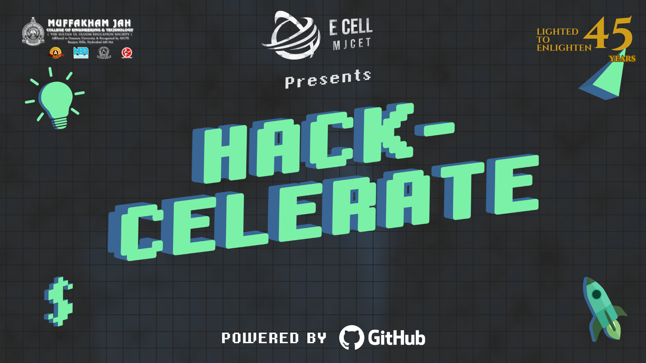

Slide 2

TEAM NUMBER-138
Team Name:
Team Connect
Domain:
Hardware
Problem Statement:
Develop an AI solution that helps students resolve doubts during study sessions without using their phones. This will minimize distractions, promote uninterrupted focus, and reduce screen time, leading to better health and improved study outcomes.

Slide 3
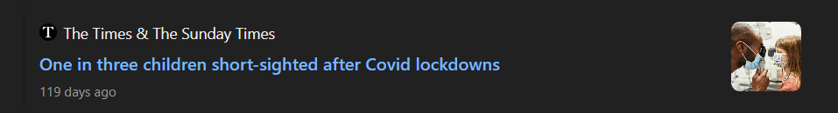
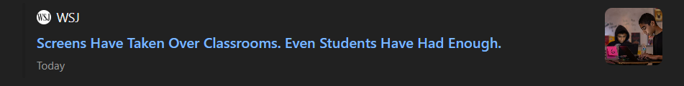
PROBLEMS
“Research indicates that students often experience distractions when using smartphones for study and doubt-solving purposes. A study published in Computers in Human Behavior found that students who used mobile phones during class had significantly lower test scores, even when the material was simple.”
“Prolonged use of smartphones for study and doubt-solving can lead to digital eye strain among students. A study published in BMC Ophthalmology found that 18% of students experienced eye strain after working on digital devices throughout the day.”
-Wikipedia
“Additionally, a study in Applied Cognitive Psychology revealed that students who had access to cell phones during lectures retained less knowledge compared to those without access.”
“Similarly, research in Applied Ophthalmology & Optometry reported that 68.53% of university students experienced digital eye strain, with symptoms like headaches, dryness, and burning sensations.”
-BMC Ophthalmology
-Wikipedia
-Dovepress

Slide 4




Staticstics related to Pre and Post Covid Era
SOURCES
Common Sense Media (2021):
Report on Media Use by Tweens and Teens: This report highlighted the increase in screen time during the pandemic and noted a surge in academic-related phone use.
Pearson's Global Learner Survey (2020):
This survey found that a large percentage of students shifted to online tools and mobile devices for academic support during COVID-19.
Stanford University's Study on Attention and Remote Learning (2020):
The study discussed how students were more distracted during online learning and spent more time on digital devices, including phones, for learning and solving doubts.
Global Web Index (2021):
This report covered global trends in increased screen time and the reliance on mobile phones for education during the pandemic.

Slide 5

SOLUTION
We propose an AI-powered solution that allows students to solve doubts in real-time without needing a phone or screen. By integrating speech-to-text and natural language processing (NLP) technologies, students can ask questions verbally, and the AI will respond with answers. This reduces distractions and promotes healthier study habits by minimizing screen time.

Slide 6
Proposed Solution
Overview
Our solution is an AI-powered assistant designed to help students resolve doubts during study sessions, eliminating the need for phones and screens. By leveraging voice input/output, it ensures students remain focused on their studies, reducing distractions and decreasing overall screen time, which is essential for both mental focus and physical well-being.
Key Features
Hands-free, distraction-free environment: The AI assistant allows students to stay focused without needing to look at a phone or computer screen.
Health-conscious: Reduces screen time, which can positively impact students’ eye health and overall well-being.
Real-time assistance: The AI can respond to queries immediately, providing efficient support during study sessions.
Customizable Knowledge Base: The AI can be trained with subject-specific knowledge, catering to different academic levels.

Slide 7
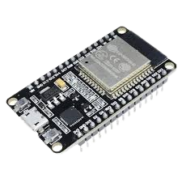
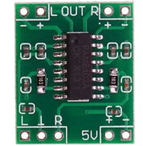
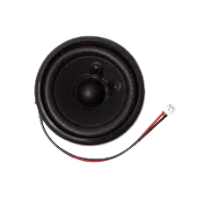
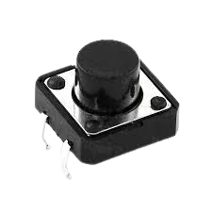
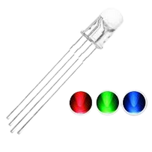
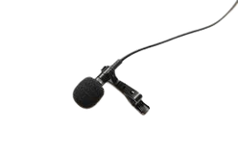

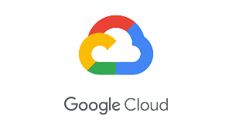
Technical Approach
Components Required
ESP32
Amplifiler
8 Ohm Speaker
Microphone
Button
RGB LEDs
Voice Input - The student asks a question using a microphone.
Speech-to-Text - The audio input is converted to text using a speech recognition module.
Query Processing - The AI processes the query using natural language processing (NLP) to find the best answer.
Text-to-Speech - The AI converts the text response back to voice and delivers the answer to the student in real time.
Feedback Loop - The student can ask follow-up questions to refine the answer or get clarification.
API Handling and server are deloped on cloud

Slide 8
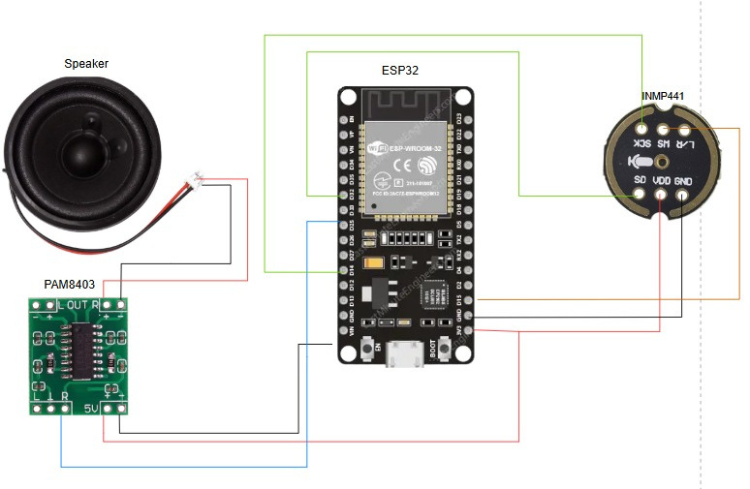
Circuit Diagram

Slide 9
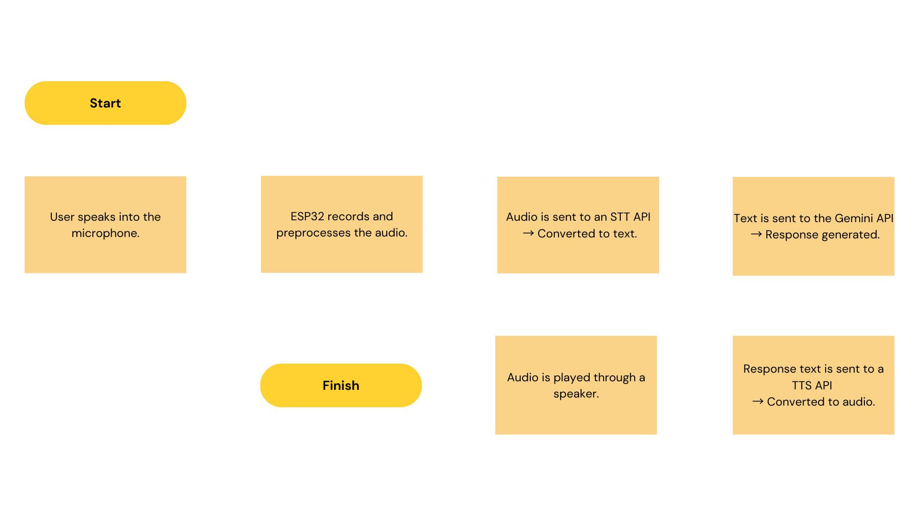
Workflow Diagram

Slide 10
Code Structure
This code sets up an ESP32-based web server that connects to WiFi and provides a simple HTML UI for users to input prompts. When a user submits a prompt, it sends the text to the Gemini API using HTTPS, retrieves the AI-generated response, and displays it on the web page. Key components include:
Libraries: WiFi, WiFiClientSecure, WebServer, HTTPClient, ArduinoJson.
Config: WiFi credentials, Gemini API key, and host.
Server: WebServer on port 80, routes for root ("/") and prompt generation ("/generate").
UI: HTML form (dark theme) with text input, button, and JavaScript for handling responses.
Functions:
setup(): Connects to WiFi, starts server, sets routes.
loop(): Handles client requests.
handleRoot(): Sends HTML page.
handleGenerate(): Receives POST prompt, calls sendRequest(), returns response.
sendRequest(prompt): Sends HTTPS POST to Gemini API, parses response, returns generated text.

Slide 11
Business Model/ USP
What Makes FocusMate Unique?
🔹Student-First Design
Tailored specifically for academics — not a general assistant — helping students focus, resolve doubts, and stay disciplined.
🔹 Screen-Free, Distraction-Free
No apps. No screens. Just voice — promoting deep, healthy, and focused learning habits.
🔹 Institution-Smart (Core USP)
Customizable with local LLMs to deliver syllabus-aligned, subject-specific responses — adaptable to any school or board.
🔹 IoT-Based & Future-Offline Ready
Built on ESP32 for affordability; future updates to support offline tasks like timers, memos, and FAQs.
🔹Mass Deployable at 1/10th Cost
Highly cost-effective — enabling widespread access in homes, schools, and low-resource environments.
🔗 Scalable for Institutional Integration
Future-ready to integrate with custom institutional LLMs (e.g., Narayana LLM), enabling schools and edtech firms to deploy personalized AI tutors tailored to their curriculum.
🎯 Purpose-Built for Focused Learning
Designed exclusively for enhancing study routines — from clearing doubts to managing time — without the distractions of a general-purpose assistant.
🚫 Zero Screen Dependency
Voice-first, screen-free interaction encourages deeper concentration, reducing eye strain and digital fatigue for students.

Slide 12
Feasibility and Real World Applications
Technology
Voice Recognition: With advances in speech-to-text systems, such as Google Speech-to-Text and osk, the technology is accessible, highly accurate, and customizable for specific subject queries.
Natural Language Processing (NLP): NLP models, such as those from Hugging Face and OpenAI, have made significant progress in understanding and processing complex student queries. These models can be fine-tuned to meet academic needs.
Hardware: Microphones, such as those embedded in ESP32 or NodeMCU, are affordable and can be used to develop a simple, standalone device for voice interaction without relying on smartphones or computers.
Text-to-Speech: Technologies like Google Text-to-Speech and AWS Polly are reliable and provide high-quality, natural-sounding voices in real time
At-Home Study
Students studying at home can use FocusMate as an interactive study companion. For example, a student studying math can ask, "What is the derivative of sin(x)?" and receive a verbal explanation immediately, without switching to their phone for a search.
Exam Preparation
During exam seasons, students often face pressure, and FocusMate can act as a reliable tool to quickly answer last-minute doubts while keeping distractions at bay. It can even be customized for various exam patterns
Health-Conscious Learning
FocusMate encourages better study habits by reducing screen time, a growing concern among students. By minimizing phone usage, students experience fewer health risks like eye strain, headaches, and disrupted sleep patterns.
Accessibility for Visually Impaired
FocusMate could be adapted for use by visually impaired students, offering a more interactive and hands-free study environment. With voice-based responses and the ability to ask questions verbally, this can significantly enhance accessibility.
Development Complexity
Developing the basic framework of FocusMate is feasible for a college student, leveraging existing open-source libraries and APIs for speech-to-text, NLP, and text-to-speech. The system’s core functionality can be tested with minimal hardware investment.
Scaling for more advanced features (like real-time language translation or integration with educational databases) may require more resources but is still achievable with the right tools.

Slide 13
THANK YOU!!
TEAM CONNECT

