Slide 1
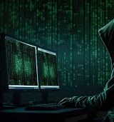
Phishing Awareness Training
Task 2

Slide 2

Introduction
Phishing is a cyber attack where attackers trick people into sharing sensitive information.
They use fake emails, websites, or messages.
This training helps you identify and avoid phishing attempts.

Slide 3
What is Phishing?
Fake attempt to steal sensitive data (passwords, bank details, etc.).
Done via emails, SMS, phone calls, or websites.
Often looks like a trusted source.

Slide 4

Types of Phishing
Email Phishing
Spear Phishing (targeted attack)
Smishing (SMS phishing)
Vishing (voice call phishing)
Clone Phishing (fake copy of real email)

Slide 5

How to Recognize a Phishing Email
Spelling/grammar mistakes
Suspicious sender address
Fake URLs (hover to check link)
Urgent language ('Your account will be blocked...')
Unusual attachments

Slide 6
Real-World Examples
Fake email pretending to be a bank
Suspicious links and attachments
Always verify before clicking any link

Slide 7
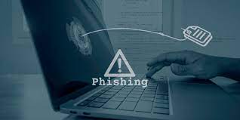
Social Engineering Tactics
Fear (account suspended, fines, etc.)
Curiosity (You won a prize!)
Urgency (Reply within 24 hours)
Trust (Pretend to be boss, bank, IT dept.)

Slide 8
Best Practices to Stay Safe
Don’t click unknown links
Verify sender before replying
Never share passwords via email
Enable two-factor authentication (2FA)
Use updated antivirus & spam filters

Slide 9

Quick Quiz
Q: If an email asks for your password, is it phishing? (Yes)
Q: Should you click links from your bank email? (No)
Q: What is Smishing? (Phishing via SMS)

Slide 10
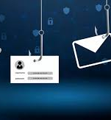
Conclusion
Phishing attacks are increasing every day.
Awareness is the best defense.
Stay alert, stay safe.

